Slide 1
Reasons behind cost overruns:
Systematic bias, selection bias, or both?
Dr. Eeva Vilkkumaa & B. Sc. Teemu Seeve
Department of Mathematics and Systems Analysis, Aalto University
Meeting for young mathematicians in Finland 2015
26.-28.8.2015, Aalto University, Espoo

Slide 2




Cost overruns
Olkiluoto nuclear reactor: Estimate in 2007: 3.2 billion €
Estimate now: 8.5 billion €
Cost overrun: 166%
Metro line Ruoholahti-Matinkylä:
Estimate in 2004: 452 million €
Estimate in 2008: 714 million €
Final estimate: 1.008 billion €
Cost overrun: 121%

Slide 3
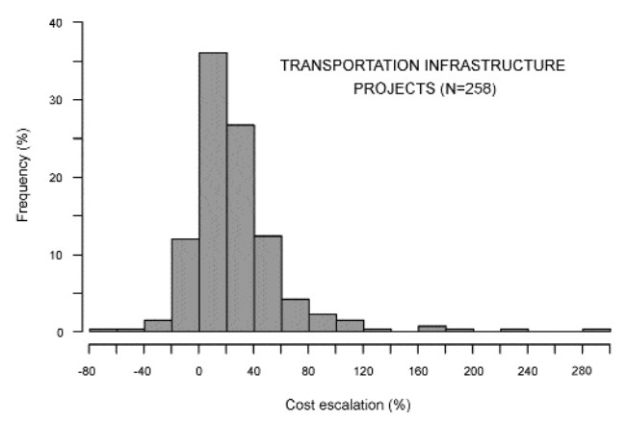
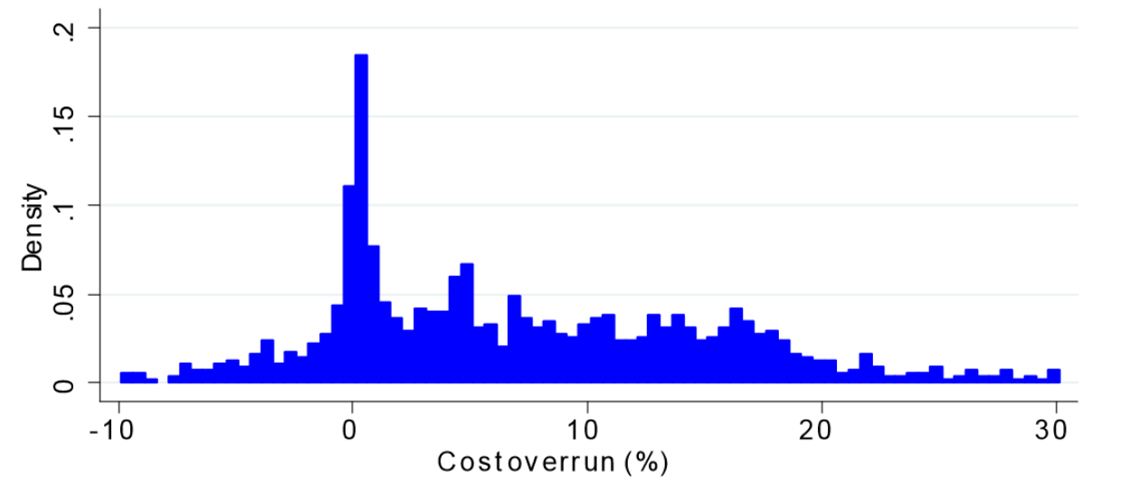
Cost overruns
Large transportation infrastructure projects, N=258
Small public works projects, N=1093
Average overrun 27.6%
Average overrun 8.33%
Source: Flyvbjerg et al. (2002), Underestimating costs in public work projects – error or lie? Journal of the American Planning Association, Vol. 68, pp. 279-295.
Source: Bucciol et al. (2011), Cost overrun and auction format in public works, Working Paper Series, WP 17, Department of Economics, University of Verona.

Slide 4
Systematic bias
Cost overruns are often attributed to a systematic bias in the projects’ cost estimates, such as:
  Optimism bias: most people have a cognitive predisposition to judge future events in a more positive light than is warranted by actual experience
  Strategic misrepresentation: project promoters deliberately and strategically overestimate benefits and underestimate costs to increase the likelihood that their project gets funded

Slide 5
Selection bias
Cost estimates of project proposals are always uncertain
  Some costs have been underestimated, some overestimated
There may not be a systematic bias in these estimates
  Upward and downward errors cancel each other out
Often only those projects with the lowest estimated costs are selected for implementation
The costs of selected projects are more likely to have been underestimated than overestimated → cost overruns occur due to selection bias!

Slide 6
Selection bias
True cost of each project
Distribution of estimation error
F
F
E
E
E
D
C
B
A
D
F
C
B
A

Slide 7
Systematic bias vs. selection bias
Different biases should be mitigated in different ways
How to determine the relative magnitudes of systematic bias and selection bias?
How to mitigate these biases?

Slide 8
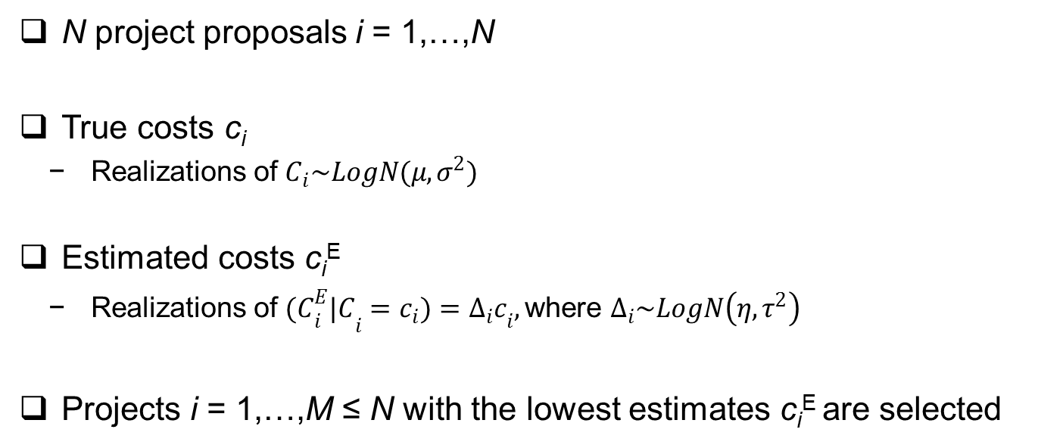
Model
N project proposals i = 1,…,N
True costs c_{i}
  Realizations of $C_{i}\sim LogN(μ,σ^{2})$
Estimated costs c_{i}^{E}
  Realizations of ${{(C}_{i}^{E}|C}_{i}=c_{i})={Δ_{i}c}_{i},$ where $Δ_{i}\sim LogN\left(η,τ^{2}\right)$
Projects i = 1,…,M ≤ N with the lowest estimates c_{i}^{E} are selected

Slide 9
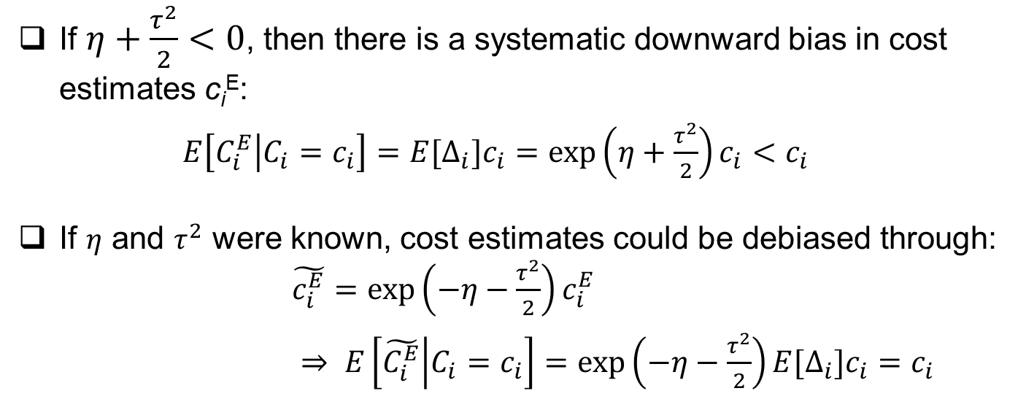
Debiasing cost estimates
If $η+\frac{τ^{2}}{2}<0$, then there is a systematic downward bias in cost estimates c_{i}^{E}:
$E\left[C_{i}^{E} | C_{i}=c_{i}\right]={E[Δ}_{i}]c_{i}=\exp\left(η+\frac{τ^{2}}{2}\right)c_{i}<c_{i}$
If $η$ and $τ^{2}$ were known, cost estimates could be debiased through: $\tilde{c_{i}^{E}}=\exp\left(−η−\frac{τ^{2}}{2}\right)c_{i}^{E}$
$⇒ E\left[\tilde{C_{i}^{E}} | C_{i}=c_{i}\right]={\exp\left(−η−\frac{τ^{2}}{2}\right)E[Δ}_{i}]c_{i}=c_{i}$

Slide 10
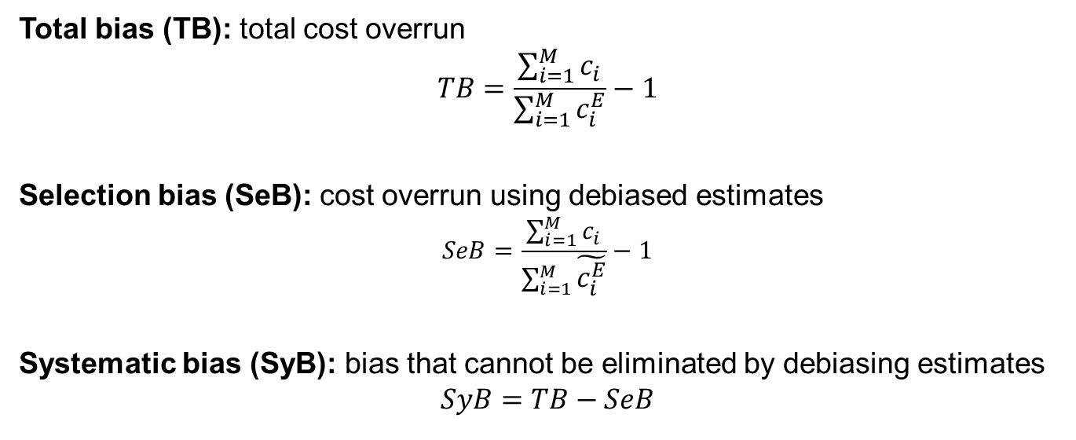
Biases
Total bias (TB): total cost overrun
$$TB=\frac{\sum_{i=1}^{M}{c_{i}}}{\sum_{i=1}^{M}{c_{i}^{E}}}−1$$
Selection bias (SeB): cost overrun using debiased estimates
$$SeB=\frac{\sum_{i=1}^{M}{c_{i}}}{\sum_{i=1}^{M}{\tilde{c_{i}^{E}}}}−1$$
Systematic bias (SyB): bias that cannot be eliminated by debiasing estimates
$$SyB=TB−SeB$$

Slide 11
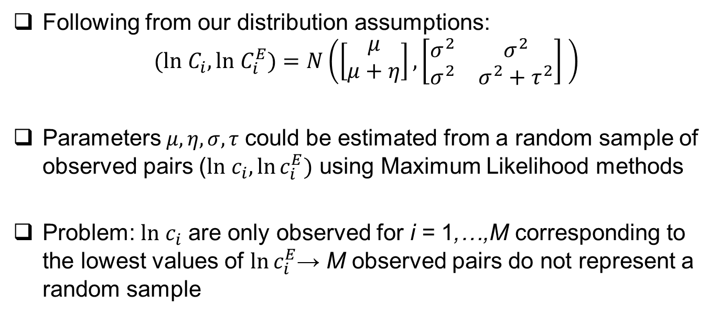
Estimation of model parameters
Following from our distribution assumptions:
$$(ln C_{i},ln C_{i}^{E})=N\left(\left[\begin{matrix}μ \\ μ+η\end{matrix}\right],\left[\begin{matrix}σ^{2} & σ^{2} \\ σ^{2} & σ^{2}+τ^{2}\end{matrix}\right] \right)$$
Parameters$μ,η,σ,τ$ could be estimated from a random sample of observed pairs ($ln{ c}_{i},\ln{c_{i}^{E}})$ using Maximum Likelihood methods
Problem: $ln{ c}_{i}$ are only observed for i = 1,…,M corresponding to the lowest values of $\ln{c_{i}^{E}}$→ M observed pairs do not represent a random sample

Slide 12

Example
N = 30 project proposals
M = 20 selected projects
True parameter values:
($μ,η, σ^{2},τ^{2})=(6.88, −0.075, 0.065, 0.0375)$

Slide 13
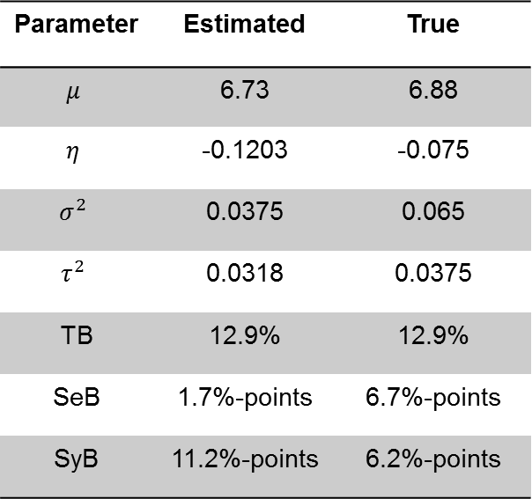
Maximum likelihood estimates
Parameter | Estimated | True
$$μ$$ | 6.73 | 6.88
$$η$$ | -0.1203 | -0.075
$$σ^{2}$$ | 0.0375 | 0.065
$$τ^{2}$$ | 0.0318 | 0.0375
TB | 12.9% | 12.9%
SeB | 1.7%-points | 6.7%-points
SyB | 11.2%-points | 6.2%-points

Slide 14
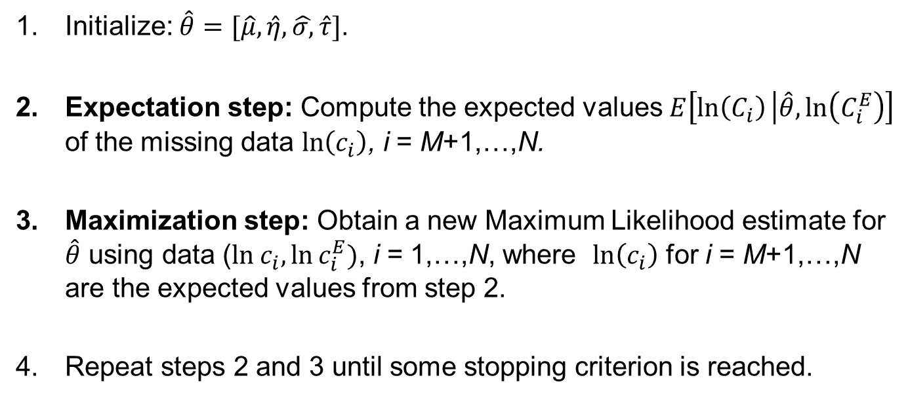
Expectation Maximization algorithm
Initialize: $\hat{θ}=[\hat{μ},\hat{η},\hat{σ,}\hat{τ}]$.
Expectation step: Compute the expected values $E\left[\ln\left(C_{i}\right) | \hat{θ},\ln\left(C_{i}^{E}\right)\right]$ of the missing data $\ln\left(c_{i}\right)$, i = M+1,…,N.
Maximization step: Obtain a new Maximum Likelihood estimate for $\hat{θ}$ using data ($ln{ c}_{i},\ln{c_{i}^{E}})$, i = 1,…,N, where $\ln\left(c_{i}\right)$ for i = M+1,…,N are the expected values from step 2.
Repeat steps 2 and 3 until some stopping criterion is reached.

Slide 15
Expectation Maximization algorithm
Iteration 1
Iteration 2
Iteration 1
Iteration 2
Iteration 3
Iteration 10
Iteration 3
Iteration 10

Slide 16
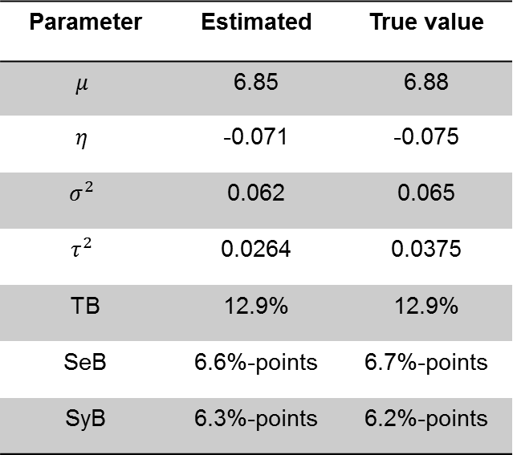
Expectation Maximization algorithm
Parameter | Estimated | True value
$$μ$$ | 6.85 | 6.88
$$η$$ | -0.071 | -0.075
$$σ^{2}$$ | 0.062 | 0.065
$$τ^{2}$$ | 0.0264 | 0.0375
TB | 12.9% | 12.9%
SeB | 6.6%-points | 6.7%-points
SyB | 6.3%-points | 6.2%-points

Slide 17
Simulation results
Expected values of parameter estimates for different N and P=M/N

Slide 18
Simulation results
Expected values of parameter estimates for different N and P=M/N

Slide 19
Simulation results
Expected biases for different values of N, given P=M/N=30%

Slide 20
Simulation results
Expected biases for different values of P, given N = 150

Slide 21
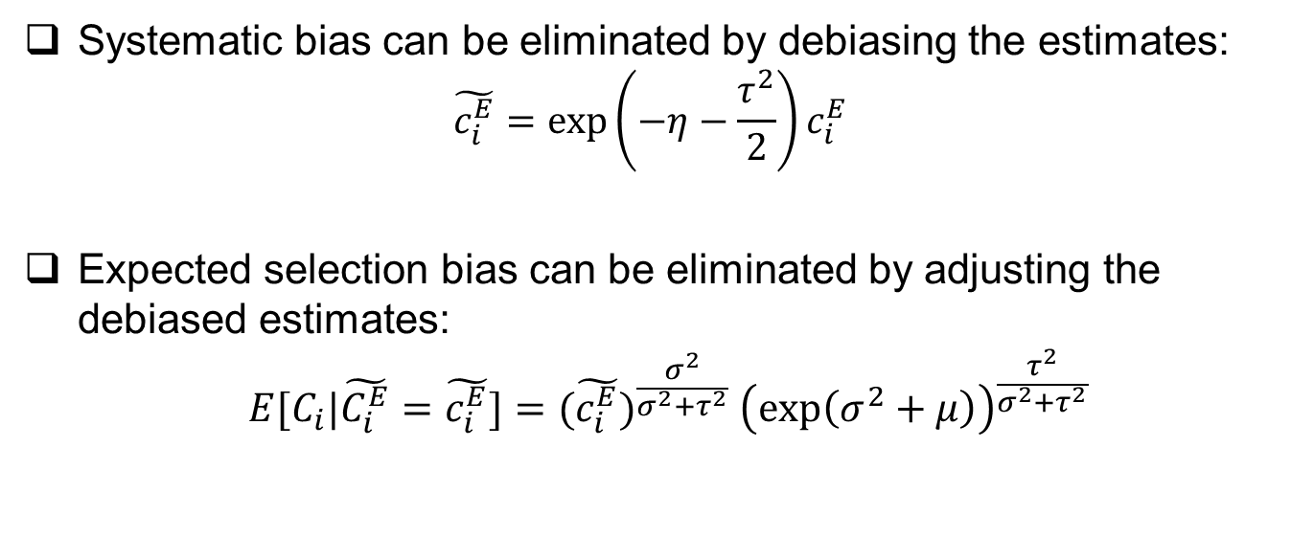
Mitigation of biases
Systematic bias can be eliminated by debiasing the estimates:
  $$\tilde{c_{i}^{E}}=\exp\left(−η−\frac{τ^{2}}{2}\right)c_{i}^{E}$$
Expected selection bias can be eliminated by adjusting the debiased estimates:
$$E[C_{i}|\tilde{C_{i}^{E}}=\tilde{c_{i}^{E}}]={(\tilde{c_{i}^{E}})}^{\frac{σ^{2}}{{σ^{2}+τ}^{2}}}{{\left(exp\left(σ^{2}+μ\right)\right)}^{\frac{τ^{2}}{{σ^{2}+τ}^{2}}}}$$

Slide 22
Conclusions
Cost overruns can result from
  Systematic bias in the projects’ cost estimates
  Selection bias: the costs of the selected projects are more likely to have been underestimated
We build a model to
  Determine the relative magnitudes of the two biases
  Mitigate both biases
The parameters of this model can be estimated using an Expectation Maximization algorithm

