Slide 1
Bayesian Networks, Influence Diagrams, and Games in Simulation Metamodeling
Jirka Poropudas (M.Sc.)
Aalto University
School of Science and Technology
Systems Analysis Laboratory
http://www.sal.tkk.fi/en/
jirka.poropudas@tkk.fi
Winter Simulation Conference 2010
Dec. 5.-8., Baltimore. Maryland

Slide 2
Contribution of the Thesis
Novel Approaches to Simulation Metamodeling
Simulation
Metamodeling
Time Evolution
of Simulation
Multiple Decision Makers
with Individual Objectives
Dynamic Bayesian Networks
Games
Decision Analysis
with Multiple Criteria
Influence Diagrams

Slide 3
The Thesis
Consists of a summary article and six papers:
Poropudas J., Virtanen K., 2010: Simulation Metamodeling with Dynamic Bayesian Networks, submitted for publication
Poropudas J., Virtanen K., 2010: Simulation Metamodeling in Continuous Time using Dynamic Bayesian Networks, Winter Simulation Conference 2010
Poropudas J., Virtanen K., 2007: Analysis of Discrete Event Simulation Results using Dynamic Bayesian Networks, Winter Simulation Conference 2007
Poropudas J., Virtanen K., 2009: Influence Diagrams in Analysis of Discrete Event Simulation Data, Winter Simulation Conference 2009
Poropudas J., Virtanen K., 2010: Game Theoretic Validation and Analysis of Air Combat Simulation Models, Systems, Man, and Cybernetics – Part A: Systems and Humans, Vol. 40, No. 5
Pousi J., Poropudas J., Virtanen K., 2010: Game Theoretic Simulation Metamodeling using Stochastic Kriging, Winter Simulation Conference 2010
http://www.sal.tkk.fi/en/publications/

Slide 4
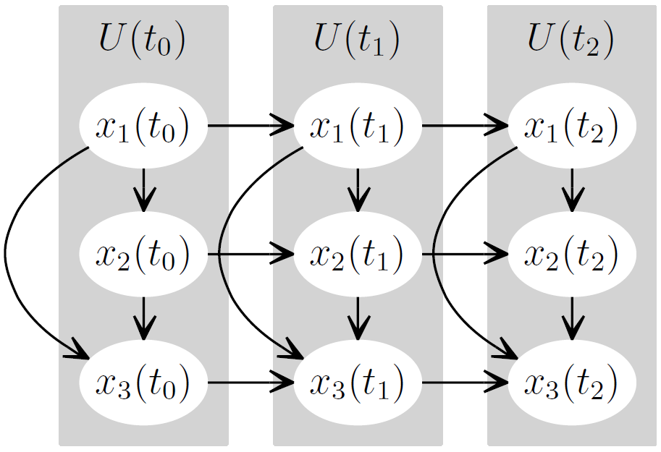
Dynamic Bayesian Networks and Discrete Event Simulation
Bayesian network
  Joint probability distribution of discrete random variables
  Nodes
  Simulation state variables
Dependencies
  Arcs
  Conditional probability tables
Dynamic Bayesian network
  Time slices → Discrete time
Simulation state at

Slide 5
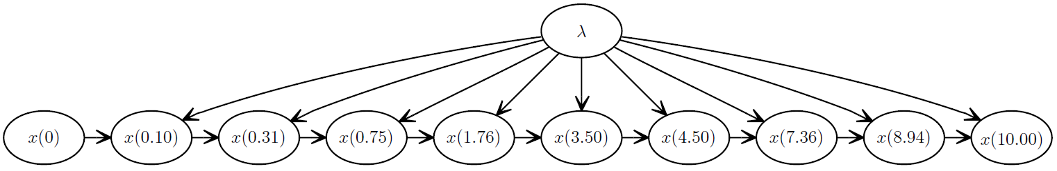
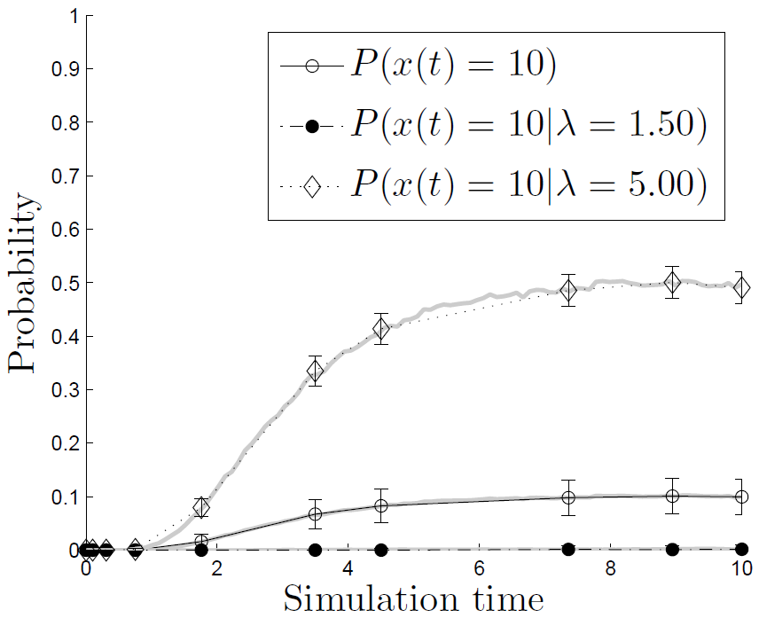
DBNs in Simulation Metamodeling
Poropudas J., Virtanen K., 2010. Simulation Metamodeling with Dynamic Bayesian Networks, submitted for publication.
Time evolution of simulation
  Probability distribution of simulation state at discrete times
Simulation parameters
  Included as random variables
What-if analysis
  Simulation state at time t is fixed
  → Conditional probability distributions

Slide 6
Construction of DBN Metamodel
Poropudas J., Virtanen K., 2010. Simulation Metamodeling with Dynamic Bayesian Networks, submitted for publication.
Selection of variables
Collecting simulation data
Optimal selection of time instants
Determination of network structure
Estimation of probability tables
Inclusion of simulation parameters
Validation

Slide 7






Approximative Reasoning in Continuous Time
Poropudas J., Virtanen K., 2010. Simulation Metamodeling in Continuous Time using Dynamic Bayesian Networks, WSC 2010.
DBN gives probabilities at discrete time instants
→ What-if analysis at these time instants
Approximative probabilities for all time instants with Lagrange interpolating polynomials → What-if analysis at arbitrary time instants
”Simple, yet effective!”
Monday 10:30 A.M. - 12:00 P.M.
Metamodeling I

Slide 8
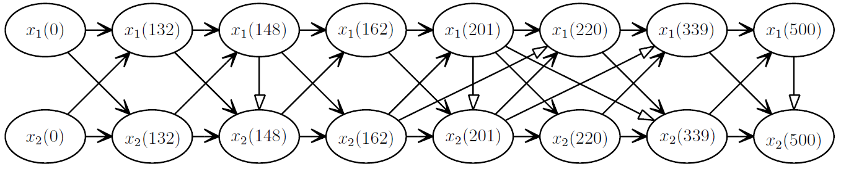
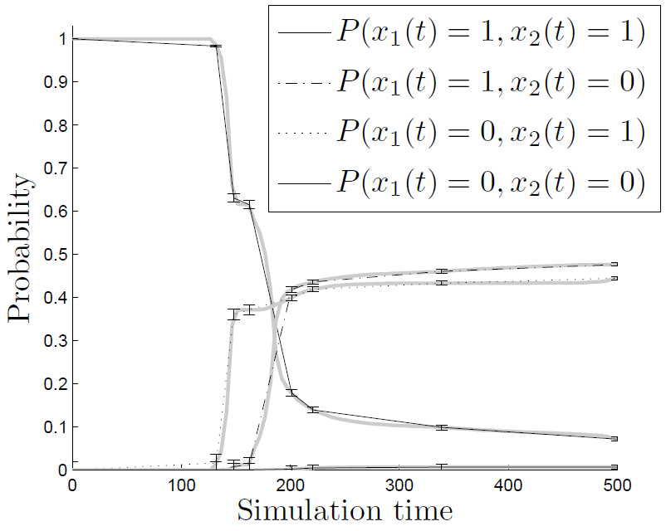
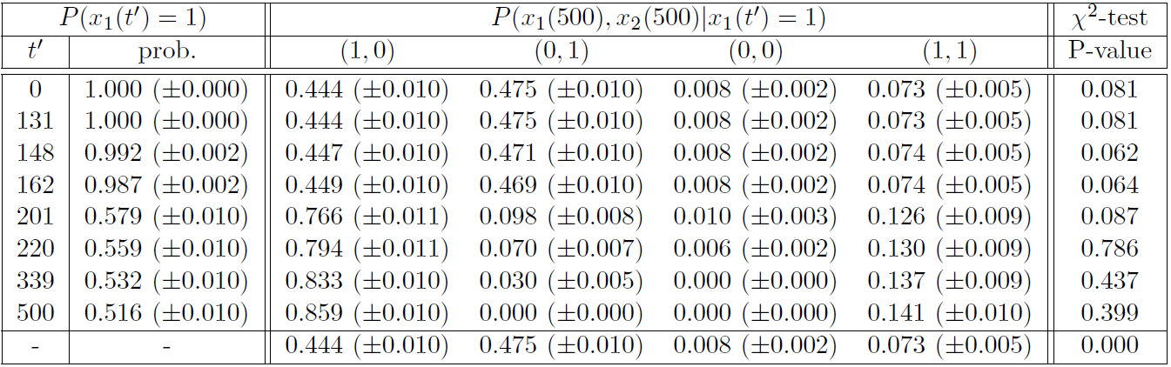
Air Combat Analysis
Poropudas J., Virtanen K., 2007. Analysis of Discrete Events Simulation Results Using Dynamic Bayesian Networks, WSC 2007.
Poropudas J., Virtanen K., 2010. Simulation Metamodeling with Dynamic Bayesian Networks, submitted for publication.
X-Brawler ̶ a discrete event simulation model

Slide 9
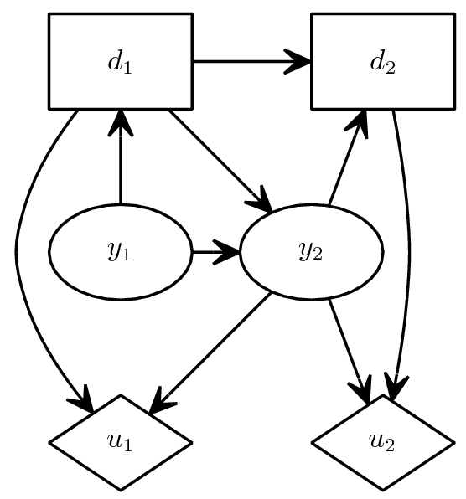
Influence Diagrams (IDs) and
Discrete Event Simulation
Poropudas J., Pousi J., Virtanen K., 2010. Simulation Metamodeling with Influence Diagrams, manuscript.
Decision nodes
  ”Controllable” simulation inputs
Chance nodes
  Uncertain simulation inputs
  Simulation outputs
  Conditional probability tables
Utility nodes
  Decision maker’s preferences
  Utility functions
Arcs
  Dependencies
  Information

Slide 10
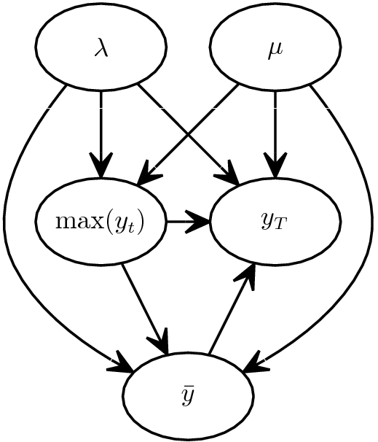
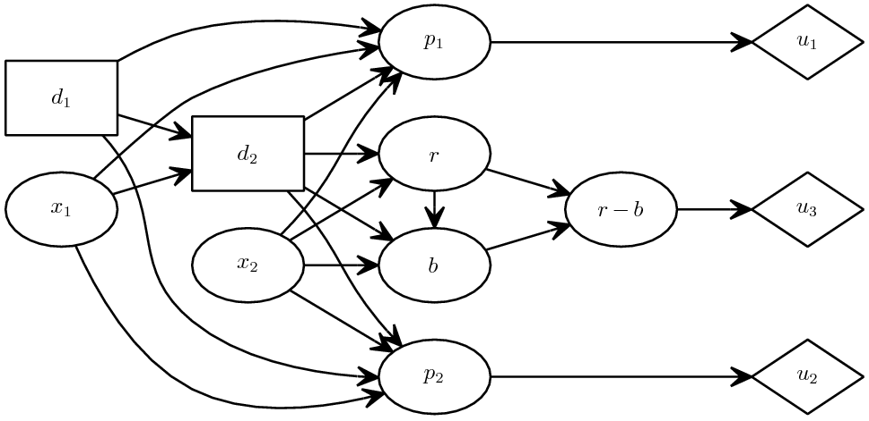
Construction of ID Metamodel
Poropudas J., Pousi J., Virtanen K., 2010. Simulation Metamodeling with Influence Diagrams, manuscript.
Selection of variables
Collecting simulation data
Determination of diagram structure
Estimation of probability tables
Preference modeling
Validation

Slide 11
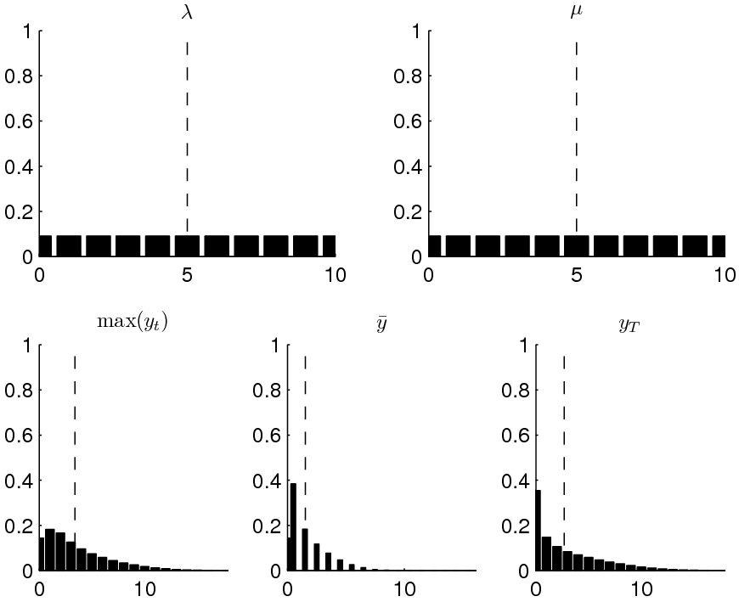
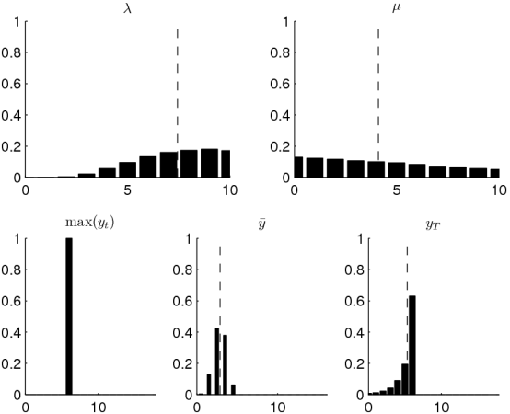
IDs as MIMO Metamodels
Poropudas J., Pousi J., Virtanen K., 2010. Simulation Metamodeling with Influence Diagrams, manuscript.
Queueing model
Simulation parameters included as random variables
Joint probability distribution of simulation inputs and outputs
What-if analysis using conditional probability distributions

Slide 12
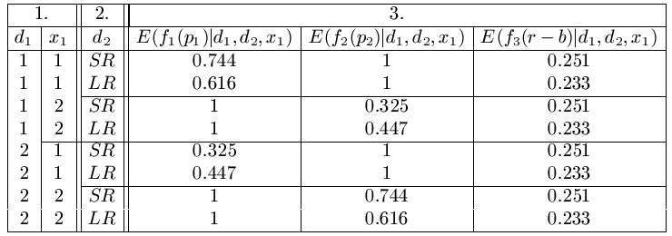
Decision Making with Multiple Criteria
Decision maker’s preferences
  One or more criteria
  Alternative utility functions
Tool for simulation based
decision support
  Optimal decisions
  Non-dominated decisions

Slide 13
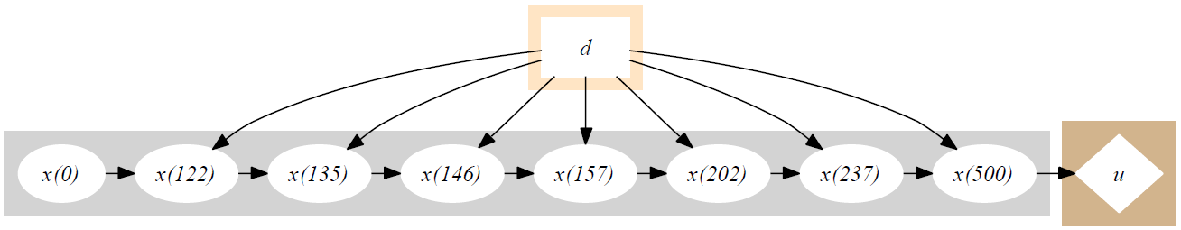
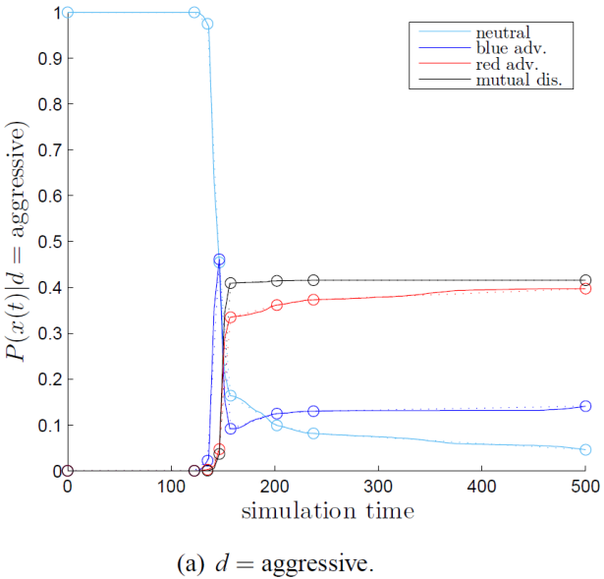
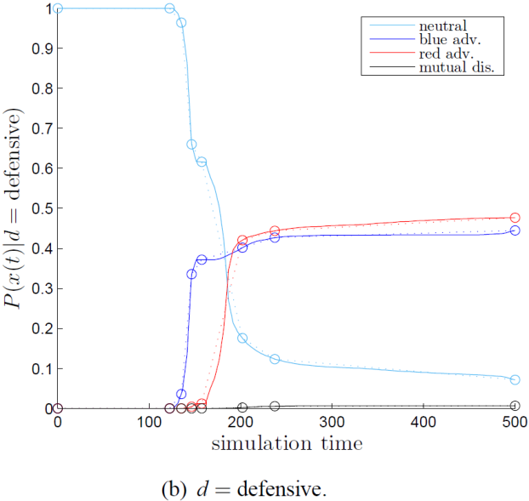
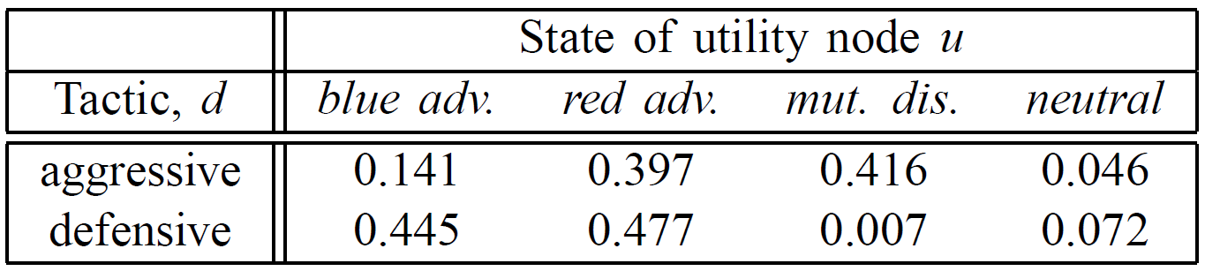
Air Combat Analysis
Poropudas J., Virtanen K., 2009. Influence Diagrams in Analysis of Discrete Event Simulation Data, WSC 2009.
Consequences of decisions
Decision maker’s preferences
Optimal decisions

Slide 14
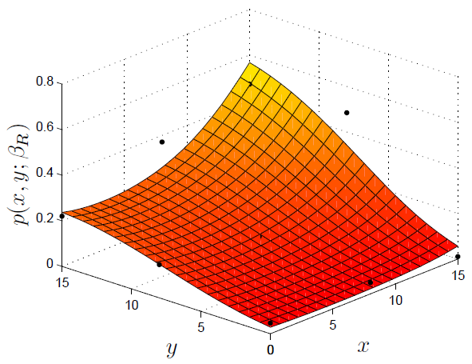
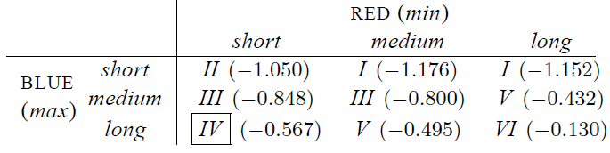
Games and
Discrete Event Simulation
Poropudas J., Virtanen K., 2010. Game Theoretic Validation and Analysis of Air Combat Simulation Models, Systems, Man, and Cybernetics – Part A: Systems and Humans, Vol. 40, No. 5, pp.1057-1070.
Game setting
Players
  Multiple decision makers with individual objectives
Players’ decisions
  Simulation inputs
Players’ payoffs
  Simulation outputs
Best responses
Equilibrium solutions

Slide 15
Construction of
Game Theoretic Metamodel
Poropudas J., Virtanen K., 2010. Game Theoretic Validation and Analysis of Air Combat Simulation Models, Systems, Man, and Cybernetics – Part A: Systems and Humans, Vol. 40, No. 5, pp.1057-1070.
Definition of scenario
Simulation data
Estimation of payoffs
  Regression model, stochastic kriging
  ANOVA

Slide 16
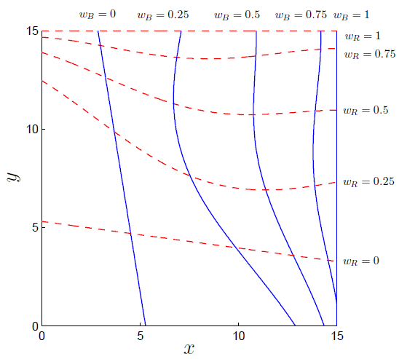
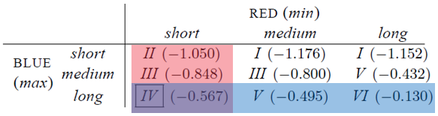
Best Responses and
Equilibirium Solutions
Poropudas J., Virtanen K., 2010. Game Theoretic Validation and Analysis of Air Combat Simulation Models, Systems, Man, and Cybernetics – Part A: Systems and Humans, Vol. 40, No. 5, pp.1057-1070.
Best responses ̶ player’s optimal decisions against a given decision by the opponent
Equilibrium solutions ̶ intersections of players’ best responses

Slide 17
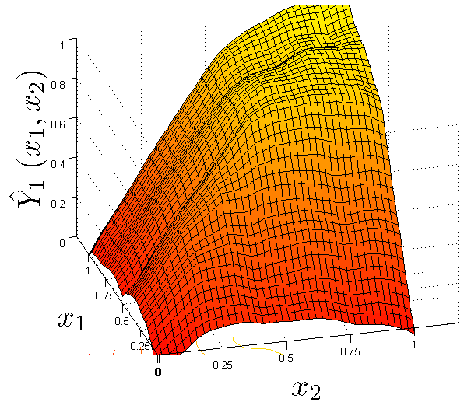
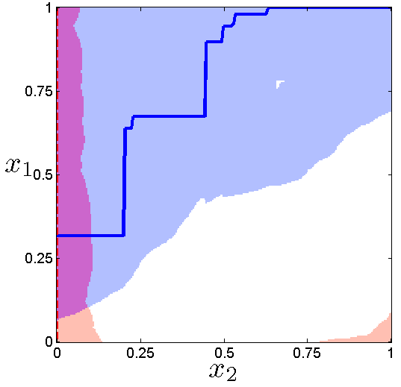
Games and Stochastic Kriging
Pousi J., Poropudas J., Virtanen K., 2010. Game Theoretic Simulation Metamodeling Using Stochastic Kriging, WSC 2010.
Extension to global response surface modeling
Tuesday 1:30 P.M. - 3:00 P.M.
Advanced Modeling Techniques for Military Problems

Slide 18
Utilization of
Game Theoretic Metamodes
Validation of simulation model
  Game properties compared with actual practices
    For example, best responses versus real-life air combat tactics
Simulation based optimization
  Best responses
  Dominated and non-dominated decision alternatives
  Alternative objectives

