Slide 1
Computational analysis for bias mitigation in multicriteria decision analysis
Tuomas J. Lahtinen, Raimo P. Hämäläinen, Cosmo Jenytin
tuomas.j.lahtinen@aalto.fi, raimo.hamalainen@aalto.fi
Systems Analysis Laboratory, Department of Mathematics and Systems Analysis, Aalto University
The document can be stored and made available to the public on the open internet pages of Aalto University. All other rights are reserved.

Slide 2
Biases in multi-criteria decision analysis
Biases are widely covered in the decision analysis literature and textbooks
Suprisingly little interest in interactive multi-criteria optimization
Very little work on bias mitigation and debiasing in practice
Biases can take place in different phases of the decision process

Slide 3
A systemic perspective is needed
Not enough to understand and avoid biases in individual steps of the decision analysis process
Path perspective: there is a sequence of steps in the decision support process
The effects of biases can build up
The effects can be reversible or irreversible
The effects can be interdependent

Slide 4
Biases are critical when they create path dependence
A
Starting
point
Biased path
Unbiased path
B
C
Step 1
Step 2
…
Result

Slide 5
Debiasing and bias mitigation approaches in multi-criteria preference elicitation
Consistency checks and feedback
Keeney and Raiffa 1976
Use different starting points in interactive multi-criteria optimization
Korhonen et al. 1990
Improvement of a preference elicitation method
Delquié 1997
Averaging responses
Anderson and Hobbs 2002
Adjusting numerical judgments with estimated bias coefficients
Bleichrodt et al. 2001, Anderson and Hobbs 2002
Training
Hämäläinen and Alaja 2008, Anderson and Clemen 2013

Slide 6
Debiasing techniques need to be evaluated taking into account the complete process
So far, narrow focus in behavioral experiments: Behavioral phenomena occurring at isolated steps
Process evaluations:
We cannot use real decision makers in testing
Even with students it can be very cumbersome to go through all different techniques repeatedly
Computational analysis provides a new approach

Slide 7
Computational approach
Based on models and estimates of the relevant biases
(Bleichrodt et al. 2001, Anderson and Hobbs 2002, Delquié 2003, Jacobi and Hobbs 2008, Lahtinen and Hämäläinen 2016)
Assume biases and debiasing methods
Compute the overall impact of biases in different settings
Enables testing of multiple techniques and helps to identify promising ones

Slide 8
Path perspective in debiasing
Try to find paths where the effects of biases cancel out (Examples: Anderson and Hobbs 2002, Lahtinen and Hämäläinen 2016)
Avoid paths where the effects of biases build up
A
B
C
Not always necessary to reduce biases in individual steps
Result

Slide 9
New techniques to help create paths with reduced overall bias
Introduce a virtual reference alternative
Introduce an auxiliary measuring stick attribute
Repeatedly rotate the reference point
Intermediate restarting of the elicitation process with a reduced set of alternatives

Slide 10
Introduce a virtual reference alternative
Can mitigate the loss aversion bias (Tversky and Kahneman 1991)
Apartment selection | Alternatives
Attributes | A | B | C | Virtual
Rent (euros per month) | 700 | 900 | 800 | 800
Size (square meters) | 30 | 40 | 35 | 35
Condition (constructed scale) | 1 | 2 | 3 | 2
Different virtual or hypothethical reference points can be used, e.g. trade-off and swing methods, interactive MCO

Slide 11
Introduce an auxiliary measuring stick attribute
Irrelevant attribute can be the measuring stick
Can mitigate the measuring stick bias (Delquié 1993) in trade-off judgments
 | Alternatives
Attributes | A | B | C
Rent (euros per month) | 700 | 900 | 800
Size (square meters) | 30 | 40 | 35
Condition (constructed scale) | 1 | 2 | 3
Commute time (minutes) | 60 | 60 | 60
Trade-offs are widely used: estimation of attribute weights, pricing out, Even Swaps method

Slide 12
Repeatedly rotate the reference point
Loss aversion bias can build up if the same original alternative defines the reference point in every attribute
Intermediate restarting of the elicitation process with a reduced set of alternatives
Can eliminate the bias that has built up over earlier steps
Swing method: Attribute swings depend on alternatives
Intermediate restarting can help to cope with range insensitivity (Fischer 1995)
Assess attribute weights and score alternatives
Eliminate low scoring alternatives so that attribute swings are reduced
Repeat steps 1 and 2 until range of swings cannot be reduced

Slide 13
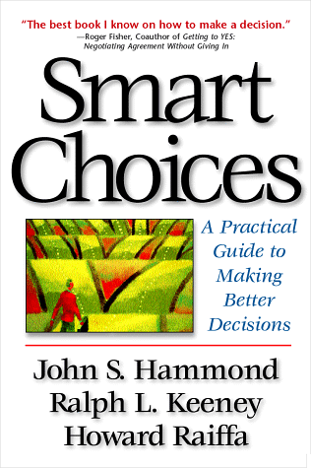
Computational approach demonstrated with the Even Swaps process
1999

Slide 14
Office selection problem (Hammond, Keeney, Raiffa 1999)
25
78
72
88
B
B
An even swap
Dominated
by
Lombard
Commute time irrelevant
Office services irrelevant
Reference method (attribute elimination method)
Eliminate dominated alternatives
Select a reference alternative (Lombard)
Select a measuring stick attribute (Client Access)
Make attributes irrelevant: Make all alternatives equal to reference alternative in all attributes besides the measuring stick attribute.

Slide 15
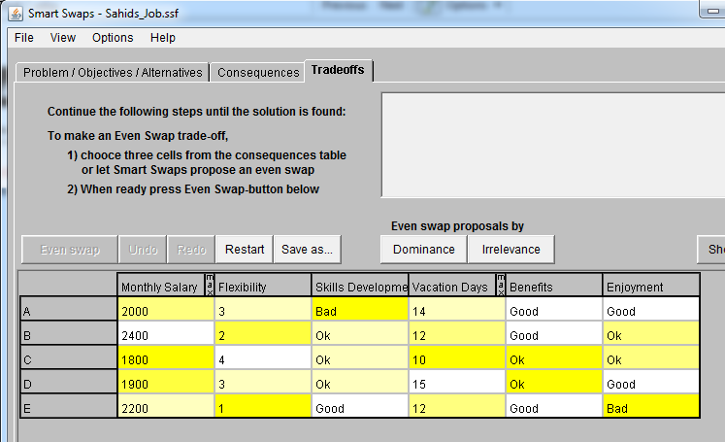
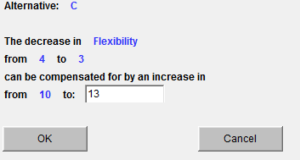
Biases can create path dependence in Even Swaps
Measuring stick bias: Extra weight for the measuring stick
Loss aversion: Extra weight for the loss attribute
What is the equally valuable loss in money if commuting time is decreased by 30 minutes?
DM chooses A
DM chooses B

Slide 16
Bias mitigation methods for Even Swaps
Reference method: Attribute elimination method with a fixed reference alternative
Method A: Attribute elimination method with a virtual reference alternative
Method B: Attribute elimination method with a virtual reference alternative and an auxiliary measuring stick
Method C: Pairwise attribute elimination method with an auxiliary measuring stick, rotating reference point and intermediate restarting
Method D: Pairwise attribute elimination method with an auxiliary measuring stick, virtual reference alternative, and intermediate restarting
Method D requires about twice as many swaps as the other methods

Slide 17
Computational analysis
Biased decision makers:
Weight of measuring stick attribute increased by a factor S (1.1, 1.3 or 1.5)
Weight of loss attribute increased by a factor L (1, 1.2 or 1.4)
Non-systematic response error included in half of the settings
Sizes of the consequences tables varied
Number of attributes: 3, 5 or 8 Number of alternatives: 2, 5 or 8
2500 randomly generated sets of alternatives per each case
Attribute weights varied
100 randomly generated weight profiles for each number of attributes
Performance criterion: Share of cases where method gives the same result as a bias free process

Slide 18
Overall results
All bias reduction methods A-D perform better than the reference method
When the value difference of top two alternatives is up to 0.3, the correct solution is not always found with all methods
Percentage of cases where a method gives the same result as a bias free process
Reference method | 86
Method A | 92
Method B | 94
Method C | 93
Method D | 98
Method D always finds the correct result if response error is zero

Slide 19
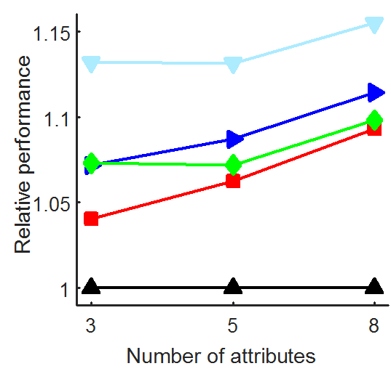
Performance of the methods in different settings
Performance of the reference method and Method A decreases with increasing magnitude of measuring stick bias
Methods A-D increasingly better than the reference method with higher number of attributes

Slide 20
Recommendations for bias mitigation in Even Swaps
Method should be designed on a case specific basis using variations of the proposed methods
Consider using an irrelevant attribute as the measuring stick
Introducing a virtual reference alternative can help
Caveat: Due to loss aversion, this technique can sometimes favor alternatives whose performance strongly varies across attributes

Slide 21
Conclusions
Debiasing approaches need to take into account the overall effect of biases that builds up along the path
Computational analysis helps to evaluate the effectiveness of different bias mitigation techniques
New bias reduction techniques have potential in other decision analysis approaches too
Virtual reference alternative and auxiliary measuring stick are applicable with almost any method
Potentially interesting in interactive multi-criteria optimization procedures too

Slide 22
References
Anderson, R. M., Clemen, R. 2013. Toward an Improved Methodology to Construct and Reconcile Decision Analytic Preference Judgments, Decision Analysis, 10(2), 121-134.
Anderson, R. M., Hobbs, B. F. 2002. Using a Bayesian Approach to Quantify Scale Compatibility Bias. Management Science, 48(12), 1555-1568.
Bleichrodt, H. J., Pinto, J. L., Wakker, P. 2001. Making descriptive use of prospect theory to improve the prescriptive use of expected utility. Management Science, 47(11), 1498-1514.
Delquié, P. (1993) Inconsistent trade-offs between attributes: New evidence in preference assessment biases. Management Science 39(11):1382-1395
Delquié, P. 1997. “Bi-matching”: A new preference assessment method to reduce compatibility effects. Management Science 43(5), 640-658
Delquié, P. (2003). Optimal conflict in preference assessment. Management Science 49(1):102-115.
Fischer, G.W. 1995. Range sensitivity of attribute weights in multiattribute value models. Organizational Behavior and Human Decision Processes 62(3), 252-266.
Hammond, J.S., Keeney, R.L., Raiffa, H., 1999. Smart Choices: A practical guide to making better decisions. Harvard Business School Press, Boston, MA.

Slide 23
Hammond, J.S., Keeney, R.L., Raiffa, H., 1999. Smart Choices: A practical guide to making better decisions. Harvard Business School Press, Boston, MA.
Hämäläinen, R. P., Alaja, S. 2008. The threat of weighting biases in environmental decision analysis. Ecological Economics 68(1), 556-569.
Hämäläinen, R. P., and Lahtinen, T. J. (2016). Path dependence in Operational Research – How the modeling process can influence the results. Operations Research Perspectives, 3:14-20.
Jacobi, S. K., Hobbs, B. F. 2007. Quantifying and mitigating the splitting bias and other value tree-induced weighting biases, Decision Analysis, 4(4), 194-210.
Keeney, R. L., & Raiffa, H. 1976. Decisions with Multiple objectives: Preferences and value trade-offs. New York: John Wiley & Sons.
Korhonen, P., Moskowitz, H., & Wallenius, J. 1990. Choice behavior in interactive multiple-criteria decision making. Annals of Operations Research, 23(1), 161– 179.
Lahtinen, T. J., and Hämäläinen, R. P. 2016. Path dependence and biases in the even swaps decision analysis method. European Journal of Operational Research, 249(3): 890-898.
Lahtinen, T. J., Guillaume, J. H., and Hämäläinen, R. P. 2017. Why pay attention to paths in the practice of environmental modelling? Environmental Modelling & Software, 92:74-81.
Tversky, A., Kahneman, D. 1991. Loss Aversion in Riskless Choice: A Reference-Dependent Model. Quarterly Journal of Economics, 106(4), 1039-1061.

