Slide 1
Path Dependence in Operational Research
Raimo P. Hämäläinen and Tuomas J. Lahtinen
Systems Analysis Laboratory, Aalto University , Finland
The document can be stored and made available to the public on the open internet pages of Aalto University. All other rights are reserved.

Slide 2

Path dependence
Discussed in economics, policy studies and organizational decision making (Arthur 1989, Webster 2008, Sydow et al. 2009)
’History matters’, i.e. current state depends on the history
Lock-in phenomena, e.g. QWERTY (David 1985)
Photo by Ileana Gonzales, CC BY-NC-ND 2.0

Slide 3
A modelling process can be realized in different ways
Process descriptions and best practices provide instructions to be followed
Following a best practice procedure does not guarantee that we find a unique desired outcome

Slide 4
Paths in Operational Research
The sequence of steps taken in the OR process
Problem identification, framing and structuring
Building the modelling team
Choice of the modelling approach
Data collection and preference elicitation
Specifying and solving the model
Choices in the steps (decision forks) determine the path
A key perspective in Behavioural Operational Research (Hämäläinen et al. 2013, Franco and Hämäläinen 2016a, 2016b)

Slide 5
Pioneer OR professionals recognized path dependence already early
Morris (1967)
Discussed the process of model development
Little (1970)
Model needs to be adjustable in case we learn more about the problem
Landry et al. (1983)
Multiple ”valid” models with different outcomes can be built for the same problem

Slide 6
Is path dependence a problem?
Yes in
Optimization
Efficiency analysis
Important policy problems
Normative decision support
Not necessarily
When goal is to increase understanding
Creation of shared understanding of the problem
Trying different paths can be beneficial to learning

Slide 7
Drivers and origins of path dependence
Learning
Procedure
Behavior
System
Motivation
Uncertainty
External environment
Can interact and occur together
=> An integrative systems perspective is needed

Slide 8
System
Drivers of path dependence
This is the
right model
Formed by the people involved in the problem solving process
Yes
Groupthink, working with ”our” models
Irreversibility. Due to budget, time or resource constraints
Also the system under study
Increasing returns, bifurcations, feedback loops
Yes
Yes
Yes
Yes
Yes

Slide 9
Learning
Drivers of path dependence
Problem owners, stakeholders and modelers learn about the problem: assumptions are revised
Unlearning preconceived solutions
Importance of initial framing: Value-focused thinking?
Procedure
Properties of the procedures used to solve the problem
Technical properties, convergence
Order of problem solving steps
Decomposition into sub-problems

Slide 10
Behavior
Drivers of path dependence
Getting stuck with previously adopted models and software
Hammer and Nail Syndrome ( we tend to use the modelling approach we know best for all problems)
Cognitive biases of modelers and decision makers
Status quo bias, sunk cost effect, anchoring, confirmation bias
Biases in preference elicitation can accumulate

Slide 11
Accumulation of bias along the process
A
Starting
point
Bias
Ideal process = no bias
B
C
Step 1
Step 2
…

Slide 12
Drivers of path dependence
Motivation
People’s goals affect the problem solving process
Higher risk in messy and controversial problems
Expert delivering desired results
Strategic behavior in group processes
Self-deception

Slide 13
Uncertainty and the external environment
Drivers of path dependence
Uncertainty in model assumptions:
Path depends on the assumptions
Sensitivity to initial modeling choices
Changes in external environment:
The same modelling path can lead to different results at different times

Slide 14

Ilustration with the Even Swaps method Hammond, Keeney, Raiffa (1999)
Goal: Find the ’best’ alternative with a process of multi-attribute evaluation
The process follows simple, clearly defined paths
Multiple paths possible
Trade-offs between attributes

Slide 15
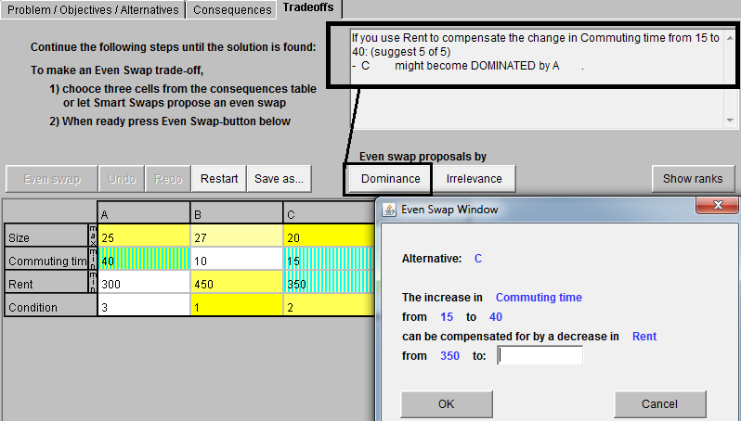
The Even Swap method Smart-Swaps software by Mustajoki and Hämäläinen (2007)

Slide 16
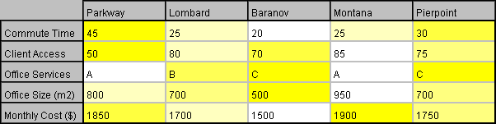
Office selection problem (Hammond, Keeney, Raiffa 1999)
25
78
Practically
dominated
by
Montana
An even swap
Dominated
by
Lombard
Commute time removed as irrelevant
(Slightly better in Monthly Cost, but equal or worse in all other attributes)

Slide 17
Biases in the even swaps
Paths consist of different sequences of trade-off judgments (even swaps)
Scale compatibility: Extra weight for the measuring stick
Loss aversion: Extra weight for the loss attribute
Effects of biases can accumulate during the process
⇒Different paths favor different alternatives
An experiment with 148 students – job, apartment selection
How much are you willing to pay to save 30 minutes of commuting time?

Slide 18
Results 1: Pricing path favors alternatives good in monetary attribute
*
***
ns
***
ns: not significant, *: p-value < 0.05, ***: p-value < 0.001. Based on McNemar’s test.

Slide 19
Experimental results 2: All swaps in the same alternative ⇒ this alternative is favored
Result is significant with p=0.004. Based on McNemar’s test.

Slide 20
Coping with path dependence
Modelling teams
Multiple independent teams solving the same problem
Alternative problem formulations and model structures
Devil’s advocate team?
Challenge crucial assumptions
Worst case analysis

Slide 21
Adaptive problem solving
Coping with path dependence
The desired path can change due to learning and new data
Plan to have checkpoints where the process can be revised
In policy problems there are often changes in the problem environment
Accumulation of information
Decrease of uncertainty over time

Slide 22
Reducing the effects of biases
Coping with path dependence
Approaches suggested in the literature:
Improve questions in preference elicitation
Train decision makers
Calibrate judgments
Design the preference elicitation process so that the effects of biases cancel out (Lahtinen, Hämäläinen , 2016)
Possible only if the mechanism of bias is well understood

Slide 23
Effects of biases can cancel out
Coping with path dependence
A
B
C
Shown to work in the Even Swaps method
( Lahtinen, Hämäläinen 2016)
Benefits: Not necessary to debias individual judgments

Slide 24
Checklist for the practitioner
What is the main goal of the modeling process – learning or prescriptive modelling?
Is path dependence a real risk and do we want to avoid it?
Consider effects related to the system created by the problem solving team and process
Consider procedural, behavioral and motivational biases
Consider technical properties, such as irreversibilities, in the problem under study
Consider the possibility of an adaptive modelling approach
Consider the possibility of using multiple models or modelling teams ?

Slide 25
Conclusions
Path dependence is a real phenomenon and risk in OR
Extra concern in large policy problems and in normative decision support
Most important driver is likely to be human behavior
Awareness is the first step to cope with path dependence
More research on the mitigation of biases is needed

Slide 26
Papers on path dependence
Hämäläinen, Lahtinen 2016. Path Dependence in Operational Research - How the Modeling Process Can Influence the Results Operations Research Perspectives, 3:14-20.
Lahtinen, Hämäläinen 2016. Path dependence and biases in the even swaps decision analysis method European Journal of Operational Research, 249(3): 890-898
Lahtinen, Guillaume, Hämäläinen 2017. Why pay attention to paths in the practice of environmental modelling? Environmental Modelling and Software, 92: 74-81.
Lahtinen, Hämäläinen, Jenytin 2017. A systems perspective on bias mitigation in multi-criteria decision analysis. Manuscript.
General Behavioural OR papers
Hämäläinen, Luoma and Saarinen 2013. On the Importance of Behavioral Operational Research: The Case of Understanding and Communicating about Dynamic Systems European Journal of Operational Research, 228, 3: 623-634.
Franco and Hämäläinen 2016a. Behavioural operational research: Returning to the roots of the OR profession. European Journal of Operational Research, 249, 3: 791-795.
Franco and Hämäläinen 2016b: Engaging with behavioural OR: On methods, actors, and praxis. In Kunc, M, Malpass, J, White, L (ed) Behavioural operational research: Theory, methodology and practice:, pp.1-14

Slide 27
References Arthur, W.B., 1989. Competing technologies, increasing returns, and lock-in by historical events. The Economic Journal 99 (394), 116-131.
David, P.A., 1985. Clio and the Economics of QWERTY. The American Economic Review 75 (2), 332-337.
Hammond, J.S., Keeney, R.L., Raiffa, H., 1999. Smart Choices: A Practical Guide to Making Better Decisions. Harward Business School Press, Boston, MA. Landry, M., Malouin, J-L., Oral, M. 1983. Model validation in operations research. European Journal of Operational Research 14 (3), 207-220.
Little, J.D.C., 1970. Models and Managers: The Concept of Decision Calculus. Management Science 16 (8), B466-B485. Reprinted in Management Science 50 (12 Supplement), 1841-1853.
Morris, W. T., 1967. On the Art of Modeling. Management Science 13 (12), B707-B717. Mustajoki, J., Hämäläinen, R.P., 2007. Smart-Swaps - A decision support system for multicriteria decision analysis with the even swaps method. Decision Support Systems 44 (1), 313-325. Ormerod, R. J. 2008. The transformation competence perspective. Journal of the Operational Research Society 59(11), 1435-1448. Sydow, J., Schreyögg, G., Koch, J., 2009. Organizational Path Dependence: Opening The Black Box. Academy of Management Review 34 (4), 689-709.
Webster, M., 2008. Incorporating Path Dependency into Decision-Analytic Methods: An Application to Global Climate-Change Policy. Decision Analysis 5 (2), 60-75.

