Slide 1
Generating Policy Alternatives for Decision Making A process model, behavioural issues and an experiment
Systems Analysis
Laboratory
Raimo P. Hämäläinen Tuomas J. Lahtinen and Kai Virtanen
Systems Analysis Laboratory, Aalto University, Finland
Available Open Access : EURO J. Decision Proceses, 2024
The document can be stored and made available to the public on the open internet pages of Aalto University. All other rights are reserved.

Slide 2
Challenges in Policy Decision Making
Decision analysis literature usually assumes that alternatives are given
In policy decisions the first decision is the choice of the policy alternatives – usually a diverse set is preferred
DM´s need help in the generation of policy alternatives
Behavioural impacts and path dependence need to be considered

Slide 3
Literature on the Generation of Alternatives
Early contributions
Arbel and Tong 1982: Describing factors
Keller and Ho 1988: Procedures
Howard 1988: Strategy table
Gregory and Keeney 1994 : Value focused approach
Recent reawakening
Ferretti, Pluchinotta and Tsoukiàs 2019: Policy context
Colorni and Tsoukiàs 2020: Design perspective
Related issues also dealt with in scenario planning

Slide 4
Terminology
A policy consists of elements (e.g. actions, instruments..)
A policy alternative is generated by bundling (collecting) together a set of elements
A policy is a portfolio of elements
For clarity here we do not use the term portfolio
The word strategy is also used
OR and policy literatures use the terms in different ways

Slide 5
The Strategy Generation Table R.Howard 1988
Strategy = Policy= Portfolio of elements
How to generate and use the strategy table?

Slide 6
A Process Model To generate a set of diverse alternatives
Problem definition
Design of approaches
seeking diversity
3. Generation of elements
actions, measures, instruments
4. Contruction of policy alternatives
different ways of bundling the elements
5. Deliberation and screening
Iteration is often needed
Result:
Alternatives for the decision makers

Slide 7
A Process Model To generate a set of diverse alternatives
Problem definition
Design of approaches
- The term approach refers to the ways and principles used in looking for new elements
- Aim to ensure that a diverse set of policy elements wil be generated
3. Generation of elements
- Different approaches are used to generate elements i.e. actions, measures, and instruments
4. Contruction of policy alternatives different ways of bundling the elements
5. Deliberation and screening
Iteration is essential !
Result:
Alternatives for the decision makers

Slide 8
A Process Model To generate a set of diverse alternatives
Problem definition
Design of approaches
seeking diversity
Generation of elements
actions, measures, instruments
4. Contruction of policy alternatives Approaches guide different ways of bundling the elements
5. Deliberation and screening
Iteration is essential !
Result:
Alternatives for the decision makers

Slide 9
Design of Approaches
Designing approaches by using different constraints, interests, scopes and time perspectives | Approach A: Emphasizing local scope and stakeholder 1 interests with a short-term perspective | Approach B: Emphasizing regional scope and stakeholder 2 interests with a short-term perspective | Approach C: Emphasizing stakeholders in a balanced way with a long-term perspective
Achievement levels and constraints must be met in all approaches
Target achievement level | X | X | X
Resource constraint 1 | X | X | X
Resource constraint 2 | X | X | X
Emphasising the interests and objectives of stakeholders
Stakeholder 1 | X |  | X
Stakeholder 2 |  | X | X
Stakeholder 3 |  |  | X
Scope
Local | X |  | X
Regional |  | X | X
Government
Time perspective
Short-term | X | X
Long-term |  |  | X
Other
Public acceptance | X |  | X
Core element |  | X

Slide 10
Behavioural Effects Heuristics and Biases
Elimination by aspects: eliminate elements below a treshold in a criterion (Tversky 1972)
Equal allocation of resources to categories (Benarzi and Thaler 2001)
Loss aversion: Adding a costly element to the portfolio causes loss of money, removing a costly element saves money (Kahneman and Tversky 1991)
Premature commitment to elements that first come to mind
Champion argument: the element presented by a high level actor will be chosen without criticism (Fasolo et al. 2011)

Slide 11
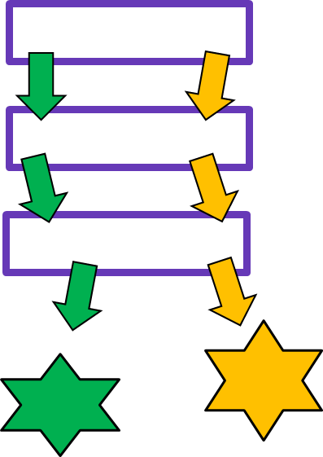
Path Dependency Drivers of path dependency in problem solving ( Hämäläinen R.P., and Lahtinen, T.J. 2016 )
System
Learning
Procedure
Behavior
Motivation
Uncertainty
External environment
Human interaction with the methods, problem, and the context can lead into path dependency

Slide 12
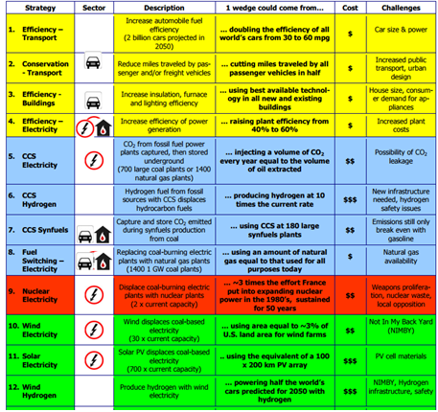
Behavioural Experiment Creating a policy for climate change mitigaton
A Princeton University Game, 2004
Projected path
Billions of Tons Carbon Emitted per Year
16
8
Historical
emissions
Goal: Flat path
1.6
1950
2000
2050
Goal to Stabilize Carbon Emissions
Year
15 action candidates
Notes:
12

Slide 13
Task: Create a policy (basket) consisting of 8 emission reduction actions
Comparison of two procedures: Adding / Removing
Behavioral questions:
Is there path dependence?
Which procedure is easier ?
What do people think when making choices?
An interactive experiment on the Internet with students (400+) from the Aalto University

Slide 14
Adding Procedure (ADD)
Starting point:
Empty basket
Result:
8 actions in the basket
1
2
5
8
Basket
3
12
11
13
Choices can be affected
by biases and heuristics
Add actions
1
2
5
8
14
10
3
4
6
6
7
4
7
9
10
15
12
11
14
13
9
15

Slide 15
Removing Procedure (REMOVE)
Starting point:
All actions in the basket
Result:
8 actions in the basket
1
2
5
8
1
2
5
8
Basket
6
3
4
7
3
9
10
10
12
11
14
13
12
14
15
Choices can be affected
by biases and heuristics
Remove actions
11
13
4
6
7
15
9

Slide 16
Results
No essential differences in the final policy with the ADD and REMOVE procedures
- REMOVE procedure is perceived more difficult and is slower to carry out than ADD
- The expressed choice behaviour of the participants reflects the use of different heuristics

Slide 17
Why is REMOVE More Difficult?
The endowment effect
We do not want to give away actions that we already have in our possession (in the policy)
Loss aversion
We do not want to give away the benefits that an action would produce if included in the policy
Ambiquity aversion
With the ADD procedure one sees all the time the composition of the policy
Desire to see the systemic big picture

Slide 18
Participants’ Choice Behavior
How did I make my decisions? | Behavioral interpretation
“First, I picked the best action, then second, and third and so on” | Add-the-best heuristic
“First I added those actions which were familiar and sustainable” | Recognition heuristic
“Avoid actions that are really bad in some attributes.” | Elimination by aspects
“Tried to find positive synergies“ | Paying attention to synergies
“When you have already removed the "stupid" ones it feels like a loss when you remove more strategies” | Loss aversion
“Developing a little bit of everything, not just one area” | Equal allocation heuristic

Slide 19
Conclusions
A structured process model can help practitioners in the generation of a rich set of policy alternatives
Behavioral effects can originate form
The procedures used
Human choice behavior and biases
Being aware of behavioral effects in policy generation is important – more research is needed

Slide 20
Literature
Arbel, A., and Tong, R. M. (1982). On the generation of alternatives in decision analysis problems. Journal of the Operational Research Society, 33(4): 377-387.
Colorni, A., & Tsoukiàs, A. (2020). Designing alternatives in decision problems. Journal of Multi‐Criteria Decision Analysis, 27(3-4), 150-158.
Fasolo, B., Morton, A., von Winterfeldt, D., 2011. Behavioural issues in portfolio decision analysis. In: Salo, A., Keisler, J.M., Morton, A. (Eds.), Portfolio Decision Analysis. Springer, pp. 149-165.
Ferretti, V., Pluchinotta, I., & Tsoukiàs, A. (2019). Studying the generation of alternatives in public policy making processes. European Journal of Operational Research, 273(1), 353-363.
Gregory, R., and Keeney, R. L. (1994). Creating policy alternatives using stakeholder values. Management Science, 40(8): 1035-1048.
Howard, R.A. (1988). Decision Analysis: Practice and Promise. Management Science, 34(6): 679-695.
Hämäläinen, R.P., Alaja, S. 2008. The Threat of Weighting Biases in Environmental Decision Analysis Ecological Economics, Vol. 68, 2008, pp. 556-569.
Hämäläinen, R.P., Luoma, J., and Saarinen, E. 2013. On the Importance of Behavioral Operational Research: The Case of Understanding and Communicating about Dynamic Systems European Journal of Operational Research, 228, 3: 623-634.
Hämäläinen, R.P. 2015. Behavioural issues in environmental modelling - the missing perspective Environmental Modelling & Software, 73, 244-253.
Hämäläinen R.P., and Lahtinen, T.J. 2016. Path Dependence in Operational Research –
How the Modeling Process Can Influence the Results Operations Research Perspectives, 3:14-20.

Slide 21
Keller, L. R., and Ho, J. L. (1988). Decision problem structuring: Generating options. IEEE Transactions on Systems, Man, and Cybernetics, 18(5): 715-728.
Kleinmuntz, D.N., 2007. Resource allocation decisions. In: Advances in Decision Analysis: from Foundations to Applications. Cambridge University Press, pp. 400-418.
Lahtinen, T. J., Hämäläinen, R. P. and Liesiö J. 2017a. Portfolio Decision Analysis Methods in Environmental Decision Making. Environmental Modelling and Software, 94, 73-86
Lahtinen, T.J., Guillaume, J.H., Hamäläinen, R.P., 2017b. Why pay attention to paths in the practice of environmental modelling? Environ. Model. Softw. 92, 74-81.
Loewenstein, G., and Lerner, J. 2003. The role of affect in decision making. In R. J. Davidson, H. H. Goldsmith, & K. R. Scherer (Eds.), The handbook of affective science. Oxford, England: Oxford University Press
Salo, A., Keisler, J. and Morton, A. (Eds.), 2011. Portfolio decision analysis: improved methods for resource allocation. Springer.
Thaler, R. H., and Sunstein, C. R. 2008. Nudge: Improving decisions about health, wealth, and happiness. New Haven, CT: Yale University Press.
Thaler, R. H., Sunstein, C. R., and Balz, J. P. 2014. Choice architecture. In E. Shafir (Ed.), Behavioral foundations of public policy: 428-439. Princeton, NJ: Princeton University Press.
Tversky, A., 1972. Elimination by aspects: A theory of choice. Psychological review, 79(4), 281.
Tversky, A. and Kahneman, D., 1985. The framing of decisions and the psychology of choice. Science, 211, 453-458.

