Slide 1
District heating systems
Dynamic simulation and optimization
Zichan Xie
2022.10.10

Slide 2



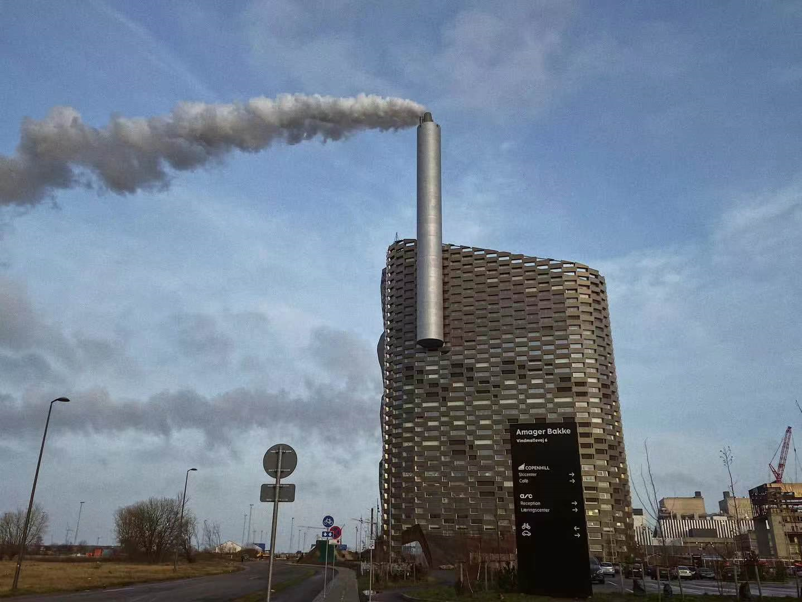
Name: Zichan Xie
Hometown: Chongqing, China
Supervisor: Risto Lahdelma
Office Room: a250
Hotpot
Education Background
Xi`an University of Architecture and Technology
Bachelor of Science in Engineering, Building Environment and Energy Application
Technical University of Denmark (DTU)
Master of Science in Engineering, Sustainable Energy
Terracotta Army
CopenHill Power Plant

Slide 3

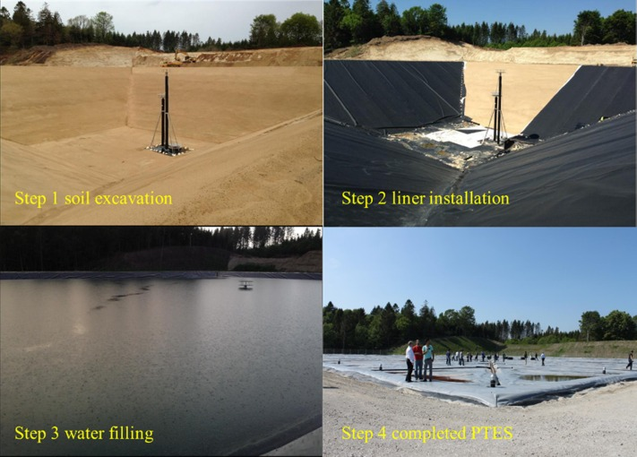
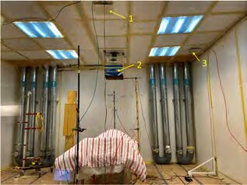
Previous Work
Simulation of a seasonal thermal storage
Experiment of ventilation in a hospital room
[1] Z. Xie, Y. Xiang, D. Wang, O. Kusyy, W. Kong, S. Furbo, et al. Numerical investigations of long-term thermal performance of a large water pit heat storage Sol. Energy, 224 (2021), pp. 808-822, 10.1016/j.solener.2021.06.027
[2] Z. Xie, M. Bivolarova, A. Melikov. Local ventilation for general patient rooms. Healthy Buildings Europe 2021

Slide 4



Research Plan
Research topic:
Optimal operation of district heating system with thermal energy storage
Dynamic thermal simulation of district heating networks
Dynamic simulation of district heating systems with thermal energy storage
Optimal system operation in the production side

Slide 5
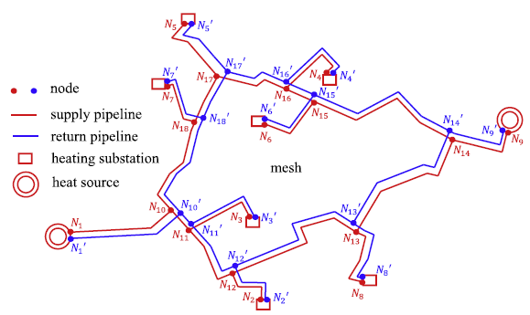
Typical district heating networks
Network without cycle
Network with cycle

Slide 6
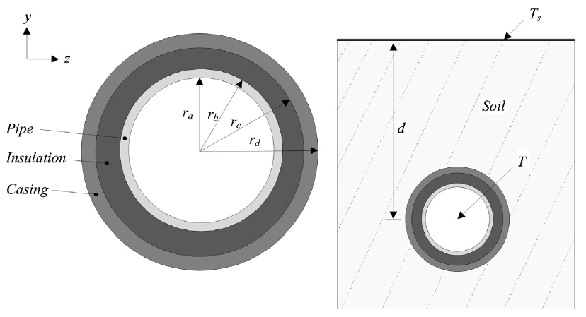
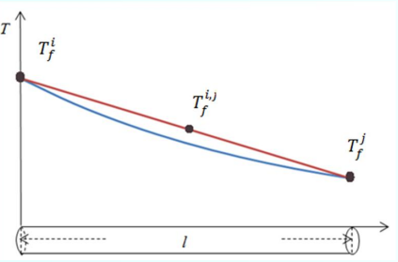

Heatloss and Time Delay in Transmission
Temperature change
$$T_{j}=T_{i}−\left(T_{i}−T_{g}\right)e^{−α∆t}$$
Ti : Inlet temperature
Tj : Outlet temperature
Tg : Ground temperature
Alpha: coefficient related to pipe properties
∆t : Traveling time

Slide 7
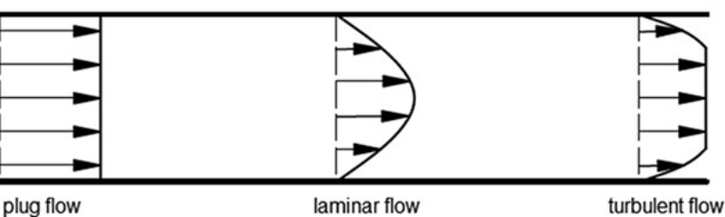
Discrete Event Simulation Method
Node 2
Pipe 1
Node 0
Node 1
Pipe 0
m₁
…
…
m₂
m₀
i+1
i
i-1
Pipe 2
Node 3

Slide 8
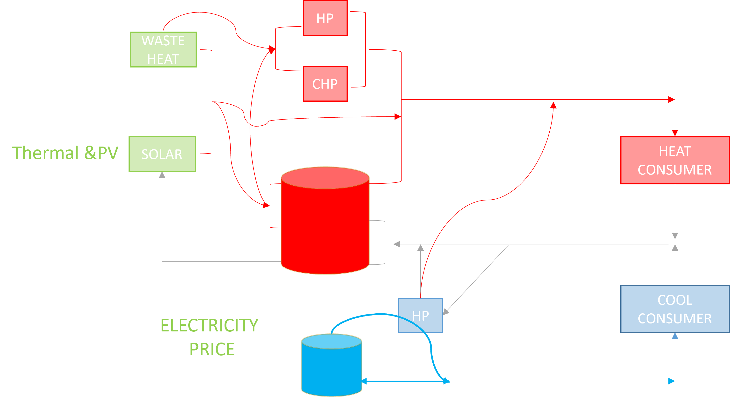
Future Work
Validate with measurement
Expand to return side simulation
Utilize for large-scale network simulation
Include hydraulic simulation
System Optimization!

Slide 9
Thank You!

