Slide 1
A short Introduction about me…
Piyalee Pattanaik​

Slide 2
I am from Odisha, India.
Located on the eastern coast of India, with the Bay of Bengal to the east.
Varied topography, including a vast coastline, rolling hills, fertile plains, and dense forests.

Slide 3
Odisha…..
Konark Temple
Odissi
White Tigers

Slide 4
Education…
Did under graduation at SRM University Chennai, India:
Bachelor’s Project: Wearable Health Monitoring and Tracking Device for Animals
Interned at Quantum Photonics Lab of the Physic department of NISER:
Project: Development of a single Photon counting Module
Worked as Programming Analyst at Cognizant
Masters in Applied Mathematics and Information at Moscow Institute of Physics and Technology:
Master’s thesis: Studying the Correlation effects in Bayesian Games

Slide 5
Studying the Correlation effects in Bayesian Games

Slide 6
Nash Equilibrium (NE) assumes: 1. Agents have correct beliefs about other agent’s behavior 2. Agents best respond given their beliefs

Slide 7
These assumptions are often violated : 1. unobservable variables (weather, temperature, framing...) 2. cognitive limitations, 3. lack of attention/willpower social preferences 4. etc.

Slide 8
Quantal rensponse Equilibrium
Quantal Response Equilibrium (QRE) relaxes the second assumption
Agents no longer always select the strategy with the highest expected payoff...
...but they are more likely to play strategies with high expected payoffs as opposed to strategies with low expected payoffs
Beliefs are still consistent: agents know others make mistakes when they compute expected payoffs

Slide 9
The idea of modeling imperfect maximization with stochastic choice stems from the work of mathematical psychologists like Thurstone and Luce .
Suppose that there are two decisions, A1 and A2, with expected payoffs denoted by 𝜋1 and 𝜋2,.
Then by Luce ratio the probability of A1 is: Pr(A1) = 𝜋1 ⁄ (𝜋1 + 𝜋2).

Slide 10
So, Luce ratio rule is a special case in QRE theory.
Consider a simple symmetric game with two players, each with two decisions.
The expected payoffs could be functions of a belief p that represents a player’s beliefs about the likelihood that the other player chooses A1
Luce quantal response function would be:
Pr(A1) = 𝜋1(𝑝)/ ( 𝜋1(𝑝)+𝜋2(𝑝))
In equilibrium, there is no opportunity for learning in the sense that the quantal response probabilities match the beliefs, i.e., Pr(A1) = p.

Slide 11
Richard McKelvey and Thomas Palfrey considered a model in which players make choices based on quantal response models and defined a quantal response equilibrium.
They showed that if the variance of the independent random terms is large enough then a quantal response equilibrium is unique.
Ui, Takashi motivated by the works of McKelvey and Palfrey studied the uniqueness of quantal response equilibrium.

Slide 12
Payoff perturbations and Quantal response
In our study we are dealing with symmetric binary-choice games.
We define A1 and A2 to be the two possible decisions
A1 will refer to the most pro-social decision in each scenario.
So, every player does have a predicted payoff function, π(p), that depends on the probability p that the other player selects the pro-social decision A1.
The expected payoffs are denoted by π1(p) and π2(p) for decisions A1 and A2, respectively.

Slide 13
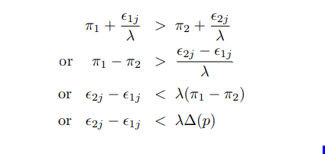
Perceived payoffs is the sum of payoffs (π(p)) and additive (player-specific) disturbances, ϵ_ij , so a player j will select A1 if:
So, the probability of actually choosing A1 is dictated by the probability that the difference in disturbances will be relatively less than the scaled payoff difference λ∆(p)

Slide 14
To simplify the notation, let consider ε_1j = x, ε_2j = y.
we consider x and y to have standard bi-variate normal distribution with correlation coefficient ρ
Then their joint PDF is given by:
So, the cumulative distribution function for the variable y − x being less than λ∆(p) is given by:

Slide 15
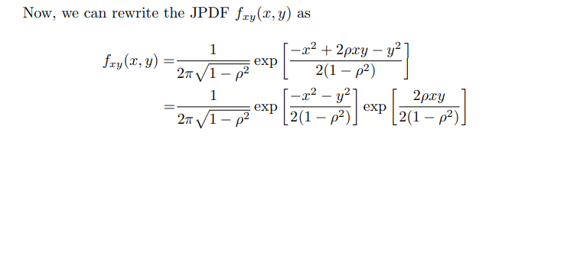

Slide 17
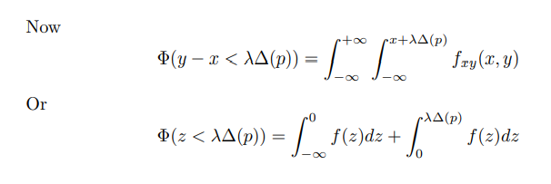
Solving the above equation give us the following result which the required cumulative distribution:

Slide 18
In equilibrium the choice probability must equal the belief probability p used in the payoff difference i.e.:
The distribution function will have the inverse property since it is an increasing function.
To split the equilibrium condition into terms relevant to noise on the left and payoffs on the right, just invert both sides of the above equation and divide by λ as shown below:

Slide 19
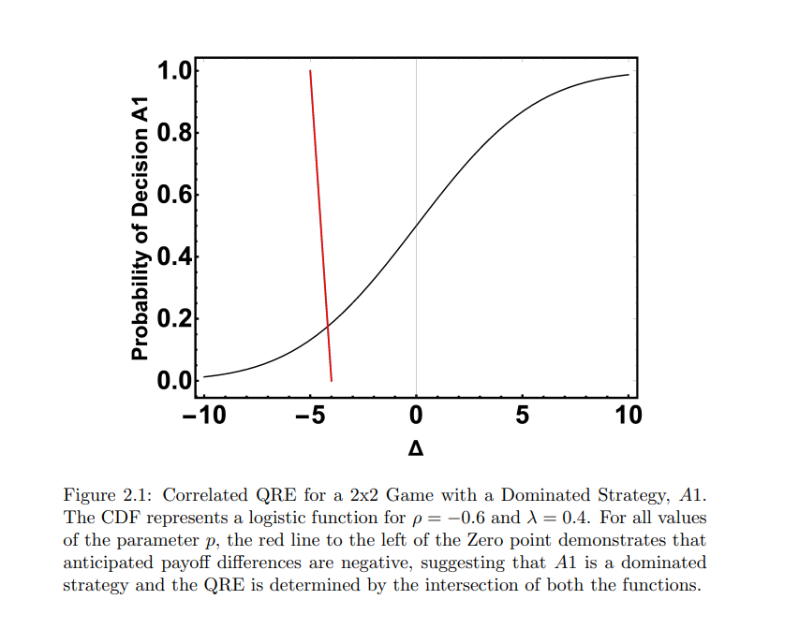
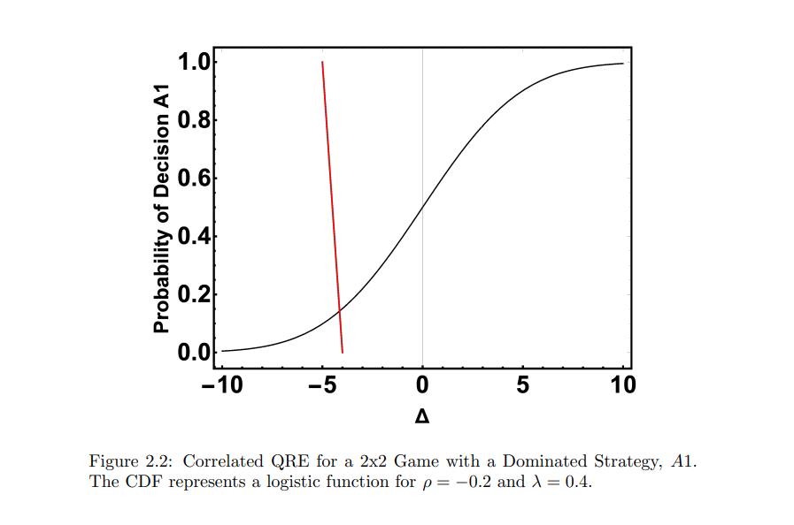
We are going to visualize the above decomposition by plotting the independent variable, p, on the y-axis and expected payoff differences on the x-axis as shown below :

Slide 20
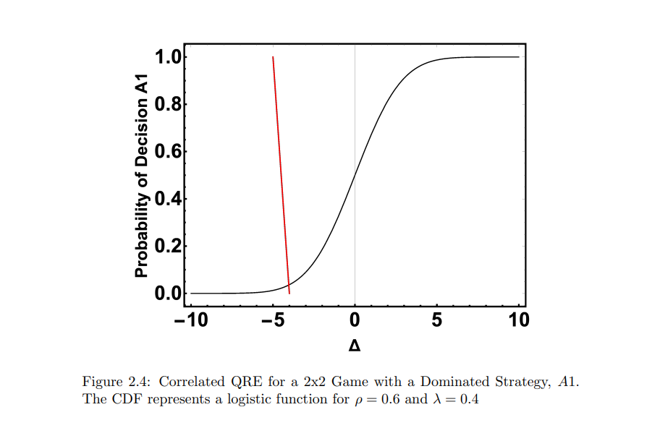
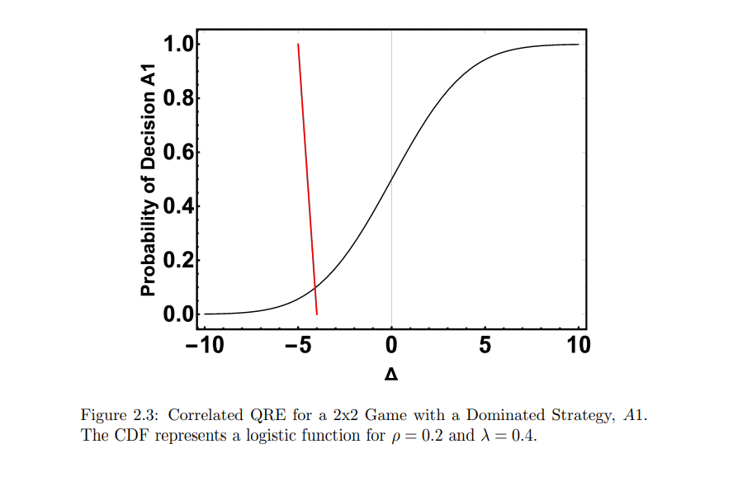

Slide 21
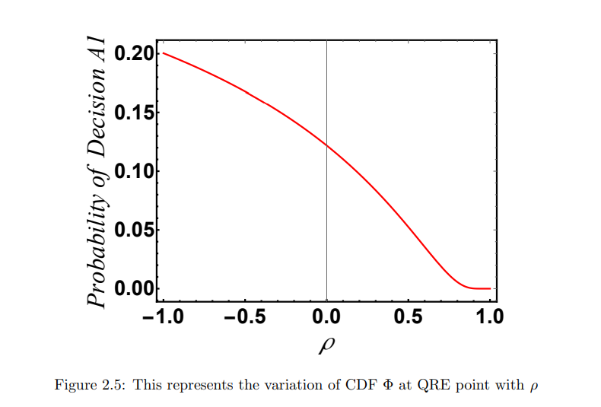

Slide 22
The payoff difference line in each panel of the above figures is derived from a prisoner’s dilemma game used by Andreoni and Miller (1993), as shown below.
For that game, cooperation yields a payoff of 7 for each, whereas a unilateral defector obtains 12, so the payoff difference is −5.
This difference determines the intercept of the dashed line with the top of the figure.
Player 1/ Player 2 | A1(cooperate) | A2(Defect)
A1(cooperate) | (7,7) | (0,12)
A2(Defect) | (12,0) | (4,4)

Slide 23
Conversely, when the other person defects, cooperation yields 0 as compared with 4 for mutual defection, so the horizontal intercept of the dashed line in the figure is −4.
The dashed expected payoff line connects these two intercepts.
As the correlation coefficient ρ in varies from -1 to 1, the inverse distribution takes on the shape of a sharp step function.
The QRE point which is derived from the intersection of expected payoff line with the distribution line also falls meaning the dominated decision has a positive (but low) probability for the game presented.
The QRE intersection converges to a zero-probability associated with the dominated decision as the correlation coefficient approaches 1, e.g., defect in a prisoner’s dilemma.
The key takeaway is that QRE smooths out sharp best responses, resulting in smoothed ”better responses” in which all actions are picked with a high probability.

Slide 24
Conclusion
The distribution function pass through the point (0, 1/2) which satisfy the i.i.d.(independent and identically distributed) condition of random terms and hence, the symmetry property.
This suggests that neither perturbation is more likely to be larger than the other.
We also observe that the QRE probability p determined by the intersection point cannot be made arbitrarily high or small.
The form of the distribution is affected by the variation of correlation effects, which flattens or sharpens it, but it remains monotone and passes through the midpoint.

Slide 25
Our findings also suggests that all QRE models with i.i.d. perturbations like logit or in our case normal distribution, will have QRE intersections at probabilities less than 1/2 for the above games.
We used the concept ϵ2j − ϵ1j < λ(π1 − π2) with correlated terms to study the uniqueness of quantal equilibrium.
We can see from our figures that when the correlation is low player ’i’ believes that with probability around 1/2 the difference ϵ2j −ϵ1j is less than the scaled payoff difference and hence the A1 is dominated.
As the correlation increases the decision of choosing a dominated choice is positive but low probability as we have seen in case of above examples.
Hence the uniqueness of QRE is further proven.

Slide 26
Thank you

