Slide 1
Macroeconomic Calibration Methods in Loss Given Default Modelling
Andrea Lyly
Supervisor: prof. Ahti salo
Advisor: M.sc. Juuso-markus jeskanen

Slide 2
Outline
Introduction
International Financial Reporting Standard 9 and Basel Accord
Thesis Objective
Expected Credit Loss
Scenarios
Loss Given Default
Definition
Model
Point-in-Time Adjustment Framework
Calibration
Output Adjustment – Loss Rate Model
Input Adjustment – Risk Driver Model
Results
Conclusions

Slide 3
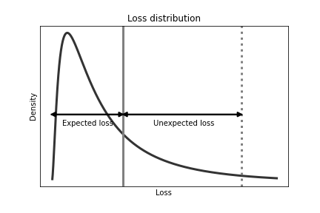
Introduction IFRS 9 and Basel
International Financial Reporting Standard 9 (IFRS 9)
Accounting standard
Credit loss provisioning to cover for expected credit losses
Basel III accord
Capital requirements
Regulatory capital to hold as buffer for unexpected losses
Internal ratings-based (IRB) models

Slide 4
Introduction Thesis objective
Problem
Both IRB and IFRS 9 models need to be developed and used → Banks usually focus more on IRB models due to regulatory guidelines
Credit risk model development requires resources and time, and having different types of models for similar risk management applications can cause challenges
Loss given default (LGD) models for IFRS 9 have not been studied in literature as extensively compared to probability of default (PD) models
Solution
Developing a framework for calibrating IRB LGD models for IFRS 9 purposes
Why is this useful?
No need to start a new model development project
Enables synergy between the different credit risk models in risk management applications
Expanding knowledge on IFRS 9 LGD modelling

Slide 5
Introduction Expected credit loss
Default = Counterparty is not able to fulfill its payment obligations
Modelled with probability of default (PD)
Exposure = The amount of loan on-balance
Modelled with exposure at default (EAD)
Consequence = The percentage loss from the exposure at default
Modelled with loss given default (LGD)
Expected credit loss (ECL) is generally calculated by
$$ECL=PD×LGD×EAD$$
Assets are allocated into stages
Stage 1: Performing assets → 12-month ECL
Stage 2: Significant increase in credit risk (SICR) → Lifetime ECL
Stage 3: Non-performing assets (defaulted) → Lifetime ECL

Slide 6
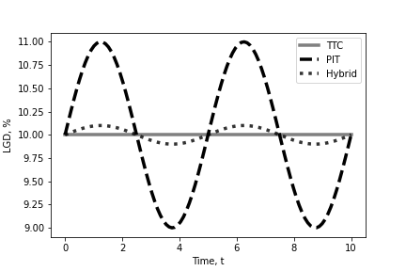
Introduction Scenarios
In IFRS 9, ECL is calculated as a probability weighted average of the expected economic outlook
Consider multiple macroeconomic scenarios
Risk parameters are conditioned on the expected macroeconomic environment
$ECL=\sum_{s∈S}{p\left(s\right)⋅PD\left(s\right)⋅LGD(s)⋅EAD(s)}$,
where $S$ is a set of scenarios
IFRS 9 calls for point-in-time (PIT) estimates, while in IRB the estimates aim to be through-the-cycle (TTC)

Slide 7
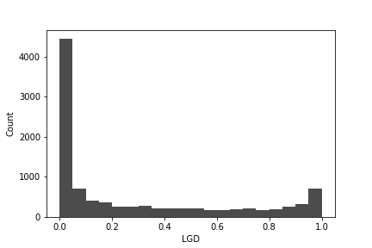
Loss Given Default Definition
Loss given default (LGD) is the percentage loss from EAD that occurs from the entire recovery process of the default
Let the moment of default be $t_{0}$ and $K$ is the length of the full recovery process
Consider a partition ${0<t}_{0}<t_{1}<⋯<t_{k}<⋯<t_{K}<T_{max}$
Let $CF_{t_{k}}$ be all cashflows received or lost at $t_{k}$
Let $e$ be a discounting rate
IRB: primary interbank offered rate + 5%
IFRS 9: effective interest rate
The discounted cash flows are $DCF_{t_{k}}=\frac{1}{{\left(1+e\right)}^{t_{k}}}CF_{t_{k}}$
The total cash flows are $TDCF=\sum_{k=1}^{K}{DCF_{t_{k}}}$
The realized recovery rate is $RR=\frac{TDCF}{EAD}$
The realized loss is $LGD=1−RR$

Slide 8
Loss Given Default Model
Risk drivers (explanatory variables) are used to predict LGD
LGD is modelled using ordinary least squares (OLS) regression
Simple, easy to understand, generally good performance
$LGD_{i}=β_{0}+\sum_{j=1}^{P}{β_{j}X_{i,j}}+ε_{i}$
Risk parameter model
Risk differentiation (rank ordering) → estimate the OLS model, in some cases grouping the estimates
Risk quantification (calibration) → correct the estimates to long-run average (LRA) levels

Slide 9
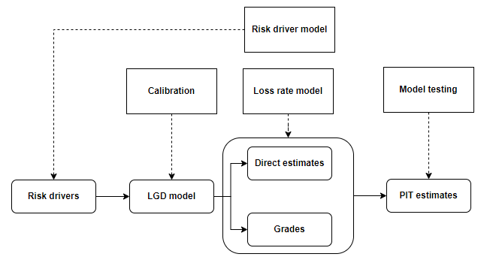
Point-in-Time Adjustment Framework Overview
Calibration of the LGD estimates to IFRS 9 loss levels
The IRB LGD (rank ordering) model as a basis
Re-calculation of realized losses under IFRS 9
Setting the LGD estimates to appropriate level
Point-in-time (PIT) adjusted LGD estimates
Adjust the LGD estimates directly (= output adjustment)
Adjust the risk drivers in model inputs (= input adjustment)
Testing the model performance

Slide 10
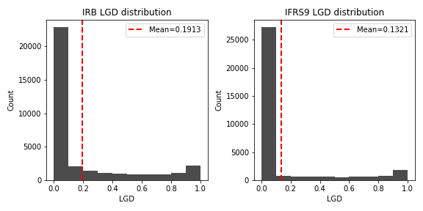
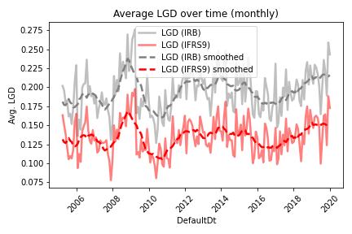
Calibration Calibrating LGD estimates to correspond IFRS 9 loss levels
Re-calculation of realized losses under IFRS 9
Consider the discounting rate and cash flow components
Using the non-calibrated IRB LGD model scores $LGD_{i}^{IRB}$
Calibration
Continuous approach: $LGD_{i}^{IFRS9}=γ_{1}⋅LGD_{i}^{IRB}+γ_{0}+ξ_{i}$

Slide 11
Loss Rate Model An output adjustment method
The loss rate is ${\overline{LGD}}_{t}=\frac{1}{N_{t}}\sum_{i=1}^{N_{t}}{LGD_{i,t}}$, where $t=1,…,T$ are default dates and $N_{t}$ is the number of defaults at $t$
The loss rate is modelled with OLS using macroeconomic factors $M_{j,t}$
${\overline{LGD}}_{t}=α_{0}+\sum_{j=1}^{J}{α_{j}M_{j,t}}+u_{t}$
LGD is generally an I(0) process, but time series operations can be applied to address stationarity depending on the data horizon used for modelling
Forecasts are used to calculate scenario scalars
$δ_{τ}=\frac{{\overline{LGD}}_{τ,s}}{LRA LGD}$, where $s∈\{weak, base, strong\}$
$LRA LGD$ is the long-run average (LRA) LGD of the modelled portfolio
Scalars $δ_{τ,s}$ are used to adjust LGD estimates for different scenarios
$LGD_{i.t_{R}+τ,s}=δ_{τ,s}⋅LGD_{{i,t}_{R}+τ}$, where $t_{R}$ is the reporting date

Slide 12
Risk Driver Model An input adjustment method
The risk driver model aims to forecast the risk driver values
It incorporates forecasted risk driver values for different scenarios into LGD model inputs
Collateral values are typically included as risk drivers to the LGD model, as LGD is highly dependent on the ratio of the exposure and collateral values → Loan-to-value
Other risk drivers can also be modelled
Can be used for both stage 1 and 2, or only for stage 2 to update risk drivers for the lifetime of the asset
For example:
Collateral values are updated using the forecasted growth rates
Exposure at default can be estimated with a separate EAD model
Forward-looking LTV can be calculated and used as LGD model input
Note: one should ensure that the shifts in risk driver distributions are adressed

Slide 13
Results Data simulation, IRB LGD model, and IFRS 9 calibration
Two LGD data sets are simulated using a Gaussian copula algorithm for generating different distributions with a correlation structure
Simulate a residential mortgage portfolio
Confidentiality of credit risk data prevents to use real data
Simulation risks are addressed
Macroeconomic dependencies are added to LGD and collateral values over time
Data sets for model development and calibration are sampled
IRB LGD model parameters
Loan-to-value
Arrears
Income
Collateral location
IFRS9 LGD calibration parameters
IRB LGD (rank ordering) model score without calibration
Long-run average LGD values

Slide 14
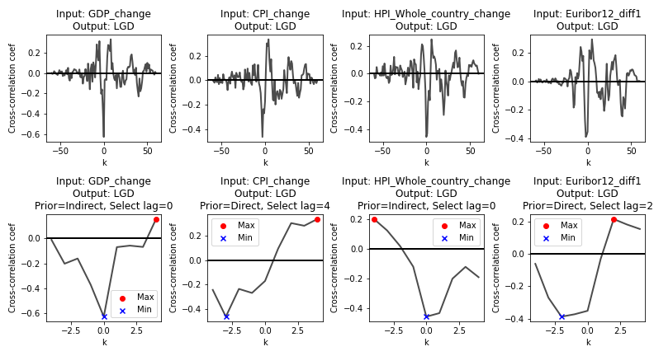
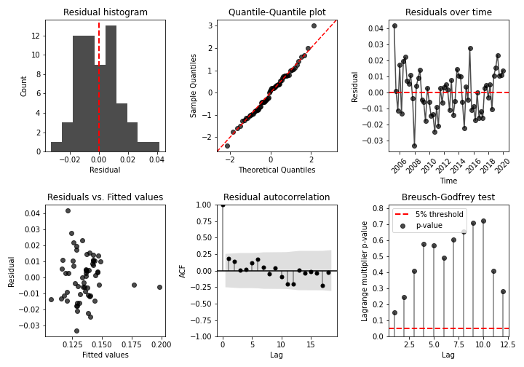
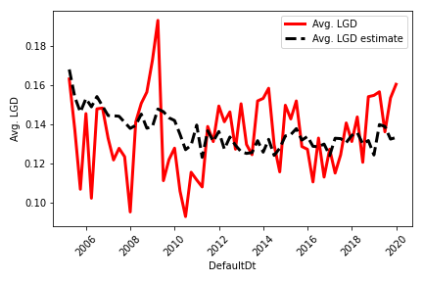
Results Developing an output adjustment model 1/2
Analysis of the LGD time series, correlation analysis for macroeconomic factors and LGD time series, model selection, model diagnostics

Slide 15
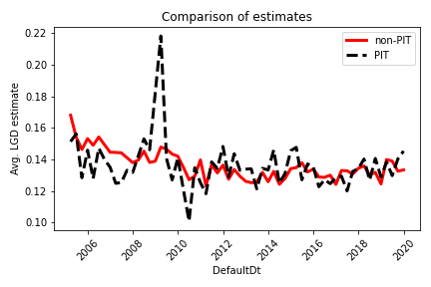
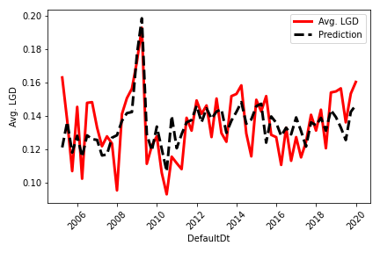
Results Developing an output adjustment model 2/2
Final model and its application to obtain PIT calibrated estimates
LRA LGD = 0.1346
Scenario | GDP | HPI | $$\overline{LGD}$$ | Scalar $δ$
Base | 0.0025 | 0.005 | 0.1351 | 1.0037
Weak | -0.005 | -00076 | 0.1471 | 1.093
Strong | 0.0099 | 0.0123 | 0.1256 | 0.9329

Slide 16
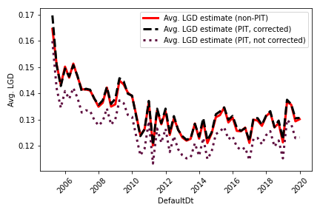
Results Developing an input adjustment model 1/2
Calculating yearly collateral value growth rates from calibration data with respect to reporting and default dates
Modelled with location based HPI using OLS, and by directly applying HPI as a proxy
Estimating the EAD with a simple conversion factor $C$
Average decrease in exposure from reporting date to default date
Updating LTV values:
Continuous variables are standardized to zero mean and unit variance in the LGD model → new standardization parameters are estimated from default date LTV data
Alternatively, one can fit the calibration function using the forward-looking data

Slide 17
Results Developing an input adjustment model 2/2
 | t_R | t_R + 1 | t_R + 2 | t_R + 3
HPI growth, base | - | 0.02 | 0.01 | 0.01
HPI growth, weak | - | -0.04 | -0.03 | 0
HPI growth, strong | - | 0.04 | 0.03 | 0.02
Exposure | 60 000 | 57 477 | 55 060 | 52 744
Collateral, base | 80 000 | 81 600 | 83 232 | 84 064
Collateral, weak | 80 000 | 76 800 | 74 496 | 74 496
Collateral, strong | 80 000 | 83 200 | 85 696 | 87 410
LTV, base | 0.75 | 0.7044 | 0.6615 | 0.6274
LTV, weak | 0.75 | 0.7484 | 0.7391 | 0.708
LTV, strong | 0.75 | 0.6908 | 0.6425 | 0.6034
LGD, base | - | 0.1774 | 0.1633 | 0.1521
LGD, weak | - | 0.1919 | 0.1888 | 0.1786
LGD, strong | - | 0.173 | 0.1571 | 0.1442
Example of the risk driver model application, where collateral value growths are directly modelled with HPI growth

Slide 18
Conclusions What was done and why is it useful
This thesis presented a framework for calibrating IRB LGD models for IFRS 9 ECL calculations
Leverage IRB LGD (rank ordering) models
Calibration for IFRS 9 loss levels
Point-in-time adjustments for macroeconomic scenarios
Output adjustment – Loss rate model
Input adjustment – Risk driver model focusing on collateral values
The framework can be used for ECL calculations and also stress testing purposes
Further research
Alternative loan portfolios with different types of collaterals and risk drivers
Defaulted facilities (Stage 3)
Focus on alternative model structures including, e.g., cure rates and discrete LGD grades

