Slide 1
Simulation Metamodeling using Dynamic Bayesian Networks in Continuous Time
Jirka Poropudas (M.Sc.)
Aalto University
School of Science and Technology
Systems Analysis Laboratory
http://www.sal.tkk.fi/en/
jirka.poropudas@tkk.fi
Winter Simulation Conference 2010
Dec. 5.-8., Baltimore, Maryland

Slide 2
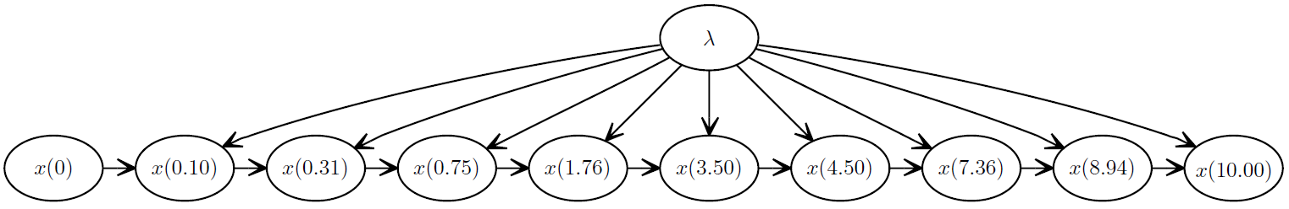
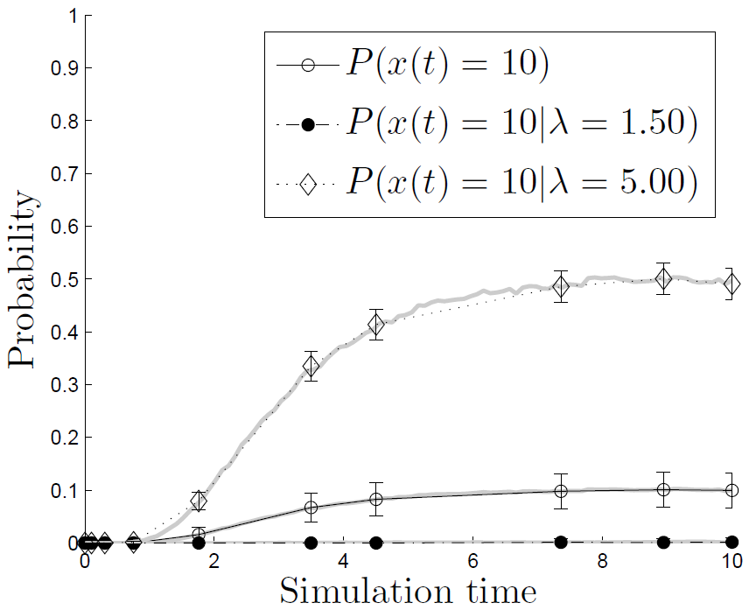
Contribution
Dynamic Bayesian network: Metamodel for the time evolution of discrete event simulation
Previously: Changes in probability distribution of simulation state presented in discrete time
Now: Extension to continuous time using interpolation

Slide 3
Outline
Dynamic Bayesian networks (DBNs) as
simulation metamodels
Construction of DBNs
Utilization of DBNs
Approximative results in continuous time using interpolation
Example analysis: Air combat simulation
Conclusions

Slide 4
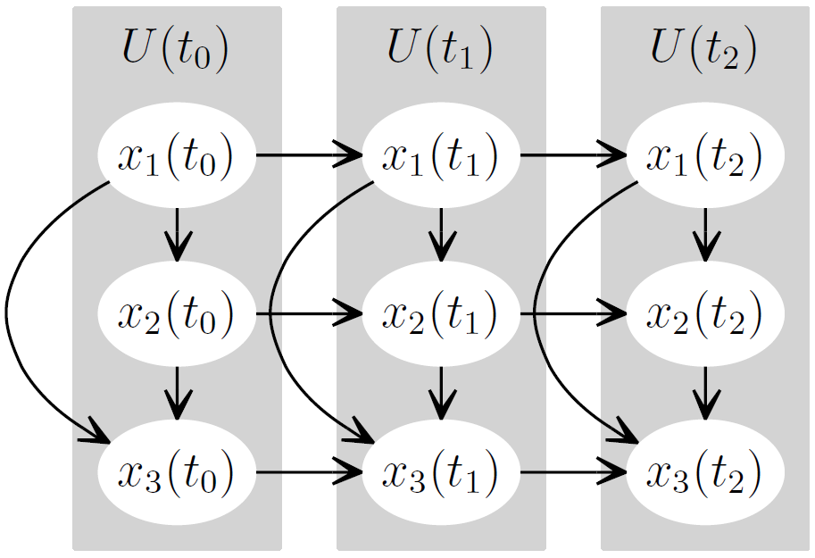
Dynamic Bayesian Network (DBN)
Joint probability distribution of a sequence of random variables
Simulation state variables
  Nodes
Dependencies
  Arcs
  Conditional probability tables
Time slices → Discrete time
Simulation state at

Slide 5
Dynamic Bayesian Networks in Simulation Metamodeling
Poropudas J., Virtanen K., 2010. Simulation Metamodeling with Dynamic Bayesian Networks, submitted for publication.
Time evolution of simulation
  Probability distribution of simulation state at discrete times
Simulation parameters
  Included as random variables
What-if analysis
  Simulation state at time t is fixed
  → Conditional probability distributions

Slide 6
Construction of DBN Metamodel
Poropudas J.,Virtanen K., 2010. Simulation Metamodeling with Dynamic Bayesian Networks, submitted for publication.
Selection of variables
Collecting simulation data
Optimal selection of time instants
Determination of network structure
Estimation of probability tables
Inclusion of simulation parameters
Validation

Slide 7

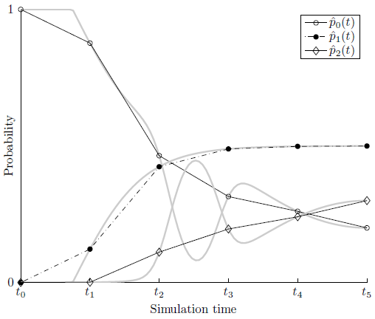

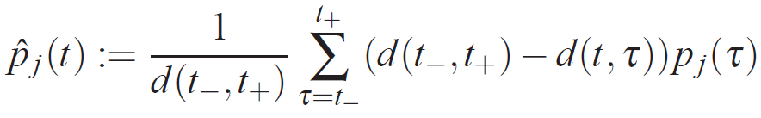



Optimal Selection of Time Instants
Probability curves
estimated from simulation data
DBN gives probabilities at discrete times
Piecewise linear interpolation

Slide 8
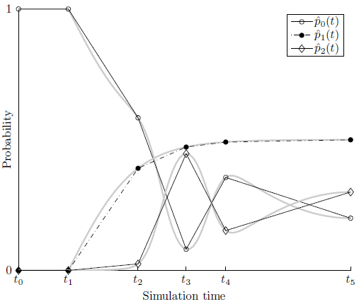

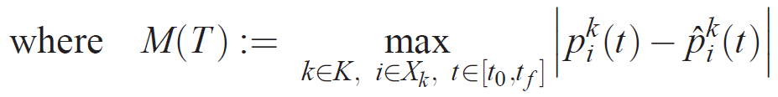
Optimization Problem
Minimize maximal absolute error of approximation
Solved using genetic algorithm
MINIMIZE

Slide 9



Approximative Reasoning in Continuous Time
DBN gives probabilities at discrete time instants
→ What-if analysis at these times
Approximative probabilities for all time instants with first order Lagrange interpolating polynomials → What-if analysis at arbitrary time instants
”Simple, yet effective!”

Slide 10




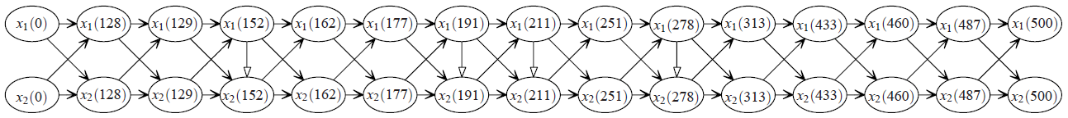
Example: Air Combat Simulation
X-Brawler ̶ discrete event simulation model for air combat
1 versus1 air combat
State of air combat
  Neutral: and
  Blue advantage: and
  Red advantage: and
  Mutual disadvantage: and

Slide 11
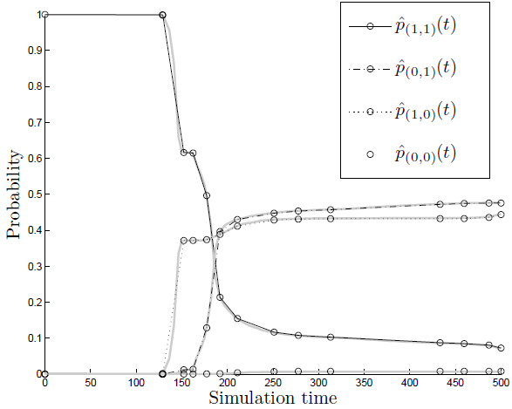
Time Evolution of Air Combat
neutral
red
blue
mutual
What happens during the combat?

Slide 12
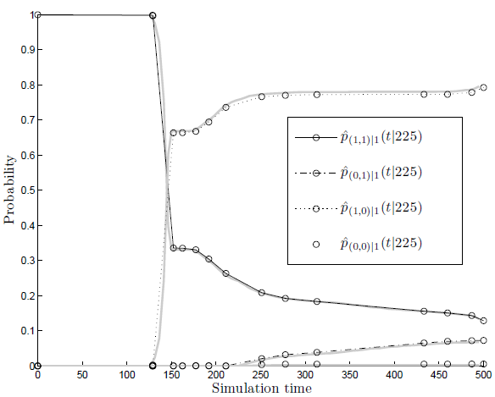
What-if Analysis
neutral
red
blue
neutral
mutual
red
blue
mutual
What if Blue is still alive after 225 seconds?

Slide 13
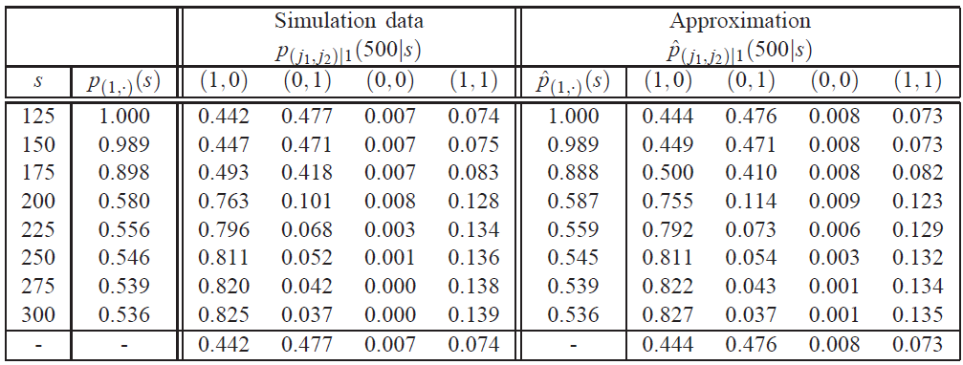
Simulation Data versus Approximation
Similar results with less effort

Slide 14
Conclusions
Dynamic Bayesian networks in simulation metamodeling
  Time evolution of simulation
  Simulation parameters as random variables
  What-if analysis
Approximation of probabilities with first order Lagrange interpolating polynomials
  Accurate and reliable results
  What-if analysis at arbitrary time instants without increasing the size of the network
  Generalization of simulation results

Slide 15
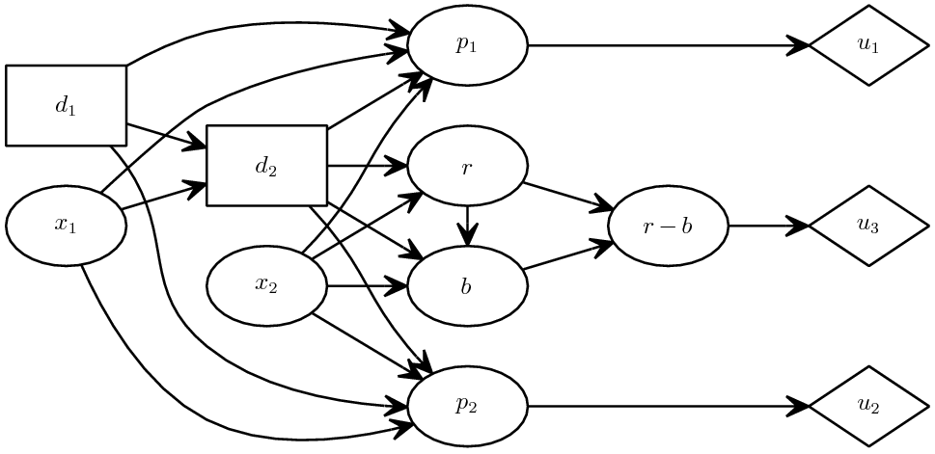
Future research
DBN metamodeling
  Error bounds?
  Comparison with continuous time BNs
Piecewise linear interpolation not included in available BN software
Simulation metamodeling using influence diagrams
  Decision making problems
  Optimal decision suggestions
Influence Diagram

Slide 16
References
Friedman, L. W. 1996. The simulation metamodel. Norwell, MA: Kluwer Academic Publishers.
Goldberg, D. E. 1989. Genetic algorithms in search, optimization, and machine learning. Upper Saddle River, NJ: Addison-Wesley Professional.
Jensen, F. V., and T. D. Nielsen. 2007. Bayesian networks and decision graphs. New York, NY: Springer-Verlag.
Nodelman, U.D., C.R. Shelton, and D. Koller. 2002. Continuous time Bayesian networks. Eighteenth Conference on Uncertainty in Artificial Intelligence.
Pearl, J. 1991. Probabilistic reasoning in intelligent systems: Networks of plausible inference. San Mateo, CA: Morgan Kaufmann.
Phillips, G. M. 2003. Interpolation and approximation by polynomials. New York, NY: Springer-Verlag.
Poropudas, J., and K. Virtanen. 2007. Analysis of discrete events simulation results using dynamic Bayesian networks”, Winter Simulation Conference 2007.
Poropudas, J., and K. Virtanen. 2009. Influence diagrams in analysis of discrete event simulation data, Winter Simulation Conference 2009.
Poropudas, J., and K. Virtanen. 2010. Simulation metamodeling with dynamic Bayesian networks, submitted for publication.
Poropudas, J., J. Pousi, and K. Virtanen. 2010. Simulation metamodeling with influence diagrams, manuscript.

