Slide 1
Risk-informed Decision Making under Incomplete Information
A. Mancuso^{a,b}, M. Compare^{b}, A. Saloª, E. Zio^{b,c}
Systems Analysis Laboratory, Department of Mathematics and Systems Analysis - Aalto University
Laboratory of Signal and Risk Analysis, Dipartimento di Energia - Politecnico di Milano
Chair on Systems Science and the Energetic Challenge - École Centrale Paris and Supelec
June 21, 2017

Slide 2
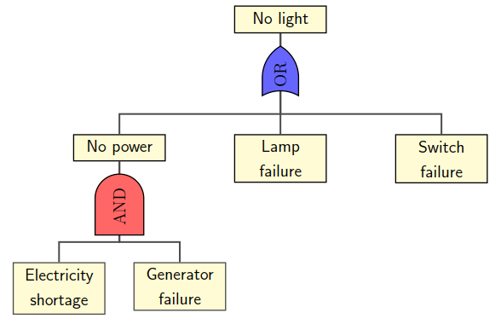



Risk-informed decisions about safety
Probabilistic Risk Assessment (PRA)
Fault Tree
$${RRW}^{Gen}=\frac{P(No light)}{P(No light|No generator failure)}$$
$${RRW}^{Lamp}=\frac{P(No light)}{P(No light|No lamp failure)}$$
$${RRW}^{Switch}=\frac{P(No light)}{P(No light|No switch failure)}$$
Concerns
  Experts choose actions according to these importance measures
  Cost of actions and feasibility constraints considered only afterwards
  The results can be sub-optimal

Slide 3
Our methodology
The methodology identifies which portfolios of actions minimize the residual risk of the system and the total cost of actions.
The methodology accounts for risk, budget and other feasibility constraints.
Methodology steps:
Step 1: Failure scenario modeling
Step 2: Definition of failure probabilities
Step 3: Specification of actions
Step 4: Optimization model

Slide 4


Slide 5
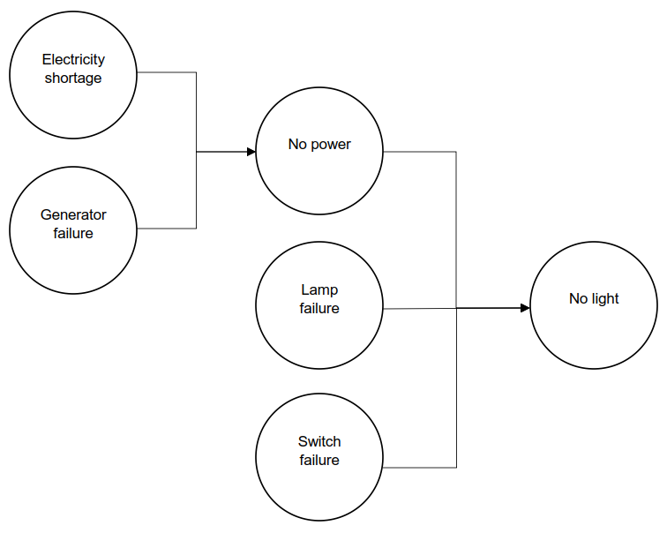
Step 1: Failure scenario modeling
Mapping of Fault Tree (FT) into Bayesian Belief Network (BBN)
Advantages
Multi-state modeling
Extension of concepts of AND/OR gates
Reference: Khakzad N., Khan F., Amyotte P., Dynamic safety analysis of process systems by mapping bow-tie into Bayesian network, Process Safety and Environmental Protection 91 (1-2), pp. 46-53 (2013).

Slide 6
Step 2: Definition of failure probabilities
Information sources
Information provided by AND/OR gates in FT
Statistical analyses
Expert elicitation
The probabilities of events are defined as interval-valued estimates for
Initiating events → Failure probabilities of system components
Intermediate and top events → Conditional probability tables

Slide 7



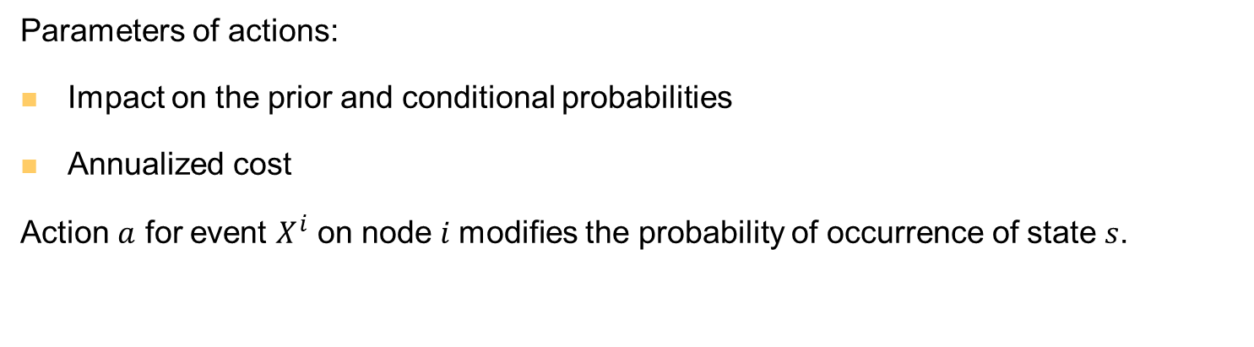



Step 3: Specification of actions
Parameters of actions:
Impact on the prior and conditional probabilities
Annualized cost
Action $a$ for event $X^{i}$ on node $i$modifies the probability of occurrence of state $s$.
$$P_{X_{a}^{i}}(s)$$
$${\overline{P}}_{X_{a}^{i}}(s)$$
$$P_{X^{i}}(s)$$
$${\underline{P}}_{X_{a}^{i}}(s)$$
$$s∈S^{i}$$
$$s∈S^{i}$$
To accommodate the imprecise probability into the scenario model we employ credal networks by extending the application of Bayesian networks to credal sets, i.e. sets of probability distributions.

Slide 8

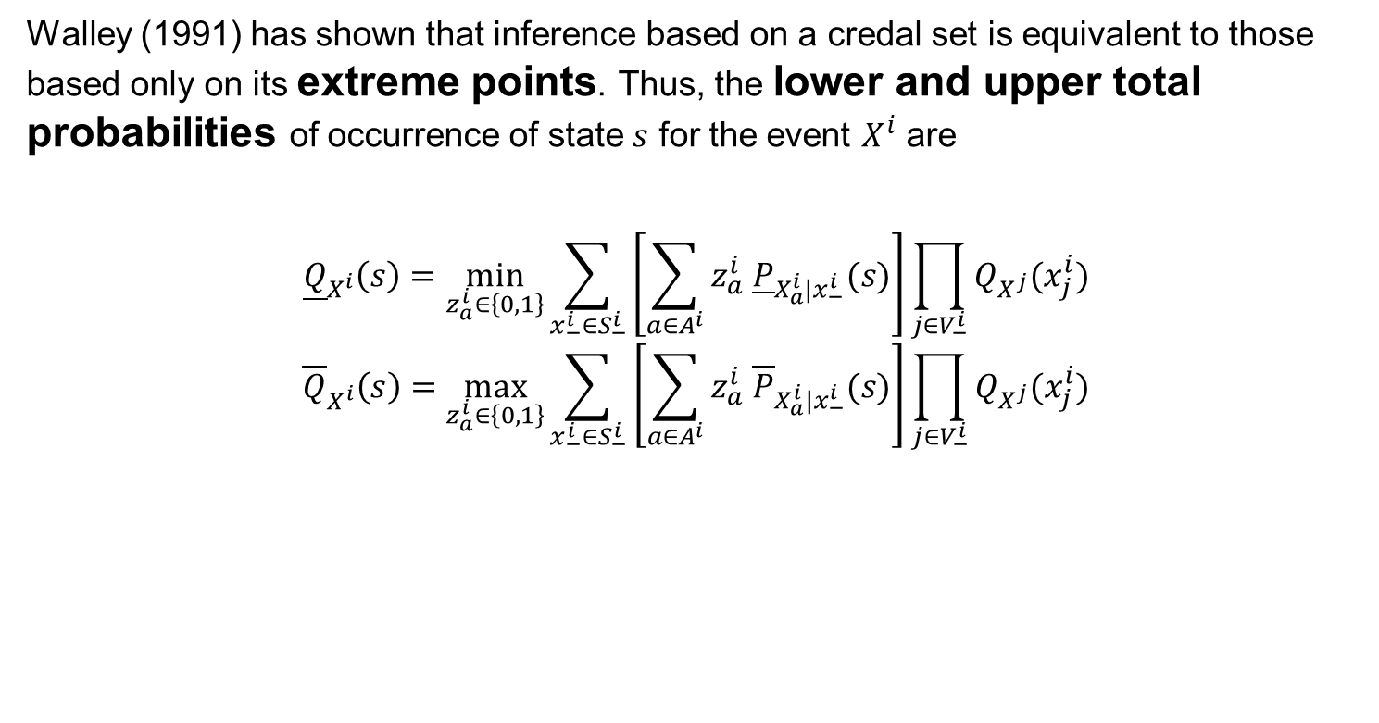
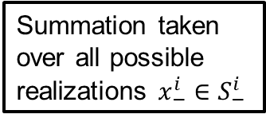
Propagation of imprecise probability
Walley (1991) has shown that inference based on a credal set is equivalent to those based only on its extreme points. Thus, the lower and upper total probabilities of occurrence of state $s$ for the event $X^{i}$ are
$${\underline{Q}}_{X^{i}}\left(s\right)=\min_{z_{a}^{i}∈\left\{0,1\right\}}{\sum_{x_{−}^{i}∈S_{−}^{i}}{\left[\sum_{a∈A^{i}}{z_{a}^{i} {\underline{P}}_{X_{a}^{i}|x_{−}^{i}}(s)}\right]\prod_{j∈V_{−}^{i}}{Q_{X^{j}}(x_{j}^{i})}}}$$
$${\overline{Q}}_{X^{i}}\left(s\right)=\max_{z_{a}^{i}∈\left\{0,1\right\}}{\sum_{x_{−}^{i}∈S_{−}^{i}}{\left[\sum_{a∈A^{i}}{z_{a}^{i} {\overline{P}}_{X_{a}^{i}|x_{−}^{i}}(s)}\right]\prod_{j∈V_{−}^{i}}{Q_{X^{j}}(x_{j}^{i})}}}$$
Product accounting for all the conditional proabilities of the states $x_{j}^{i}$ of the predecessors $j∈V_{−}^{i}$
Summation taken over all possible realizations $x_{−}^{i}∈S_{−}^{i}$
Reference: Walley P., Statistical reasoning with imprecise probabilities, Chapman and Hall, New York (1991).

Slide 9








Dominance condition
$$Q_{X^{t}}(z)$$
$${z }_{3}$$
$${z }_{1}≻{z }_{3}$$
$${z }_{1}⊁{z }_{2}$$
$${z }_{2}$$
$${z }_{1}$$
$${z }_{2}⊁{z }_{1}$$
Pareto-optimal solutions
$$z$$
To identify which portfolios of actions minimize the residual risk of the system, we compute the set of non dominated portfolios, which forms the Pareto optimal frontier.

Slide 10
Step 4: Optimization model
Action portfolio #1
Action portfolio #2
Risk acceptability
Implicit enumeration algorithm to identify the non-dominated portfolios of safety actions.
The resulting portfolios are globally optimal: they minimize the failure risk of target events (instead of selecting actions that target the riskiness of the single components).
Action portfolio #3
Action portfolio #4
Action portfolio #5
Budget constraints
Action portfolio #6
Action portfolio #7
Select the optimal action portfolio
Action portfolio #8
Action feasibility
Action portfolio #9
Action portfolio #10
Action portfolio #11
Action portfolio #12

Slide 11
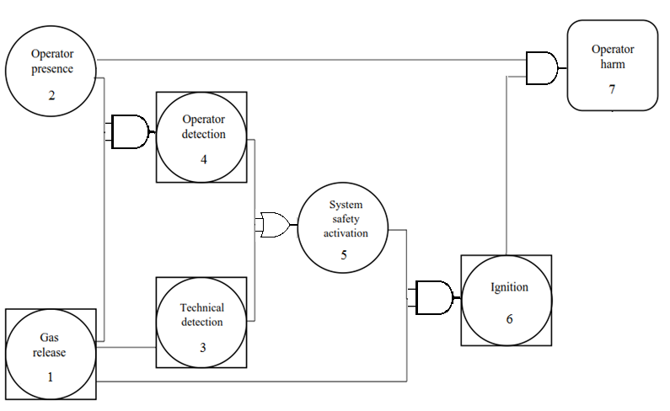
Illustrative example: Accidental gas release
The gas release can cause the operator harm if it is not detected or the safety system is not activated.
Top event = “Operator harm”.
Reference: Mancuso A. et al., “Bayesian approach for safety portfolio optimization”, Risk, Reliability and Safety: Innovating Theory and Practice, pp. 285-292 (2016).

Slide 12
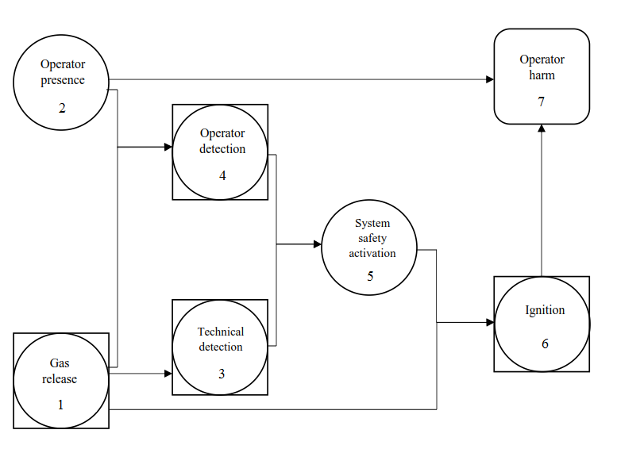
Step 1: Failure scenario modeling
Multi-state description of gas release and operator harm.
Probability
No harm
Minor harm
Major harm
Probability
No release
Minor release
Major release

Slide 13

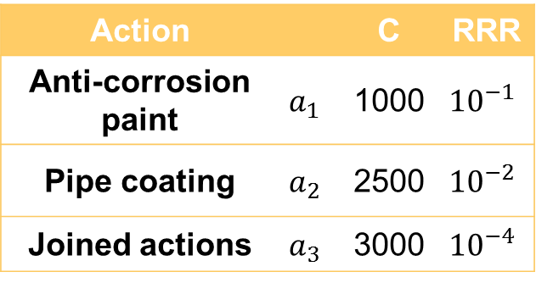

Step 2 and 3: Definition of failure probabilities
Gas release
Action |  | C | RRR
Anti-corrosion paint | $$a_{1}$$ | 1000 | $${10}^{−1}$$
Pipe coating | $$a_{2}$$ | 2500 | $${10}^{−2}$$
Joined actions | $$a_{3}$$ | 3000 | $${10}^{−4}$$
$${\overline{P}}_{X_{2}^{1}}\left(s\right)={10}^{−4}∙{10}^{−2}$$
$${\underline{P}}_{X_{2}^{1}}\left(s\right)={10}^{−5}∙{10}^{−2}$$
Risk Reduction Rate
(RRR)

Slide 14
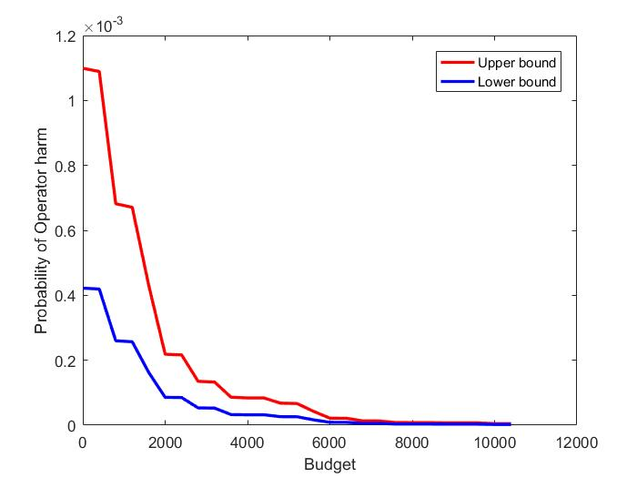
Step 4: Optimization results
Operator harm probability for the optimal portfolio of actions for different budget levels.
Bigger budget → more effective actions → lower residual risk of operator harm.

Slide 15
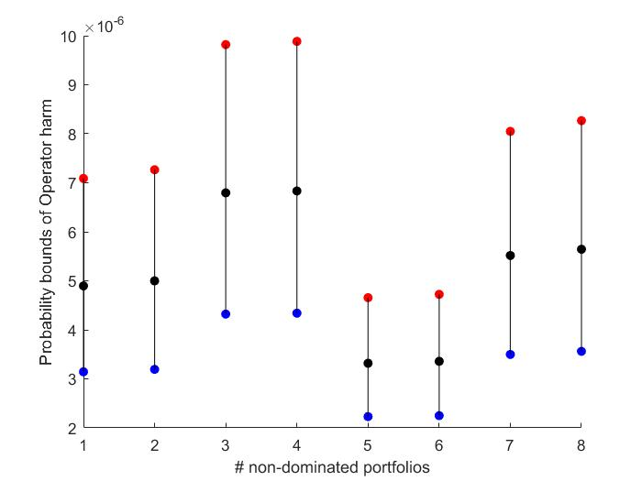
Step 4: Optimization results
Pareto-optimal solutions by minimizing “Operator harm” probability in case of no budget constraint. The optimal portfolio characterized by minimal lower bound and upper bound is the fifth solution.

Slide 16
Application of Risk Importance Measures (RIMs)
Limitations of using RIMs (such as RRW)
They cannot be applied in case of multi-state and multi-objective failure scenarios → they account only a unique target event
Actions can be applied to initiating events only → not accounting for synergies of joined actions
They do not account for feasibility and budget constraints
They do not necessarily lead to the global optimal portfolio of actions because the procedure implies assumptions and expert opinions which strongly affect the decisions at the following iterations

Slide 17
Future research
Extend the methodology to support decisions the timing of executing the safety actions
Formulate and solve dynamic Defense-in-Depth models in the designing of safety actions (e.g. fire scenarios in a Nuclear Power Plant)
Ongoing collaboration with an industrial partner with interests in optimization for occupational safety and other partners in energy field

Slide 18
Thank you for your attention!
Alessandro Mancuso
System Analysis Laboratory, School of Science, Aalto University, Finland
Laboratory of Signal and Risk Analysis, Politecnico di Milano, Italy
alessandro.mancuso@aalto.fi

