Slide 1
Bayesian approach for portfolio optimization of safety barriers
A. Mancuso^{a,b}, M. Compare^{b}, A. Saloª, E. Zio^{b,c}
Systems Analysis Laboratory, Department of Mathematics and Systems Analysis - Aalto University
Laboratory of Signal and Risk Analysis, Dipartimento di Energia - Politecnico di Milano
Chair on Systems Science and the Energetic Challenge - École Centrale Paris and Supelec
September 29, 2016

Slide 2
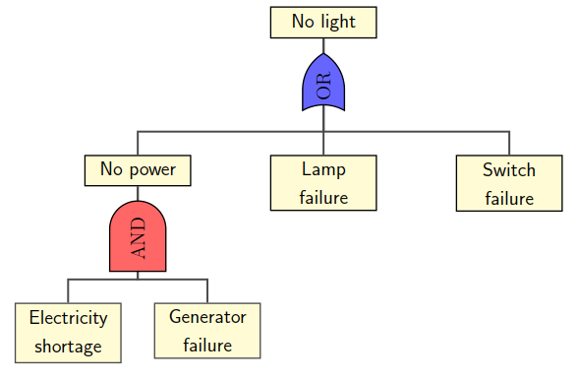



Risk-informed decision making in safety critical context
Based on Probabilistic Risk Assessment (PRA)
Fault Tree
$${RRW}^{Gen}=\frac{R(No light)}{R(No light|No generator failure)}$$
$${RRW}^{Lamp}=\frac{R(No light)}{R(No light|No lamp failure)}$$
$${RRW}^{Switch}=\frac{R(No light)}{R(No light|No switch failure)}$$
Concerns
  Experts interpret these importance measures and choose actions
  Action costs and feasibility constraints considered only afterwards
  The results can be sub-optimal

Slide 3
Our methodology
The methodology identifies portfolios of actions for the whole system which minimize the residual risk of the system and the total cost of actions.
The methodology accounts for risk, budget and other feasibility constraints.
Methodology steps:
Step 1: Failure scenario modeling
Step 2: Definition of failure probabilities
Step 3: Specification of actions
Step 4: Optimization model

Slide 4
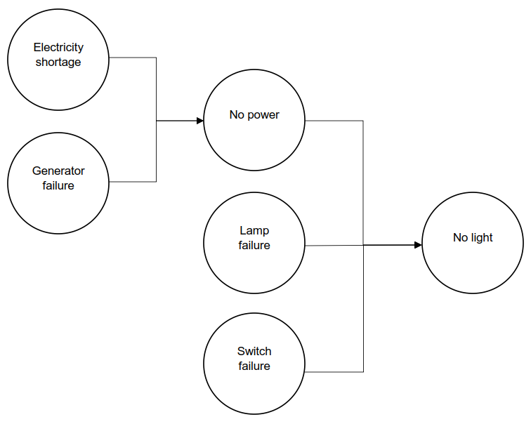
Step 1: Failure scenario modeling
Mapping of Fault Tree (FT) into Bayesian Belief Network (BBN)
Advantages
Multi-state modeling
Extension of concepts of AND/OR gates
Reference: Khakzad N., Khan F., Amyotte P., Dynamic safety analysis of process systems by mapping bow-tie into Bayesian network, Process Safety and Environmental Protection 91 (1-2), pp. 46-53 (2013).
Notes:
Initiating, intermediate and top events are mapped into nodes of BBN;
Nodes are connected in the same way as the corresponding events in FT;
The conditional probability tables extend the logic of the AND/OR gates of the FT.

Slide 5
Step 2: Definition of failure probabilities
Information sources
Information provided by AND/OR gates in FT
Statistical analyses
Expert elicitation
The probabilities of events are defined as follows:
Initiating events → failure probabilities of system components
Intermediate and top events → conditional probability tables

Slide 6

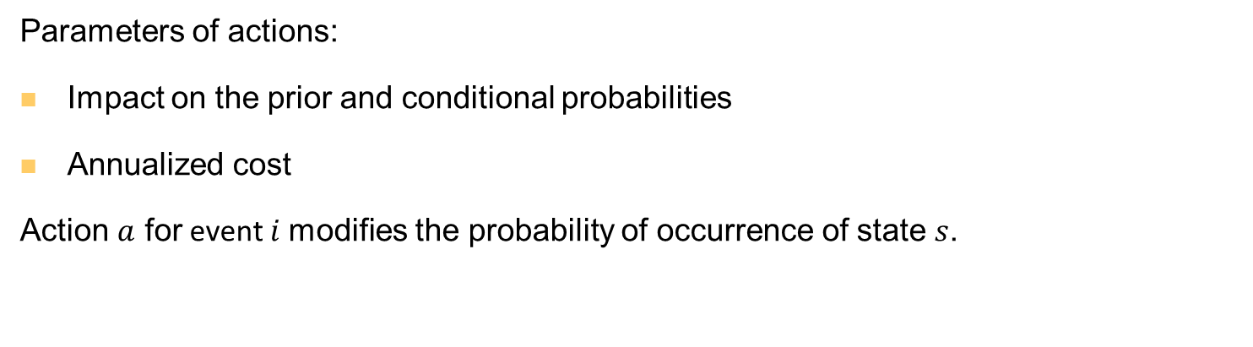



Step 3: Specification of actions
Parameters of actions:
Impact on the prior and conditional probabilities
Annualized cost
Action $a$ for event $i$modifies the probability of occurrence of state $s$.
$$P^{i}(s)$$
$$P_{a}^{i}(s)$$
$$s$$
$$s$$

Slide 7
Step 4: Optimization model
Action portfolio #1
Action portfolio #2
Risk acceptability
Implicit enumeration algorithm to identify the optimal portfolios of safety actions.
The resulting portfolios are globally optimal: they minimize the failure risk of target events (instead of selecting actions that target the riskiness of the single components).
Action portfolio #3
Action portfolio #4
Action portfolio #5
Budget constraints
Action portfolio #6
Action portfolio #7
Select the optimal action portfolio
Action portfolio #8
Action feasibility
Action portfolio #9
Action portfolio #10
Action portfolio #11
Action portfolio #12

Slide 8
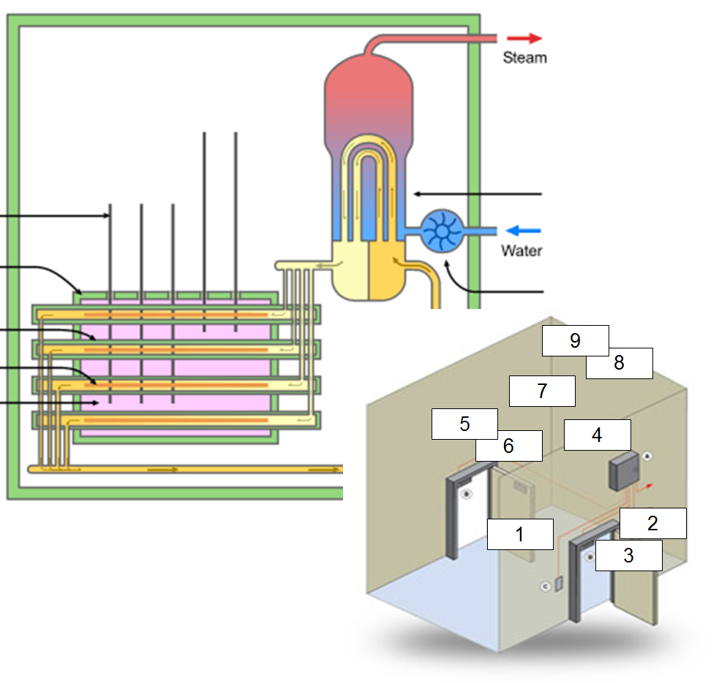
Illustrative example: CANDU airlock system
 | Basic Failure Events | ID Code
1 | Pressure equalizer valve failure | V1
2 | Doors failure | D1
3 | Seal failure | S1
4 | Gearbox failure | G1
5 | Minor pipe leakages | P1
6 | Major pipe leakages | P2
7 | Exhaust pipe failure | E1
8 | Empty tank | T1
9 | Tank failure | T2
The Airlock System (AS) keeps the pressure of the inner side of the reactor vault lower than the outer side to avoid the dispersion of contaminants out of the reactor bay.
Lee A., Lu L., “Petri Net Modeling for Probabilistic Safety Assessment and its Application in the Air Lock System of a CANDU Nuclear Power Plant”, Procedia Engineering, 2012 International Symposium on Safety Science and Technology, Volume 25, pp.11-20, 2012.

Slide 9
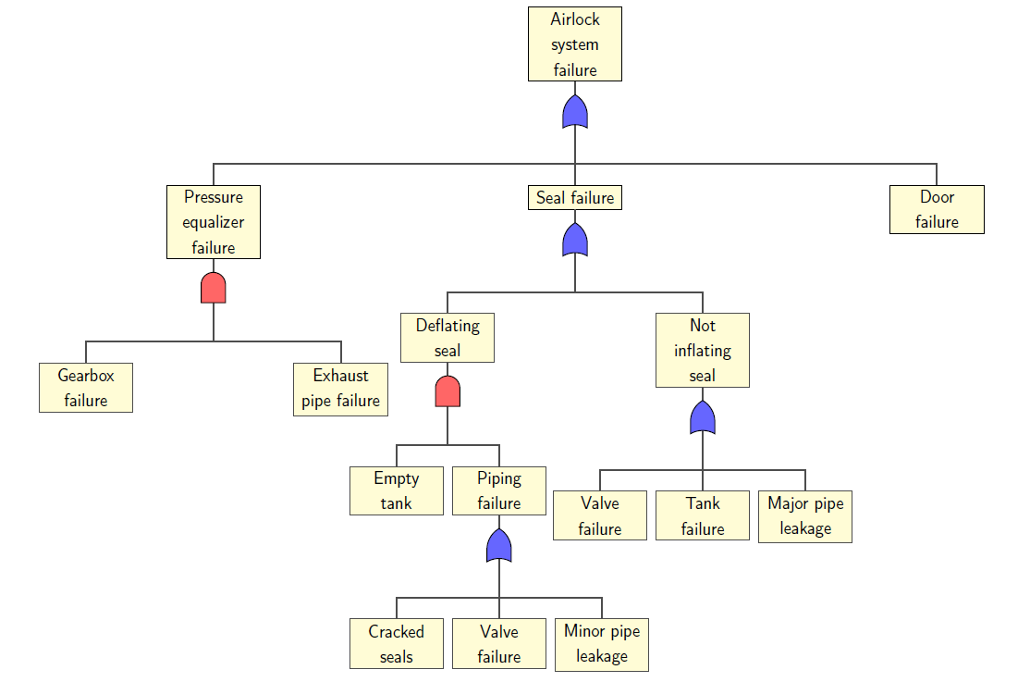
CANDU airlock system
Fault Tree (FT) for analyzing the scenario of a Design Basis Accident which occurred in the Airlock System (AS) of a CANDU Nuclear Power Plant in 2011.
Top event = “AS fails to maintain the pressure boundary”.
Reference: Di Maio F., Baronchelli S., Zio E., Hierarchical differential evolution for minimal cut sets identification: Application to nuclear safety systems, European Journal of Operational Research 238, pp. 645-652 (2014).

Slide 10
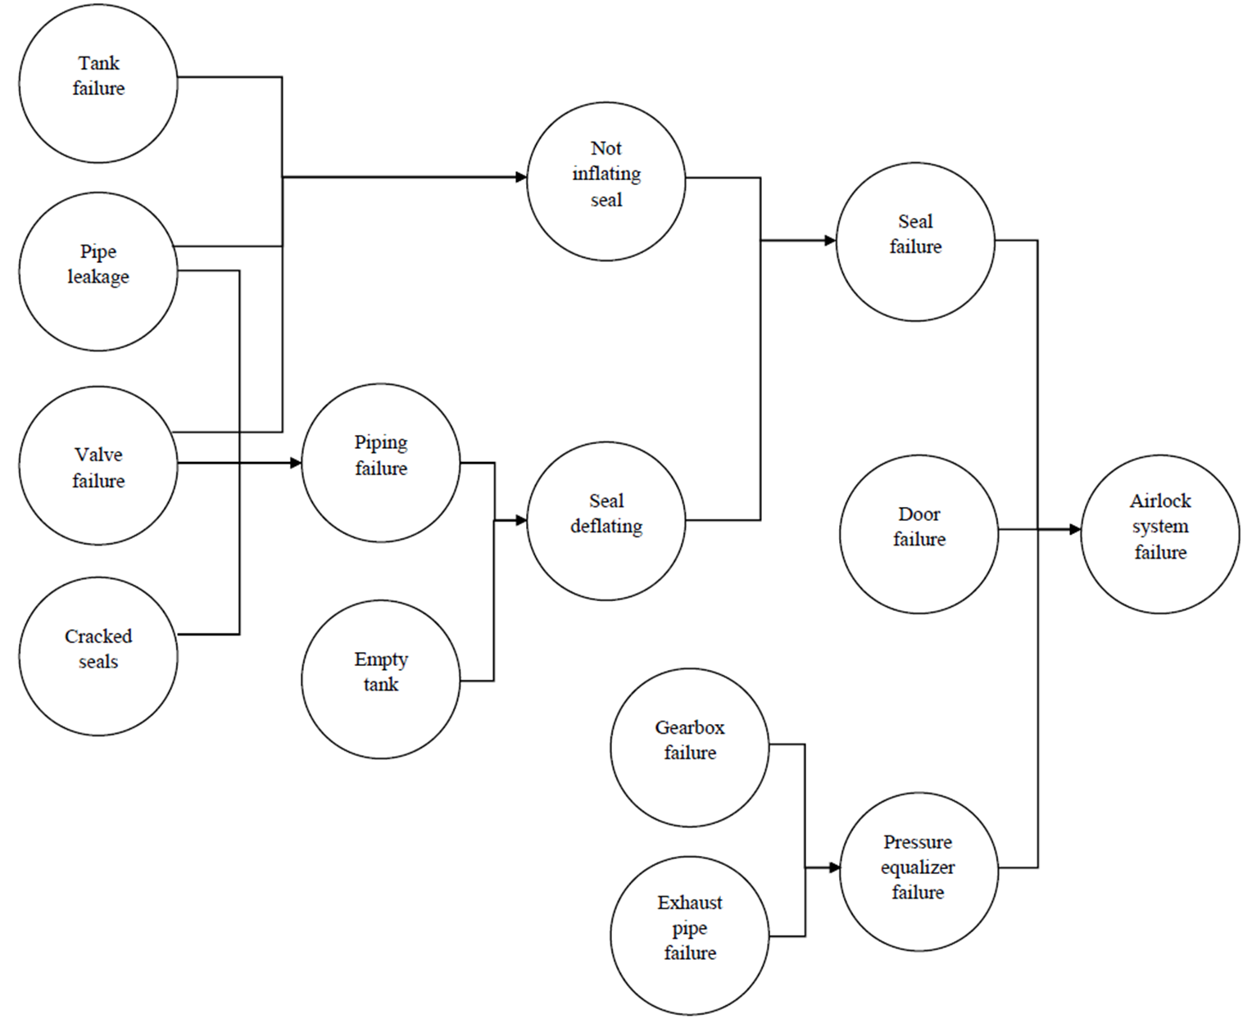
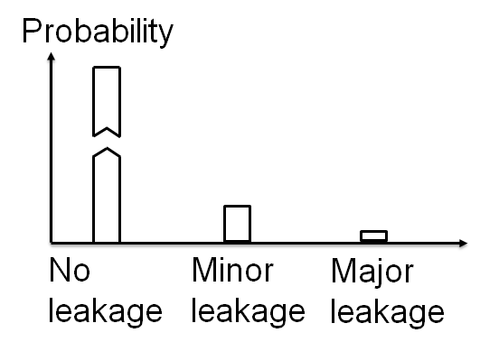
Step 1: Airlock system failure modeling
Multi-state description of pipe leakage event

Slide 11
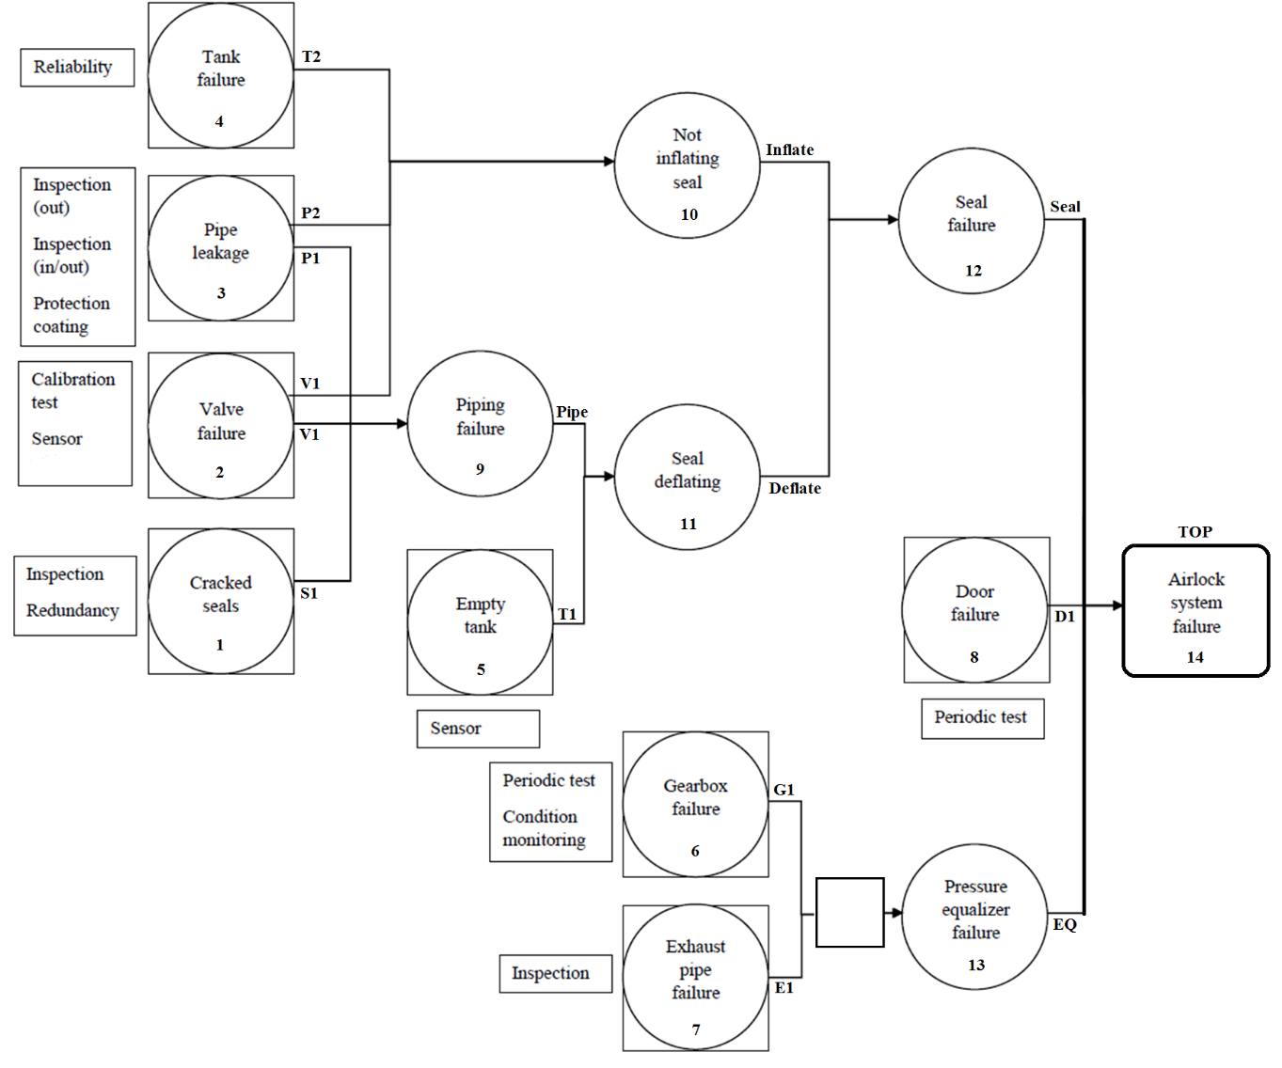
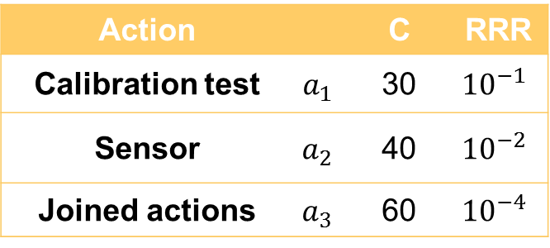



Step 2 and 3: Definition of failure probabilities
Valve failure
Action |  | C | RRR
Calibration test | $$a_{1}$$ | 30 | $${10}^{−1}$$
Sensor | $$a_{2}$$ | 40 | $${10}^{−2}$$
Joined actions | $$a_{3}$$ | 60 | $${10}^{−4}$$
$$P_{a_{1}}^{2}\left(s=1\right)={10}^{−4}∙{10}^{−1}$$
$$P_{a_{2}}^{2}\left(s=1\right)={10}^{−4}∙{10}^{−2}$$
$$P_{a_{3}}^{2}\left(s=1\right)={10}^{−4}∙{10}^{−4}$$
Risk Reduction Rate
(RRR)

Slide 12
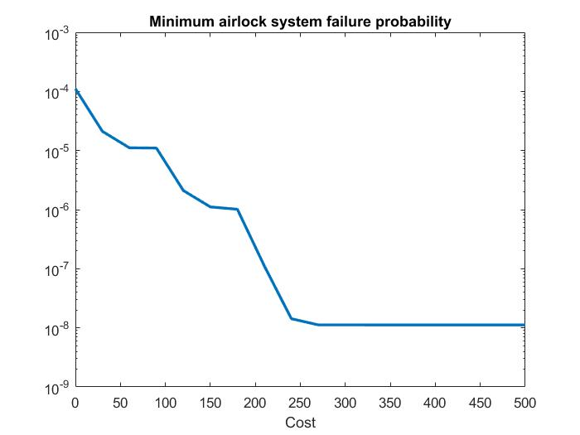
Step 4: Optimization results
Airlock failure probability for the optimal portfolio of actions for different budget levels.
Bigger budget → more effective actions → lower residual risk of failure of the airlock system.

Slide 13
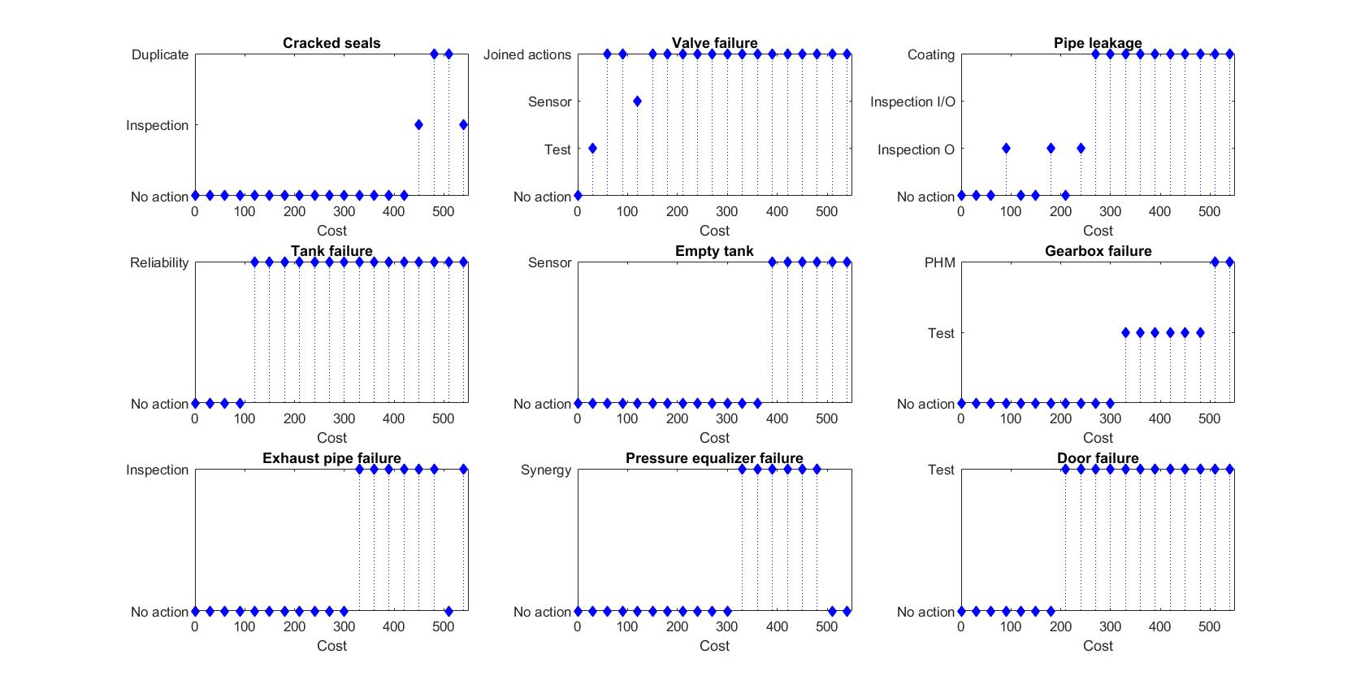
Step 4: Optimization results
Notes:
Optimal portfolios depend on the budget because the optimization model does not pursue a local optimization (at the single node level). The model identiﬁes the optimal actions for the whole system accounting for budget and other feasibility constraints.

Slide 14
Step 4: Optimization results
Notes:
Optimal portfolios depend on the budget because the optimization model does not pursue a local optimization (at the single node level). The model identiﬁes the optimal actions for the whole system accounting for budget and other feasibility constraints.

Slide 15
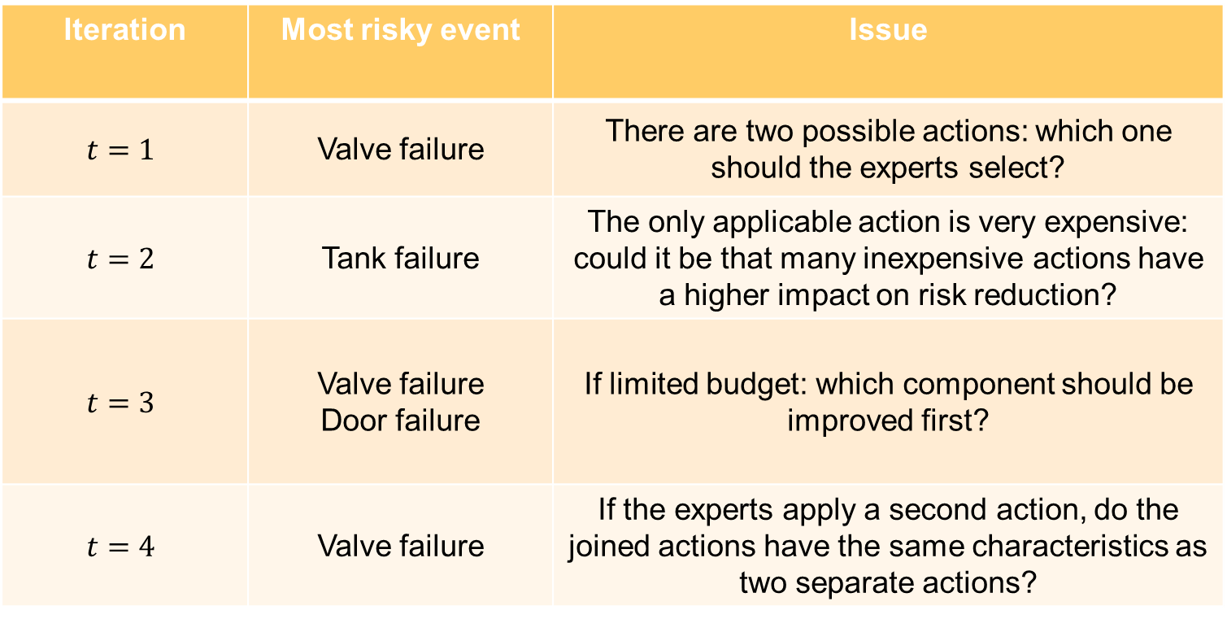
Application of RRW approach
The application of this approach leads to the following issues
Iteration | Most risky event | Issue
$$t=1$$ | Valve failure | There are two possible actions: which one should the experts select?
$$t=2$$ | Tank failure | The only applicable action is very expensive: could it be that many inexpensive actions have a higher impact on risk reduction?
$$t=3$$ | Valve failure Door failure | If limited budget: which component should be improved first?
$$t=4$$ | Valve failure | If the experts apply a second action, do the joined actions have the same characteristics as two separate actions?

Slide 16
Application of Risk Importance Measures (RIMs)
Limitations of using RIMs (such as RRW)
They cannot be applied in case of multi-state and multi-objective failure scenarios → they account only a unique target event
Actions can be applied to initiating events only → not accounting for synergies of joined actions
They do not account for feasibility and budget constraints
They do not necessarily lead to the global optimal portfolio of actions because the procedure implies assumptions and expert opinions which strongly affect the decisions at the following iterations

Slide 17
Future research
Accommodate imprecise information about event probabilities and action impacts
Formulate and solve dynamic Defense-in-Depth models in the designing of safety actions (e.g. fire scenarios in a Nuclear Power Plant)
Ongoing collaboration with an industrial partner with interests in optimization for occupational safety and other partners in energy field

Slide 18

Thank you for your attention!
Alessandro Mancuso
System Analysis Laboratory, School of Science, Aalto University, Finland
Laboratory of Signal and Risk Analysis, Politecnico di Milano, Italy
alessandro.mancuso@aalto.fi

