Slide 1

A risk-based approach for the prioritization of pipe inspections

Slide 2
The Goal
Pipe Inspections
Degradation State
Maintenance Actions
Identification of an optimal portfolio of pipe inspections for which the
subsequent renovation actions (if necessary) are expected to most improve
the network operability with larger money saving.

Slide 3
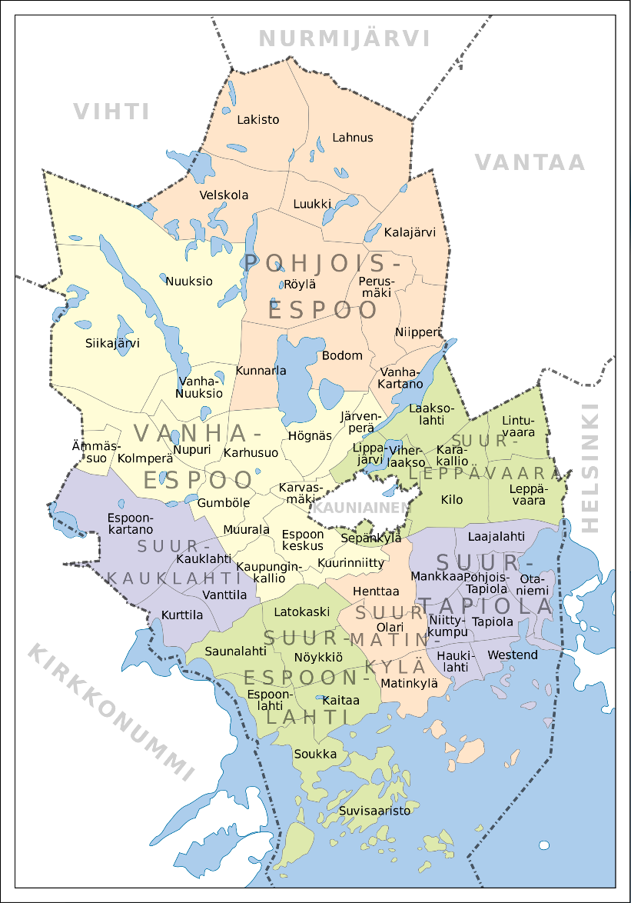
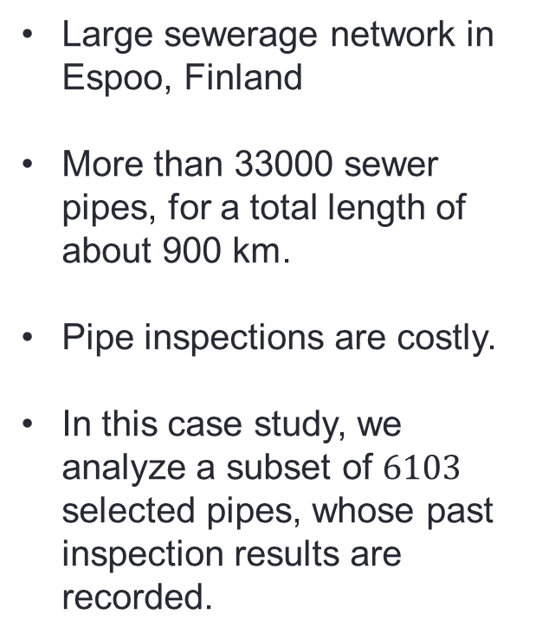
Network Analysis
Large sewerage network in Espoo, Finland
More than 33000 sewer pipes, for a total length of about 900 km.
Pipe inspections are costly.
In this case study, we analyze a subset of $6103$ selected pipes, whose past inspection results are recorded.

Slide 4
Methodology Snapshot

Slide 5
Failure Likelihood
Likelihood
Pipe Features
Local Circumstances
Material
Diameter
Soil
Traffic Load
Pipe Age
Past Events
Blockages
Flushings

Slide 6
Failure Severity
Class 1
Undoubled pressure pipes from critical pump stations
Main tunnels
Sewer mains and pressure sewers that are within significant groundwater areas
Sewers close to primary or secondary raw water resources
Pipes under railways
Pipes under significant roads
Sewer mains of crucial functional importance for the whole network
Very high pipe-specific flow
Class 2
Sewer mains not included in Class 1
Sewers in protected areas / nature conservation areas
Pipes crossing main water tunnels
Pipes going under a water body (river, lake, sea)
Pipes under buildings
Pipes close to protected ditches
Pipes close to swimming beaches
Pipes other than sewer mains which are within significant groundwater areas
Sewer mains within groundwater areas of less significance
Sewers close to critical underground structures (e.g. subway)
High pipe-specific flow
Class 3
Every remaining pipe

Slide 7
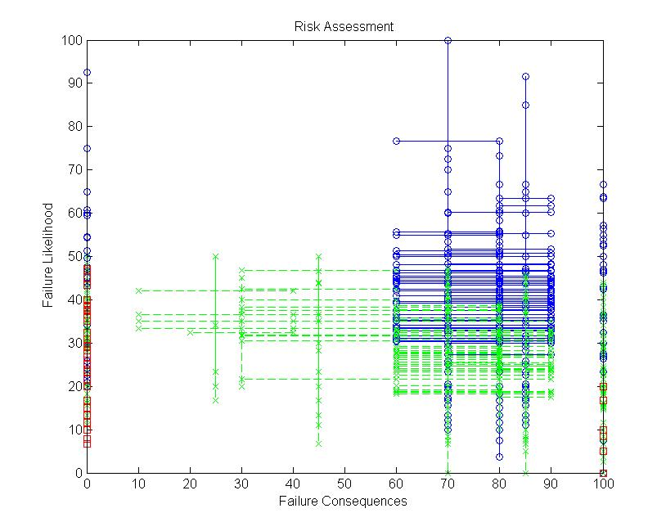
Risk Assessment

Slide 8
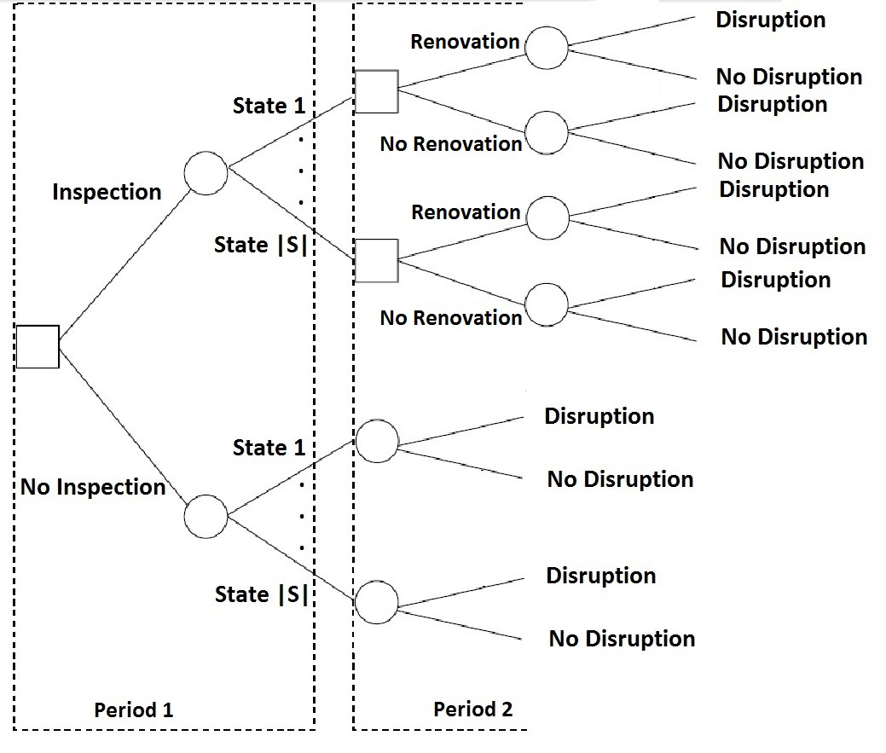
Decision Tree Analysis

Slide 9
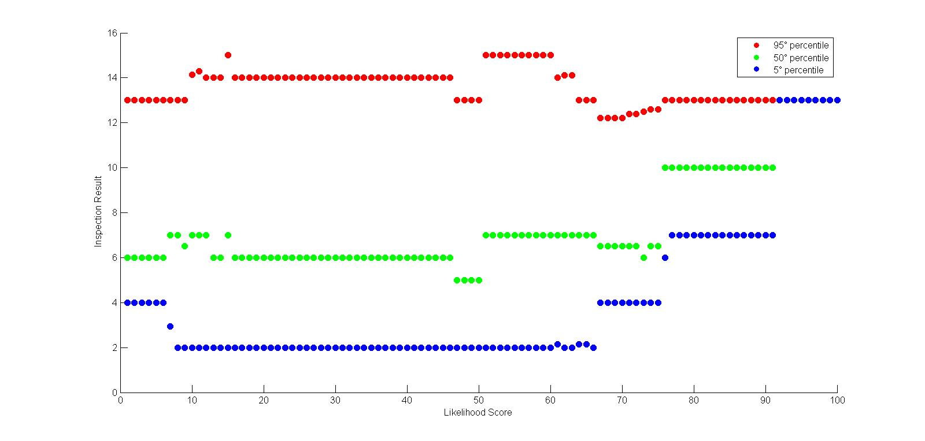
Expected degradation state

Slide 10
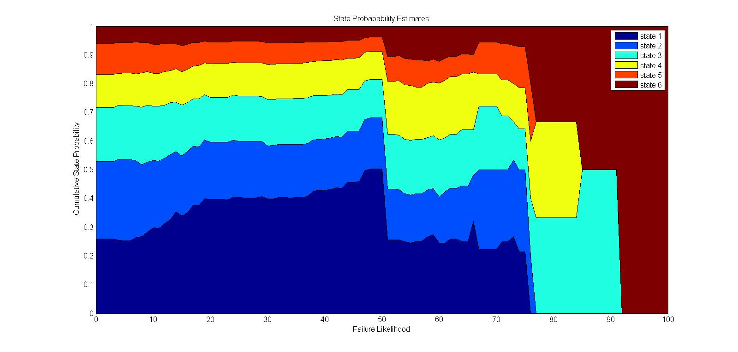
Expected degradation state

Slide 11
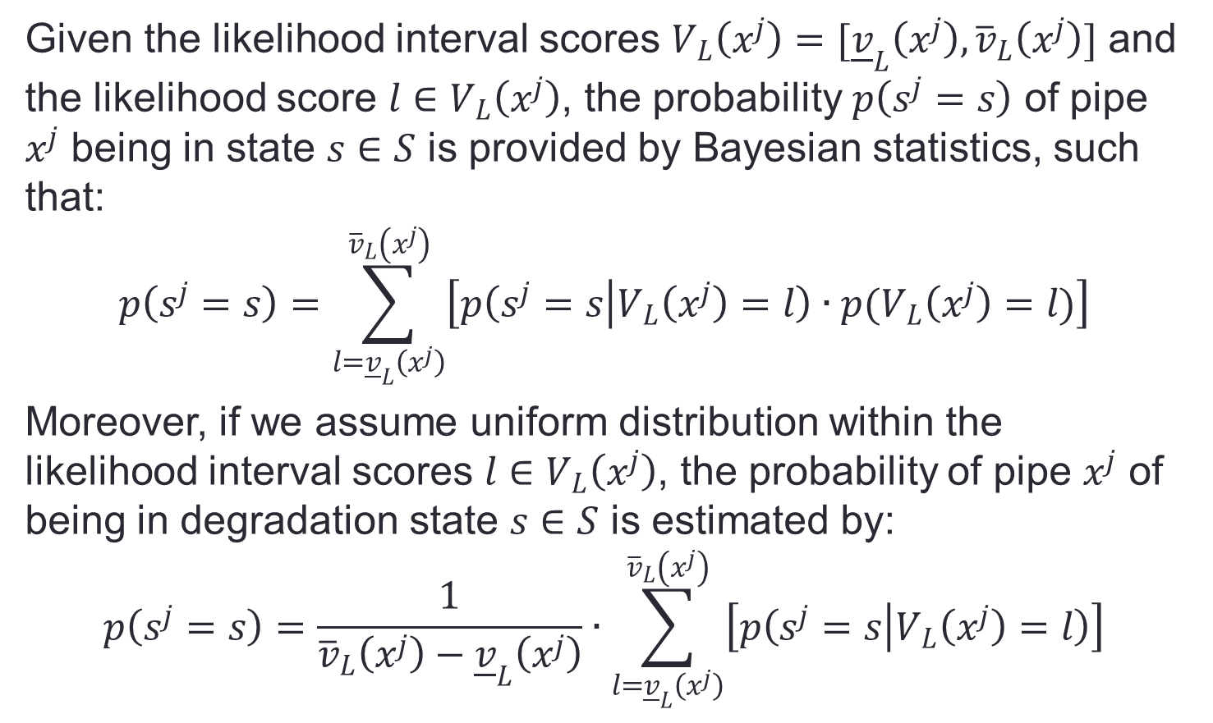
State probabilities
Given the likelihood interval scores $V_{L}\left(x^{j}\right)=[{\underline{v}}_{L}\left(x^{j}\right),{\overline{v}}_{L}\left(x^{j}\right)]$ and the likelihood score $l∈V_{L}\left(x^{j}\right)$, the probability $p\left(s^{j}=s\right)$ of pipe $x^{j}$ being in state $s∈S$ is provided by Bayesian statistics, such that:
$$p\left(s^{j}=s\right)=\sum_{l={\underline{v}}_{L}\left(x^{j}\right)}^{{\overline{v}}_{L}\left(x^{j}\right)}{\left[p\left(s^{j}=s | V_{L}\left(x^{j}\right)=l\right)∙p(V_{L}\left(x^{j}\right)=l)\right]}$$
Moreover, if we assume uniform distribution within the likelihood interval scores $l∈V_{L}\left(x^{j}\right)$, the probability of pipe $x^{j}$ of being in degradation state $s∈S$ is estimated by:
$$p\left(s^{j}=s\right)=\frac{1}{{\overline{v}}_{L}\left(x^{j}\right)−{\underline{v}}_{L}\left(x^{j}\right)}∙\sum_{l={\underline{v}}_{L}\left(x^{j}\right)}^{{\overline{v}}_{L}\left(x^{j}\right)}{\left[p\left(s^{j}=s | V_{L}\left(x^{j}\right)=l\right)\right]}$$

Slide 12
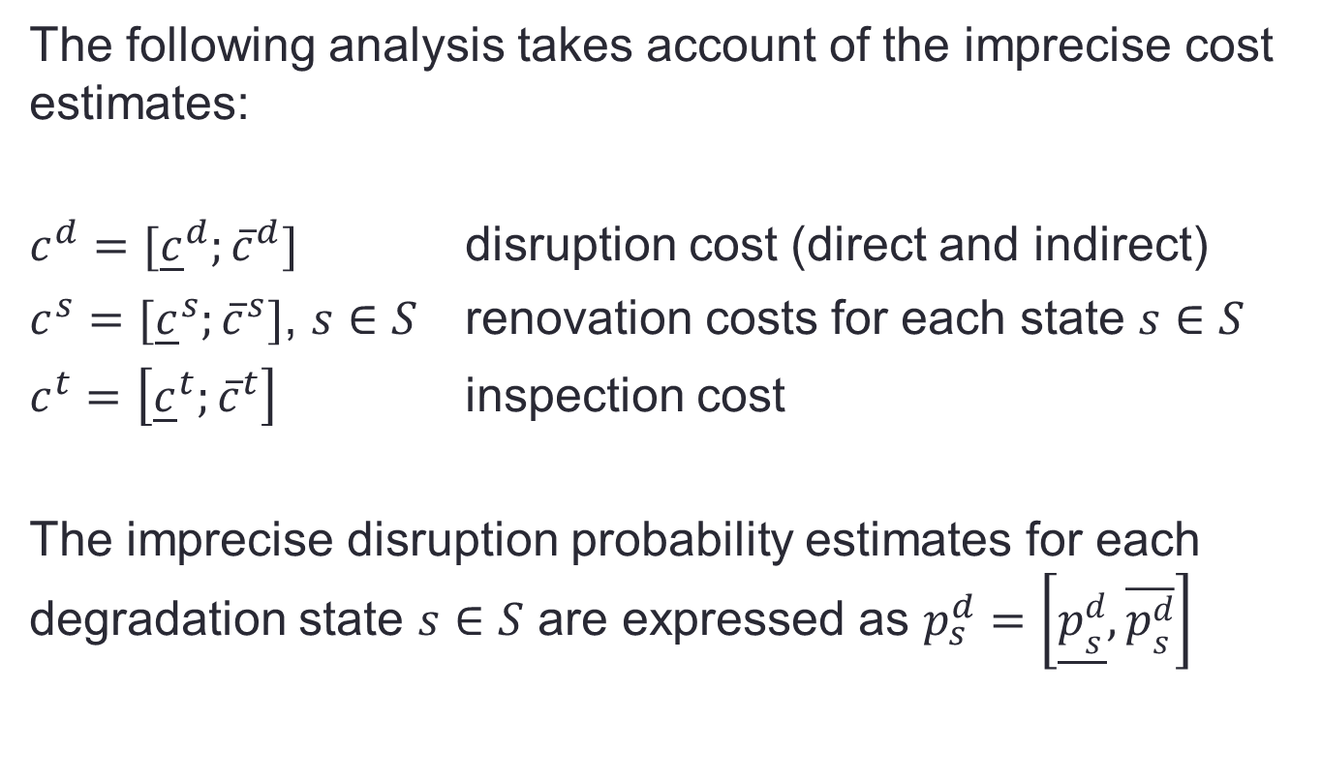
Inspection Benefit
The following analysis takes account of the imprecise cost estimates:
$c^{d}=[{\underline{c}}^{d};{\overline{c}}^{d}]$ disruption cost (direct and indirect)
$c^{s}=[{\underline{c}}^{s};{\overline{c}}^{s}]$, $s∈S$ renovation costs for each state $s∈S$
$c^{t}=\left[{\underline{c}}^{t};{\overline{c}}^{t}\right]$ inspection cost
The imprecise disruption probability estimates for each degradation state $s∈S$ are expressed as $p_{s}^{d}=\left[\underline{p_{s}^{d}},\overline{p_{s}^{d}}\right]$

Slide 13
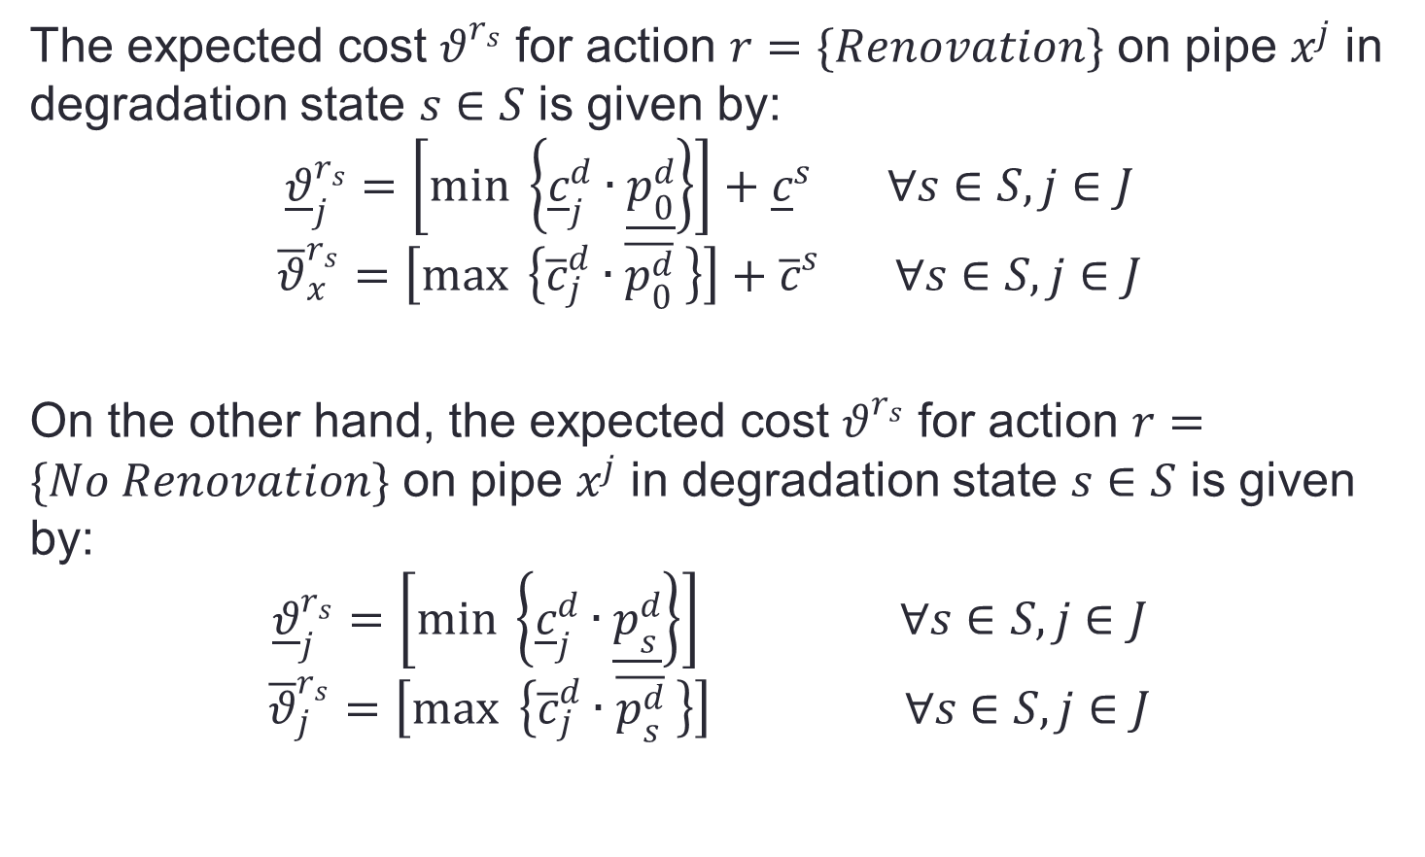
Inspection Benefit
The expected cost $θ^{r_{s}}$ for action $r=\{Renovation\}$ on pipe $x^{j}$ in degradation state $s∈S$ is given by:
$${\underline{θ}}_{j}^{r_{s}}=\left[\min{ \left\{{\underline{c}}_{j}^{d}∙\underline{p_{0}^{d}}\right\}}\right]+{\underline{c}}^{s} ∀s∈S,j∈J$$
$${\overline{θ}}_{x}^{r_{s}}=\left[\max{ \left\{{\overline{c}}_{j}^{d}∙\overline{p_{0}^{d}} \right\}}\right]+{\overline{c}}^{s} ∀s∈S,j∈J$$
On the other hand, the expected cost $θ^{r_{s}}$ for action $r=\{No Renovation\}$ on pipe $x^{j}$ in degradation state $s∈S$ is given by:
$${\underline{θ}}_{j}^{r_{s}}=\left[\min{ \left\{{\underline{c}}_{j}^{d}∙\underline{p_{s}^{d}}\right\}}\right] ∀s∈S,j∈J$$
$${\overline{θ}}_{j}^{r_{s}}=\left[\max{ \left\{{\overline{c}}_{j}^{d}∙\overline{p_{s}^{d}} \right\}}\right] ∀s∈S,j∈J$$

Slide 14
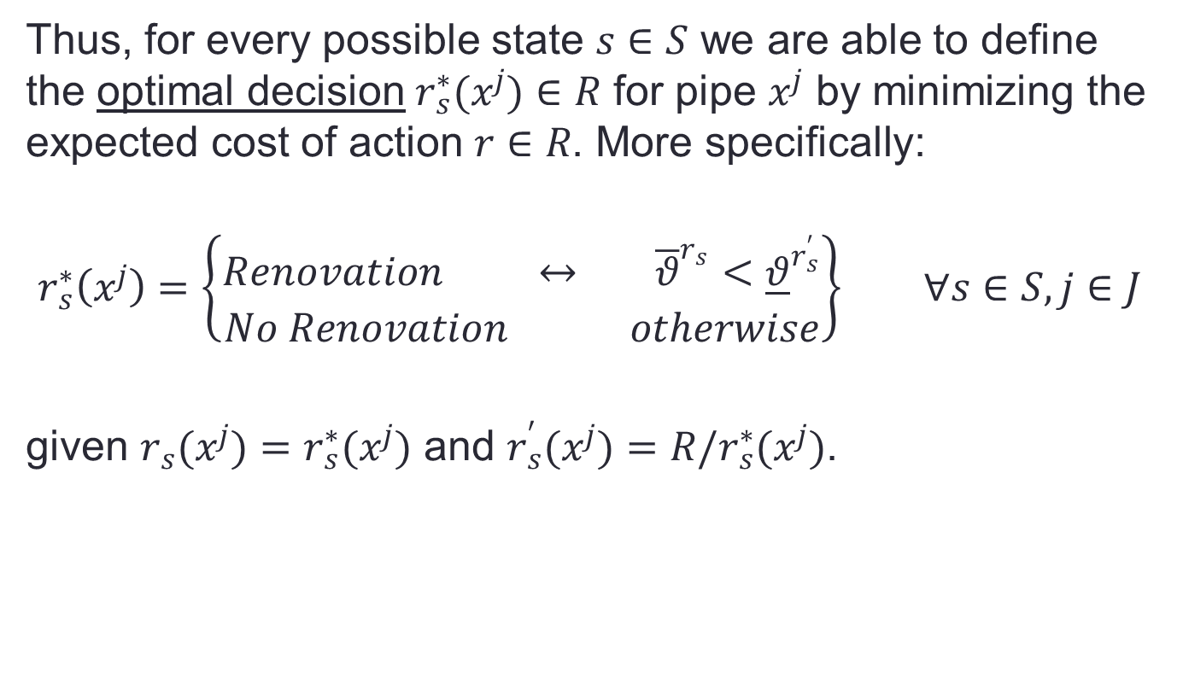
Inspection Benefit
Thus, for every possible state $s∈S$ we are able to define the optimal decision $r_{s}^{∗}(x^{j})∈R$ for pipe $x^{j}$ by minimizing the expected cost of action $r∈R$. More specifically:
$$r_{s}^{∗}\left(x^{j}\right)=\left\{\begin{aligned}Renovation ↔ {\overline{θ}}^{r_{s}}<{\underline{θ}}^{r_{s}^{′}} \\ No Renovation otherwise\end{aligned}\right\} ∀s∈S,j∈J$$
given $r_{s}(x^{j})=r_{s}^{∗}(x^{j})$ and $r_{s}^{′}(x^{j})=R/r_{s}^{∗}(x^{j})$.

Slide 15
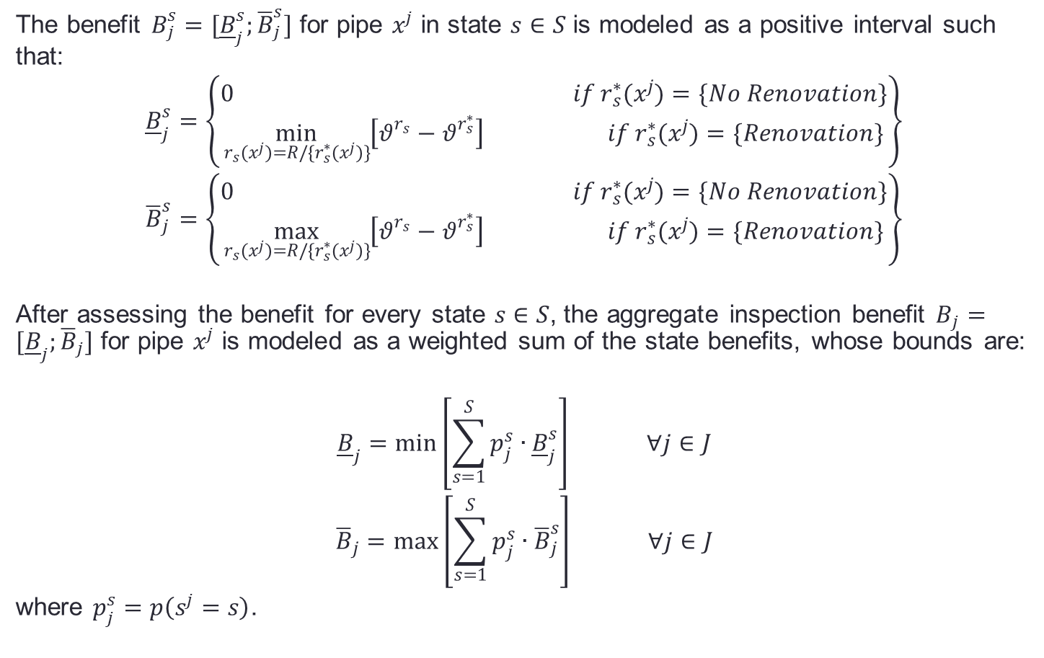
Inspection Benefit
The benefit $B_{j}^{s}=[{\underline{B}}_{j}^{s};{\overline{B}}_{j}^{s}]$ for pipe $x^{j}$ in state $s∈S$ is modeled as a positive interval such that:
$${\underline{B}}_{j}^{s}=\left\{\begin{aligned}0 if r_{s}^{∗}(x^{j})=\{No Renovation\} \\ \min_{r_{s}(x^{j})=R/\{r_{s}^{∗}(x^{j})\}}\left[θ^{r_{s}}−θ^{r_{s}^{∗}}\right] if r_{s}^{∗}(x^{j})=\{Renovation\}\end{aligned}\right\}$$
$${\overline{B}}_{j}^{s}=\left\{\begin{aligned}0 if r_{s}^{∗}(x^{j})=\{No Renovation\} \\ \max_{r_{s}(x^{j})=R/\{r_{s}^{∗}(x^{j})\}}\left[θ^{r_{s}}−θ^{r_{s}^{∗}}\right] if r_{s}^{∗}(x^{j})=\{Renovation\}\end{aligned}\right\}$$
After assessing the benefit for every state $s∈S$, the aggregate inspection benefit $B_{j}=[{\underline{B}}_{j};{\overline{B}}_{j}]$ for pipe $x^{j}$ is modeled as a weighted sum of the state benefits, whose bounds are:
$${\underline{B}}_{j}=\min\left[\sum_{s=1}^{S}{p_{j}^{s}∙{\underline{B}}_{j}^{s}}\right] ∀j∈J$$
$${\overline{B}}_{j}=\max\left[\sum_{s=1}^{S}{p_{j}^{s}∙{\overline{B}}_{j}^{s}}\right] ∀j∈J$$
where $p_{j}^{s}=p\left(s^{j}=s\right)$.

Slide 16
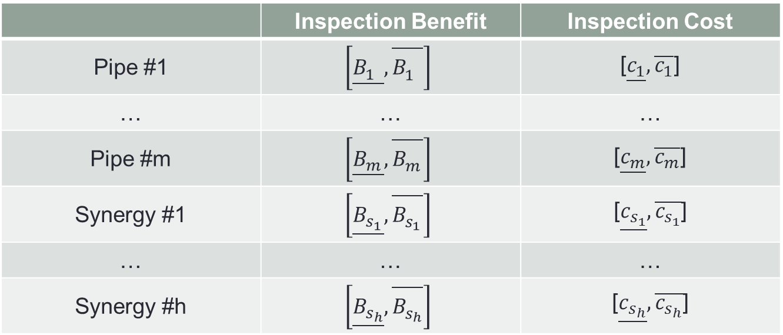
Cost efficient inspection portfolios
 | Inspection Benefit | Inspection Cost
Pipe #1 | $$\left[\underline{B_{1}^{}}{,}\overline{B_{1}^{}}\right]$$ | [$\underline{c_{1}}{,}\overline{c_{1}}$]
… | … | …
Pipe #m | $$\left[\underline{B_{m}^{}}{,}\overline{B_{m}^{}}\right]$$ | [$\underline{c_{m}}{,}\overline{c_{m}}$]
Synergy #1 | $$\left[\underline{B_{s_{1}}^{}}{,}\overline{B_{s_{1}}^{}}\right]$$ | [$\underline{c_{s_{1}}}{,}\overline{c_{s_{1}}}$]
… | … | …
Synergy #h | $$\left[\underline{B_{s_{h}}^{}}{,}\overline{B_{s_{h}}^{}}\right]$$ | [$\underline{c_{s_{h}}}{,}\overline{c_{s_{h}}}$]
Definition of efficient testing portfolios by approximate Robust Portfolio Modeling, taking account of eventual synergies in pipe inspections. By this way, we can employ a benefit-cost analysis in order to define a suitable budget for inspection activities.

Slide 17
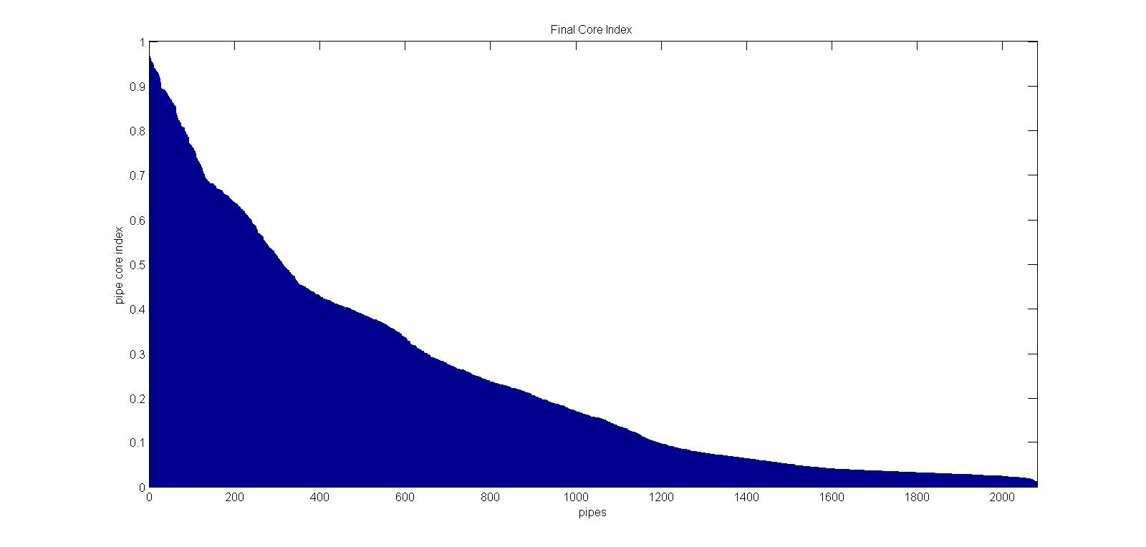
Portfolio Decision Analysis

Slide 18
Kiitos huomiostanne!
Kysymyksiä?

