Slide 1
Portfolio optimization of security measures for protecting electric power grids from cyber threats
M.Eng. Alessandro Mancuso
Supervisor: Dr. Piotr Żebrowski
Advanced Systems Analysis

Slide 2
Outline
Introduction to project
Analysis of standard practice
Methodology
Probabilistic Risk Assessment
Portfolio optimization
Results

Slide 3
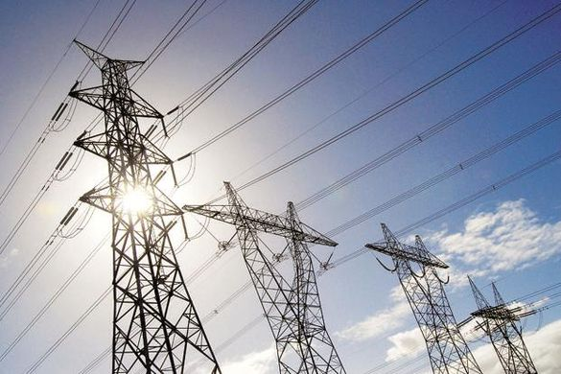
Research project
Objective: Selection of the cost-efficient portfolios of security measures that minimize the risk of cyber threats.
Case study: electric power grid.
Motivations:
Extensive reliance on IT systems makes electric power grids vulnerable to cyber threats.
Frequent and costly impacts worldwide (a cyber attack caused a power outage in Ukraine in 2015).
Notes:
The cyberattack was complex and consisted of the following steps:
- prior compromise of corporate networks using spear-phishing emails with BlackEnergy malware;
- seizing SCADA under control, remotely switching substations off;
- disabling/destroying IT infrastructure components (uninterruptible power supplies, modems, RTUs, commutators);
- destruction of files stored on servers and workstations with the KillDisk malware;
- denial-of-service attack on call-center to deny consumers up-to-date information on the blackout.
In total, up to 73 MWh of electricity was not supplied (or 0.015% of daily electricity consumption in Ukraine).

Slide 4
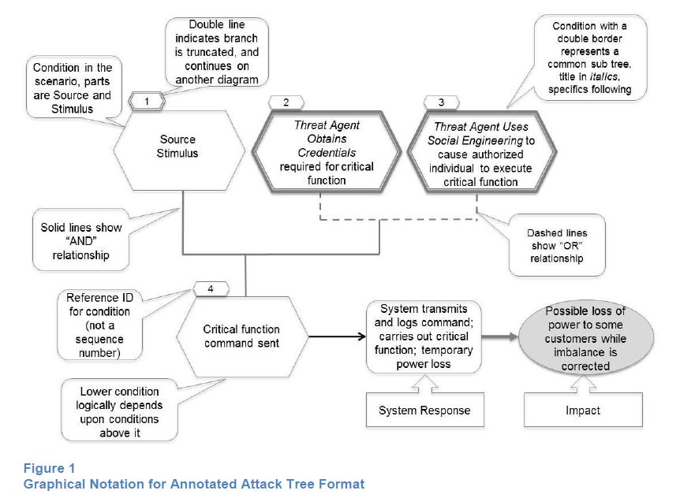
Cyber threat scenario

Slide 5
Cyber threats analysis - standard practice
Cyber threat scenarios are analyzed one-by-one, possibly resulting in:
sub-optimal solutions for the system, due to lack in systemic thinking;
difficulties in modeling budget and technical constraints across different scenarios.
Cyber threat scenario

Slide 6
Cyber threats analysis - standard practice
Likelihood and impact of scenarios are evaluated through scoring system based on a additive model, which raises concerns on how meaningful and comparable the scores are.
Impact
15 criteria
Likelihood
5 criteria
$$S_{i}∈[0,9]$$
$$S_{j}∈[0,9]$$
$$Impact=\sum_{i}{S_{i}}$$
$$Likelihood=\sum_{j}{S_{j}}$$
$$Impact∈[0,135]$$
$$Likelihood∈[0,45]$$

Slide 7
Scenario prioritization
Risk Matrix
Apply security measures to reduce risk of cyber threat scenario
Is budget depleted?
Yes
Done!
Composite impact score
No
Apply security measures to reduce risk of cyber threat scenarios
Composite likelihood score

Slide 8
Goals
Standard practice
Our framework
Qualitative assessment
Quantitative analysis
Scenario analyzed separately
Comprehensive multi scenario analysis
[1] Assess the risk of cyber threats, defined as
$$Risk=Occurrence Probability ×Impact$$
[2] Reduce the risk through the optimal portfolio of security measures!

Slide 9
Probabilistic Risk Assessment
Risk assessment performed through Bayesian Networks,
Nodes → random events of cyber threat scenarios.
Arcs → causal dependencies among random events.
Bayesian Networks enable probability update on the cascading events of the cyber threat scenarios.

Slide 10
 | $$A$$ |  | $$\overline{A}$$
 | $$B$$ | $$\overline{B}$$ | $$B$$ | $$\overline{B}$$
$$C$$ | 0.9 | 0.6 | 0.2 | 0
$$\overline{C}$$ | 0.1 | 0.4 | 0.8 | 1
S
$$A$$ | 0.4
$$\overline{A}$$ | 0.6
A
$$A$$ | 0.2
$$\overline{A}$$ | 0.8
 | $$I$$
$$C$$ | 9
$$\overline{C}$$ | 0
C
I
 | $$A$$ | $$\overline{A}$$
$$B$$ | 0.8 | 0.1
$$\overline{B}$$ | 0.2 | 0.9
B
$$ℙ\left(A\right)=0.4$$
$$ℙ\left(A\right)=0.2$$
$$ℙ\left(B\right)=ℙ\left(B|A\right)∙ℙ\left(A\right)+ℙ\left(B|\overline{A}\right)∙ℙ\left(\overline{A}\right)=0.8∙0.4+0.1∙0.6=0.38$$
$$ℙ\left(B\right)=ℙ\left(B|A\right)∙ℙ\left(A\right)+ℙ\left(B|\overline{A}\right)∙ℙ\left(\overline{A}\right)=0.8∙0.2+0.1∙0.8=0.24$$
$$ℙ\left(C\right)=ℙ\left(C|A,B\right)∙ℙ\left(A\right)∙ℙ\left(B\right)+ℙ\left(C|\overline{A},B\right)∙ℙ\left(\overline{A}\right)∙ℙ\left(B\right)+ℙ\left(C|A,\overline{B}\right)∙ℙ\left(A\right)∙ℙ\left(\overline{B}\right)+ℙ\left(C|\overline{A},\overline{B}\right)∙ℙ\left(\overline{A}\right)∙ℙ\left(\overline{B}\right)=0.184$$
$$ℙ\left(C\right)=ℙ\left(C|A,B\right)∙ℙ\left(A\right)∙ℙ\left(B\right)+ℙ\left(C|\overline{A},B\right)∙ℙ\left(\overline{A}\right)∙ℙ\left(B\right)+ℙ\left(C|A,\overline{B}\right)∙ℙ\left(A\right)∙ℙ\left(\overline{B}\right)+ℙ\left(C|\overline{A},\overline{B}\right)∙ℙ\left(\overline{A}\right)∙ℙ\left(\overline{B}\right)=0.348$$
$$R\left[I\right]=ℙ\left(C\right)∙I\left(C\right)+ℙ\left(\overline{C}\right)∙I\left(\overline{C}\right)=0.184∙9+0.816∙0=1.656$$
$$E\left[I\right]=ℙ\left(C\right)∙I\left(C\right)+ℙ\left(\overline{C}\right)∙I\left(\overline{C}\right)=0.348∙9+0.652∙0=3.132$$

Slide 11
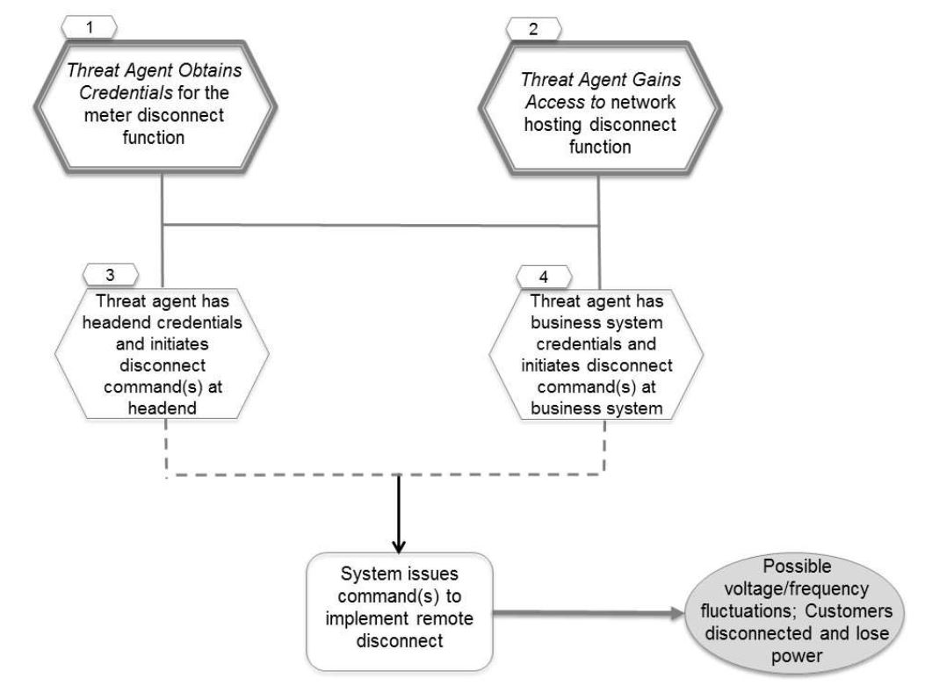
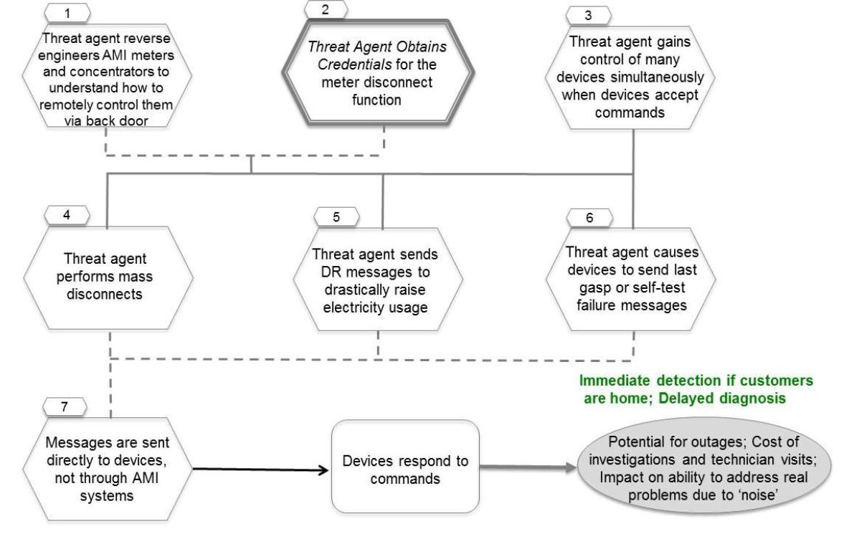
Integration of cyber threat scenarios
Analysis of possible synergies of security measures that may affect multiple cyber threat scenarios

Slide 12
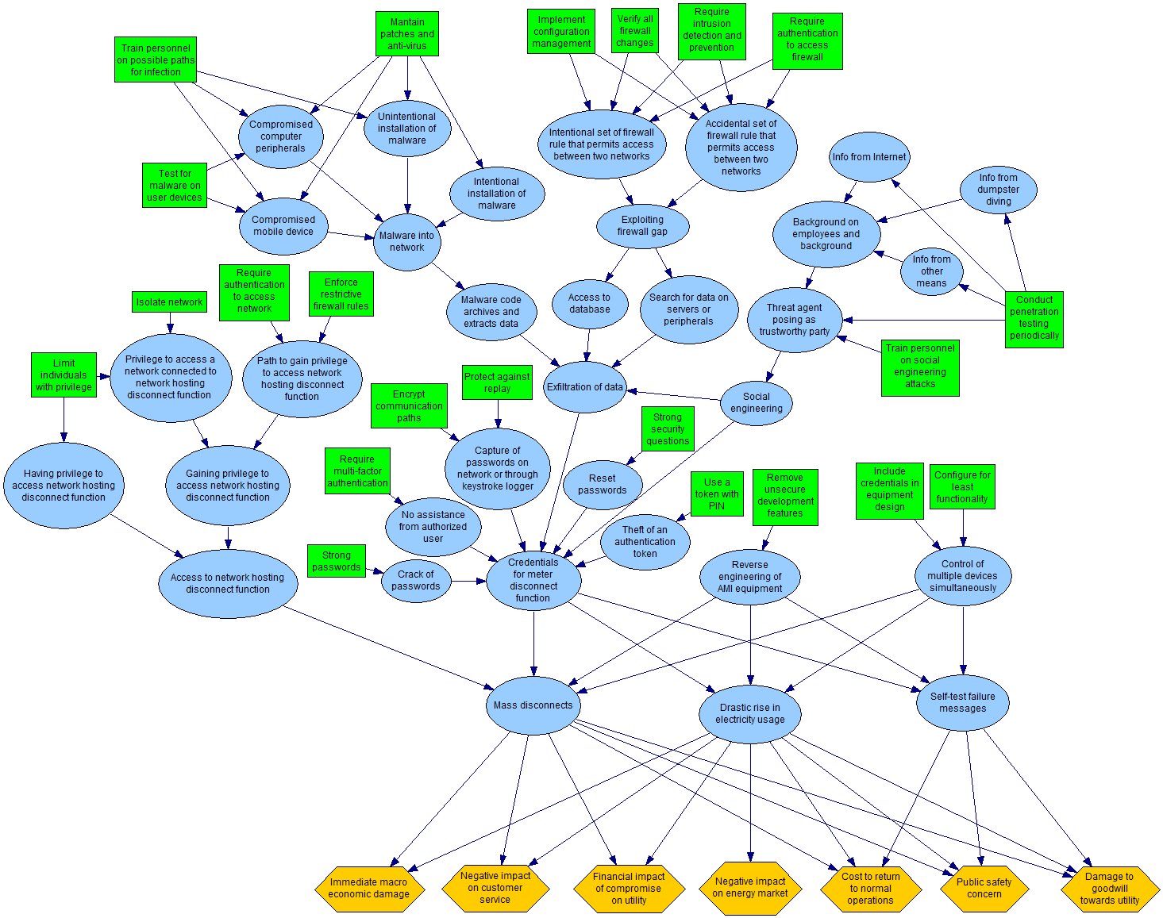
Cyber threat scenarios for Advanced Metering Infrastructure with 22 possible security measures.

Slide 13
Portfolio of security measures
Index | Security measure
1 | Train personnel on possible paths for infection
2 | Maintain patches and anti-virus
3 | Test for malware before connection
4 | Implement configuration management
5 | Verify all firewall changes
6 | Require intrusion detection and prevention
7 | Require authentication to access firewall
8 | Conduct penetration testing periodically
9 | Train personnel on social engineering attacks
10 | Strong passwords
11 | Encrypt communication paths
Index | Security measure
12 | Protect against replay
13 | Strong security questions
14 | Require multi-factor authentication
15 | Use a token with PIN
16 | Limit individuals with privilege
17 | Isolate network
18 | Enforce restrictive firewall rules
19 | Require authentication to access network
20 | Remove unsecure development features
21 | Include credentials in equipment design
22 | Configure for least functionality
Portfolio ≡ combination of security measures
Each portfolio is represented by a binary vector $z$ such that
$$z_{a}=1↔security measure a is included in the portfolio$$

Slide 14
Pareto optimal portfolios
Portfolios are Pareto optimal if no other feasible portfolio further reduces the risks of cyber threats for any impact criterion $k$ without increasing the risk for other, such that
$$z^{∗}≻z↔\left\{\begin{matrix}R[I_{k}](z^{∗})≤R[I_{k}](z) & for all k \\ R\left[I_{k}\right]\left(z^{∗}\right)<R[I_{k}](z) & for any k\end{matrix}\right.$$
Economic risk
Dominance relations
≻
⊁
Pareto optimal solutions
⊁
Safety risk

Slide 15
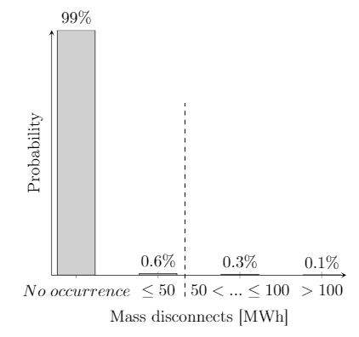
Constraints
The selection of Pareto optimal portfolios accounts for budget and technical constraints:
$$\sum_{a}{z_{a}∙c_{a}}≤B$$
$$\sum_{s}{ℙ[X=s|z]≤ε}$$
$$z_{a^{′}}+z_{a^{′′}}≤1$$
$$z_{a^{′}}−z_{a^{′′}}=0$$
Budget
Risk acceptability
Mutually exclusive
Mutually inclusive

Slide 16
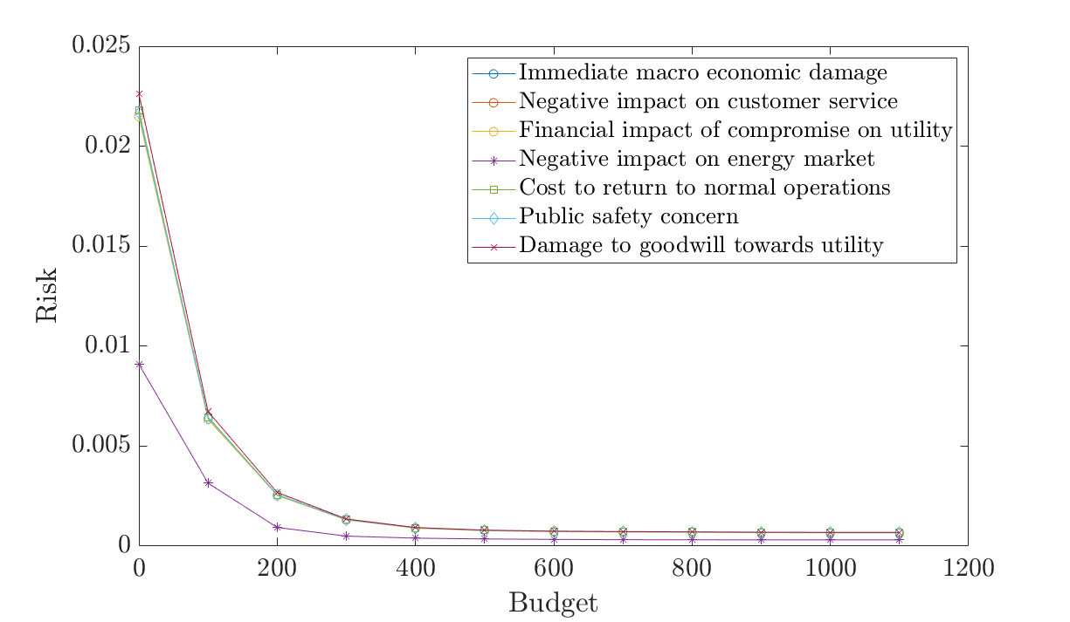
Risk profile
B
U
D
G
E
T
R
I
S
K
S

Slide 17
Cost-efficient portfolios
Pareto optimal portfolios are not necessarily cost-efficient!
Pareto optimal portfolios for budget 200:
Cost
1 | 1 | 0 | 0 | 0 | 0 | 0 | 0 | 0 | 1 | 0 | 0 | 0 | 0 | 1 | 0 | 0 | 0 | 0 | 0 | 1 | 0
1 | 1 | 0 | 0 | 0 | 0 | 0 | 0 | 0 | 0 | 0 | 0 | 0 | 0 | 1 | 1 | 0 | 0 | 0 | 0 | 1 | 0
1 | 1 | 0 | 0 | 0 | 0 | 0 | 0 | 0 | 0 | 0 | 0 | 0 | 0 | 1 | 0 | 0 | 0 | 0 | 0 | 1 | 1
200
200
200
Pareto optimal portfolios for budget 300:
Cost
1 | 1 | 1 | 0 | 0 | 0 | 0 | 0 | 0 | 1 | 0 | 0 | 1 | 0 | 1 | 0 | 0 | 0 | 0 | 0 | 1 | 0
1 | 1 | 1 | 0 | 0 | 0 | 0 | 0 | 0 | 1 | 0 | 0 | 1 | 0 | 0 | 0 | 0 | 0 | 0 | 0 | 1 | 1
1 | 1 | 1 | 0 | 0 | 0 | 0 | 0 | 0 | 1 | 0 | 0 | 0 | 0 | 0 | 1 | 0 | 0 | 0 | 0 | 1 | 1
280
290
290

Slide 18
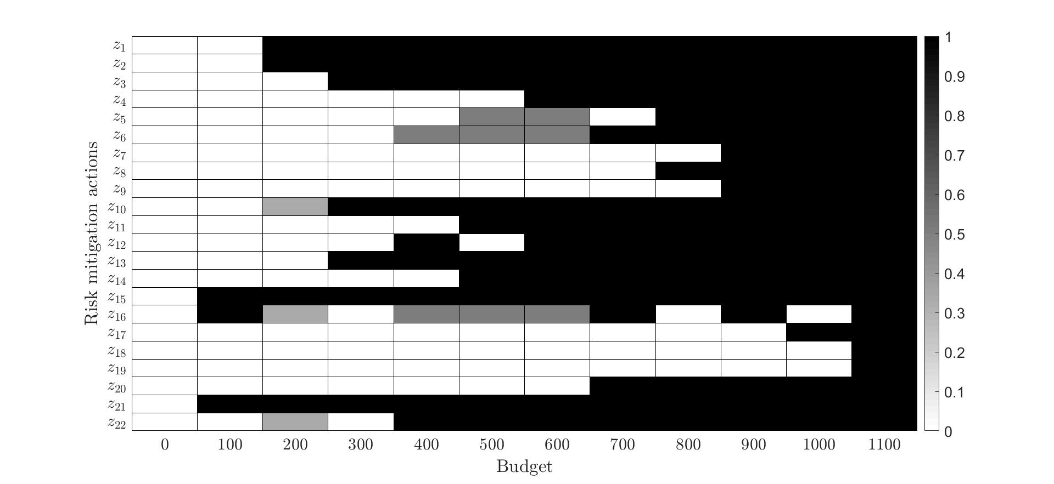
Optimal resource allocation

Slide 19
Summary
Systemic analysis of multiple cyber threat scenarios leads to an optimal resource allocation.
The optimization model integrates budget and technical constraints that limit the set of feasible portfolios.
Novel practice for assessing the risks of cyber threats and for supporting risk-based decisions on resource allocation to cyber-physical systems.

Slide 20
Possible extensions
Possible extensions need to be investigated, such as:
Consider imprecise information on occurrence probability.
Determine cyber resilience of the system.
Model the objectives of the threat agent(s) through Adversarial Risk Analysis.
Cyber resilience refers to an entity's ability to continuously deliver the intended outcome despite adverse cyber events (source: Wikipedia).

Slide 21
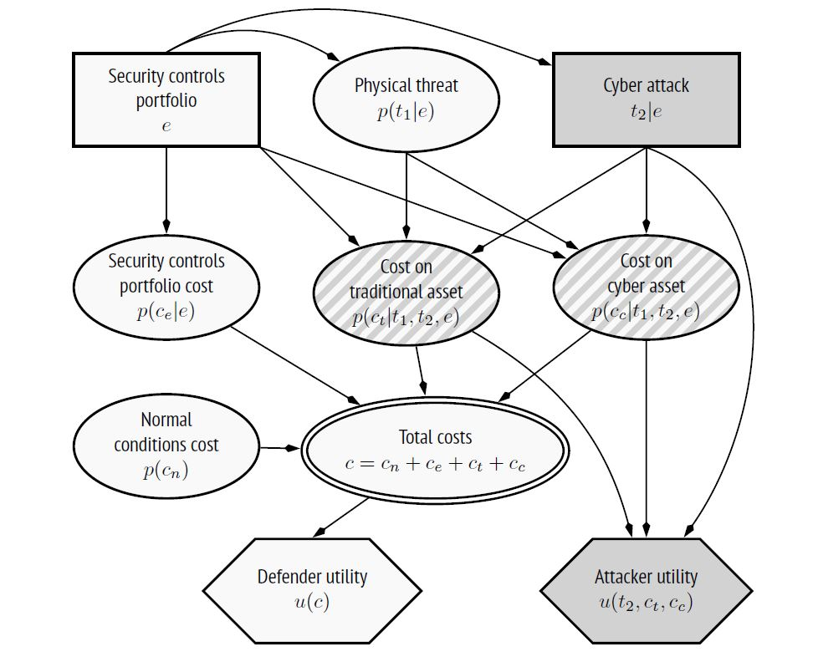
Adversarial risk analysis
Adversarial risk analysis provides one-sided decision support to a decision maker who faces risks in which probabilities and outcomes depend on the decisions of other self-interested actors.
Defense-Attack problem in cybersecurity

