Slide 1
Market Impacts of Energy Storage in a
Transmission-Constrained Power System
Vilma Virasjokiª, Paula Rocha^{a,b}, Afzal S. Siddiqui^{b,c}, and Ahti Saloª
ª Department of Mathematics and Systems Analysis, Aalto University, Finland
^{b} Department of Statistical Science, University College London, UK
^{c} Department of Computer and Systems Sciences, Stockholm University, Sweden
EURO2015, 12-15 July, Glasgow
Stochastic Models in Renewably Generated Electricity, Energy Storage and Renewables
The document can be stored and made available to the public on the open internet pages of Aalto University. All other rights are reserved.

Slide 2
Agenda
Introduction and Research Objectives
Problem Formulation
Discussion and Conclusions
Numerical Example
1
2
3
4

Slide 3
Introduction: Electricity Market Trends
I. Deregulation
→ Economic efficiency via competition
→ But, evidence of market power
Strain on the Power System
→ Ramping of conventional plants
→ Possibility of network congestion
Storage Technologies
→ Facilitate of RE integration
→ Combined with, e.g.:
1. Reinforcements of the grid
2. Better congestion management
3. Enhanced demand response
II. Sustainability
→ Regulation & economic incentives
→ But, uncertainty & intermittency
Electricity
not directly
economically
storable
Limited
transmission
infrastructure

Slide 4
Literature Review
Storage increases social welfare at the expense of producers (market failure), and reduces price-differentials (Schill and Kemfert, 2011)
Greenhouse gas (GHG) emissions may increase in the presence of both wind power and storage (Sioshansi, 2011)
Strategic use of storage, Mixed complementarity problems (MCP)
Environmental and economic impacts,
Perfect competition vs. market power
Under some structures, storage can reduce social welfare (Sioshansi, 2014)
Perfectly competitive, transmission-constrained energy system models
Optimal energy storage size and location (Awad et al., 2014)
The annualized capital costs of storage would exceed the social welfare gains, and storage modestly increases CO₂ emissons (Lueken and Apt, 2014)
Cournot producers typically underuse their storage (Bushnell, 2003)

Slide 5
Research Objectives and Contribution
Research objectives
Investigate the technical, economic and environmental impacts of energy storage by taking stochastic RE generation into account
Uncertainty in RE
Market power vs. perfect competition
Complementarity modeling
Contribution
The combination of handling market power and RE uncertainty in a transmission-constrained energy market model with storage
Framework
Test network, Western Europe

Slide 6
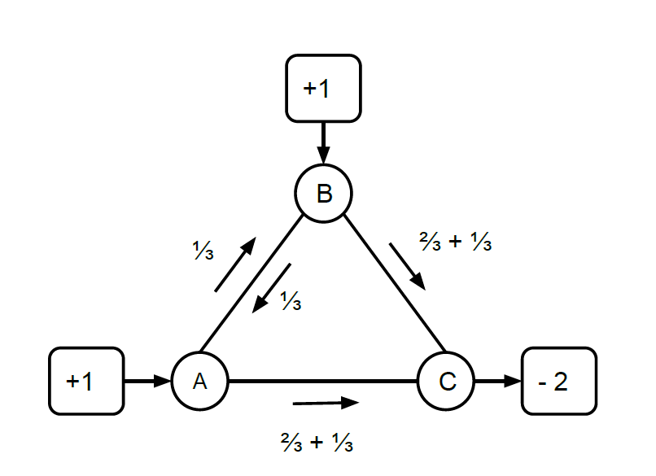
Problem Formulation: Assumptions
Power line network with constraints: DC load-flow linearization
Uncertainty in RE generation: Stochastic, discrete scenario tree
  Idea based on the winter school material by Daniel Huppmann and Friedrich Kunz, 2011
  Corresponding to the critical morning ramp, availability factors based on typical morning hours’ production (6-7/2011, Germany, EEX), each path equiprobable
  Priority grid access, zero marginal costs

Slide 7
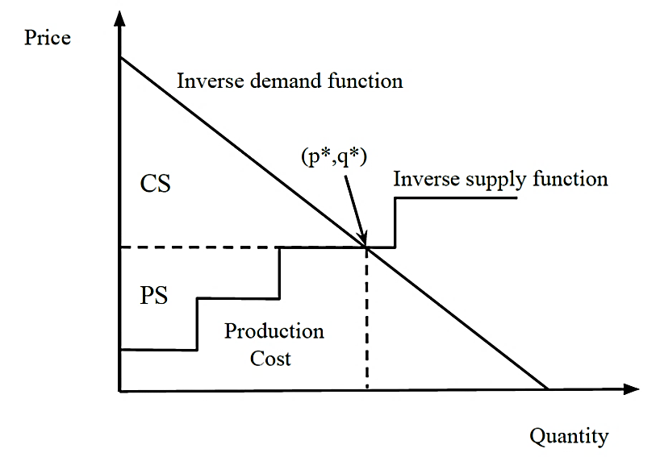
Problem Formulation: Decision-makers
Market participants’ simultaneous optimization problems
  Producers: A. Objective: Maximize exp. profit from sales incl. congestion fees
  B. Decisions: Power plant and storage operations
  C. Constraints: Energy balance, generation capacity, ramping, storing
  Grid owner: A. Objective: Maximize exp. profit from congestion fees B. Decisions: Electricity transmission between nodes
  C. Constraints: Transmission capacity
Perfect competition
  Expected social welfare maximized
Cournot oligopoly
  Producers make assumptions on their competitors’ production quantities
SW

Slide 8
Complementarity Modeling
Required to represent the market equilbrium of
  Several interacting players (companies, grid owner)
  Interacting markets in time (dynamics of storage and power plant ramping)
  Interacting markets in place (the physical power system)
Primal (decisions) and dual (price) variables considered simultaneously
  Efficient algorithms
  → Suitable for a variety of energy market structures

Slide 9
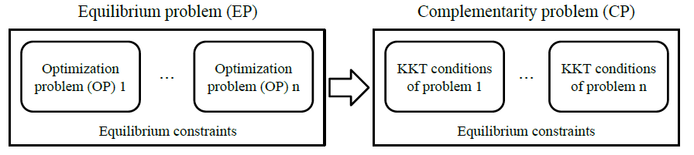
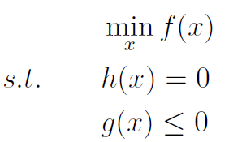
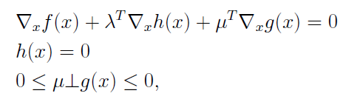

Mixed Complementarity Problem (MCP)
For each producer
& for the grid owner
Market-clearing condition
(i.e. supply matches demand)
Lagrangian function
Complementarity conditions

Slide 10
Numerical Example
15-node and 28-line test network
representing Western Europe
  Based on Gabriel and Leuthold (2010)
Data based on 2011
Storage capacity
  No assumption on technology type
  Zero marginal costs (> 90% pumped hydro storage)
  Cycle efficiency 75 %
  Maximum charge/discharge rate 16 %
  Minimum level 30 %
Four test cases
Implemented in GAMS,
Solver PATH
Case | Competition | Storage
Case 1: PC (ns) | PC | -
Case 2: PC (s) | PC | Yes
Case 3: CO (ns) | CO | -
Case 4: CO (s) | CO | Yes

Slide 11
Results – Prices
Moving electricity from excess supply to scarcity with storage leads to a price-smoothing effect between off-peak and peak periods.

Slide 12
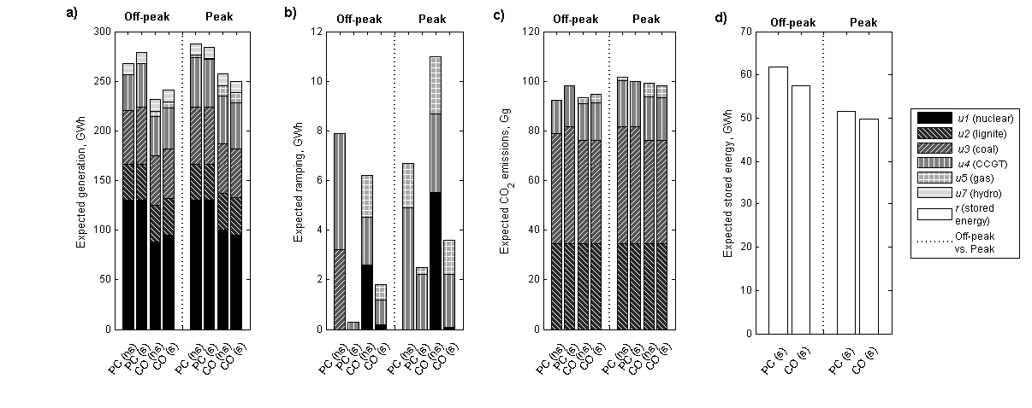
Results – Expected Generation & Storing
Producers with storage shift production from peak hours to off-peak’s storage charging. CO producers withhold their power production and storage use.
1)
2)
3)

Slide 13
Results – Ramping Costs
Producers with storage rely less on ramping their conventional generation at peak demand, which brings savings on costs.

Slide 14
Results – Network Congestion
Storage alleviates network congestion because it reduces the expected congestion rent collected by the grid owner.

Slide 15
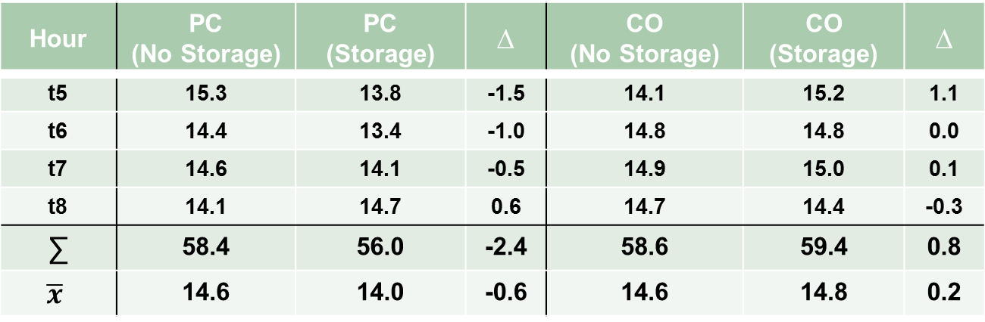
Results – Expected Power Flows
Storage decreases total expected power flows under PC, but increases them under CO due to strategic withholding of supply.
Table 1: Expected hourly power flows (GW), their sum (∑) and mean ($\overline{x})$. ∆ denotes difference between ”No Storage” and ”Storage” cases.
Hour | PC (No Storage) | PC (Storage) | ∆ | CO (No Storage) | CO (Storage) | ∆
t5 | 15.3 | 13.8 | -1.5 | 14.1 | 15.2 | 1.1
t6 | 14.4 | 13.4 | -1.0 | 14.8 | 14.8 | 0.0
t7 | 14.6 | 14.1 | -0.5 | 14.9 | 15.0 | 0.1
t8 | 14.1 | 14.7 | 0.6 | 14.7 | 14.4 | -0.3
∑ | 58.4 | 56.0 | -2.4 | 58.6 | 59.4 | 0.8
$$\overline{x}$$ | 14.6 | 14.0 | -0.6 | 14.6 | 14.8 | 0.2

Slide 16
Case n2: The Impact of Market Power
Expected transmission is reversed to flow from east to west under CO due to strategic withholding of sales, and strategic use of storage.
Table 2: Expected sales, n2 vs. total (GWh)
Dominating transmission directions:
Unchanged from PC:
Reversed from PC:
Bottlenecks
Hour | CO(s) in n2 | ∆ from PC(s)
t5 | 44,3 | -18%
t6 | 47,2 | -21%
t7 | 50,8 | -18%
t8 | 53,7 | -19%
CO(s) Total | ∆ from PC(s)
116,6 | -14%
125,4 | -15%
133,9 | -13%
141,4 | -14%
Table 3: Expected storage levels, n2 vs. total (GWh)
Hour | CO(s) in n2 | ∆ from PC(s)
t5 | 12,6 | 0%
t6 | 14,2 | +8%
t7 | 12,9 | +3%
t8 | 9 | 0%
CO(s) Total | ∆ from PC(s)
27,9 | -8%
29,5 | -6%
28,1 | -6%
21,6 | 0%

Slide 17
Results – CO₂ emissions
Storage may increase CO₂ emissions under PC due to efficiency losses and an increase in coal and CCGT based generation at off-peak storage charging.

Slide 18
Conclusions
In addition to corroborating some previous findings on storage impacts, e.g. price-smoothing effect, storage may...
  Reduce ramping and ramping costs
  Alleviate network congestion
  Increase (and reverse) expected power flows under market power due to
  a) strategic withholding of supply and
  b) strategic storage use
  Increase CO₂ emissions under PC

Slide 19
Discussion
Model limitations
  Relatively short studied time frame
  Stylized and aggregated form of the network
Future research
  Market design
    Provide incentives to invest into storage capacity
    Essentially, ways to avoid market failure (i.e. society benefits but producers do not invest) and making use of the technical benefits
  Increase in GHG emissions
    Including emissions regulation

Slide 20
Selected References
Awad, A., Fuller, J., EL-Fouly, T., Salama, M.: Impact of Energy Storage Systems on Electricity Market Equilibrium. IEEE Transactions on Sustainable Energy, 2014
Bushnell, J.: A Mixed Complementarity Model of Hydrothermal Electricity Competition in the Western United States. Operations Research, 2003
European Energy Exchange: EEX Transparency Platform. http://www.eex-transparency.com/
Gabriel, S. A., Conejo, A. J., Fuller, J. D., Hobbs, B. F. and Ruiz, C.: Complementarity Modeling in Energy Markets. Springer, 2013
Gabriel, S. A. and Leuthold, F. U.: Solving Discretely-Constrained MPEC Problems with Applications in Electric Power Markets. Energy Economics, 2010
Hobbs, B. F.: Linear Complementarity Models of Nash-Cournot Competition in Bilateral and POOLCO Power Markets. IEEE Transactions on Power Systems, 2001
Huppmann, D. and Kunz, F.: Introduction to Electricity Network Modelling - PhD Winterschool ”Managing Uncertainty in Energy Infrastructure Investments” held in Oppdal, Norway, 2011
IEA (International Energy Agency): www.worldenergyoutlook.org
Lueken, R. and Apt, J.: The Effects of Bulk Electricity Storage on the PJM Market. Energy Systems, 2014
Schill, W.-P. and Kemfert, C.: Modeling Strategic Electricity Storage: The Case of Pumped Hydro Storage in Germany. The Energy Journal, 2011
Sioshansi, R.: Emissions impacts of Wind and Energy Storage in a Market Environment. Environmental Science & Technology, 2011
Sioshansi, R.: When Energy Storage Reduces Social Welfare. Energy Economics, 2014

Slide 21
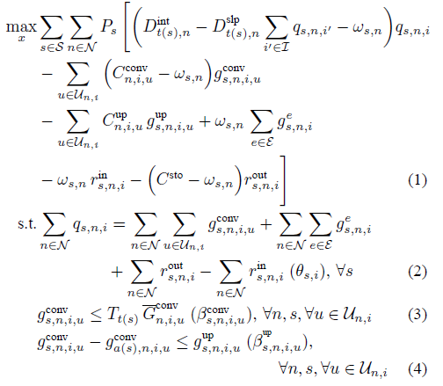
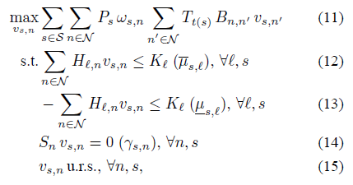
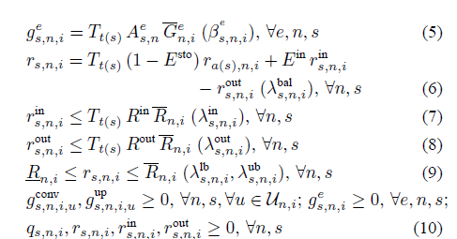
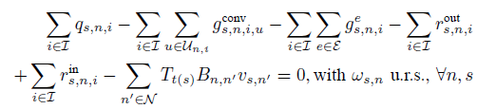
Backup Material: DM Problems
Producers’ problem: (1) – (10)
Grid owner’s problem: (11) – (15)
Market-clearing condition:

Slide 22
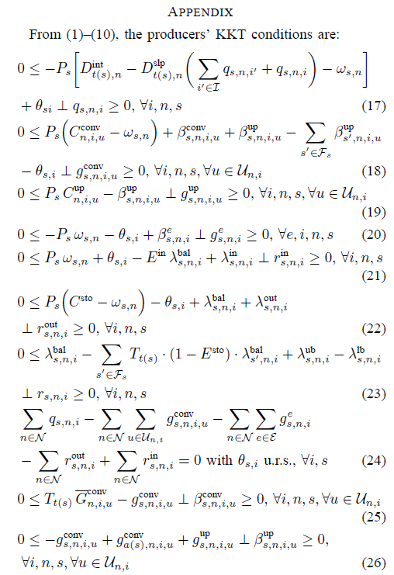
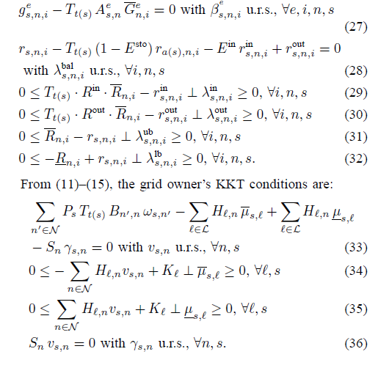
Backup Material: KKT Conditions (CO)

Slide 23
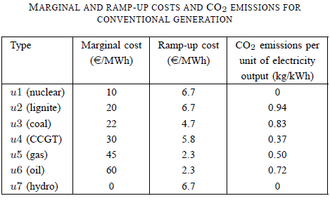
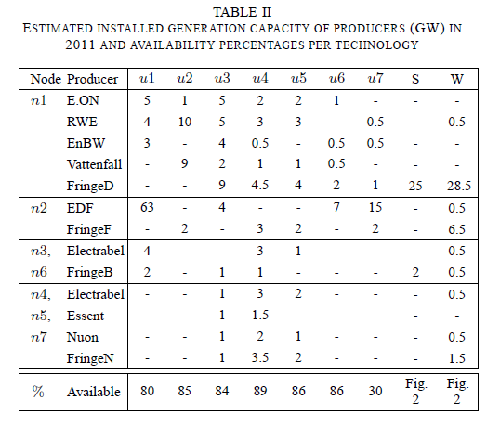
Backup Material: Data
Load profile from t5 to t8: 0.84, 0.92, 1.01, 1.07
The annual average hourly loads (GW): 62, 55, 2, 8, 3, 8, and 3 for nodes n1–n7, respectively
The weighted average price is 50.2€/MWh
Estimates for installed storage are based on operational installations’ power in 2014. At node n1, E.ON, RWE, EnBW, Vattenfall, and a fringe of German producers own 5, 11, 1, 16, and 3 GWh, respectively. EDF owns 30 GWh at node n2, and Electrabel owns a combined 6 GWh at nodes n3 and n6.

Slide 24
Backup Material: Data References
Gabriel, S. A. and Leuthold, F. U.: Solving Discretely-Constrained MPEC Problems with Applications in Electric Power Markets. Energy Economics, 2010
ENTSO-E: European Network of Transmission System Operators for Electricity. https://www.entsoe.eu/
European Energy Exchange: EEX Transparency Platform. http://www.eex-transparency.com/
Egerer, J., Gerbaulet, C., Ihlenburg, R., Kunz, F., Reinhard, B., Von Hirschhausen, C., Weber, A., and Weibezahn, J.: Electricity Sector Data for Policy-Relevant Modeling. Deutsches Institut für Wirtschaftsforschung, DIW Data Documentation 72, 2014
Werner, D.: Electricity Market Price Volatility: The Importance of Ramping Costs. Working paper, Department of Agricultural and Resource Economics, University of Maryland, College Park 2014
Kumar N., Besuner, P., Lefton, S., Agan, D., and Hilleman, D.: Power Plant Cycling Costs. Intertek APTECH for the National Renewable Energy Laboratory (NREL) and Western Electricity Coordinating Council (WECC), Tech. Report, 2012
IPCC: 2006 IPCC Guidelines for National Greenhouse Gas Inventories. Intergovernmental Panel on Climate Change, International Guidelines, 2006
Sandia National Laboratories: DOE Global Energy Storage Database. http://www.energystorageexchange.org/
Companies websites and annual reports

