Slide 1
Binary decision diagrams for computing the non-dominated set
July 13, 2015
Antti Toppila and Ahti Salo
27th European Conference on Operational Research, 12-15 July 2015, University of Strathclyde, Glasgow, Scotland

Slide 2
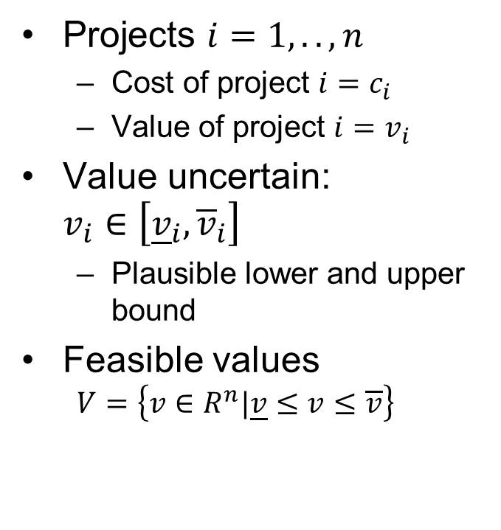
Portfolio selection with interval-values 1/2
Projects $i=1,..,n$
Cost of project $i=c_{i}$
Value of project $i=v_{i}$
Value uncertain: $v_{i}∈\left[{\underline{v}}_{i},{\overline{v}}_{i}\right]$
Plausible lower and upper bound
Feasible values
$$V=\left\{v∈R^{n}|\underline{v}≤v≤\overline{v}\right\}$$
3
Project value
1
2
Project cost

Slide 3
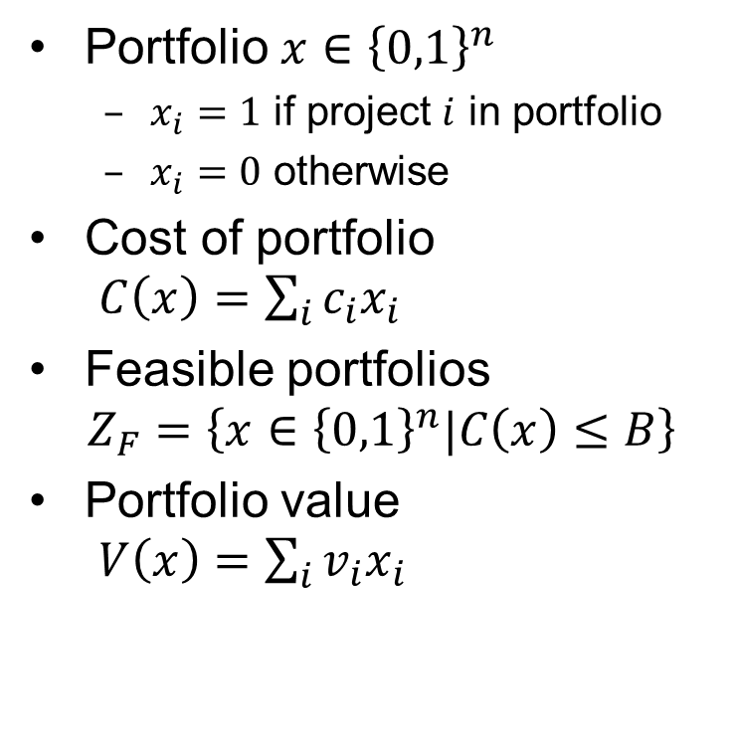
Portfolio selection with interval-values 2/2
Portfolio $x∈{\left\{0,1\right\}}^{n}$
$x_{i}=1$ if project $i$ in portfolio
$x_{i}=0$ otherwise
Cost of portfolio $C\left(x\right)=\sum_{i}{c_{i}x_{i}}$
Feasible portfolios $Z_{F}=\left\{x∈{\left\{0,1\right\}}^{n}|C\left(x\right)≤B\right\}$
Portfolio value $V\left(x\right)=\sum_{i}{v_{i}x_{i}}$
2&3
1&2&3
1&2
3
1&3
Portfolio value
1
2
Portfolio cost
B

Slide 4
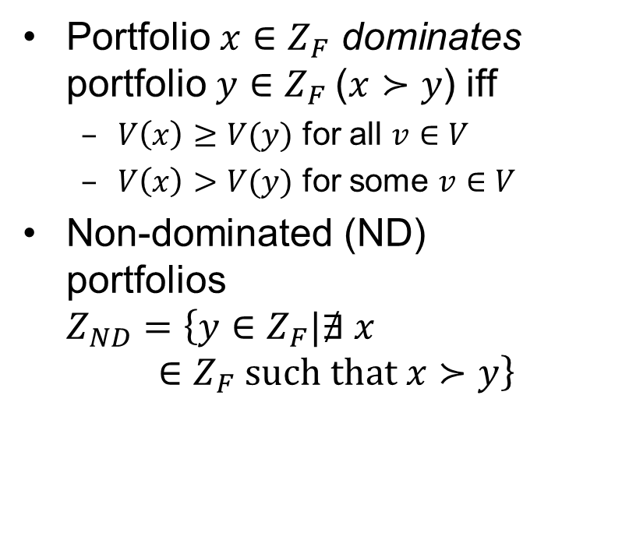
Non-dominated set
Portfolio $x∈Z_{F}$ dominates portfolio $y∈Z_{F}$($x≻y$) iff
$V\left(x\right)≥V(y)$ for all $v∈V$
$V\left(x\right)>V(y)$ for some $v∈V$
Non-dominated (ND) portfolios $Z_{ND}=\left\{y∈Z_{F}|∄ x∈Z_{F} \text{such} \text{that} x≻y\right\}$
Infeasible
Portfolio value
= dominance
= ND set
Portfolio cost
B

Slide 5
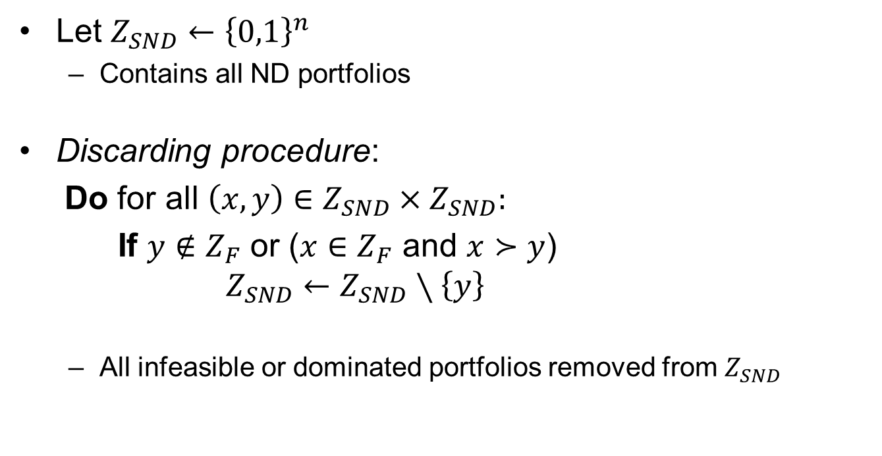
Computing the non-dominated set 1/2
Let $Z_{SND}←{\left\{0,1\right\}}^{n}$
Contains all ND portfolios
Discarding procedure:
Do for all $\left(x,y\right)∈Z_{SND}×Z_{SND}:$
If $y∉Z_{F}$ or ($x∈Z_{F}$ and $x≻y$) $Z_{SND}←Z_{SND}∖\left\{y\right\}$
All infeasible or dominated portfolios removed from $Z_{SND}$
Check all pairs

Slide 6
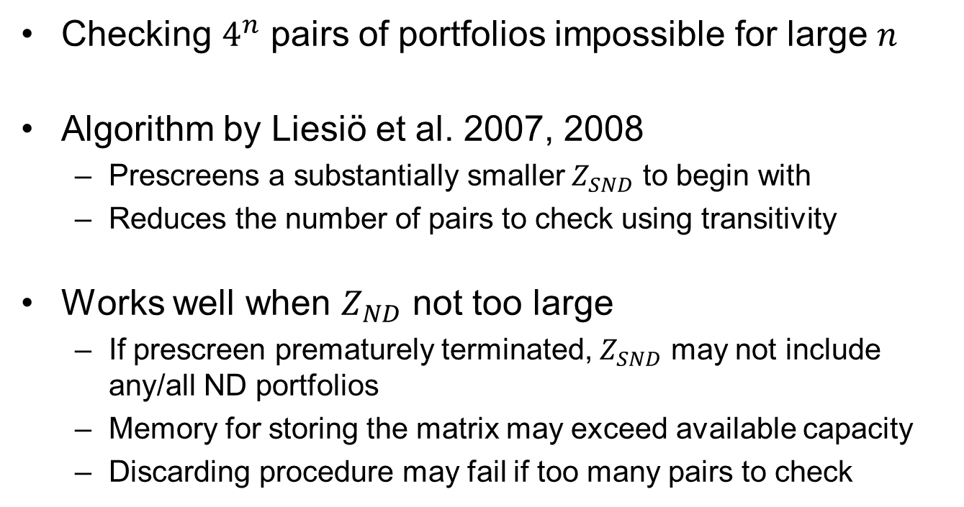
Computing the non-dominated set 2/2
Checking $4^{n}$ pairs of portfolios impossible for large $n$
Algorithm by Liesiö et al. 2007, 2008
Prescreens a substantially smaller $Z_{SND}$ to begin with
Reduces the number of pairs to check using transitivity
Works well when $Z_{ND}$ not too large
If prescreen prematurely terminated, $Z_{SND}$ may not include any/all ND portfolios
Memory for storing the matrix may exceed available capacity
Discarding procedure may fail if too many pairs to check

Slide 7
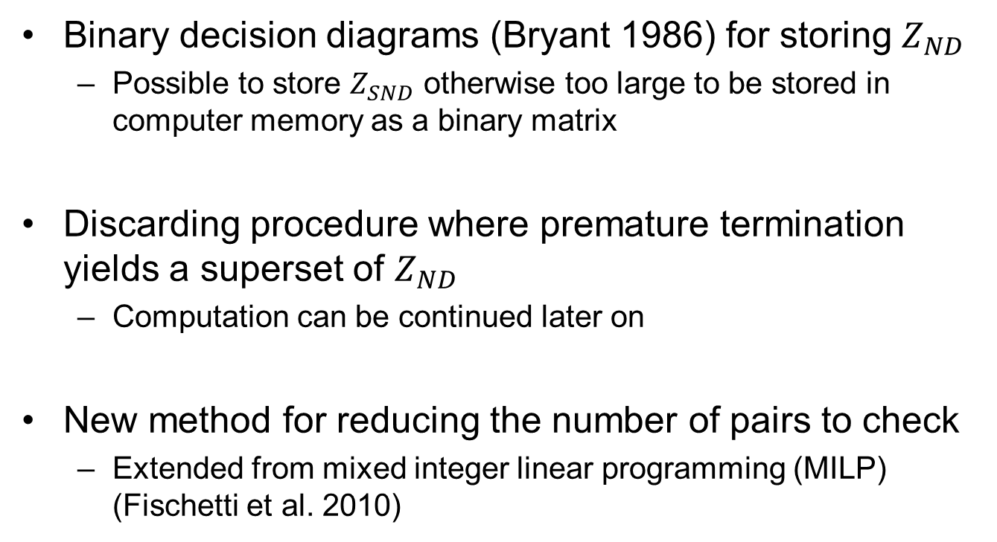
Our contribution
Binary decision diagrams (Bryant 1986) for storing $Z_{ND}$
Possible to store $Z_{SND}$ otherwise too large to be stored in computer memory as a binary matrix
Discarding procedure where premature termination yields a superset of $Z_{ND}$
Computation can be continued later on
New method for reducing the number of pairs to check
Extended from mixed integer linear programming (MILP) (Fischetti et al. 2010)

Slide 8





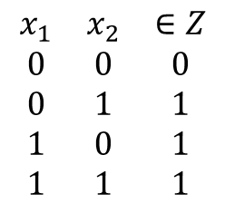




Storing sets using Binary Decision Diagrams (BDDs)
BDD = compressed binary decision tree (BDT)
Identical nodes merged
Redundant nodes eliminated
$$x_{1}$$
BDT
Truthtable
Redundant
BDD
$$x_{1}$$
$$\begin{matrix}x_{1} & x_{2} & ∈Z \\ 0 & 0 & 0 \\ 0 & 1 & 1 \\ 1 & 0 & 1 \\ 1 & 1 & 1\end{matrix}$$
=
=
$$x_{2}$$
$$x_{2}$$
$$x_{2}$$
0
1
1
1
0
1
$$x_{i}$$
$$x_{i}=1$$
$$Z⊆{\left\{0,1\right\}}^{n}$$
Identical
$$x_{i}=0$$

Slide 9
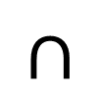
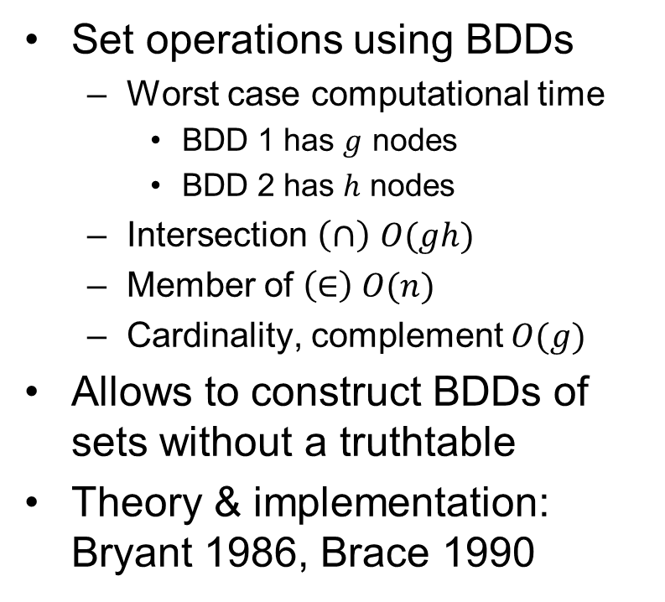





Efficient set operations using BDDs
Set operations using BDDs
Worst case computational time
BDD 1 has $g$ nodes
BDD 2 has $h$ nodes
Intersection $\left(∩\right)$ $O(gh)$
Member of $\left(∈\right) O(n)$
Cardinality, complement $O(g)$
Allows to construct BDDs of sets without a truthtable
Theory & implementation: Bryant 1986, Brace 1990
$$x_{2}$$
$$∩$$
$$x_{30}$$
1
0
0
1
$$x_{2}$$
$$=$$
$$x_{30}$$
0
1

Slide 10
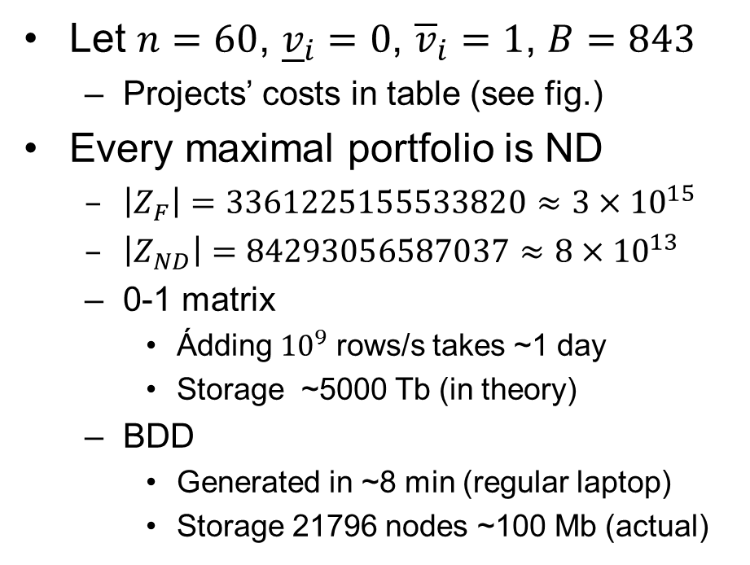
Example: Compression of a ND set
Let $n=60$, ${\underline{v}}_{i}=0$, ${\overline{v}}_{i}=1$, $B=843$
Projects’ costs in table (see fig.)
Every maximal portfolio is ND
$\left|Z_{F}\right|=\text{3361225155533820}≈3×{10}^{15}$
$\left|Z_{ND}\right|=84293056587037≈8×{10}^{13}$
0-1 matrix
Ádding ${10}^{9}$ rows/s takes ~1 day
Storage ~5000 Tb (in theory)
BDD
Generated in ~8 min (regular laptop)
Storage 21796 nodes ~100 Mb (actual)
Cost
Project
98 | 96 | 95 | 92 | 89 | 88
81 | 79 | 78 | 78 | 78 | 77
77 | 76 | 74 | 74 | 69 | 68
62 | 59 | 58 | 57 | 56 | 55
54 | 54 | 48 | 48 | 47 | 46
45 | 44 | 44 | 42 | 37 | 36
35 | 34 | 34 | 33 | 32 | 31
30 | 29 | 26 | 25 | 24 | 23
22 | 20 | 18 | 16 | 14 | 11
11 | 5 | 3 | 2 | 1 | 1

Slide 11
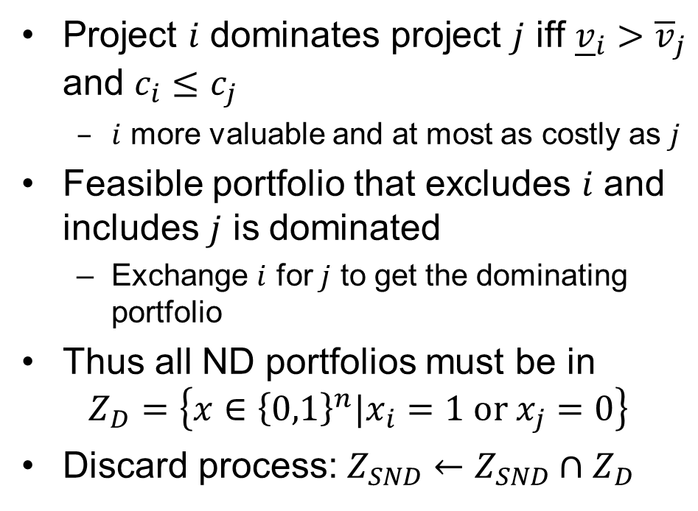
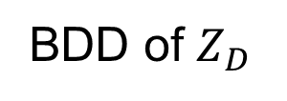


Discarding sets of projects using BDDs: Project dominance
Project $i$ dominates project $j$ iff ${\underline{v}}_{i}>{\overline{v}}_{j}$ and $c_{i}≤c_{j}$
$i$ more valuable and at most as costly as $j$
Feasible portfolio that excludes $i$ and includes $j$ is dominated
Exchange $i$ for $j$ to get the dominating portfolio
Thus all ND portfolios must be in
$$Z_{D}=\left\{x∈{\left\{0,1\right\}}^{n}|x_{i}=1 \text{or} x_{j}=0\right\}$$
Discard process: $Z_{SND}←Z_{SND}∩Z_{D}$
$$x_{i}$$
$$x_{j}$$
1
0
BDD of $Z_{D}$

Slide 12
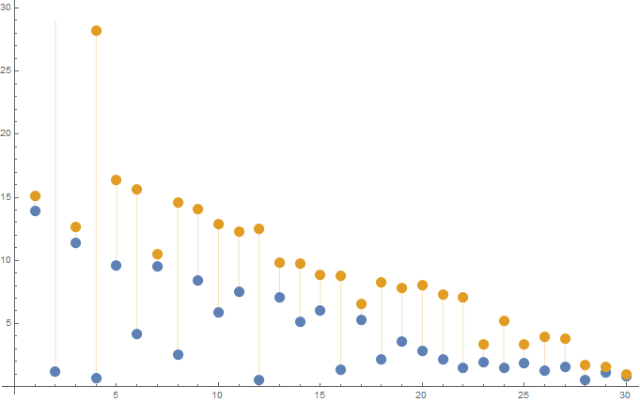
Example 1/2
Total of 190 project dominances
Project 1 dominates project 3, 7, and 10-30, etc.
Each project dominance yields a set within which ND portfolios are
Each set stored as BDD
The intersection of these sets computed using BDD set operations
Value
1
10-30
3
7
Project
30 projects of equal cost

Slide 13
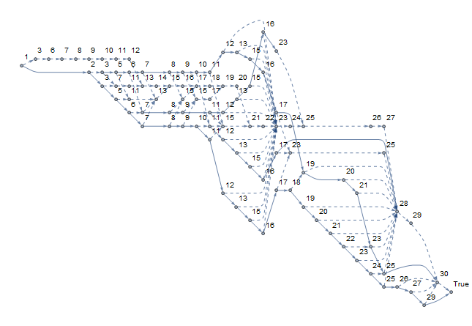

Example 2/2
For clarity, node 0 and arcs to it removed from BDD
BDD of the intersection of the 190 sets
97 nodes
Corresponds to 61456 portfolios
0.005 % of all $2^{30}≈{10}^{9}$ portfolios

Slide 14
Discussion: Discarding process using BDDs
We implemented the discarding process using Branch-and-Bound (B&B)
Sytematically cuts sets of dominated portfolios
Many of these methods BDD variants of those presented by Liesiö et al. 2007
Developed a method for reducing the number of pairs to check
Extension of the Fischetti-Toth dominance procedure (1988)
Preliminary results suggest that large ND sets can computed using this implementation

Slide 15
Conclusions
Storage as BDD opens new possiblities
Deriving stronger bounds using information from the BDD
Optimizing over BDD set = solving shortest path problem
Use of implied dominance checks makes it possible to pairwise compare possibly huge ND sets
Possible future research directions
Zero-suppressed BDDs for improved storage (Minato 2007)
Additive linear value functions (Liesiö et al. 2007)
Uncertainty set defined by linear inequalities (Liesiö et al. 2007)
Cost efficiency (Liesiö et al. 2008)

Slide 16
References
Brace KS, Rudell RL, Bryant RE, Efficient implementation of a BDD package. Design Automation Conference, Proceedings 27th ACM/IEEE, 40-45, Jun 24-28, 1990
Bryant RE. Graph-based algorithms for Boolean function manipulation. IEEE Transactions on Computers 100(8):677-691, 1986
Fischetti M, Salvagnin D. Pruning moves. INFORMS Journal on Computing 22(1):108-119, 2010
Fischetti M, Toth P. A new dominance procedure for combinatorial optimization problems. Operations Research Letters 7(4):181-187,1988
Liesiö J, Mild P, Salo A. Preference programming for robust portfolio modeling and project selection. European Journal of Operational Research 181(3):1488-1505, 2007
Liesiö J, Mild P, Salo A. Robust portfolio modeling with incomplete cost information and project interdependencies. European Journal of Operational Research 190(3):679-695, 2008
Minato S. Zero-suppressed BDDs for set manipulation in combinatorial problems. Proceedings of 30th Conference on Design Automation, 272-277, 14-18 June 1993
Pisinger D. Where are the hard knapsack problems? Computers & Operations Research 32(9) 2271-2284, 2005

