Slide 1
Cellular Automaton Evacuation Model Coupled with a Spatial Game
Anton von Schantz, Harri Ehtamo
anton.von.schantz@aalto.fi, harri.ehtamo@aalto.fi
The document can be stored and made available to the public on the open internet pages of Aalto University. All other rights are reserved.

Slide 2
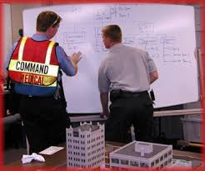
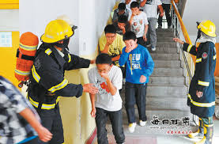
Real-Time Evacuation Simulations
Evacuation simulations help to locate bottlenecks and areas of reduced flow.
The incident commander could give timely and accurate instructions with a real-time model.

Slide 3
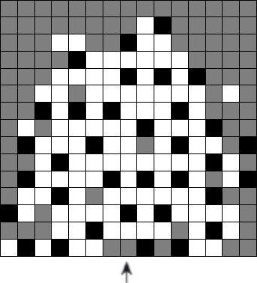
Cellular Automaton Evacuation Model
In a Cellular Automaton (CA) model, the agents move in a discrete square grid towards the exit.
The agents leave a virtual trace, which other agents can follow.
Computationaly light enough for-real time simulations.
Agents lack individualistic decision-making abilities, i.e., their behavior is static (not very realistic?)
OUR AIM: to provide the agents in a CA with decision-making abilities.

Slide 4
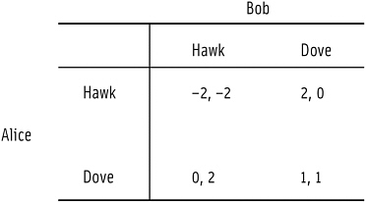
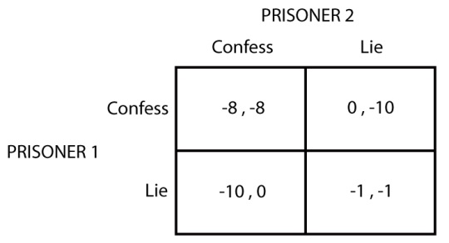
Game Theory in Evacuation Modeling 1/2
In contrary to popular belief, people in evacuation situations behave most of the time RATIONALLY.
Evacuees decision-making can be modelled with game theory
Game theory is a theory of rational agents in an interactive decision-making situation.

Slide 5
Game Theory in Evacuation Modeling 2/2
Hawk-Dove and Prisoners-Dilemma are used to model social dilemmas, and are thus suitable in modeling evacuation situations.

Slide 6
CA Coupled with a Spatial Game 1/2
In our model, a spatial game is coupled to a CA.
The game is Hawk-Dove or Prisoner’s Dilemma depending on where the agent is located.
In a spatial game the agents play against their immediate neighbours.
Agents observe their surroundings and choose strategy.
The agent can play either Impatient or Patient.
The choice of strategy, results in the agent moving individualistically or following the footsteps of others in the CA.

Slide 7
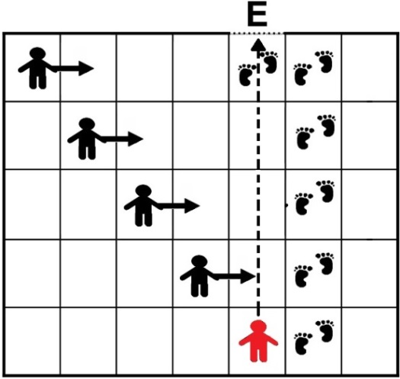
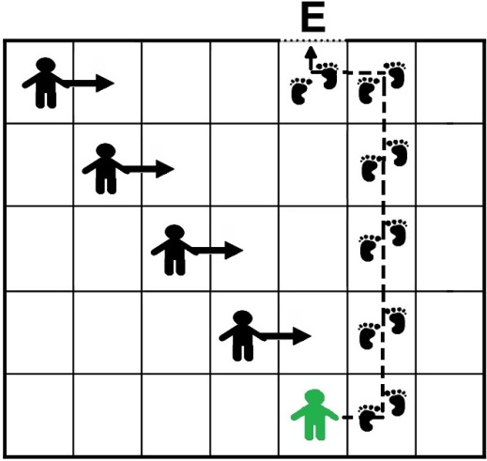
CA Coupled with a Spatial Game 2/2
For example, a football stadium, where people can choose to evacuate nice and orderly, or rush towards the exit disregarding others.
In our model, the agents can react to their environment. Compared to before, when the behavior of the agents had to be pre-defined before simulating.

Slide 8
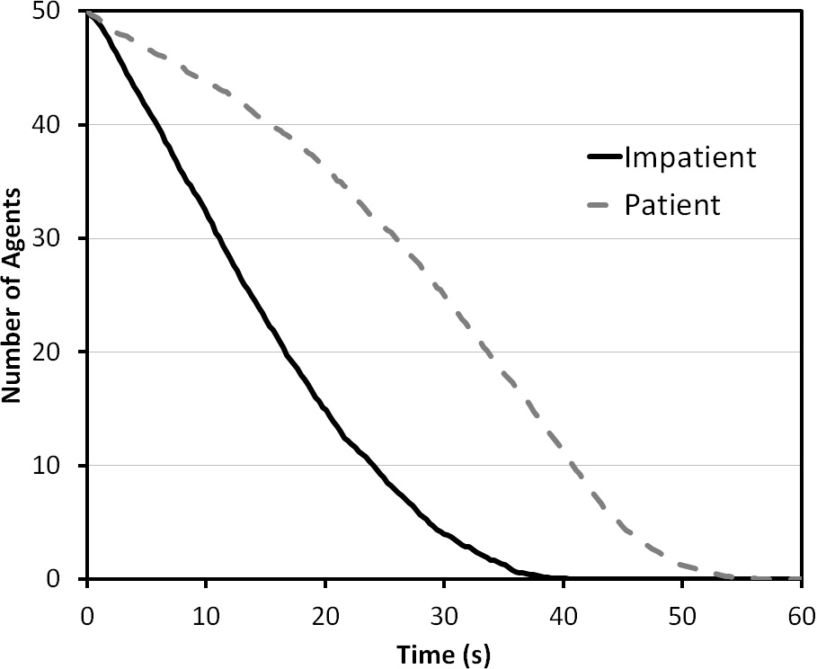
Performance on an individual level
Impatient agents rushing towards the exit results in that the impatient agents will evacuate faster than patient agents

Slide 9
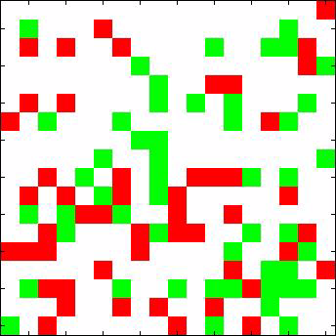
Evacuation from a room
EXIT

Slide 10
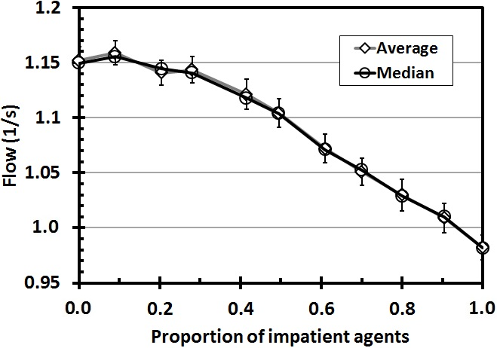
Faster-is-slower effect
The more agents play Impatient, the slower the whole crowd will evacuate
This is a result of increased amount of conflict situations
However, a small amount of impatient agents gives the highest flow at the exit
A phenomenon observed also in real-life

Slide 11
Future Steps
Validation of the model
Comparing the performance to other softwares

Slide 12
References
von Schantz, A.: Modeling Egress Congestion Using a Cellular Automaton Approach. Master's Thesis (2014) (available from http://sal.aalto.fi/fi/julkaisut/opinnaytetyot/mas)
Ehtamo, H., Heliövaara, S., Korhonen, T., Hostikka, S.: Game Theoretic Best-Response Dynamics for Evacuees' Exit Selection. Advances in Complex Systems 13, 113-134 (2010)
Heliövaara, S., Korhonen, T., Hostikka, S., Ehtamo, H.: Counterow Model for Agent-Based Simulation of Crowd Dynamics. Building and Environment 48, 89-100 (2012)
Heliövaara, S., Kuusinen, J.-M., Rinne, T., Korhonen, T., Ehtamo, H.: Pedestrian Behavior and Exit Selection in Evacuation of a Corridor - an Experimental Study. Safety Science 50, 221-227 (2012)
Heliövaara, S., Ehtamo, H., Helbing, D., Korhonen, T.: Patient and Impatient Pedestrians in a Spatial Game for Egress Congestion. Physical Review E 87, 012802 (2013)
Korhonen, T., Hostikka, S.: Fire Dynamics Simulator with Evacuation: Fds+Evac. Tech. rep., VTT Technical Research Centre of Finland (2009)
Burstedde, C., Klauck, K., Schadschneider, A., Zittartz, J.: Simulation of Pedestrian Dynamics Using a Two-Dimensional Cellular Automaton. Physica A: Statistical Mechanics and its Applications 295, 507-525 (2001)
Kirchner, A., Schadschneider, A.: Simulation of Evacuation Processes Using a Bionics-Inspired Cellular Automaton Model for Pedestrian Dynamics. Physica A: Statistical Mechanics and its Applications 312, 260-276 (2002)

Slide 13
References
Kirchner, A., Nishinari, K., Schadschneider, A.: Friction Eects and Clogging in a Cellular Automaton Model for Pedestrian Dynamics. Physical Review E 67, 056122 (2003)
Helbing, D., Farkas, I., Vicsek, T.: Simulating Dynamical Features of Escape Panic. Nature 407, 487-490 (2000)
Zheng, X., Cheng, Y.: Conict Game in Evacuation Process: A Study Combining Cellular Automata Model. Physica A: Statistical Mechanics and its Applications 390, 1024-1050 (2011)
Zheng, X., Cheng, Y.: Modeling Cooperative and Competitive Behaviors in Emergency Evacuation: A Game-Theoretical Approach. Computers & Mathematics with Applications 62, 4627-4634 (2011)
Hao, Q. Y., Jiang, R., Hu, M.B., Jia, B., Wu, Q.S.: Pedestrian Flow Dynamics in a Lattice Gas Model Coupled with an Evolutionary Game. Physical Review E 84, 036107 (2011)
Shi, D. M., Wang, B. H. Evacuation of Pedestrians from a Single Room by Using Snowdrift Game Theories. Physical Review E 87, 022802 (2013)
Bouzat, S., Kuperman, M. N.: Game Theory in Models of Pedestrian Room Evacuation. Physical Review E 89, 032806 (2014)
Sysi-Aho, M., Saramaki, J., Kertesz, J., Kaski, K.: Spatial Snowdrift Game with Myopic Agents. The European Physical Journal B 44, 129-135 (2005)

