Slide 1
How I Became a Decision Analyst Inspirational People and Building Bridges Ramsey Medal Acceptance Talk INFORMS 2019 Raimo P. Hämäläinen Aalto University Finland

Slide 2
I Feel Extremely Honoured for the Ramsey Medal

Slide 3
I Feel Extremely Honoured for the Ramsey Medal
It also makes me very happy – Thank You!

Slide 4

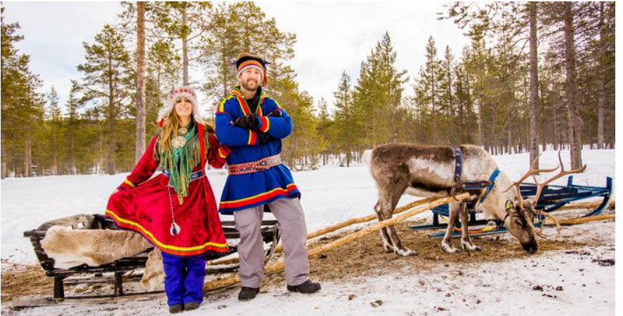


I Feel Extremely Honoured for the Ramsey Medal
It also makes me very happy – Thank You!
Source: DW

Slide 5
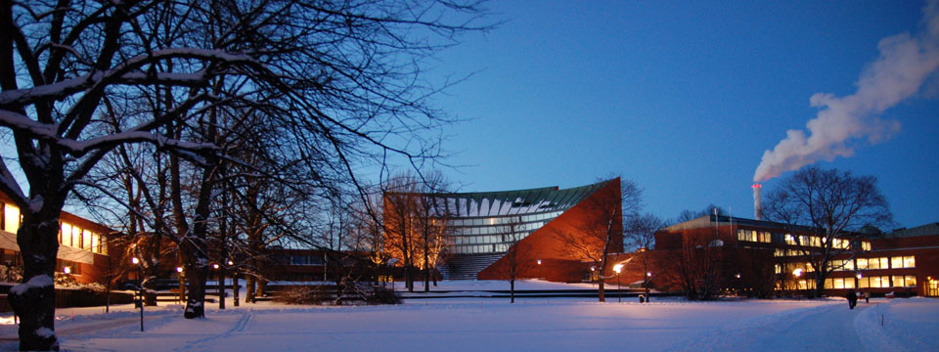




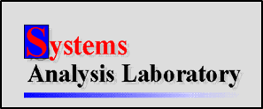
Academic Degrees in my Alma Mater Helsinki University of Technology Aalto University
Engineering Physics, Systems Theory, Operations Research
Human Physiology
Professor 1981, Systems Analysis Laboratory 1984

Slide 6
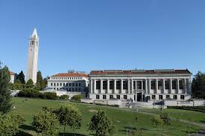

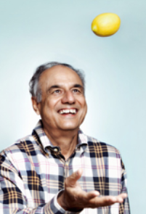
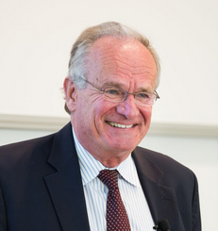
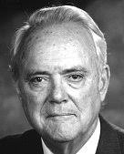

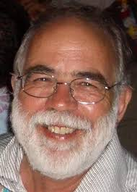
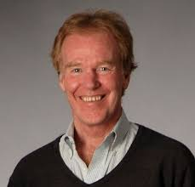
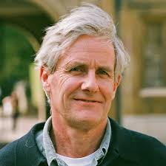
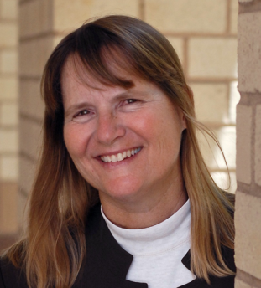

Sabbaticals and People
Los Angeles 1981,1985,1991
UC Berkeley,1980
Judea Pearl
UCLA
Ward Edwards
USC
Rakesh Sarin
UCLA
Detlof v. Winterfeldt
USC
Nat. U. of Singapore, 2010
Peter Senge
MIT, 2005
Andy Philpott,
U.Auckland, 2006
U.Technology Sydney,2013
Theo Stewart,
U. Cape Town 1996
L. Robin Keller
UC Irvine

Slide 7
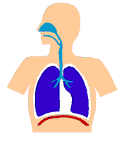
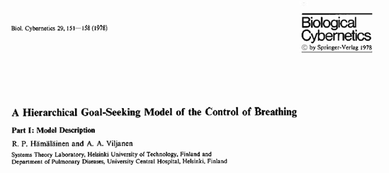
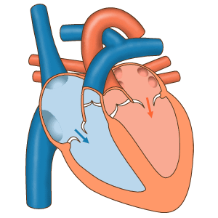
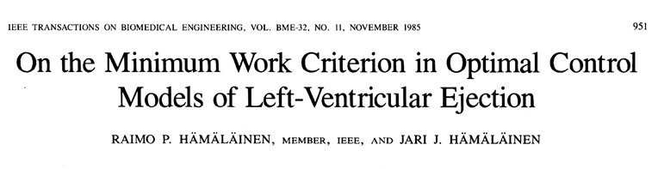
Autonomous Decision Making in Our Body Why do we breathe the way we do? Why does the heart contract the way it does?

Slide 8
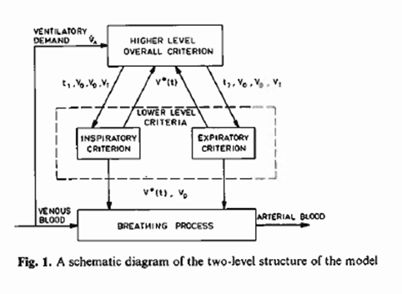
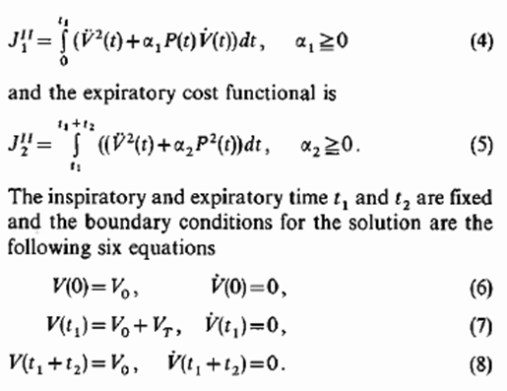


Utility function explains autonomous decisions
Performance function with
individual weighting parameters
- Energy cost minimization
- Soft movements
1985

Slide 9
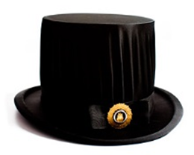
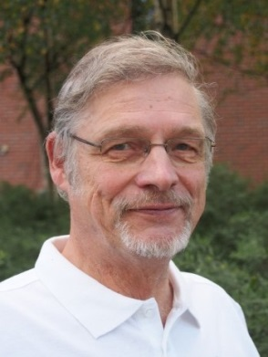
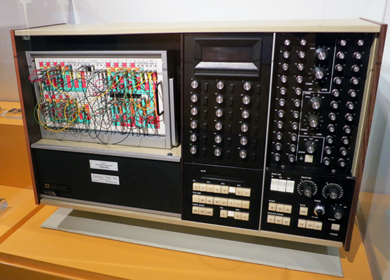
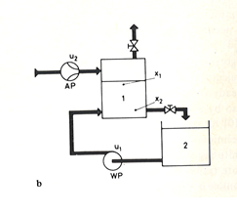
Doctoral Thesis Optimal Conroller Design by Non-linear and Game Theoretic Methods , 1977
Game theoretic worst case design:
Optimal adversary disturbance ( player )
trying to destabilize the system
Test runs :
Analogue computer model of the head-box of a paper machine
Supervisor:
Prof. Aarne Halme
Helsinki U. of Technology

Slide 10
From Game Theory to Decision Analysis
In 1977 game theory seemed useless in engineering contexts – I wanted to be usefull
New research topics:
Incentives in dynamic decision problems
Computational agent modelling
- Negotiation processes
- By removing extra players I found
Multi - Criteria Decision Analysis and AHP
-

Slide 11
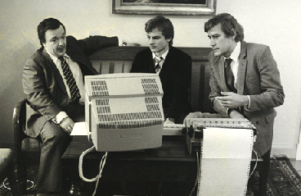
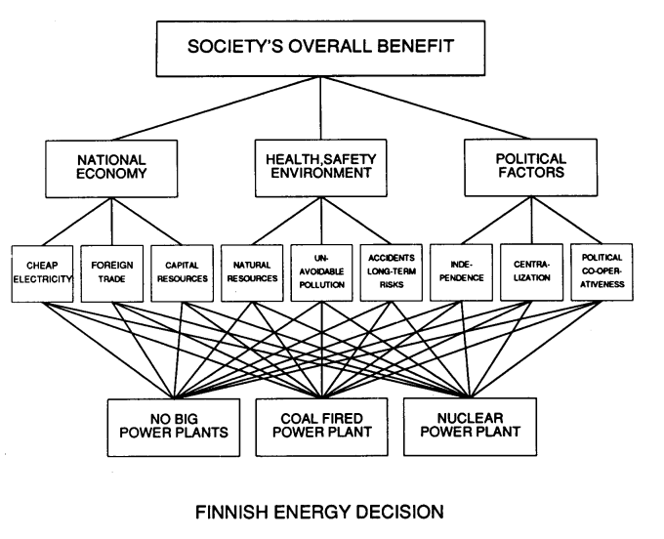
Energy Policy Decision in the Parliament of Finland, 1984
Debate based on individual MCDA evaluations
Separating facts and values
Extensive coverage ( also critical ) on TV and press
Minister Pekka Vennamo working with our HIPRE DOS- software for AHP
Interfaces 1988

Slide 12
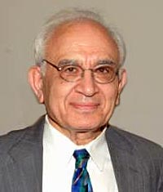
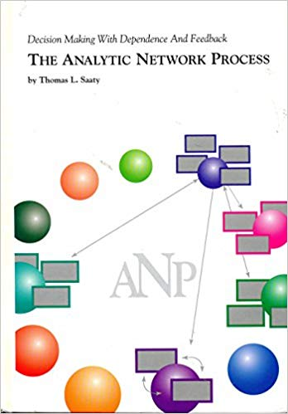
AHP and MAV Theory
Value difference interpretation in ratio elicitation makes AHP compatible with MAV theory (Salo and Hämäläinen, 1997)
Paper took 7 years to get published. Finally in J. MCDA followed by 8 commentary papers.
Today over 400 citations
New Balanced Scale for AHP
Coined the term The Analytic Network Process (Hämäläinen and Seppäläinen ,1986)
Thomas Saaty

Slide 13
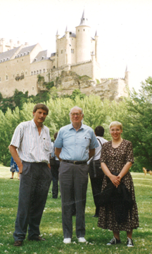
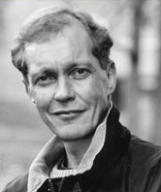
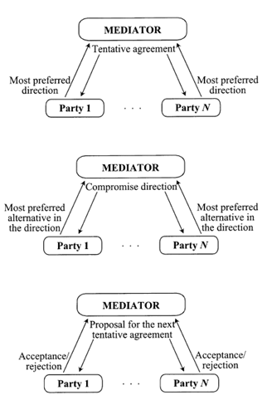
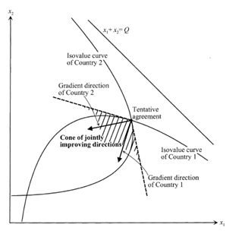
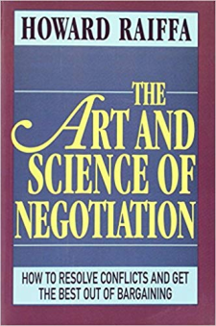
Negotiation Support
Joint Gains procedure: Mutually improving steps towards a Pareto solution
( Single Negotiation Text idea – Fisher)
Prof. Harri Ehtamo
Aalto U.
Howard Raiffa ,
Alcazar Castle Segovia,Spain 1992

Slide 14
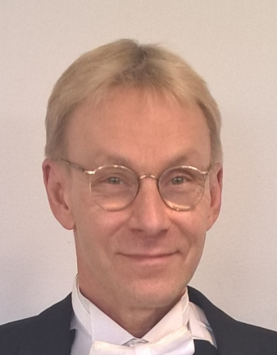
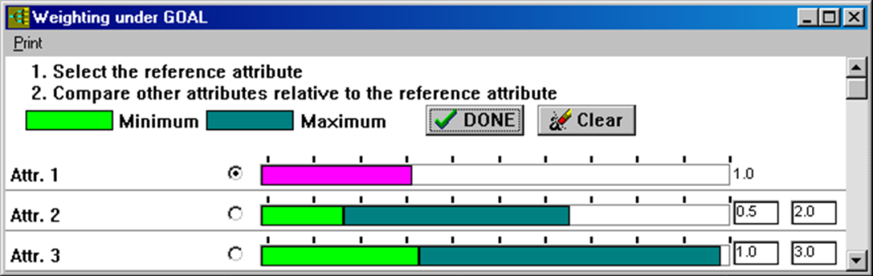
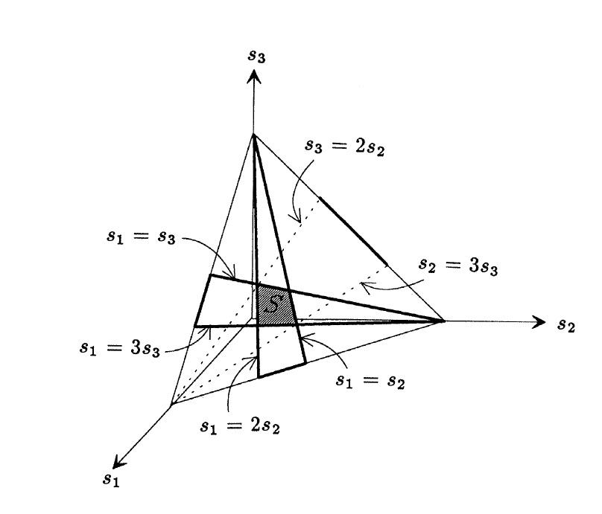
Preference Programming
Decision analysis with incomplete information – interval statements
Preference Ratios in Multiattribute Evaluation (PRIME)
Interval SMART/SWING and AHP
Basis for new methods in portfolio decision analysis
Prof. Ahti Salo
Aalto University

Slide 15
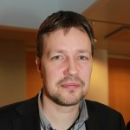

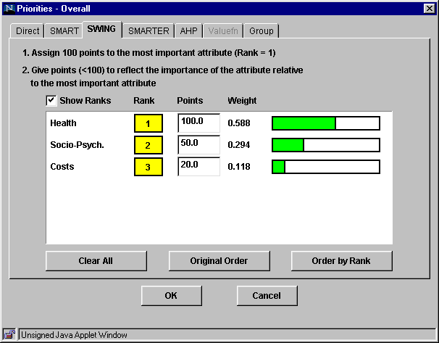

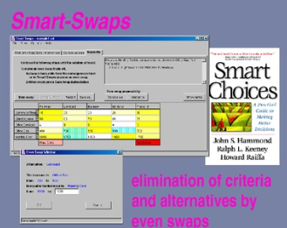
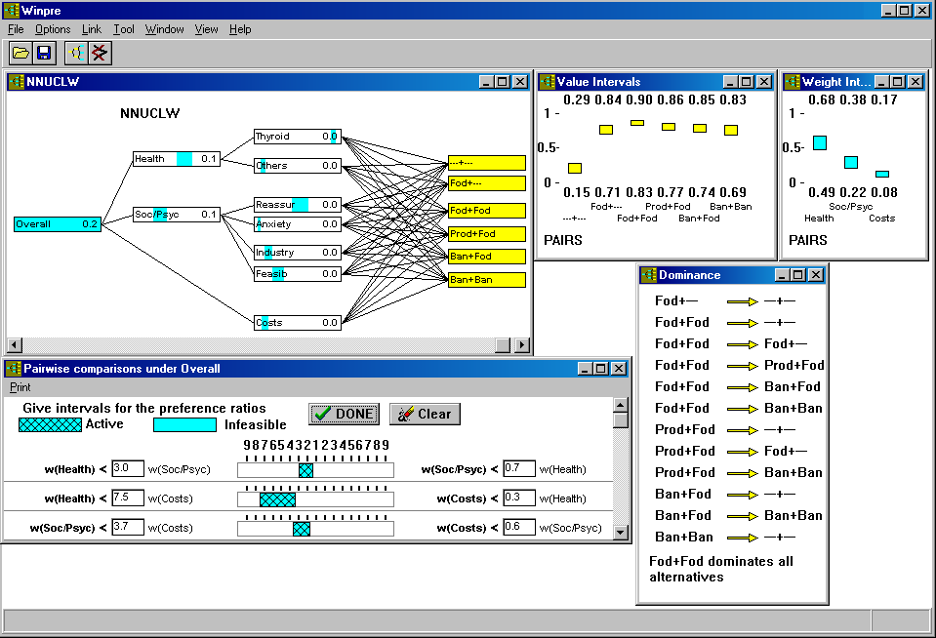
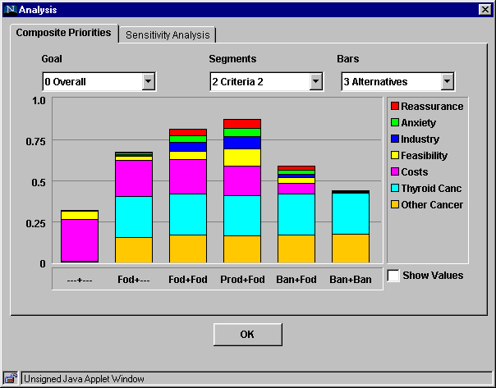
Decision Support Software on the Web
Web-HIPRE (1998) ,Winpre ja Smart-Swaps
Opinions-Online, Joint-Gains
Jyri Mustajoki
Finnish Environment Institute

Slide 16
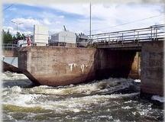
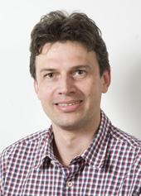

Environmental Decision Making
Interactive participatory
decision analysis processes
for water course regulation
policies
Internet based approaches
Decision Analysis basis for valuation in in Life Cycle Impact Analysis (LCA) (Miettinen & Hämäläinen 1997)
Portfolio Decision Analysis in environmental policies
Mika Marttunen
Finnish Environment Institute

Slide 17
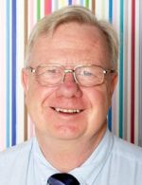
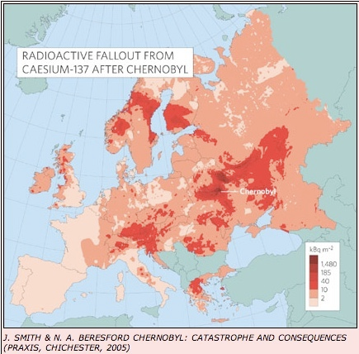
Decision Conferencing
Emergency responses in nuclear accidents
European workshops 1992-2004
Our Web-HIPRE decision analysis software implemented in the RHODOS system ( Real time Online DecisiOn Support ) for radiation accidents
Installed in emergency response centers in more than 20 countries in Europe and the world.
Simon French
Warwick U.
Ramsey Medal 2017

Slide 18
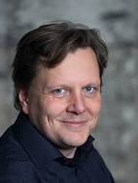
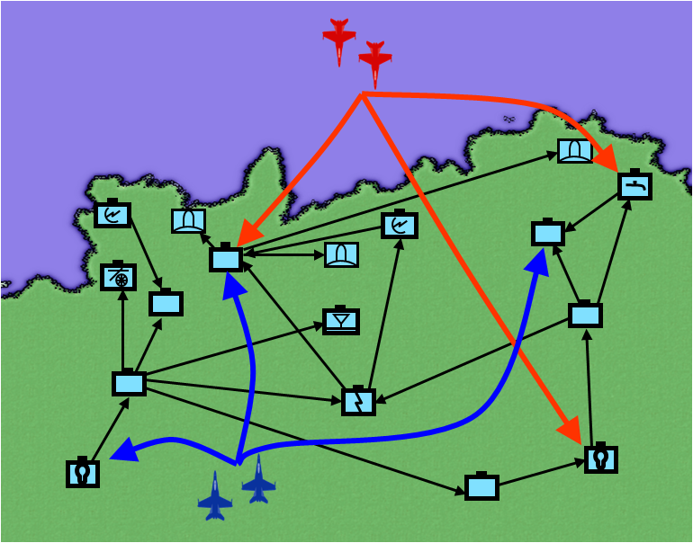
Pilot Decision Making
Evaluation of uncertainties with multi-criteria inluence diagrams
Kai Virtanen
Aalto U.
multiple
courses of actions
multiple
objectives,
preferences,
risk attitudes
uncertainty in
adversary
behavior
complex
system

Slide 19
DA methods are important
In practice behaviour and engagement is crucial
Decision analysis process creates
a social system

Slide 20
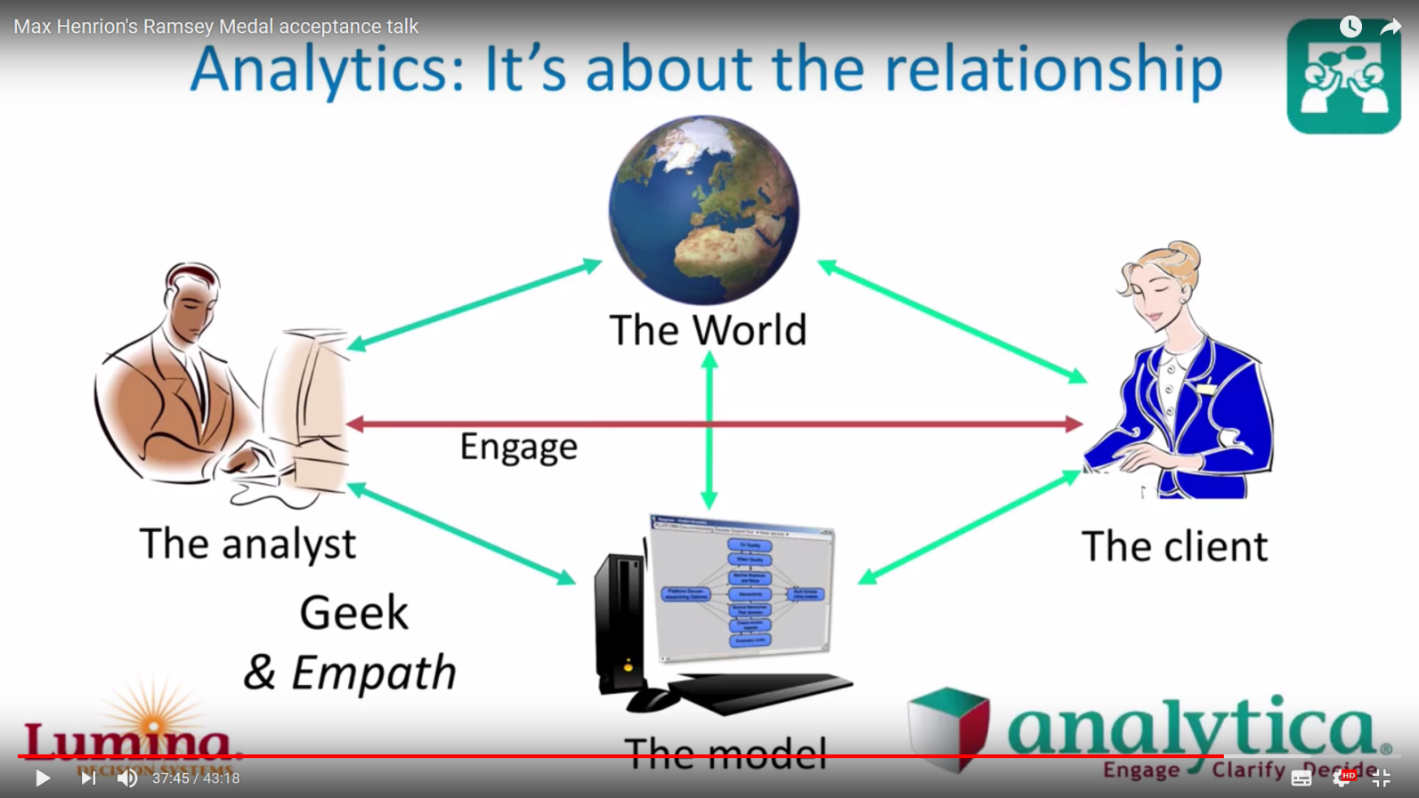
Screenshot of
Max Henrion´s Ramsey Medal Talk 2018

Slide 21
Screenshot of
Max Henrion´s Ramsey Medal Talk 2018
One who has the ability to sense emotions

Slide 22
Screenshot of
Max Henrion´s Ramsey Medal Talk 2018
One who has the ability to sense emotions
Social system

Slide 23
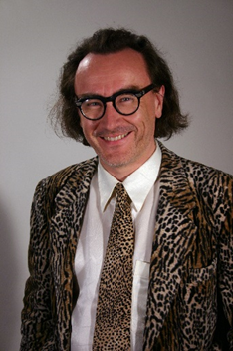
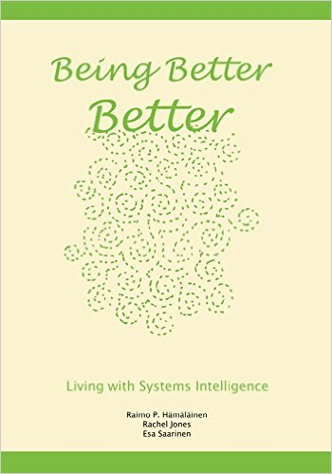
Systems Intelligence
``Intelligent behaviour in the context of complex systems involving interaction and feedback`` ( Saarinen and Hämäläinen 2004)
``Seeing oneself as being part of the overall system including both the technical and human elements``
Esa Saarinen
Aalto University
A core competence in the practice of decision analysis?
- behaviour , context, engagement , trust , biases
http://systemsintelligence.aalto.fi/

Slide 24
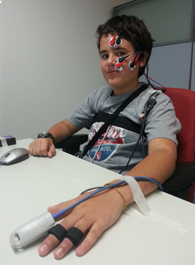
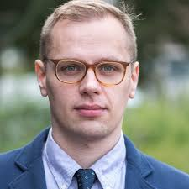
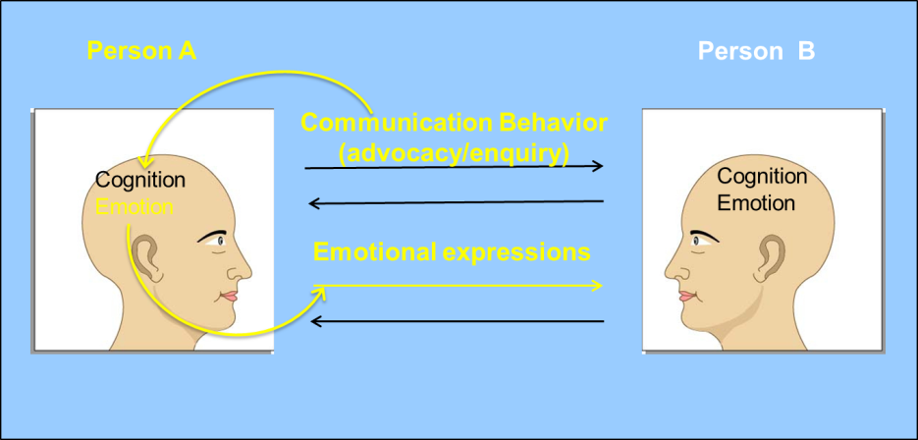
Emotions Play a Role in Decision Making
New measurement tools
- psycho-physiological
- brain imageing
How to take emotions into account in preference elicitation and decision support?
Impact of of communication
style
Ilkka Leppänen
Loughborough U.

Slide 25

Behavioral Operational Research
´´ The study of behavioral aspects related to the use of operations research methods in modeling, problem solving and
decision support´´
What is the impact of the OR modeller and facilitator on the outcome?
Concept introduced in 2013 by
Hämäläinen ,Saarinen Luoma

Slide 26




Behavioral Operational Research
Returning to the roots:
´´OR is not mathematics only´´
Growing active community
- EJOR Special Issue
- Streams in EURO and IFORS conferences
- EURO Working Group on Behavioural OR , 2017
- Workshops , Summer Schools
C. West Churchman
Russell L. Ackoff

Slide 27










The Future is in Our Students
Decision Analysis Seniors´ insights are highly valued
Thank You !
Herbert Moskowitz
Jeffrey M. Keisler
Ralph Keeney
Ramsey 1989
Theodor J. Stewart
Erin Baker
Benjamin Hobbs
James S. Dyer
Ramsey 2002
Robert T. Clemen
Ramsey 2012
Vicki Bier,
Ramsey 2016
Don Kleinmuntz
Ramsey 2011

