Slide 1
Systems Intelligence and Situational Awareness
Raimo P. Hämäläinen*, Kai Virtanen*’** and Heikki Mansikka*
*Systems Analysis Laboratory,
Aalto University, Finland
**Department of Military Technology,
National Defence University, Finland
Systems Analysis Laboratory

Slide 2
Themes
Systems in structured decision making
Team situational awareness
Systems in pilot performance
Artificial Intelligence systems
Systems Intelligence and leadership

Slide 3
Why Systems?
We live embedded in systems
Structures of interacting agents
The whole is more (or less) than the sum of its parts
Human performance often depends on systems
The future of military power is increasingly systemic
How can we act better in systems?

Slide 4
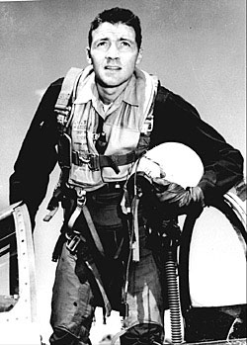
Pilot and U.S. Military Strategist John Boyd (1927-1997) A Systems Thinker
``All intelligent organisms and organizations undergo a continuous cycle of interaction with their environment``
Relevance in Air Power and Leadership today?

Slide 5
Structured Decision Making The OODA Loop
Observation: the collection of data
Orientation: the analysis and synthesis of data to form one's current mental perspective
Decision: the determination of a course of action based on one's current mental perspective
Action: the physical playing-out of decisions
Can be automatized when the situation is well defined
OO-Problems when the situation is unclear or ill-structured

Slide 6
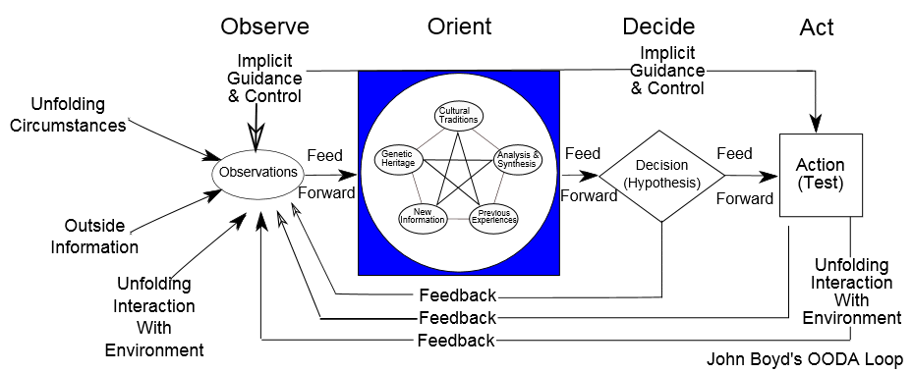
Observe-Orient-Decide-Act The OODA Loop
Picture by Patrick Edwin Moran

Slide 7
Observe-Orient-Decide-Act The OODA Loop
Picture by Patrick Edwin Moran

Slide 8
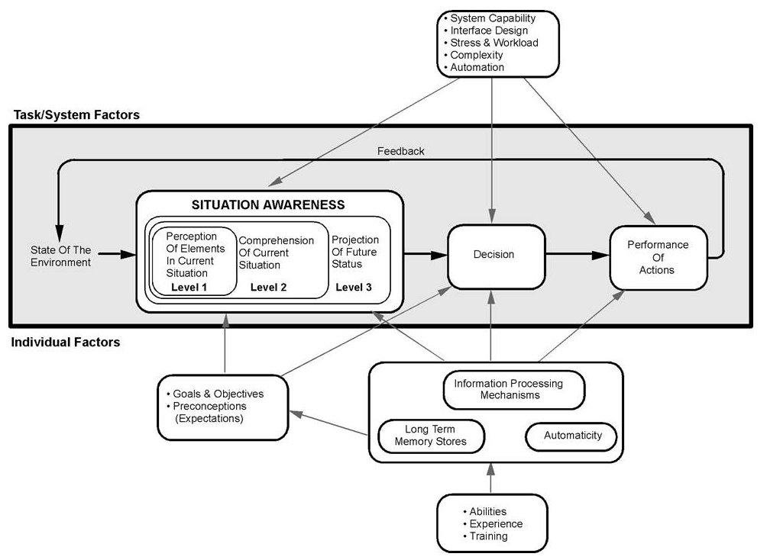
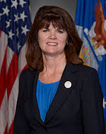
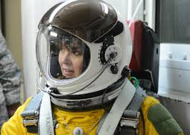
Situational Awareness (SA) in Decision Making Endsley 1995
Dr. Mica Endsley
Former Chief Scientist of the US. Air Force

Slide 9
Orientation and Mindset Determine What You Can Observe
The OODA Loop: Observations depend on situational awareness and mental model
Situational Awareness: Perception depends on goals and preconceptions
You do not see things if you do not know they exist
How to deal with Black Swans – Unknown Unknowns A problem in automated algorithmic warfare?
2007
2007

Slide 10
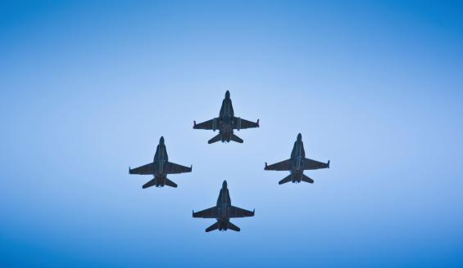
We Make Decisions in Teams: Team Situational Awareness
A team is a system with social dynamics related to
Communication
Attunement and coordination with others
Creation of trust
Team situational awareness:
Seeing oneself as a member of the team
Understanding that the mental models/situational awareness of others can differ
Creation of a shared mental model is essential
A 4-ship is a complex human-machine team
Team SA in air combat is still a research challenge

Slide 11
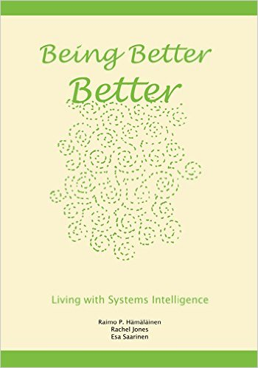
Systems Intelligence Saarinen and Hämäläinen 2004 http://systemsintelligence.aalto.fi/
``Intelligent behaviour in the context of complex systems involving interaction and feedback``
``Seeing oneself as being part of the overall system including both the technical and human elements``
``Understanding that structures can create behaviour``
`
`By considering the overall system one looks for intelligent ways of acting ``
Creating team SA in 4-ships is a realization of systems intelligence

Slide 12
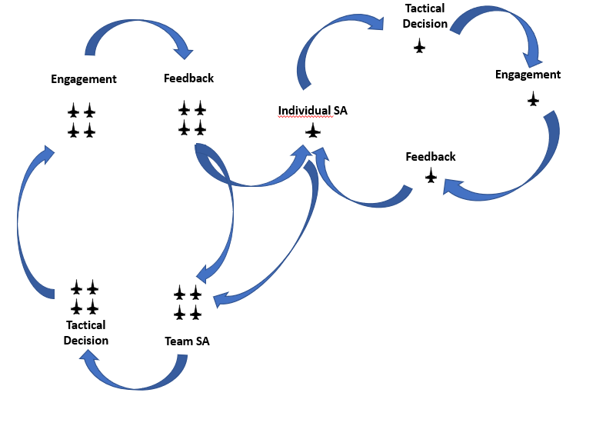
Research on Team SA of 4-ships in Air Combat Mansikka, Virtanen and Harris 2018b,c
Developement of Team SA measurement methodology
About 300 Team SA knowledge components identified

Slide 13
Systems Perspective on System Effectiveness Mansikka, Virtanen and Harris 2018a
In the human-machine system of a 4-ship,
the output is a function of pilots’
Performance
Situational awareness
Mental workload
All need to be considered when improving the human-machine output

Slide 14
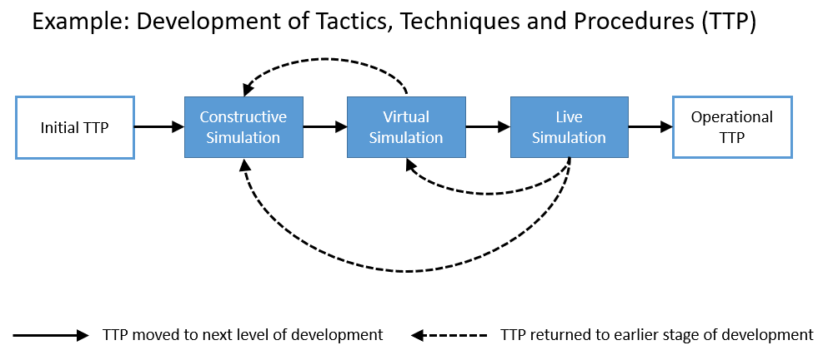
Development of System Effectiveness Mansikka, Virtanen, Harris and Salomäki 2018
Pilots’ performance, situational awareness and mental workload are considered in each phase of the development process

Slide 15
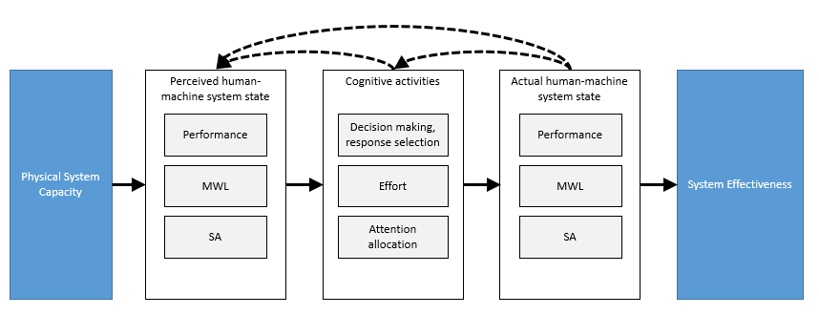
Understanding Human Elements in Human-Machine Systems
Ref.: Mansikka, Virtanen and Harris 2018c

Slide 16
Cognitive Challenges in Decision Making
Thinking Fast (System 1: Automatic Instinctive) and Slow ( System 2: Conscious Deliberating) (Stanovitch, Kahneman)
Decision theory is not enough to explain human choices
Bounded rationality (Simon)
Heuristics (Gigerenzer)
Prospect theory: Gains and Losses seen
differently (Kahneman and Tversky)
Cognitive biases
1 unit
Gain
1 unit
Loss

Slide 17
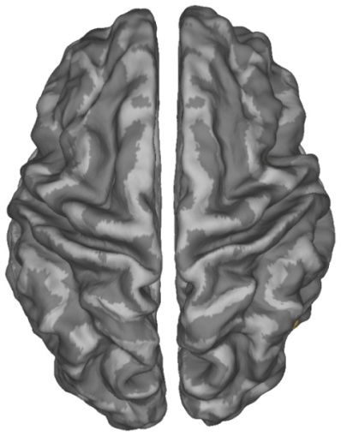
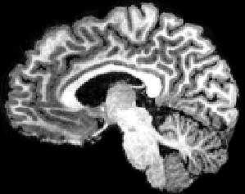
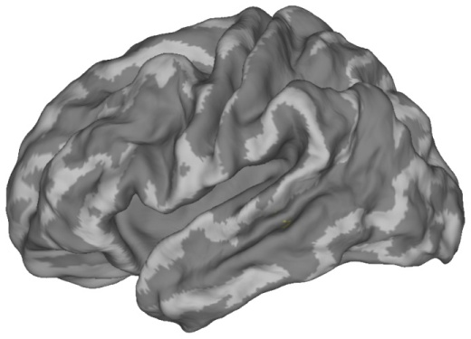
Decision Making is Not Logic Only
Emotional brain areas are needed in decision making
Brain imaging research on decision making – neuroeconomics:
In risk decisions both emotional and logical brain areas are activated

Slide 18
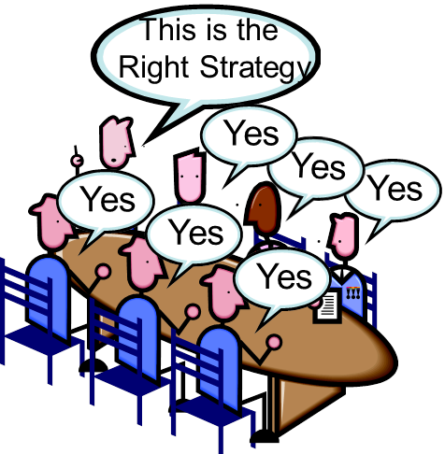
Cognitive Biases Related to SA
Anchoring: we are influenced by numbers or objects that we see first
Cognitive Dissonance: we try to believe in two incompatible things at the same time
Confirmation Bias: we interpret evidence to
support our prior beliefs
Group Think: strive to consensus without
critical evaluation of alternative viewpoints,
Risk when: Group is cohesive, external threats
Bay of Pigs, Janis 1972

Slide 19
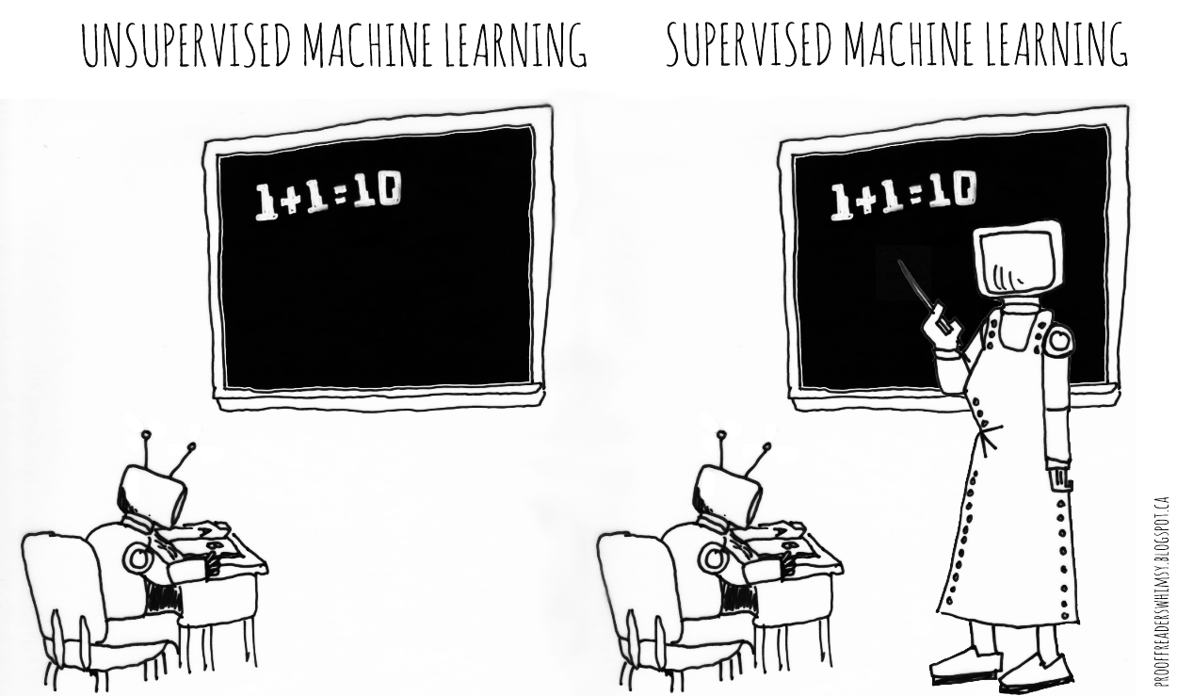
Cognitive Biases Can Enter Artificial Intelligence (AI) Systems Training data can be biased
Anchoring: Situational data used around a biased anchor
Cognitive Dissonance: Belief that the data used is representative of the situation
Confirmation Bias: The data worked
well in earlier situations
Data can be contaminated by enemy
Missing Black Swan data
Situational system awareness is needed
Picture by David Taylor

Slide 20
Situational Awareness in Leadership
Organizations are systems in which one solves problems
How one frames the system defines the problem and the solutions one can see
Situational Awareness needs System Awareness not only data
In leadership challenges relate to human interactions :
-Emotional Intelligence: ability to deal with emotions
-Systems Intelligence: ability to deal with systems including emotional systems

Slide 21
llll
Emotional Intelligence
Salovey and Mayer 1989, Goleman 1995
Perceiving emotions
Including the ability to identify one's own emotions
Using emotions
Understanding emotions
Managing emotions
You cannot prevent or eliminate emotions
but you can act intelligently with emotions
Emotional intelligence is suggested to be
a military leadership competence
2014

Slide 22
Systems Intelligence Saarinen and Hämäläinen 2004 http://systemsintelligence.aalto.fi/
Ability to see and understand systems
Looking for systemic leverage points
Understanding that structures can create behaviour
Ability to take efficient actions
Taking into account social systems
Embedding emotional intelligence
Active self-leadership
Is SI a core military leadership competence?

Slide 23
The SI Self Evaluation Test Some of the 32 questions
I quickly get a sense of what matters
I critically evaluate my ways of thinking
I view things from many different perspectives
I praise people for their achievements
I am willing to take advice
I successfully manage problematic situations
Questionnaire is available on the web: http://systemsintelligence.aalto.fi/

Slide 24
8 Factors of Systems Intelligence
Based on psychometric analysis
Törmänen, Hämäläinen and Saarinen 2016
Perceiving
Systemic Perception
Attunement
Attitude
Positive Attitude
Spirited Discovery
Thinking
Reflection
Wise Action
Acting
Positive Engagement
Effective Responsiveness

Slide 25
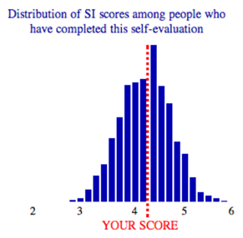
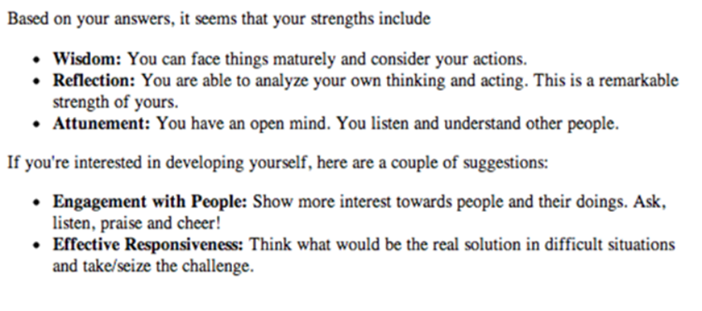
SI Results and Feedback
~ 3000 answers

Slide 26
Who is High in SI?
Gender: Little difference
Age improves your SI
Managers are higher in SI
Military?

Slide 27
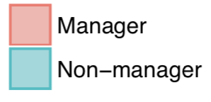
Managers Score Higher in all SI Factors
Especially in Systemic Perception, Spirited Discovery, Positive Engagement and Effective Responsiveness
UK or US residents, N=908

Slide 28
Top Organizations Score Higher in all SI Factors Employee rating of the performance of their organization: rated 0-8, rated 10

Slide 29
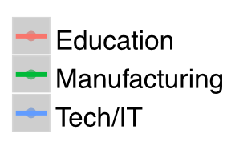
SI and Work Performance go Hand in Hand
Peer evaluation of a person’s work performance and SI by a colleague
Military?
Future research

Slide 30
Summary
Situational and System Awareness form the basis of decision making
SA and decision making are not data only but have a human component too
In leadership the human component is essential
Adopting the Systems Intelligence perspective can help in building and maintaining SA and in taking intelligent actions
More research on SI in military and in Air Power would be interesting

Slide 31
References
R.P. Hämäläinen and E. Saarinen, “Systems intelligence - The way forward? A note on Ackoff’s ‘why few organizations adopt systems thinking,’” Syst. Res. Behav. Sci., vol. 25, no. 6, pp. 821–825, 2008.
R.P. Hämäläinen, R. Jones, and E. Saarinen, ”Being Better Better - Living with Systems Intelligence,” Aalto University Publications, CROSSOVER 4/2014.
H. Mansikka, K. Virtanen, and D. Harris, “The dissociation between mental workload, performance and task awareness in pilots of high performance aircraft,” IEEE Transactions on Human-Machine Systems, accepted for publication, 2018a.
H. Mansikka, K. Virtanen, and D. Harris, “Team mental model measure for beyond-visual-range air intercepts,” manuscript, 2018b.
H. Mansikka, K. Virtanen, and D. Harris, “Relationship of team mental models, mental workload and performance during beyond-visual-range air intercepts,” manuscript, 2018c.
H. Mansikka, K. Virtanen, D. Harris, and J. Salomäki, “Live-virtual-constructive simulation framework for the development, testing and evaluation of air combat tactics, techniques and procedures,” manuscript, 2018.
E. Saarinen and R.P. Hämäläinen, “Systems Intelligence: Connecting engineering thinking with human sensitivity,” in Systems Intelligence - Discovering a Hidden Competence in Human Action and Organizational Life, Espoo, Finland: Helsinki University of Technol., pp. 1–29, 2004.
J. Törmänen, R.P. Hämäläinen, and E. Saarinen, “Systems intelligence inventory,” Learn. Organ., vol. 23, no. 4, pp. 218–231, 2016.

