Slide 1
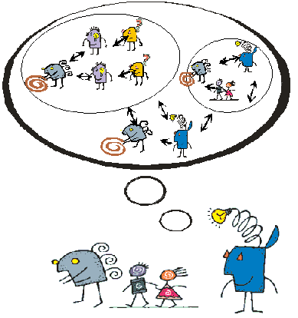
From Systems Thinking to Systems Intelligence
Raimo P. Hämäläinen
systemsintelligence.aalto.fi

Slide 2
Disciplines for coping with complexity
Systems Theory
Operation Research / Management Science /
OR - The “Science of Better”
Based on a systems thinking perspective
Social and human systems also important

Slide 3
Prof. Hans Blomberg’s licentiate seminar:

Slide 4
Systems Thinking
Emphasizes the importance of wholes and perspectives
Models systems of interaction from outside
Can become a trap when one only sees the system from outside and does not recognize herself being an active player in the system

Slide 5
Systems Thinking - the common understanding
Observes interdependencies and wholes
Views matters from different perspectives
Especially through the eyes of others (Churchman)
Becomes Systems Intelligence when a person takes active personal responsibility for her actions within the system

Slide 6
Systems Intelligence (Hämäläinen and Saarinen, 2004)
Intelligent behaviour in the context of complex systems involving interaction,dynamics and feedback
Combines human sensitivities with engineering thinking
Pursuing the idea of making things work better

Slide 7
Multiple Intelligences (Howard Gardner 1983)
Linguistic
Musical
Logical-Mathematical
Spatial
Bodily-Kinesthetic
Personal Intelligences – intra / inter
Plus higher-level cognitive capacities e.g. common sense and wisdom

Slide 8
SI and Multiple Intelligences
Systems Intelligence is another higher level cognitive capacity
SI links intelligence with the concept of system and systemic thinking
SI embedds Social and Emotional intelligence (Goleman 1995, 2006)
Systems Intelligence is a survival asset we have as a species

Slide 9
SI relates to
Systems Thinking
(Churchman 1968, Senge 1990,Checkland 1999,Jackson 2003)
Organizational theories and Action research
(Argylis, Schön , Schein ,Bohm 1980, Isaacs 1999)
Philosophy, Socratic tradition for thinking for good life
Positive psychology
(Bateson 2000, Goffman 1974, Seligman 2002)
Theories of decision making and problem solving
(Simon 1956, Keeney 1992, Kahneman, Tversky 2000)

Slide 10
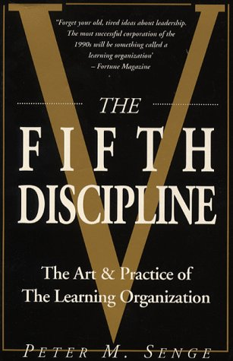
Organizational learning – The Fifth Discipline (Peter Senge 1990):
Personal Mastery
Mental Models
Shared Vision
Team Learning
Systems Thinking
Systems Intelligence is the link between
Personal Mastery and Systems Thinking.

Slide 11
Characteristics of systems
Whole is more than the sum of its parts
“Whole” and “Part” are relative abstractions
Always subject to redefinition by changing the perspective

Slide 12
Invisible system
We often perceive systems only through a mechanistic perspective
We see materials, products and costs
When people are considered:
the true system often includes hidden
subsystems
such as processes of trust or fear generation

Slide 13
Systems Theory and Systems Intelligence
A system is defined by identifying the system inputs i.e. control, intervention, decision or stimulus variables and system output variables i.e. the observed responses or reactions
The state of a system consists of the variables representing the elements in the system which determine its future behaviour
Systems can have many different state representations

Slide 14
How we see systems determines the model
Beliefs about needs and goals
Framing: costs or benefits
Boundaries: fixed or flexible
Alternatives: fixed or flexible
Values: fixed or evolving and constructed in the context.

Slide 15
Complexity
Well known parts – unknown interactions
control /
intervention
output /
observation
The interdependence of subsystems is unknown
Sometimes a minor intervention can trigger unexpected, chaotic or bifurcating responses in the system
The most essential part of the system may be one that was never intentionally built into it

Slide 16
Observability
The observability of subsystems
output/
observation/
measurement
control/
intervention
A system is observable if one can derive the values of all the states by a sufficiently long observation of the outputs
Without a sufficient set of observation (measurement) variables one can remain unaware of important active subsystems
You cannot manage systems which you do not see

Slide 17
Controllability
The controllability of subsystems
control/
intervention
output/
observation
A system is controllable if it can be driven to any state value by sufficiently rich controls
In addition to the seemingly controllable visible system there can be an uncontrollable subsystem – human or technical
You must have a sufficient set of inputs to cause an impact on all the states

Slide 18
Systems Intelligence
control/
intervention
output/
observation
Seeing the previously invisible parts
Systems Intelligent intervention
SI looks for ways to observe and address the invisible subsystems and interactions of emotions and beliefs
Without the management of the whole the structure starts to produce uncontrollable behaviour – we have systems dictatorship

Slide 19
Uncontrollability – System Dictatorship
The structure and limited input and observation variables can create a situation of uncontrollability – system dictatorship
Even if a system mainly consists of human agents the overall behaviour can be determined by the non-human elements and dynamic structures such as time delays and sequential communication patters (e.g. Beer Game, Senge 1990)
Systems Intelligence is aware of structures: even if all the agents try to do their best the resulting system response can be bad due to the structure

Slide 20
Systems can take over
People can get caught in systems that serve nobody’s interests
People can feel helpless regarding their possibilities of changing the system
People react to the system without seeing their effect on the whole

Slide 21
Thinking about thinking
Key to learning Systems Intelligence
One’s actions are a function of one’s thinking (mental models, beliefs, assumptions, interpretations, etc.)
Challenge my mental models by meta-level thinking regarding my own thinking

Slide 22
Systems Intelligence
Becomes a challenge for personal learning
Trusts that people can influence complex systems
The theoretical understanding of Systems Thinking need not increase Systems Intelligence

Slide 23
Managing the invisible
To understand the system, it can be more important to know what is not produced than what the standard output is
SI tries to understand both the visible and the invisible part

Slide 24
Perceptual and behavioural change
Seeing both the organizational/physical and the human parts
SI looks for productive inputs to impact both parts

Slide 25
Change in the system
People adjust to systems instinctively.
If a system is changed, people also change their behaviours. This leads to further change
A small change in my behaviour might trigger a chain of changes in the behaviours of others

Slide 26
5 step ladder of SI
Seeing oneself in the System – Ability to see ones roles and behaviour in the system. Also through the eyes of other people and with different framings of the system. Systems thinking awareness.
Thinking about Systems Intelligence – Ability to envision and identify productive ways of behaviour for oneself in the system and understanding systemic possibilities.
Managing Systems Intelligence – Ability to personally work with systems intelligence.
Sustaining Systems Intelligence – Ability to continue and foster systems intelligence in the long run .
Leadership with Systems Intelligence – Ability to initiate and create systems intelligence culture in one’s organization.

Slide 27
Ecological Systems Intelligence
Evolutionary processes exhibit a spontaneous emergence of co-operation generating superior overall behaviour for all the actors (Axelrod 1984, Gintis et al. 2003)
Human decision making does not follow the axioms of rationality assumed in economic theory.
Bounded rationality: choice behaviour strongly reflects the systemic decision environment
We can escape the Prisoner’s Dilemma: a deviation from local status quo is not possible by self-interested rationality
Can be interpreted as a manifestation of ecological Systems Intelligence?

Slide 28
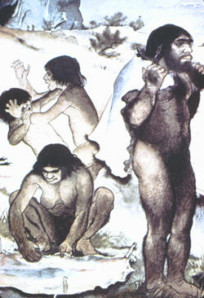
Evolution gave us SI
In experimental games :
People choose co-operative strategies with Systems Intelligence. They do not take everything for themselves.

Slide 29
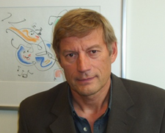
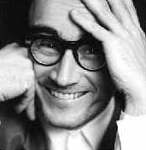
Systems Intelligence Research Group
Co-directors:
Professors
Raimo P. Hämäläinen, Systems Analysis Laboratory
Esa Saarinen, Laboratory of Work Psychology and Leadership

Slide 30
Downloadable articles and books on SI:
systemsintelligence.aalto.fi

Slide 31
References
Churchman C. West. 1968. The Systems Approach. New York, Delta
Gardner Howard. 1983. Frames of Mind: The Theory of Multiple Intelligences, Tenth anniversary edition. New York, Basic Books
Goleman Daniel. 1995. Emotional Intelligence, New York, Bantam Books
Goleman Daniel. 2006. Social Intelligence, London, Hutchinson
Goleman Daniel. 2009. Ecological Intelligence, Bantam
Hämäläinen Raimo P. and Saarinen Esa (Eds.). 2004b. Systems Intelligence - Discovering a Hidden Competence in Human Action and Organizational Life, Helsinki University of Technology, Systems Analysis Laboratory Research Reports, A88, October 2004
Jackson Michael C. 2000. Systems Approaches to Management, New York, Kluwer
Senge Peter. 1990. The Fifth Discipline: The Art and Practice of the Learning Organization, New York, Doubleday Currency

