Slide 1
Intrapersonal emotional responses to inquiry and advocacy
Ilkka Leppänenª
Raimo P. Hämäläinen^{b}
Esa Saarinen^{b}
Mikko Viinikainen^{b}
ªSchool of Business and Economics
Loughborough University, UK
^{b}Systems Analysis Laboratory
Aalto University, Finland

Slide 2
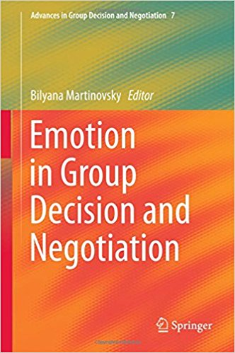
Emotions play an important role in negotiations
Increasing interest in the GDN community
Emotions also play a role in non face - to - face e-negotiation
Communication behaviour has
intrapersonal emotional effects
2015

Slide 3
Emotional expressions
Positive
Increase co-operation (e.g. Barsade 2002)
Broaden attention and increase cognitive flexibility (e.g. Fredrickson 2001)
Increase trust and willingness to implement the agreement (e.g. Mislin et al 2011)
Negative
Anger can elicit larger concessions but also retaliations (e.g. van Kleef at al 2004)

Slide 4
Emotions and Negotiations
Negotiatior A
Negotiatior B
Behaviour
Cognition
Emotion
Cognition
Emotion
Emotional expressions

Slide 5
Emotions and Negotiations
Negotiatior A
Negotiatior B
Communication
Behaviour
Cognition
Cognition
Emotion
Emotion
Emotional expressions

Slide 6
Inquiry
Communication modes of interest
Ask questions, be open, explore and show interest in other’s points of view
Advocacy
Assert, be narrow and aggressive, explain own points of view

Slide 7
Backgroud
Inquiry improves and is essential in dialoque and organizational learning (Argyris & Schön 1978, Senge 1990, Slotte & Hämäläinen 2015)
Inquiry an approach in Systems intelligence theory (Hämäläinen, Jones & Saarinen 2014, Törmänen, Hämäläinen & Saarinen 2016): positive engagements improve team performance
Balancing inquiry and advocacy can improve decision making by cognitive conflict (Schwenk 1990)

Slide 8
Our experiment
Emotional correlates of inquiry and advocacy
Psychophysiological measurements
Emotional expressions: Duchenne smile (genuine positive), non-Duchenne smile (non-genuine), furrowed brows (negative)
Emotional arousal: sympathetic ANS activation
Emotional empathy questionnaire

Slide 9
Our hypotheses
Inquiry elicits Duchenne smiles (positive)
Advocacy elicits furrowed brows (negative)
Emotional arousal level is different between inquiry and advocacy
Empathy is related to a high frequency of expressions and a high level of arousal

Slide 10
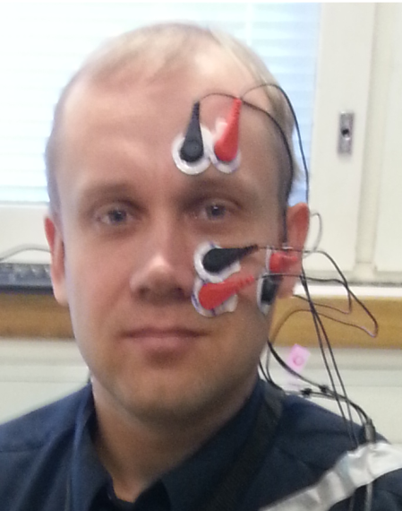
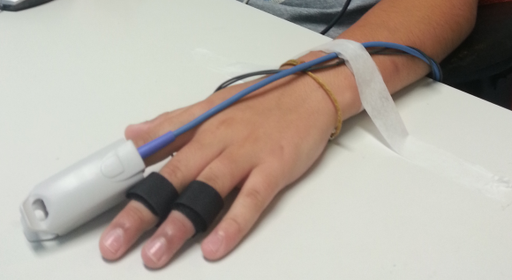
Psychophysiological measurements
Emotional expressions: electromyography (EMG) from 3 muscle regions on the left hemisphere of face
Emotional arousal: skin conductance response (SCR) from left hand fingers

Slide 11
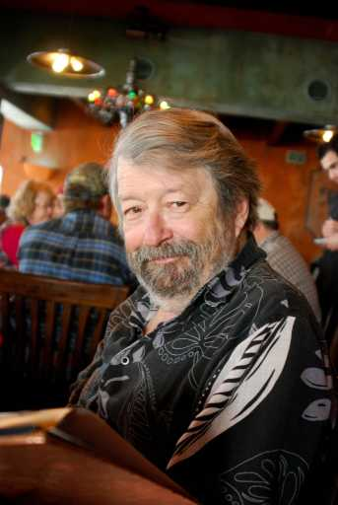
Setup
Inquiry: take an inquisitive approach on the statements of the persons shown on the screen
Advocacy: be critical and if possible, form objections to the statements of the persons shown on the screen
Dimly lit room
Comfortable chair
Stimulus shown on a computer screen
Hunting is a great hobby
We should abandon nuclear power

Slide 12
Stimuli and treatments
In each treatment the subjects are shown photographs with statements. This is the stimuli. Tasks:
Inquiry: view the stimuli in an inquiry mode (series of 26 stimuli)
Break 1 min
Advocacy: view the stimuli in an advocacy mode (series of same 26 stimuli)
Break 1 min
Neutral: view the stimuli in a neutral mode (series of same 26 stimuli)
Each stimulus shown for 18 s with 5 s breaks in between
Order of stimuli in the series randomized in each treatment
Order of inquiry/advocacy randomized for each subject, neutral treatment always last
Baseline measurement before the treatments, duration 5 min
Total measurement duration 38 min

Slide 13
Stimuli and treatments
26 photographs with statements
18 s
5 s
5 s
18 s
In randomized order in each treatment
baseline
(5 min)
inquiry (10 min)
advocacy (10 min)
neutral
(10 min)
randomized order

Slide 14
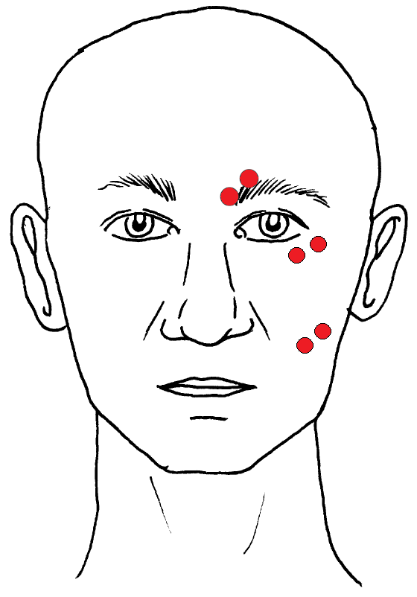
EMG electrode placements
A: Corrugator supercilii – contracts the eyebrow
B: Orbicularis oculi – wrinkles the eye
C: Zygomaticus major – raises the cheek
A
B
C

Slide 15
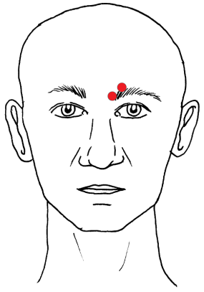
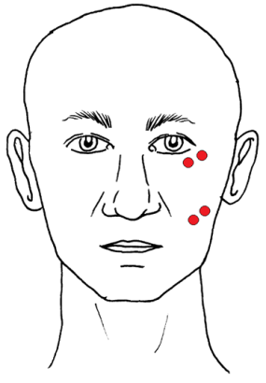
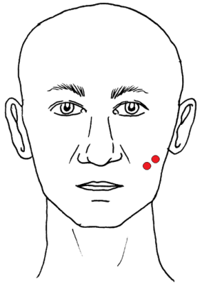
Furrowed brow: only corrugator active in a bin
Duchenne smile: orbicularis and zygomaticus active in a bin
Non-duchenne: only zygomaticus active in a bin

Slide 16
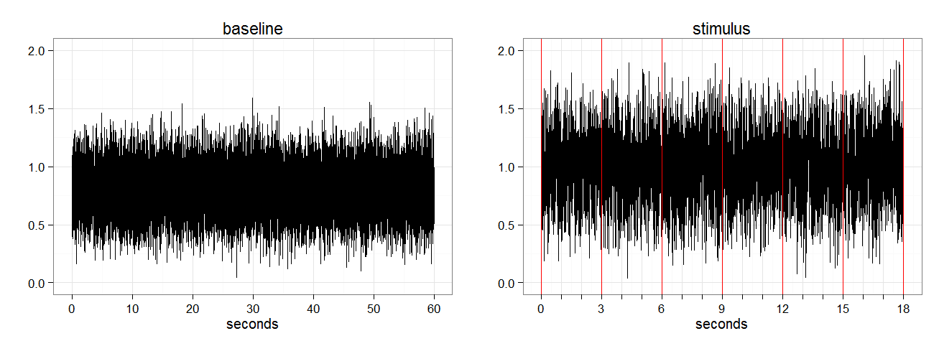
EMG score processing
2048-Hz signal filtered to 90-200 Hz, smoothed, logarithmized
Signal during stimulus averaged into 3 s bins
Bin scored active if bin mean > baseline mean
Bin count = sum of active bins

Slide 17
SCR score processing
SCR has 2 components: tonic and phasic
Phasic is of interest, corresponds to sudomotor nerve firing at ≈ .62 Hz
128-Hz signal down-sampled by half and smoothed, deconvoluted to extract the phasic component, integrated in a 17 s window and logarithmized => ISCR score
Benedek & Kaernbach (2010)
www.Ledalab.de (Matlab add-on)

Slide 18
Emotional empathy questionnaire
Mehrabian & Epstein (1972)
Empathy: sharing the emotional experience of others
Before the experiment, 33 item questionnaire
“I makes me sad to see a lonely stranger in a group”
“Some songs make me happy”
=> Empathy score 0 – 100

Slide 19
Subjects
N = 40, M_{age} = 34.6, 22—61 years
Exclusions from data-analysis:
7 excluded because they failed to understand task (post-experiment questionnaire)
6 excluded from SCR analysis because they did not show the signal

Slide 20
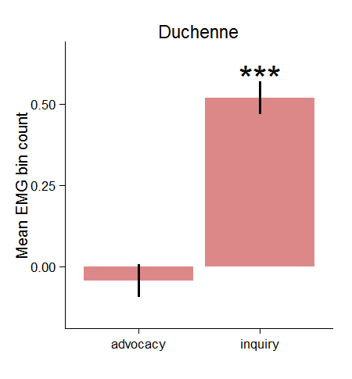
Duchenne smiles in inquiry
Linear mixed models (LMM) with subjects as random effects
Treatments as deviation coded contrasts
Ref. treatment (neutral) level not shown, moved to zero
Error bars = SEM

Slide 21
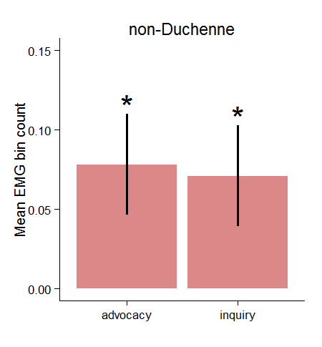
Non-Duchennes in both inquiry and advocacy
The difference between inquiry and advocacy is not significant (LMM, p = .79)
=> The non-Duchenne smile is not differentially activated in inquiry and advocacy

Slide 22
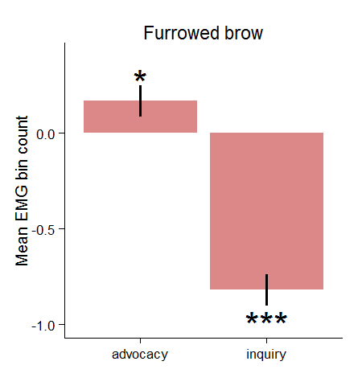
Furrowed brows show reciprocal effect
More furrowed brows in advocacy
Less furrowed brows in inquiry
This is a known pattern of corrugator activation (Larsen et al. 2003)

Slide 23
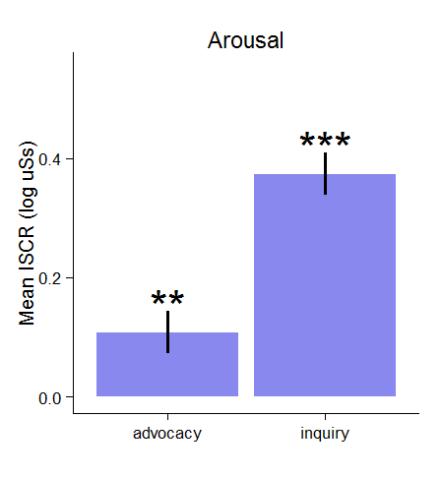
Arousal in both inquiry and advocacy
Arousal is significantly higher in inquiry than in advocacy (LMM, p < .0001)
Is arousal only related to the smiles?

Slide 24
Empathy is related to Duchennes
Subjects with higher empathy scores express more Duchenne smiles (p = .014)
Others expressions or arousal are not significantly related to empathy

Slide 25
Summary of results
First study on the intrapersonal psychophysiological correlates of inquiry and advocacy modes of interaction
Inquiry elicits positive emotions (Duchenne smiles) and advocacy elicits negative emotions (furrowed brows)
Emotional arousal is higher in inquiry than in advocacy and related to positive emotions
More empathetic subjects have more positive emotions

Slide 26
Conclusions
Communication mode triggers intrapersonal emotional responses
Essential to realize in negotiations
Inquiry can be used intentionally to generate positive emotional expressions
Unintentional responses can create problems
Psychophysiological measurements and new two person brain imaging methods have potential for GDN research

Slide 27
Future research
Psychophysiological correlates of inquiry and advocacy in interactive situations:
Interactive encounters; groups, negotiations
Decision making
Trust and cooperation
Role of empathy ?

Slide 28
References
Argyris, C., & Schön, D.A. (1978). Organizational Learning: A Theory of Action Perspective, Addison-Wesley.
Barsade, S. (2002). The ripple effect: Emotional contagion and its influence on group behavior. Administrative Science Quarterly 47, 644–675.
Benedek, M., & Kaernbach, C. (2010). A continuous measure of phasic electrodermal activity. Journal of Neuroscience Methods 190, 80 – 91.
Hämäläinen, R.P., Jones, R., & Saarinen, E. (2014). Being Better Better – Living with Systems Intelligence. Aalto University Publications, CROSSOVER 4/2014.
Larsen, J.T., Norris, C.J., & Cacioppo, J.T. (2003). Effects of positive and negative affect on electromyographic activity over zygomaticus major and corrugator supercilii. Psychophysiology 40, 776 – 785.
Mehrabian, A. & Epstein, N. (1972). A measure of emotional empathy. Journal of Personality 40, 525 – 543.
Mislin, A.A., Campagna, R.L. & Bottom, W.P. (2011). After the deal: Talk, trust building and the implementation of negotiated agreements. Organizational Behavior and Human Decision Processes 115, 55--68.

Slide 29
References
Schweiger, D.M., Sandberg, W.R., & Rechner, P.L. (1989). Experiential effects of dialectical inquiry, devil’s advocacy, and consensus approaches to strategic decision making. Academy of Management Journal 32, 745 – 772.
Schwenk, C.R. (1990). Effects of devil’s advocacy and dialectical inquiry on decision making: A meta-analysis. Organizational Behavior and Human Decision Processes 47, 161 – 176.
Senge, P. (1990). The Fifth Discipline: The Art & Practice of The Learning Organization, Random House.
Slotte, S., & Hämäläinen, R.P. (2015). Decision Structuring Dialogue. EURO Journal on Decision Processes 3, 141 -- 159.
Törmänen, J., Hämäläinen, R.P., & Saarinen, E. (2016). Systems intelligence inventory. The Learning Organization, 23, 218–231.
Valacich, J.S., & Schwenk, C. (1995). Devil’s advocacy and dialectical inquiry effects on face-to-face and computer mediated group decision making. Organizational Behavior and Human Decision Processes 63, 158–173.
Van Kleef, G.A., De Dreu, C.K.W., & Manstead, A.S.R. (2004). The interpersonal effects of anger and happiness in negotiations. Journal of Personality and Social Psychology 86, 57–76.

