Slide 1


On the NEED for behavioral operations research
Raimo P. Hämäläinen
Systems Analysis Laboratory
Aalto University, School of Science
Co-authors: Jukka Luoma and Esa Saarinen

Slide 2
Behavioral Operations Research
The study of behavioral aspects
related to the use of
operations research methods
in modeling, problem solving and
decision support

Slide 3
Behavioral research
How people behave in different settings?
What are the consequences of humans being involved?
Research methods: experimental and qualitative
What is the human impact on the OR process?

Slide 4
Operations Research
The Science of Better
“Scientific methods to improve the effectiveness of operations and systems to make better decisions”
Scientific methods:
Modeling, data analysis, optimization etc.

Slide 5
What is essential in our profession?
The pioneers West Churchman and Russel Achoff:
OR is not mathematics only

Slide 6
Goal to help people in problem solving
but
Have we omitted the people,
the problem owners and the OR experts,
from the analysis?

Slide 7
Methods and problem solving
Theory and algorithms are free of behavioral effects
but
as soon as we use them in real life problem solving behavioral effect will be present.

Slide 8
Model validity The lure of objectivity
Model validity discussed a lot in early OR
There exists one ideal model and a good OR specialist needs to find it.
Hidden assumption:
A valid model automatically produces a valid process and bias free objective results

Slide 9
Best practices in OR Acknowledgement of subjectivity
Focus on the OR process
Based on successful of case studies
First steps towards behavioral OR
So far, no behavioral research
How do the best practices compare against each other? Can different processes lead to different outcomes? What are the benefits to the client?

Slide 10
Soft OR and Systems Thinking
Criticized OR for being too narrowly concerned with mathematical models only
New qualitative methods for framing and structuring
Attention to the sociology and philosophy of modeling
Has remained mainly methodology and tool focused with limited behavioral research

Slide 11
Some areas of OR have a tradition in behavioral studies

Slide 12
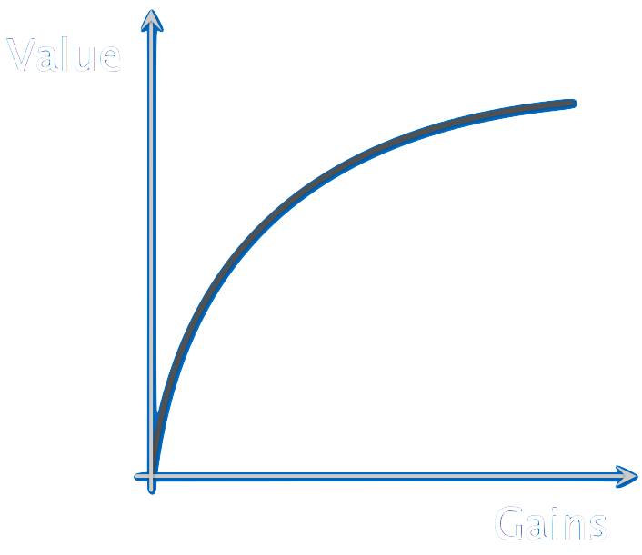
Decision and Risk Analysis
Subjectivity is explicitly taken into account
Value and utility functions to describe preferences
Risk attitudes seeking/averse
Multicriteria evaluation of alternatives with subjective weighting
Research on biases and
risk perceptions

Slide 13
Operations Management
Studies how people act in complex decision settings
Judgemental forecasting
Behavioural operations conference series started in 2006
The Bullwhip effect in Supply chains - Beer game
Delay
Factory
Delay
Distributor
Delay
Wholesaler
Delay
Retailer

Slide 14
Interest in behavioral issues emerges when the basic theoretical core of a discipline has matured

Slide 15
Behavioral finance and economics
What is the actual behavior of agents in economic decision making?
How do people make personal investment decisions?
Active research area acknowledged also by theoretical economists
Nobel price 2002 in economics to Vernon Smith together with Daniel Kahneman

Slide 16
Embracing the behavioral perspective in economics helps:
“in generating theoretical insights, making better predictions, and suggesting better policy”
(Colin Camerer et al., 2004)
If this is true for economics it surely applies to OR as well

Slide 17
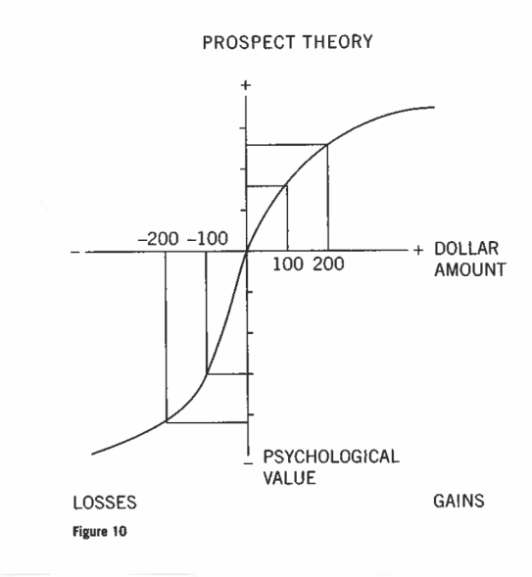
Judgement and Decision making
Decision theory is not enough to explain human choices
Axioms of rationality not followed
Bounded rationality (Herbert Simon)
Prospect theory: gains and
losses seen differently (Daniel
Kahneman and Amos Tversky)
Cognitive biases
Heuristics (Gerd Gigerenzer)
From: Kahneman and Tversky

Slide 18
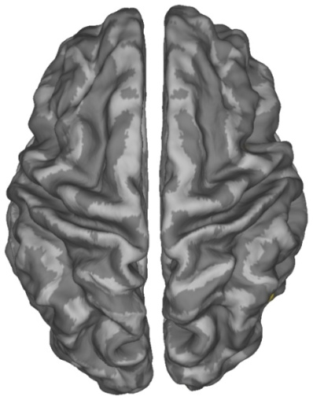
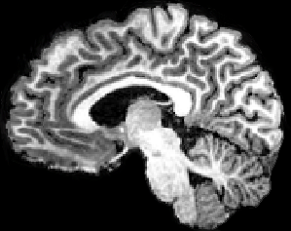
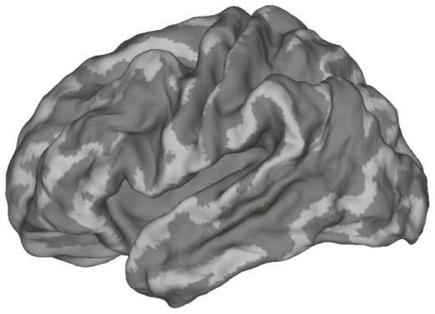
From behavioral to neural
Emotions are needed in decision making
Somatic marker hypothesis (Antonio Damasio)
Brain imaging research on decision making – neuroeconomics
How do we evaluate risks - What brain areas are activated in risk decisions

Slide 19



Experimental Game Theory
How do people interact?
Ultimatum game
The receiver should accept 1 €, 50% reject offers < 20 €
Strong tendency towards co-operative behaviour
Typically fair offers near 50 euros
Research on reciprocity and fairness
Practical implications on auctions?
Split 100 €
Offer x €
100-x € if accept x €
0 € if reject 0 €

Slide 20
OR is a mature discipline
We are ready to start the behavioral era!
It is natural to pay attention to how
human behavior moderates the OR process

Slide 21
OR process creates a system
Formed by the interaction of the client and the OR analyst – usually a team
The client and the analyst are subject to behavioral effects
The OR analyst needs to observe and understand this system to improve its performance
A key to good practice
Use Systems Intelligence i.e. your ability to successfully and engage with systems (Saarinen and Hämäläinen, 2004)

Slide 22
Social group processes in OR facilitation
This is the
right model
Groupthink – overconfidence (Irving Janis)
Strategic behavior by analyst
and stakeholders
Hidden agendas in modeling:
omission of factors and adverse
selection of data
Gender and cultural effects
Facilitator styles, personality etc.
Yes
Yes
Yes
Yes
Yes
Yes

Slide 23
Problem solving processes
What is the main intended result - learning or optimizing?
What are the criteria used -optimizing or satisficing?
How to facilitate when rationality cannot be enforced?
Human behavior can seem irrational – intransitive preferences, bounded rationality and path dependence

Slide 24
Research challenge
Comparative experimental research on problem solving and structuring is very difficult
Real problems can seldom be approached repeatedly
with the real decision makers
Experiments with students a good first step

Slide 25
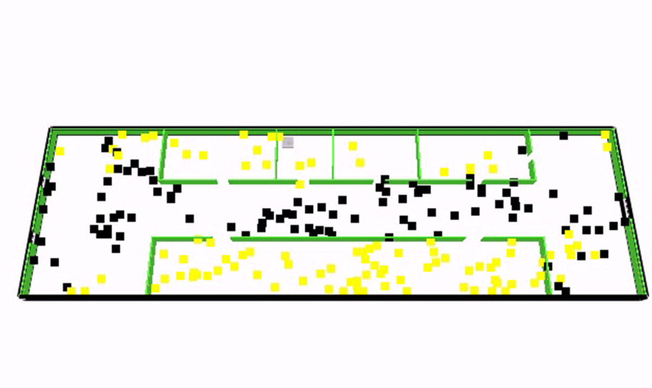

OR models of people behavior
People in the loop models – pilots, operators etc.
People behavior in service systems: queuing and waiting for service
Crowd behavior in emergency situations – Evacuation in fires, festivals
(From: Ehtamo et al)

Slide 26
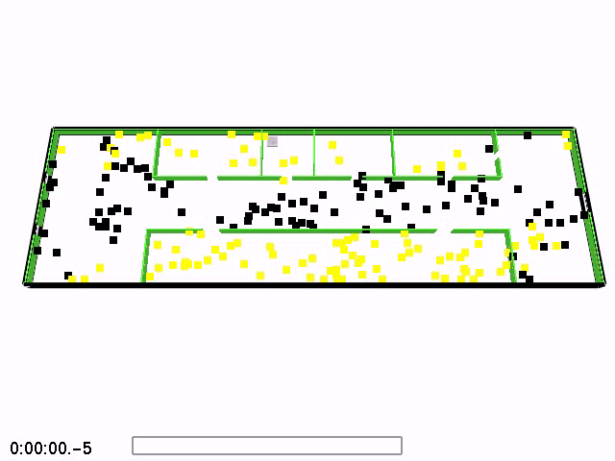

Slide 27
OR models of people behavior
People in the loop models – pilots, operators etc.
People behavior in service systems: queuing and waiting for service
Crowd behavior in emergency situations – Evacuation in fires, festivals
(From: Ehtamo et al)

Slide 28
We are subject to cognitive biases
Appeal to Authority: we tend to thoughtlessly obey those (modeling traditions) we regard as being in positions of authority
Beauty Effect: we attribute qualities to people (models) based on their appearance
Cognitive Dissonance: the effect of simultaneously trying to believe in two incompatible things (model/real world) at the same time
Commitment Bias: once we are publicly committed ourselves to a position (model) we find it difficult to retreat

Slide 29
Confirmation Bias: we interpret evidence to support our prior beliefs (models)
Fundamental Attribution Error: we attribute success to our own skill (model) and failure to everyone else's skill (rivaling models)
Inter-group Bias: we evaluate people within our own group (modelling tradition) more favorably than those outside of it
Loss Aversion: we do stupid things to avoid realizing a loss (acknowledging failure of our modelling)

Slide 30
Man With A Hammer Syndrome: some people have a single tool (model) and see every problem as a nail
Overconfidence: we're way too confident in our abilities (models)
Priming: exposure to some event (modelling approach) changes our response to a later event (problem needing another model)
Representative Heuristic: we compare the under consideration (modelling approach) to whatever we happen to bring to mind

Slide 31
Behavioral studies in OR aim to find ways to reveal and avoid cognitive biases in the OR process

Slide 32
Framing
Increasingly important when moving from optimization to solving people related problems
Behavioral elements are strong
Definition of system boundaries and stakeholders
Stakeholders have different perspectives and mental models
Creating a common language
A key step in many environmental problems

Slide 33
Model building
Usefulness of simple versus complex models
How to build models to maximize learning
Anchoring effect in selecting model scale and reference point
Are prospect theory related phenomena relevant when choosing the sign (increasing/decreasing) of variables

Slide 34
Communication with and about models
Visual representation of system models are essential in communication
Effects of graphs and scales used
What is the effect of educational and cultural backgrounds of the problem owners
What can we learn from statistics?
Is software development based on behavioral studies?

Slide 35
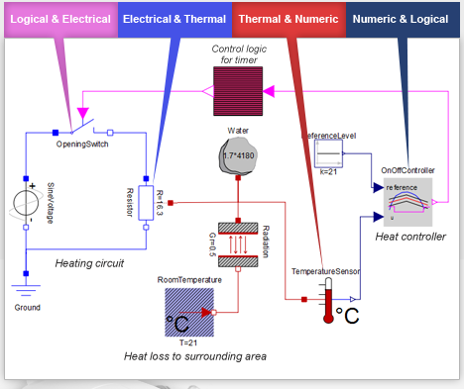
Effect of Graphical Interfaces and
Example:Simulation

Slide 36
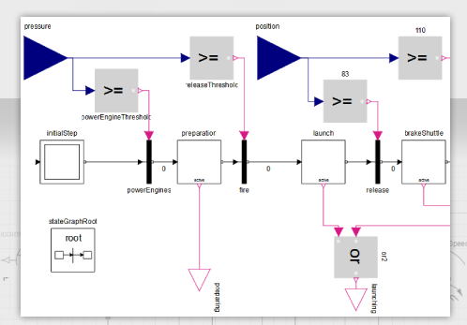
Mathematica System Modeler

Slide 37
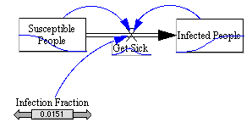
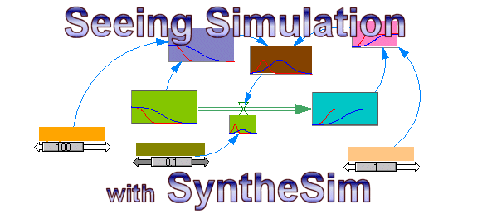
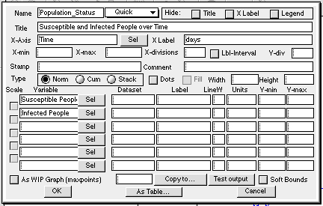
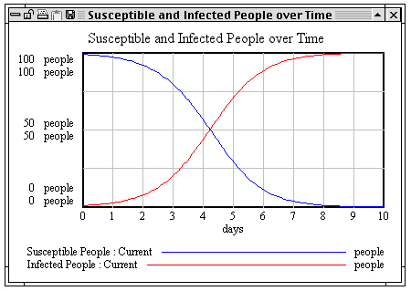
Vensim

Slide 38
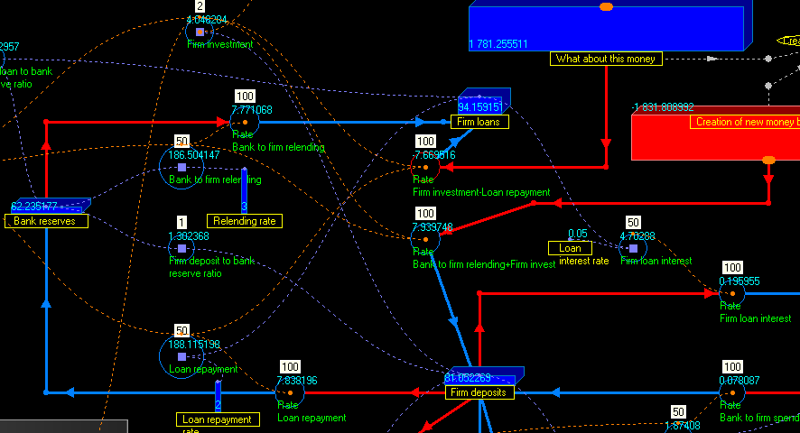
True

Slide 39
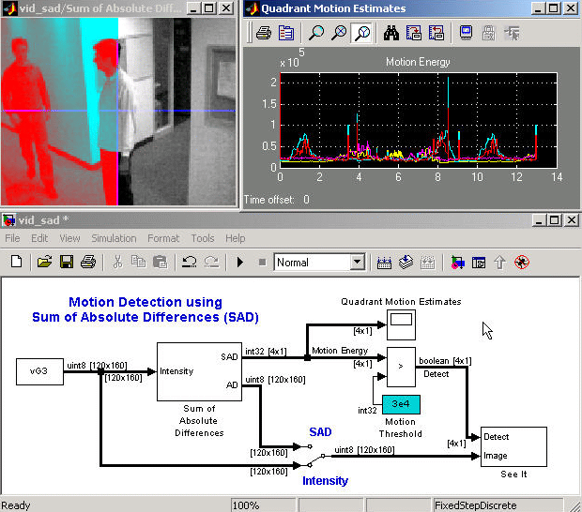
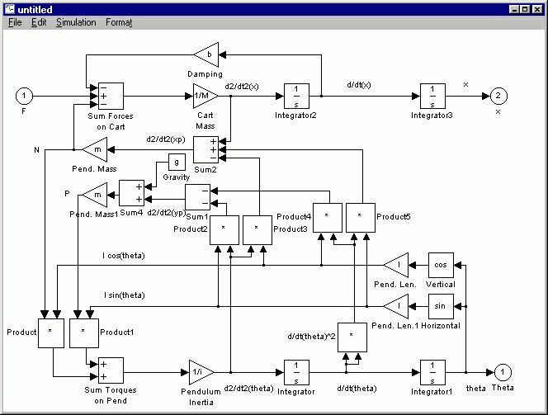
Matlab Simulink

Slide 40
Behavioral research topics in OR Teaching of OR
Balance between methods and people skills
Should every OR student learn behavioral issues?
How to teach best practices?
Developing facilitation and systems intelligence skills
Role of software

Slide 41
Ethics and OR
Ethical OR takes behavioral challenges seriously
OR is used in the most important problems of mankind – climate models and policies
Unintentional biases in model use
Are we really solving the problem or selling our model?
How to improve self leadership skills in OR practice

Slide 42
Non-expert use of OR methods
Modelling is a tool used in many fields
Easy OR software invites non-experts
What is the result?
What are the typical pitfalls and risks?
Who should supervise the use of OR models?
Is quick learning of the OR process possible?
Collaboration between experts and non-experts

Slide 43
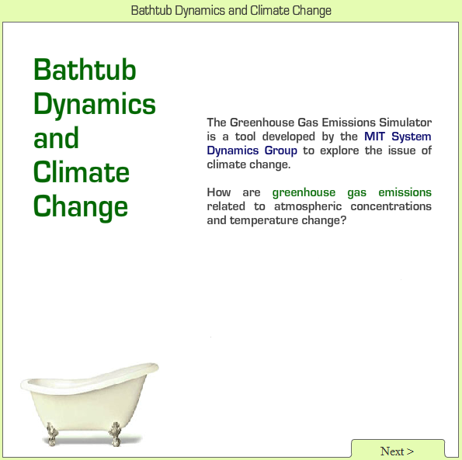
Example Behavioral studies in system dynamics
Understanding dynamics in climate
change is important in modern world
(John Sterman, MIT)

Slide 44
Why don’t well-educated adults understand accumulation? A challenge to researchers, educators and citizens Cronin, Gonzalez, Sterman (2009)
Accumulation refers to the growth of a stock variable when the inflow exceeds the rate of outflow
Carbon dioxide in the atmosphere, Balance of bank accounts, Milk in the refrigerator etc.
Experiments with the Department store task with MIT students

Slide 45
People entering and leaving the department store
entering
leaving

Slide 46
During which minute did the most people enter the store?
entering
leaving

Slide 47
During which minute did the most people enter the store? 96% correct answers
entering
leaving

Slide 48
During which minute were the most people in the store?
entering
leaving

Slide 49
During which minute were the most people in the store? 44% correct
entering
leaving

Slide 50
During which minute were the fewest people in the store? 31% correct
entering
leaving
Wrong
Wrong
Correct

Slide 51
Easy to adopt a misleading starting frame
General stock and flow system – try the general procedure and integrate the difference between the inflow and the outflow
The department store task is a simple special case
Computation is not required
Observe the fact that the inflow and outflow curves intersect only once
The correct answer is obvious

Slide 52
Behavioural problems
False cues which mislead the participants
Questions do not address accumulation directly
Shapes of the curves trigger inappropriate heuristics
Availability heuristic: maximum, inflow and outflow stand out
“Cannot be determined,” box primes to think the task is very difficult

Slide 53
Re-examining the experiment Aalto University students in Finland
Repetition of MIT procedure
Similar results
Revised questionnaire
Smoother curves to reduce the impact of availability heuristic
Added questions asking about the accumulation phenomenon directly

Slide 54
Revised smoother curves
entering
leaving

Slide 55
Almost all of the participants were able to understand accumulation
“During which minute were the most people in the store?” (88-90% correct – originally 44%)
“During which minute were there the fewest people in the store?” (72 - 76% correct – originally 31%)
People’s poor performance in the department store task does not reflect the existence of a new cognitive bias as suggested by Cronin et al.

Slide 56
Lesson learnt
Even the simple accumulation phenomenon can be misunderstood in the presence of distacting triggers of biases
Extreme care needed when communicating about systems and models

Slide 57
Summary
Behavioral aspects influence the OR process
Framing, biases, communication, learning, group processes
The practice of OR can be improved by behavioral research
Using the term Behavioral OR will stimulate research
Behavioral OR needs to be recognized as an integral part of OR
Behavioral OR could take a leading role in advancing the responsible use of models in policy issues
A mature field like OR becomes stronger with behavioral research

Slide 58
Developing practitioner skills with a behavioral lens will keep
OR alive and interesting
for our customers and the society at large
Thank you!

Slide 59
References and links
Presentation based on paper:
R.P. Hämäläinen, J. Luoma and E. Saarinen: On the Importance of Behavioral Operational Research: The Case of Understanding and Communicating about Dynamic System, European Journal of Operational Research 2013, Vol. 228, Issue 3, pp. 623-634.
References:
R.L. Ackoff: Some unsolved problems in problem solving. Operational Research Quarterly, 13:1-11, 1962
C.F. Camerer and G. Loewenstein: Behavioral economics: Past, Present Future in: C.F. Camerer, G. Loewenstein, M. Rabin: Advances in Behavioral Economics, Princeton University Press, pp. 3-51. 2004.
C.W. Churchman: Operations research as a profession. Management Science, 1970, 17(2), B37-B-53.
M.A. Cronin, C. Gonzalez and J.D. Sterman: Why don’t well-educated adults understand accumulation? A challenge to researchers, educators, and citizens. Organizational Behavior and Human Decision Processes, 2009, 108(1), 116-130.
A.R. Damasio: Descartes' Error: Emotion, Reason, and the Human Brain, London, Vintage,1994.
H. Ehtamo, S. Heliövaara, T. Korhonen and S. Hostikka: Game Theoretic Best-Response Dynamics for Evacuees' Exit Selection Advances in Complex Systems, 2010, 13(1), 113-134. G. Gigerenzer, P.M. Todd and the ABC Group: Simple heuristics that make us smart, New York: Oxford University Press, 1999.
R.P. Hämäläinen and E. Saarinen: Systems intelligence - the way forward? A note on Ackoff’s “Why few organizations adopt systems thinking.” Systems Research and Behavioral Science, 2008, 25(6), 821-825.

Slide 60
I. Janis: Groupthink: Psychological Studies of Policy Decisions and Fiascoes , Wadsworth, USA,1982.
I. P. Levin, S.L. Schneider and G.J. Gaeth: All Frames Are Not Created Equal: A Typology and Critical Analysis of Framing Effects,. Organizational Behavior and Human Decision Processes, 1998, 76(2), 149-188.
J. Luoma, R.P. Hämäläinen and E. Saarinen: Acting with systems intelligence: integrating complex responsive processes with the systems perspective. Journal of the Operational Research Society, 2010, 62(1), 3-11.
E. Saarinen and R.P. Hämäläinen: Systems Intelligence: Connecting Engineering Thinking with Human Sensitivity. Systems Intelligence: Discovering a Hidden Competence in Human Action and Organizational Life, Systems Analysis Laboratory Research Reports. Helsinki University of Technology, 2004.
H. Simon: Models of Bounded Rationality, Vol. 1. MIT Press, 502 pp,1997.
J.D. Sterman: Modeling Managerial Behavior: Misperceptions of Feedback in a Dynamic Decision Making Experiment. Management Science, 1989, 35(3), 321-339.
J.D. Sterman: Economics: Risk Communication on Climate: Mental Models and Mass Balance. Science, 2008, 322(5901), 532-533.
D. von Winterfeldt and W. Edwards: Decision analysis and behavioral research (Vol. 1),1986, Cambridge University Press.
Systems Intelligence Research Group
www.systemsintelligence.tkk.fi/

