Slide 1
Bayesian networks for comprehensive scenario analysis of nuclear waste repositories
Edoardo Tosoni^{a,b}, Ahti Saloª, Enrico Zio^{b,c}
Systems Analysis Laboratory, Dept of Mathematics and Systems Analysis - Aalto University
Laboratory of signal and risk analysis, Dipartimento di Energia - Politecnico di Milano
Chair on Systems Science and the Energetic Challenge - École Centrale Paris and Supelec
June 21, 2017

Slide 2
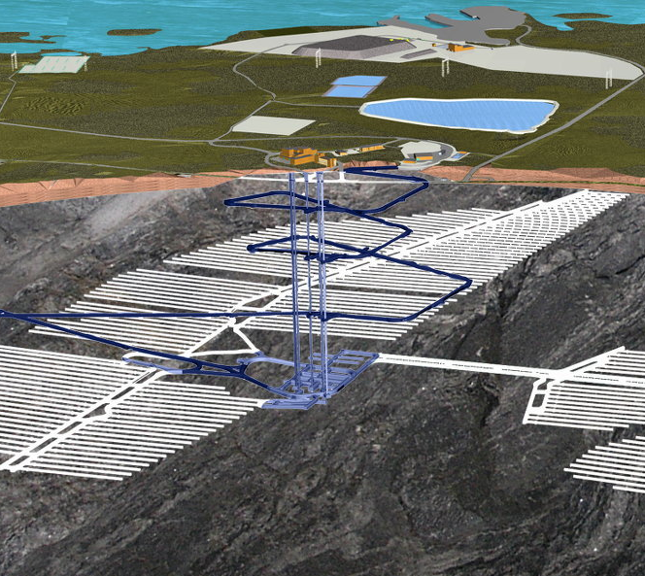
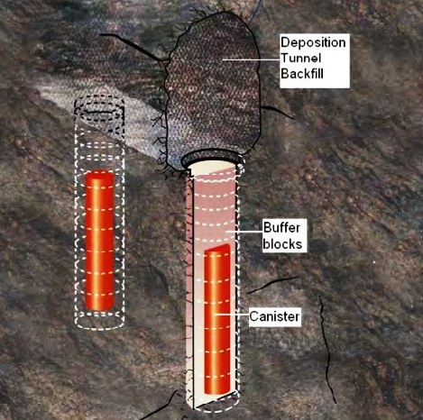
Scenario analysis of nuclear waste repository
Deep geological disposal of nuclear waste
Performance Assessment:
Many physical and chemical phenomena interacting
Long time horizon (10,000 – 1,000,000 years)
Large aleatory uncertainty about the evolution of the disposal system
Scenario 1
?
Scenario Analysis
Safety
Scenario 2
Scenario ...
Scenario n

Slide 3
Challenges in scenario analysis
Review of methodologies for Scenario Analysis of nuclear waste repositories
Very few repositories licensed to date
Challenges:
1
Building a system model to guide scenario development
Bayesian network (BN) of the disposal system
Algorithm to select which simulations to run for analyzing scenarios
2
Ensuring comprehensiveness
Conservative aggregation of multiple experts’ beliefs on probabilities in the BN
3
Treating the epistemic uncertainties

Slide 4
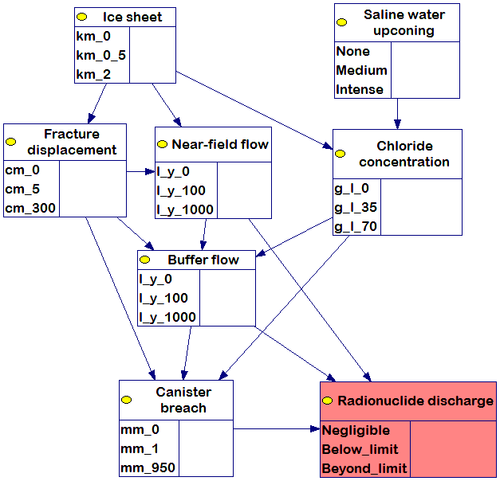
Definitions
Set of nodes and of directed arcs
FEPs
Stochastic variables with discrete states
e.g.
Probabilities
Independent nodes → Unconditional
Dependent nodes → Conditional
Radiological consequence
Scenarios?
Combination of FEPs states
7 FEPs
3 states per FEP
3⁷ = 2,187 scenarios

Slide 5
Bayesian network - safety
State of unacceptable consequences
Each scenario z:
Occurs with probability
Causes failure with probability
Overall failure probability of the disposal system
Failure!
Sum over all scenarios
Probability of the scenario z
Failure probability in the scenario z
Safety:
How to obtain these probabilities?

Slide 6

Expert judgments
Set of experts at each node
Experts’ beliefs on the probabilities
EPISTEMIC UNCERTAINTY
For each probablity multiple values
e.g.
Weight to expert e at node i

Slide 7
Optimization
What values of the weights?
Assign values to obtain the most conservative estimate of the failure probability, given the elicited beliefs
Optimization model:

Slide 8
Deterministic tools in the BN (1/2)
Some dependences modeled by deterministic tools (computer codes, laboratory experiments)
Better capure the physical phenomena
Resource-intensive simulations (time, cost...)
q_{NF}
q_{B}
Very strong assumption!
Soon removed
D
r
Notes:
Another option for obtaining the probabilities is to resort to deterministic tools. Specifically, some dependences in the Bayesian network can be modeled by deterministic tools like computer codes or laboratory experiments.
In our example, we modeled the dependence of the Radionuclide discharge on its parents Canister breach, Buffer flow and Near-field flow by a computer code of radionuclide transport.
In general, when such tools are available, they may be preferred to expert judgment, as they are supposed to better capture the physical phenomena behind the dependences.
Another implication of using a deterministic tool is that we get a conditional probability table with integer conditional probabilities. Specifically, each row corresponds to a computer-code simulation whose input is a specific combination of states of the parent nodes, and whose output is a deterministic prediction of the state of Radionuclide discharge. This is actually a very strong assumption, which we are going to remove soon from our work. The implication is that we will have to solve the problem differently form what you will see in the next slides, but the underlying idea will stay the same, and this is why i will still present the next slides.
Anyway, at the beginning of the analysis, the table is empty, and we can fill it in by progressively simulating all the rows. If we can afford running all simulations, we should just do that. However, the problem is that each simulation can be resource-intensive in terms of computational time and also cost, especially in the case of lab experiments. So, we may not be able or not be willing to run simulations for all the rows, which are 27 in this case.

Slide 9
Deterministic tools in the BN (2/2)
P^{Fail} depends on the realization of the table
Finite discrete set of table realizations
MONOTONICITY!
Here, at the beginning:
The interval may not be conclusive for assessing safety, if
Run simulation → Fill in the corresponding row → Discard realizations → Update interval
COMPREHENSIVENESS
Notes:
As long as there are empty rows in the table, the failure probability is not uniquely determined, even more so before any simulation is run and the table is totally empty. If we look at the equation of the failure probability, even if we assume that we have all the other probabilities in the network, for instance by expert judgment, we’re still missing the probabilities for the last node, because they’re missing from the table.
In practice, the failure probability depends on what will be the realization of the table. But how many ex ante possible realizations of the table are there?
Well, because of the strong assumption of integer probabilities, there is a finite set of them. The table might look like this, like this, like this. Proceeding in this way, the number of possible realizations would be almost intractable. But if we introduce resonable assumptions of monotonocity, this number drop down considerably.
Anyway, we compile the full collection of ex ante possible realizations, and compute the failure probability corresponding to each of them. Then we take the smallest and the largest of these values to build an interval for the failure probability.
This interval may not be conclusive for safety. An interval is conclusive if it is entirely below the maximum threshold epsilon for the failure probability, in what case the system is safe, or if it is entirely above the threshold, in what case the system is unsafe. In our example, when the table was still empty, the failure probability interval was 0 to 71%, which was not conclusive because we had set the threshold epsilon at 5%.
Then the idea is, if we run one more simulation, we can fill in the corresponding row of the table, we can discard realization which are not possible anymore in the light of the new information, and we update the failure probability interval. And if the updated interval is still non conclusive, we iterate.
Here comes the challenge of comprehensiveness in our Bayesian network: instead of running all simulations, can we simulate a restricted number of rows, corresponding to a restricted number of scenarios, and still be able to obtain a failure-probability interval which is conclusive for safety?

Slide 10
Simulation-selection algorithm
Algorithm for iteratively selecting next simulation
Assign a conclusivity score to each simulation
Run the simulation with the highest score
0
0.31
1
1
0.155
Simulation’s score:
0.78
Notes:
In order to answer this question, we’re in the process of developing an algorithm. The machinery of the algorithm will change completely after we will remove the assumption of integer probabilities. The underlying idea will stay the same, and I will now try to communicate it.
At each iteration, the algorithm selects the next simulation to be run, in the attempt of obtaining a conclusive interval for the failure probability with the least number of simulations.
Basically we wish to give a conclusivity score to the remaining simulations. For each simulation, we anticipate its possible results, and we anticipate the failure-probability interval as it would be updated after each of the possible results. Then we score each interval by two attributes which try to capture how conclusive the interval is. By averaging over the possible intervals, we obtain the conclusivity score for the simulation. We do the same for all simulations, and we run the simulation with the highest conclusivity score.

Slide 11
Selected simulations
0
1
0
[ 0 - 0.709]
1
0
0
0
1
0
[ 0.016 - 0.709]
[ 0.035 - 0.709]
0
1
0
[ 0.035 - 0.090]
[ 0.035 - 0.077]
[ 0.035 - 0.060]
[ 0.035 - 0.046]
0
0
1
0
0
1
Notes:
Here, we briefly show the results of the algorithm.
First it tells us to simulate the last row, we run it, and we update the interval, which is still very large. We proceed, and at the third simulation the interval gets much narrower, but still across the maximum acceptable failure probability. Finally, at the sixth simulation we obtain a failure-probability interval which is conclusive because it is entirely below the threshold, whereby we can say that the system is safe.
In summary, instead of simulating all 27 rows, we ran a restricted set of 6 simulations which was comprehensive because we obtained a conclusive interval for the failure probability.

Slide 12
Summary and next steps
Methodology to address challenges in Scenario Analysis of nuclear waste repository
Notes:
Just a few notes on the next steps for improving the methodology: let me just emphasize the attachment of post-processing techniques for identifying the most important failure scenarios, and the removal of the assumptions of integer probabilities from computer codes, as i said many times.

