Slide 1
A Prospective Review of Scenario Analysis of Nuclear Waste Repositories
Edoardo Tosoni^{a,b}, Ahti Saloª, Enrico Zio^{b,c}
Systems Analysis Laboratory, Dept of Mathematics and Systems Analysis - Aalto University
Laboratory of signal and risk analysis, Dipartimento di Energia - Politecnico di Milano
Chair on Systems Science and the Energetic Challenge - École Centrale Paris and Supelec
edoardo.tosoni@aalto.fi
June 22, 2016

Slide 2
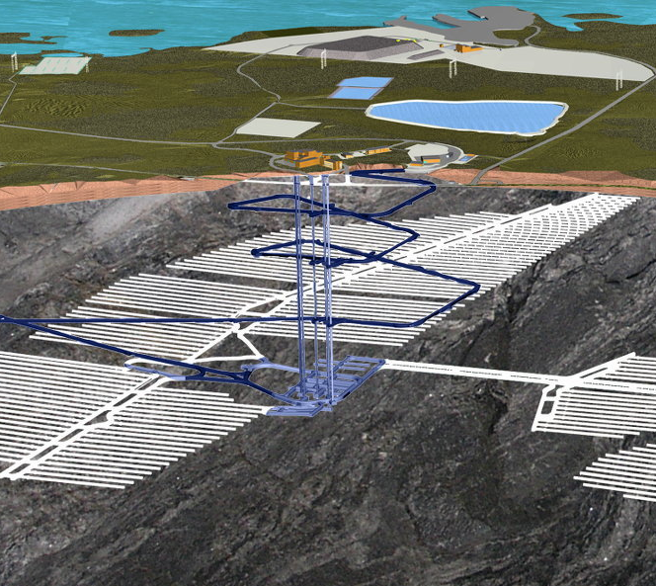
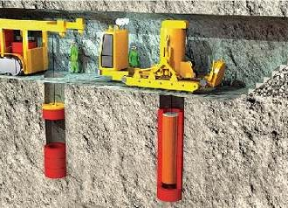

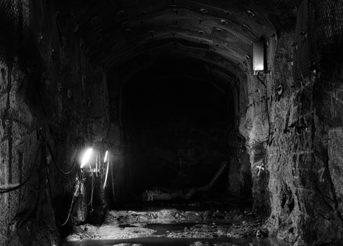
Safety Assessment of nuclear waste repositories
Geological disposal of nuclear waste (repository + environment = disposal system)
Safety Assessment:
To demonstrate repository’s compliance with regulatory limits
Radionuclide release
Dose to humans
Large uncertainty about the evolution of the disposal system:
Scenario Analysis

Slide 3
Research objectives
Systematize the process of Scenario Analysis
Ensure comprehensiveness of Scenario Analysis:
What scenarios do we have to simulate for demonstrating the compliance of the repository?
How to make sure that we are taking everything into account?
Questions addressed since the 80’s
Is it still possible to advance Safety Assessment methodologies?

Slide 4

Literature review
14 projects worldwide
Technical reports
Scientific papers
Regulations & Guidelines
Books
SITE94 - SWE
Tila-99 - FIN
CNFWNP - CAN
SR SITE - SWE
Olkiluoto - FIN
DGR - CAN
DryRun3 - UK
KRDC – S.KOR
WIPP- USA
Drigg - UK
Kristallin-I - SWI
ANDRA - FRA
H12 – JAP
Yucca Mountain - USA
Two-stage review process:
Analysis of current Safety Assessment methodologies
Identification of challenges

Slide 5
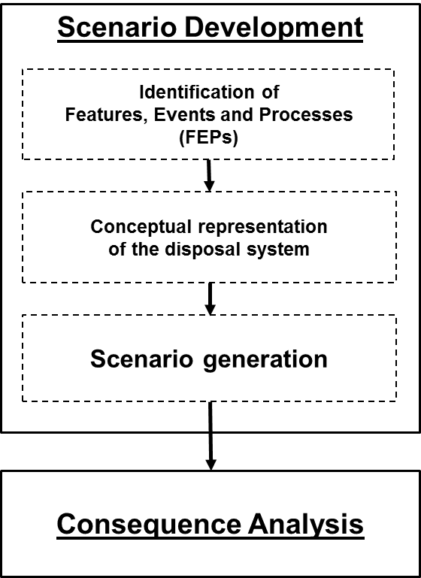
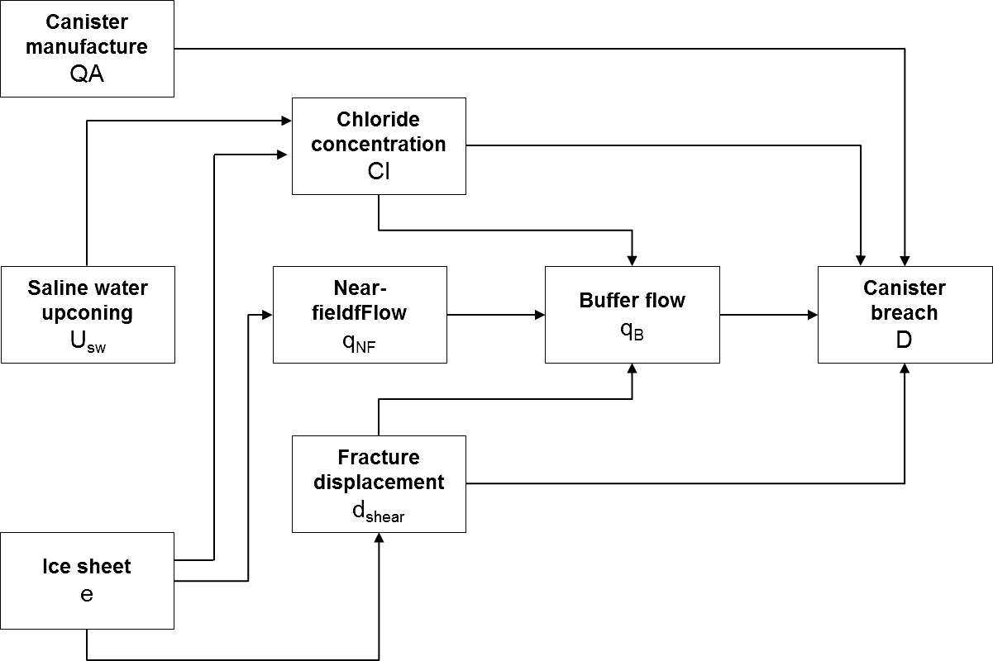
Scenario Analysis as a process
FEPs:
Climate
Water flow rates
Cl⁻ concentration
Seismic events
...
Conceptual representation:
interactions!
Scenario Generation
approaches:
Scenario 1
Scenario 2
Scenario 3
Scenario 4
...
Scenario N
Pluralistic
Probabilistic

Slide 6

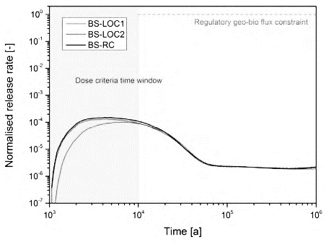
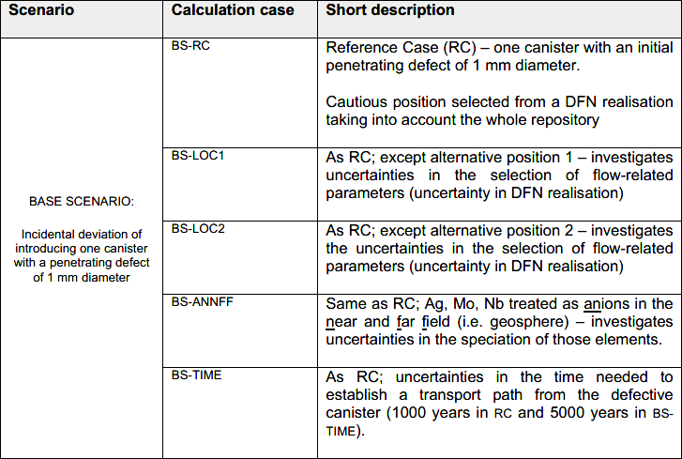
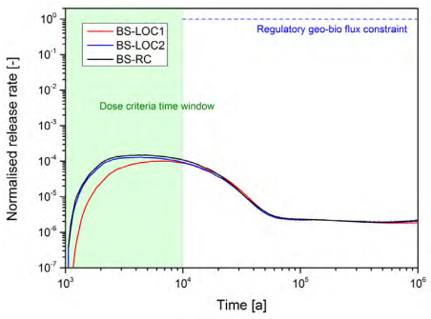
Pluralistic approach
Scenarios are postulated by expert judgment
Interpretation of a scenario:
Set of assumptions about (some of) the FEPs
Interpretation of comprehensiveness:
Representativeness
Scenario 1
Scenario 2
Scenario 3
Scenario 4
Scenario 5
POSIVA, 2012
POSIVA, 2012

Slide 7
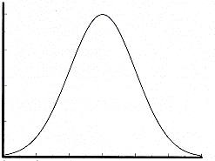
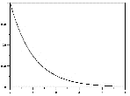
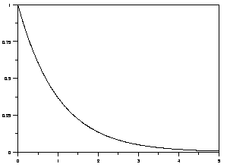
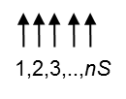
Probabilistic approach
Scenarios are sampled from probability distributions of (some of) the FEPs
Interpretation of a scenario:
Realization in a probability space
Interpretation of comprehensiveness:
Very large sample of scenarios
Helton&Sallaberry, 2009
Scenario 1
Scenario 2
Scenario 3
...
Scenario nS
90th perc
Mean
Early waste package failure
Eruptive events
Earthquake
Median
10th perc

Slide 8
Challenges in Scenario Analysis (1/3)
Approach-dependent interpretations of comprehensiveness, rather than a universal one
The link between FEP identification and scenario generation is not very strong
Trade-off between:
Systematic identification of the interactions
Systematic generation of scenarios
Characterization of the epistemic uncertainties

Slide 9
Challenges in Scenario Analysis (2/3)
The link between FEP identification and scenario generation is not very strong
Pluralistic approach:
Scenarios are postulated through assumptions on a restricted set of FEPs
Probabilistic approach:
Scenarios are sampled from distributions of a restricted set of FEPs

Slide 10
Challenges in Scenario Analysis (3/3)
Trade-off between :
Systematic identification of the interactions
Systematic generation of scenarios
Pluralistic approach:
Interactions are identified systematically, but scenarios are postulated
Probabilistic approach:
Scenarios are sampled systematically, but FEPs are usually taken to be independent
Recall:
Conceptual representation of the system
→ interactions

Slide 11

Research directions (1/2)
Approach-dependent interpretations of comprehensiveness, rather than a universal one
Comprehensiveness: focus on the subset of scenarios with violations of the Performance Targets (STUK 2011, SKB 2011, POSIVA 2012)
FEP | Performance Target
Chloride concentration | < 35 g/l
Fracture displacement | < 5 cm
SKB 2011, POSIVA 2012

Slide 12
Research directions (2/2)
The link between FEP identification and scenario generation is not very strong
Trade-off between (i) systematic identification of the interactions and (ii) systematic generation of scenarios
Improve system view in Scenario Analysis
Integrate scenario generation to the conceptual representation of the system
(Bayesian Beliefs Networks, IDPSA techniques)

Slide 13
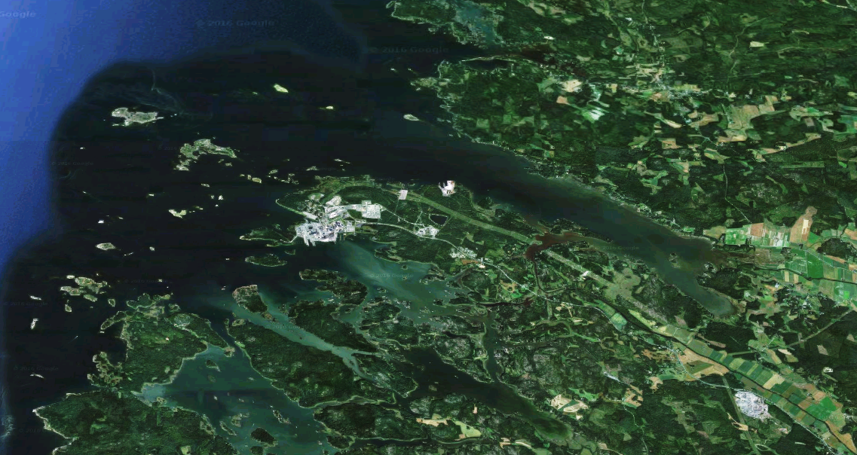
Thank you for attending
LINKS:
KYT 2018
TURMET
POSIVA videos
SKB videos
ANDRA videos

