Slide 1
Systeemiäly ja oppiva organisaatio
Juha Törmänen , Raimo P. Hämäläinen ja Esa Saarinen
10.11.2020

Slide 2
Systeemiälyn ulottuvuudet
Systeeminen havaintokyky
Systemic Perception
Sanaton yhteys
Attunement
Positiivinen asenne
Positive Attitude
Innostuva mieli
Spirited Discovery
Ajattelevaisuus
Reflection
Viisas toiminta
Wise Action
Rakentava toiminta
Positive Engagement
Aikaansaavuus
Effective Responsiveness
Notes:
Systemic Perception: Seeing, identifying and recognizing systems, patterns, and interconnections, having situational awareness
Attunement: Engaging intersubjectively, being present, mindful, situationally sensitive and open.
Positive Attitude: Keeping a positive outlook, not getting stuck on negative impressions and effects
Spirited Discovery: Engaging with new ideas, embracing change
Reflection: Reflecting upon one’s thinking and actions, challenging one’s own behavior
Wise Action: Exercising long-term thinking and realizing its implications, understanding that consequences may take time to develop
Positive Engagement: Taking systemic leverage points and means successfully into action with people
Effective Responsiveness: Taking systemic leverage points and means successfully into action with the environment, being able to dance with systems

Slide 3
Systeemiälyn kyselyt
Itsearviointi:
“I am willing to take advice”
Vertaisarviointi:
“My colleague is willing to take advice”
Organisaatio:
“In my organization, people are willing to take advice”

Slide 4
Oppiva organisaatio – Senge
Personal Mastery
Mental Models
Shared Vision
Team Learning
Systems Thinking

Slide 5
Oppiva organisaatio – Senge
Personal Mastery
Mental Models
Shared Vision
Team Learning
Systems Thinking
Dimensions of the
Learning Organization
Questionnaire

Slide 6
Systeemiäly ja oppiva organisaatio
DLOQ keskittyy vahvasti oppimiseen, ja organisaation rakenteidenja käytäntöjen kuvaamiseen (esim. “In my organization, people are rewarded for learning”).
Moni Sengen keskeisenä pitämä tekijä jää vähemmälle huomiolle – oppivaa organisaatiota ei tällä hetkellä mitata kovin ihmiskeskeisesti!
→ Esittelemme käsitteen OSI – Organizational Systems Intelligence

Slide 7
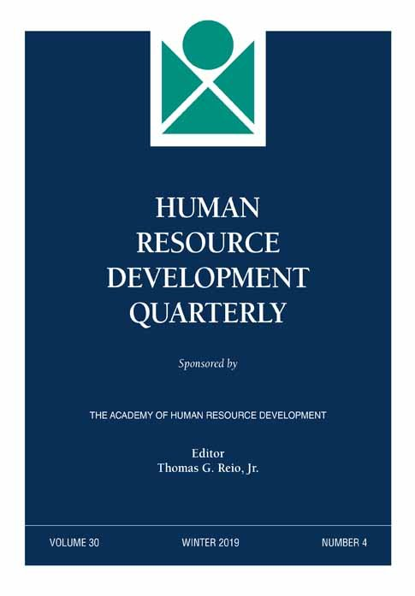
On the Systems Intelligence of a Learning Organization: Introducing a New Measure
Tarjottiin vuoden alussa Human Resource Development Quarterly –lehteen (Impact Factor 3.688).
Vasta nyt syksyllä saimme kuulumisia – hyvin positiivinen revisiopyyntö. Aihepiiri ja lähestymisemme selkeästi kiinnostaa.

Slide 8
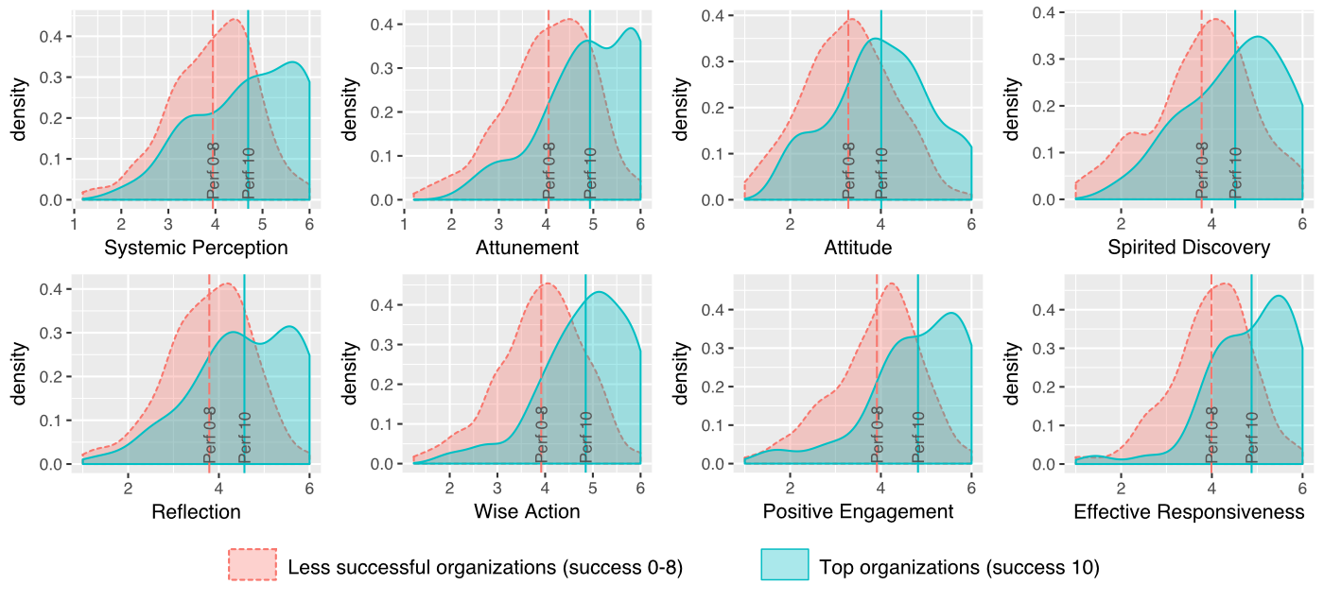
Huippuorganisaatiot erottuvat kaikissa OSI-faktoreissa

Slide 9
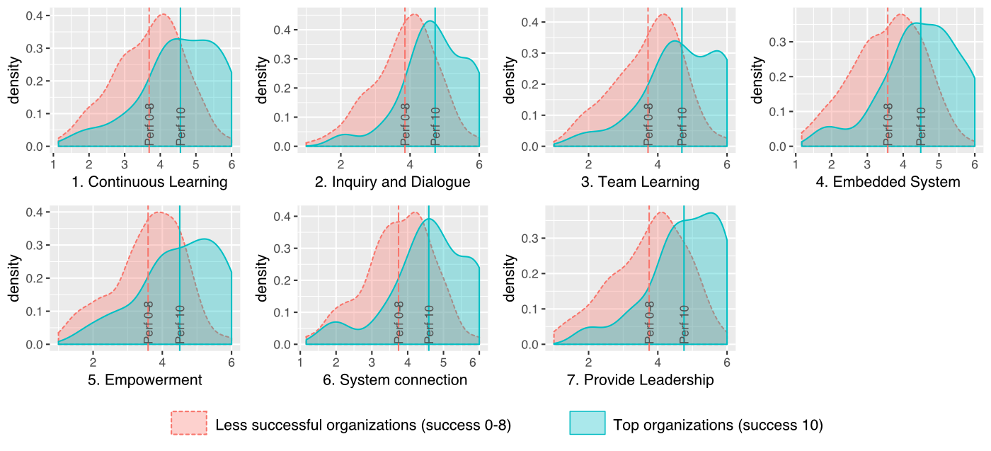
Huippuorganisaatiot erottuvat myös DLOQ-faktoreissa

Slide 10
Organisaation menestyminen
Paljastuu, että OSI ja DLOQ näyttävät olevan jokseenkin yhtä hyviä mittaamaan havaittua organisaation menestystä.
→ OSI ruohonjuuritason mittarina on arvokas lisä oppivan organisaation työkalupakkiin!
R² for perceived organizational success | DLOQ | OSI | Both
All | 0.35 | 0.32 | 0.36
Mid or senior managers | 0.21 | 0.19 | 0.23
Supervisors | 0.43 | 0.44 | 0.53
Non-managers | 0.40 | 0.36 | 0.42
UK residents | 0.35 | 0.32 | 0.38
USA residents | 0.37 | 0.32 | 0.39

Slide 11
Tulevia kysymyksiä
Miltä näyttäisi OSI-mittaus yhden tai muutaman organisaation sisällä? Kuinka samankaltaisia eri ihmisten näkemykset olisivat, ja missä olisi varianssia?
Kuinka OSI linkittyy muihin metriikoihin, kuten taloudelliseen menestykseen tai työhyvinvointiin?
Kuinka OSI:tä voisi käyttää osana interventioita, yksin tai yhdessä DLOQ:n kanssa?

Slide 12
Viitteitä
Hämäläinen, R. P., Jones, R., & Saarinen, E. (2014). Being better better: living with systems intelligence. Aalto University.
Marsick, V. J., & Watkins, K. E. (2003). Demonstrating the value of an organization's learning culture: the dimensions of the learning organization questionnaire. Advances in developing human resources, 5(2), 132-151.
Saarinen, E., & Hämäläinen, R. P. (2004). Systems intelligence: Connecting engineering thinking with human sensitivity. Systems intelligence in leadership and everyday life, 51-78.
Senge, P. (1990). The fifth discipline: The art and science of the learning organization. New York: Currency Doubleday.
Törmänen, J, Hämäläinen, R. P., & Saarinen, E. (2016). Systems intelligence inventory. The Learning Organization, 23(4), 218-231.

Slide 13
Organizational SI dimensions (1)
Systemic Perception In my organization, people form a rich overall picture of situations In my organization, people easily grasp what is going on In my organization, people see what is essential in a given situation In my organization, people keep both the details and the big picture in mind | Attunement In my organization, people approach each other with warmth and acceptance In my organization, people take into account what others think of the situation In my organization, people are fair and generous with people from all walks of life In my organization, people let others have a voice
Positive Attitude In my organization, people explain away their mistakes In my organization, people have a positive outlook on the future In my organization, people easily complain about things In my organization, people let problems in their surroundings get them down | Spirited Discovery In my organization, people like to play with new ideas In my organization, people look for new approaches In my organization, people like to try out new things In my organization, people act creatively

Slide 14
Organizational SI dimensions (1)
Reflection In my organization, people view things from many different perspectives In my organization, people pay attention to what drives their behaviour In my organization, people think about the consequences of their actions In my organization, people make strong efforts to grow as a person | Wise Action In my organization, people are willing to take advice In my organization, people take into account that achieving good results can take time In my organization, people are wise in their judgements In my organization, people keep their cool even under pressure
Positive Engagement In my organization, people contribute to the shared atmosphere In my organization, people praise others for their achievements In my organization, people are good at alleviating tension in difficult situations In my organization, people bring out the best in others | Effective Responsiveness In my organization, people prepare themselves for situations to make things work In my organization, people easily give up when facing difficult problems In my organization, people are able to put the first things first In my organization, when things don’t work, people take action to fix them
Notes:
Vrt: In my organization, people keep their cool even when situations are not under control

Slide 15
DLOQ dimensions (1)
A Continuous Learning In my organization, people openly discuss mistakes in order to learn from them. In my organization, people identify skills they need for future work tasks. In my organization, people help each other learn. In my organization, people can get money and other resources to support their learning. In my organization, people are given time to support learning. In my organization, people view problems in their work as an opportunity to learn. In my organization, people are rewarded for learning. | B Inquiry and Dialogue In my organization, people give open and honest feedback to each other. In my organization, people listen to others’ views before speaking. In my organization, people are encouraged to ask “why” regardless of rank In my organization, whenever people state their view, they also ask what others think. In my organization, people treat each other with respect. In my organization, people spend time building trust with each other. | C Collaboration and Team Learning In my organization, teams/groups have the freedom to adapt their goals as needed. In my organization, teams/groups treat members as equals, regardless of rank, culture, or other differences. In my organization, teams/groups focus both on the group’s task and on how well the group is working. In my organization, teams/groups revise their thinking as a result of group discussions or information collected. In my organization, teams/groups are rewarded for their achievements as a team/group. In my organization, teams/groups are confident that the organization will act on their recommendations.

Slide 16
DLOQ dimensions (2)
D Systems to Capture Learning My organization uses two-way communication on a regular basis, such as suggestion systems, electronic bulletin boards, or town hall/open meetings. My organization enables people to get needed information at any time quickly and easily. My organization maintains an up-to-date database of employee skills. My organization creates systems to measure gaps between current and expected performance. My organization makes its lessons learned available to all employees. My organization measures the results of the time and resources spent on training. | E Empower People My organization recognizes people for taking initiative. My organization gives people choices in their work assignments. My organization invites people to contribute to the organization’s vision. My organization gives people control over the resources they need to accomplish their work. My organization supports employees who take calculated risks. My organization builds alignment of visions across different levels and work groups.

Slide 17
DLOQ dimensions (3)
F Connect the Organization My organization helps employees balance work and family. My organization encourages people to think from a global perspective. My organization encourages everyone to bring the customers’ views into the decision making process. My organization considers the impact of decisions on employee morale. My organization works together with the outside community to meet mutual needs. My organization encourages people to get answers from across the organization when solving problems. | G Provide Strategic Leadership for Learning In my organization, leaders generally support requests for learning opportunities and training. In my organization, leaders share up-to-date information with employees about competitors, industry trends, and organizational directions. In my organization, leaders empower others to help carry out the organization’s vision. In my organization, leaders mentor and coach those they lead. In my organization, leaders continually look for opportunities to learn. In my organization, leaders ensure that the organization’s actions are consistent with its values.

