Slide 1
We Have the Tools but
How to Engage the People?
Competences, Systems Intelligence and Leadership in Group Problem Solving
Section Award Talk, GDN Conference Toronto, June 2021 Group Decision and Negotiation Section of the Institute for Operations Research and the Management Sciences, USA
Raimo P. Hämäläinen
Systems Analysis Laboratory
Aalto University, Finland

Slide 2
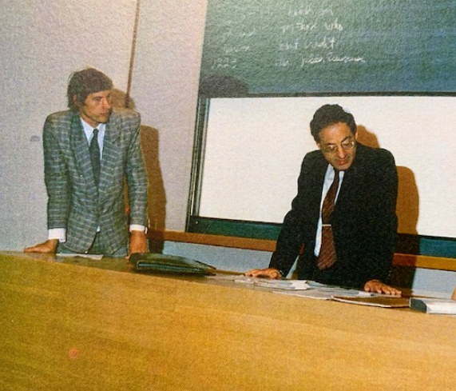
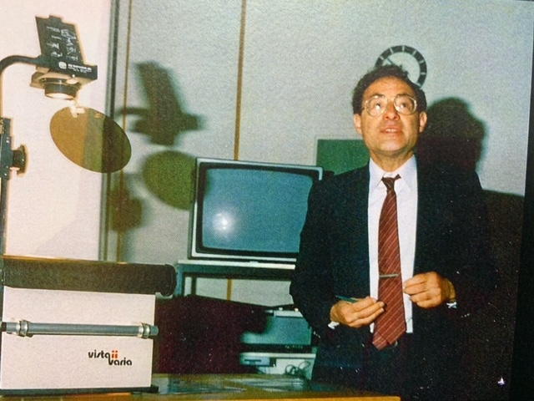
I feel extremely honoured for the GDN Section Award
Thank You!
GDN Section is a unique welcoming and open community
People in this community have given me great inspirations
Many of my publications are in the GDN Journal
Prof. Melvin E. Shakun visiting Systems Analysis Laboratory 1990+/- ?

Slide 3
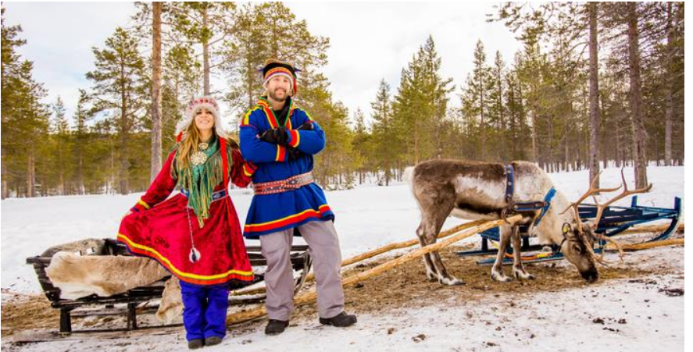
I feel extremely honoured for the GDN Section Award
It also makes me very happy – Thank You!
Source: DW
Number One in the World Happiness Reports :
2021,2020 ,2019, 2018

Slide 4
My personal research journey in GDN

Slide 5
Participatory Modelling (PM)
Any interactive model based group decision support project
OR studies often focus on
- the model
- one stage only (structuring, modelling, decision making, negotiation …)
Real life problem solving is a process with multiple actors and stages :
- problem owner, modeller, facilitator, … setting up the project, identification of stakeholders, modelling…
Need to consider the whole process

Slide 6
Model Based Group Problem Solving Stages and Research Communities
Participatory Modelling (PM)
Stakeholder engagement
Modelling the system
Focus on understanding the problem and the participatory process
Group Decision Making and Negotiation
Facilitation
Modelling prefefences
Decision support
Focus on decision making and negotiation
Problem definition
Setting up the project
Stakeholder identification
Modelling to understand the system
Generation of objectives and data
Design of the participatory process
Stakeholder engagement
Group interaction
Facilitation
Elicitation of preferences
Supporting decision making
and negotiations

Slide 7
My early interest was in developing models and tools

Slide 8
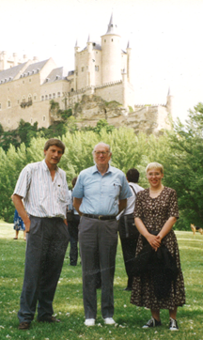
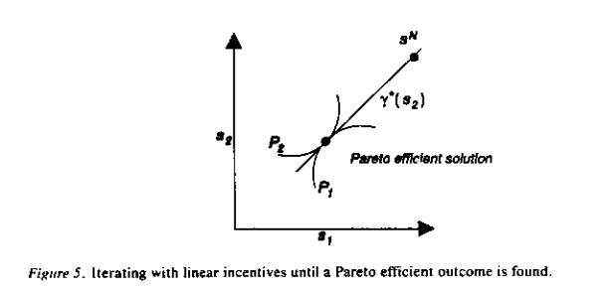
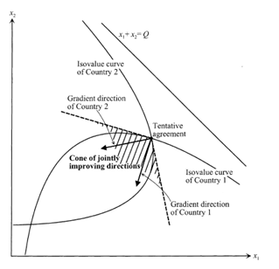
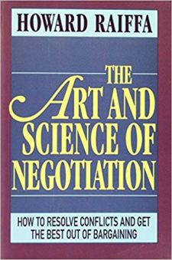
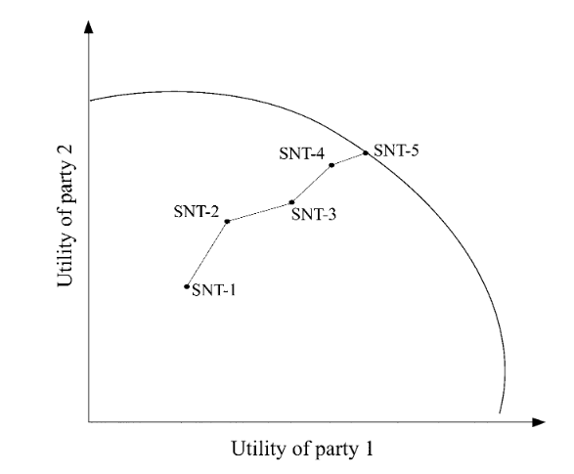
Multi-Agent Interaction Processes
Negotiation Support with Joint Gains
Multi-agent interaction processes: From oligopoly theory to decentralized artificial intelligence, Verkama, Hämäläinen and Ehtamo, GDN, Vol. 1, No. 2, 1992
Interactive multiple‐criteria method for reaching Pareto optimal agreements in negotiations, Ehtamo and Hämäläinen, GDN 2001
Howard Raiffa at Alcazar Castle Segovia, Spain 1992
1982

Slide 9
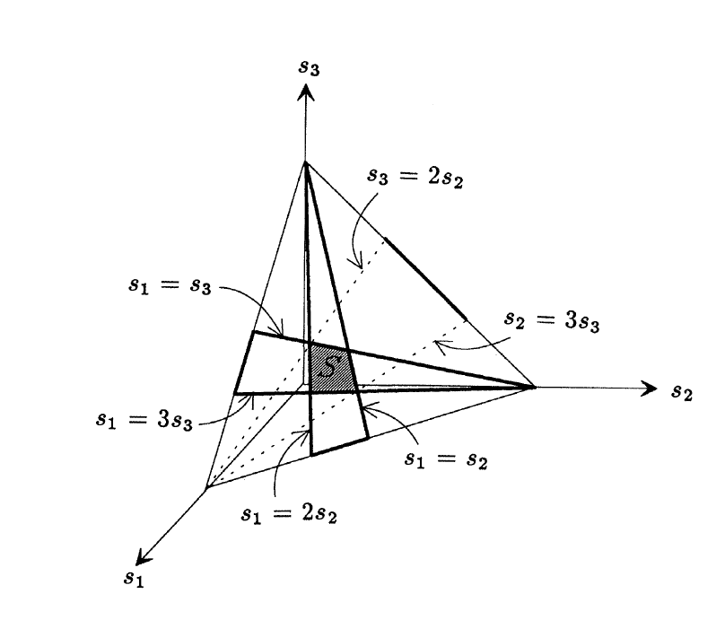
Preference Programming
A. Salo and R.P. Hämäläinen, Operations Research, 1992
Decision analysis with incomplete information
New approaches:
Interval SMART/SWING and interval AHP
Preference Ratios in Multiattribute Evaluation - PRIME
Group decisions: Embedd group members´ preferences into a group interval model and bargain on the ranges of weights
Observations about consensus seeking in a multiple criteria environment, Hämäläinen, Salo and Pöysti, HICSS 1991
On-line group decision support by preference programming in traffic planning, Hämäläinen and Pöyhönen
GDN, 1996

Slide 10
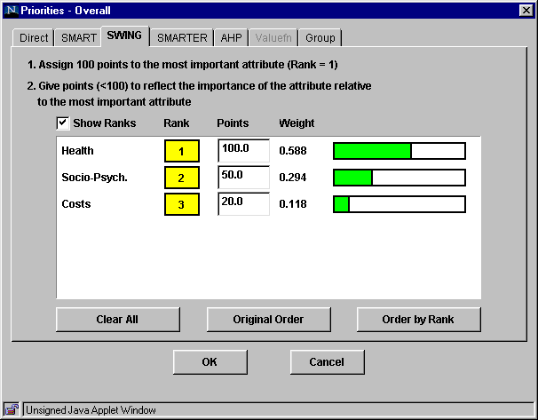
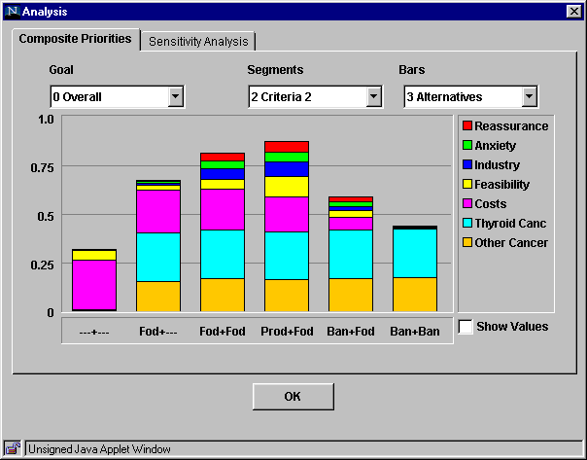
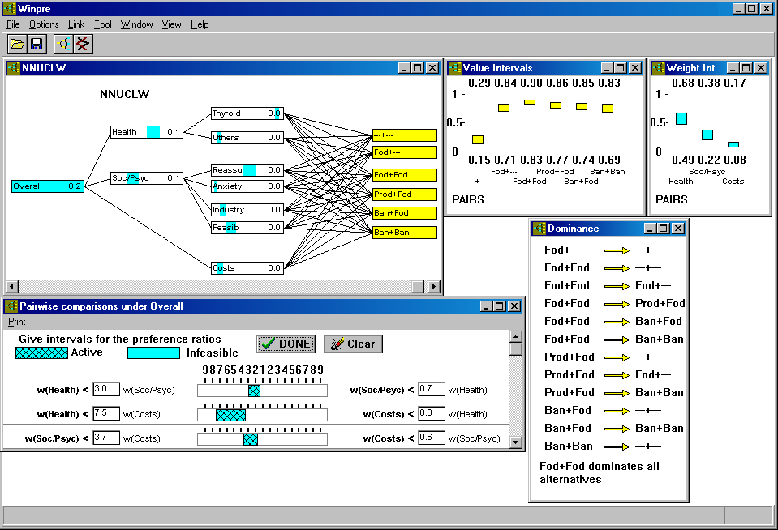
Decision Support Software
Group Collaboration over the Internet
Web-HIPRE (1998), Winpre, Opinions-Online, Joint-Gains, Smart-Swaps
R.P. Hämäläinen, JMCDA 2003

Slide 11
Tools were also taken to real life group decisions

Slide 12
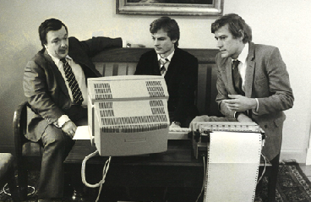
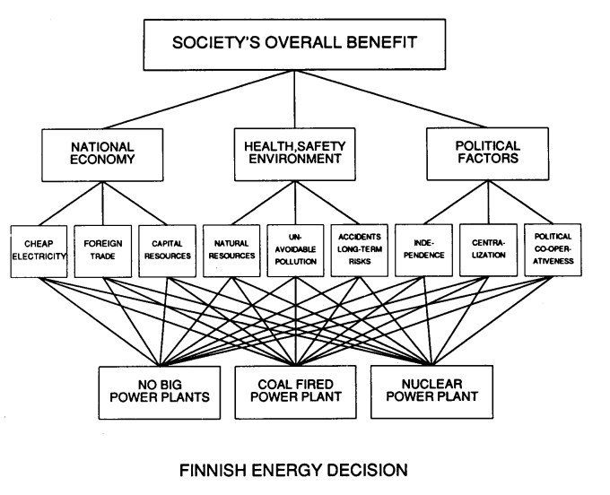
Energy Policy Decision in the Parliament of Finland
R.P. Hämäläinen, Interfaces 1988
Debate based on individual MCDA evaluations
Separating facts from values
Extensive coverage on TV and the press
Minister Pekka Vennamo working with our HIPRE DOS- software for AHP in 1984

Slide 13
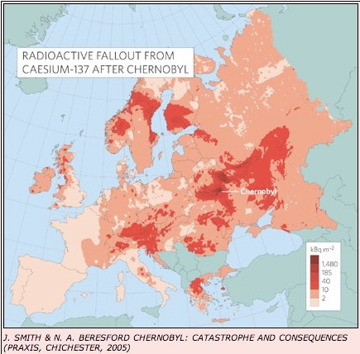
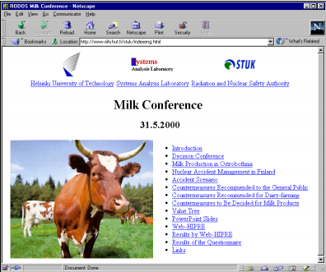
Emergency Response in Nuclear Accidents
Wake-up after Chernobyl (1986)
Emergency decisions are multi-criteria problems:
Not only safety but also social, organizational and resource criteria
Decision conferences in European countries 1992-2004
Web-HIPRE included in the RODOS system ( Real time Online DecisiOn Support ) for radiation accidents
Installed in emergency response centers in more than 20 countries in Europe and the world
Prof. Simon French
Multiattribute risk analysis in nuclear emergency management, Hämäläinen, Lindstedt and Sinkko, Risk Analysis, 2000

Slide 14
Participatory Decision Making in
Water Course Management
A general framework :
1. Framing, structuring and learning the problem
– identification of interest groups
– screening of value dimensions
– selection of decision criteria
– defining operational, measurable attributes
– testing alternative structures of value tree model
– testing the elicitation procedures to minimize biases
2. Identifying Pareto-optimal alternatives
– interactive search of Pareto-optimal alternatives
3. Seeking group consensus
– value tree prioritizations of Pareto-optimal alternatives
– consensus seeking by joint prioritizations
4. Seeking public acceptance
– public evaluation of value tree prioritizations
– voting
Projects with the Finnish Environment Institute
Evaluating a framework for multi-stakeholder decision support in water resources management, Hämäläinen, Kettunen, Marttunen and Ehtamo, GDN, 2001

Slide 15
Modelling is a great tool but
we also need to pay attention to the whole process:
Behavioral perspective
Actors and their roles
Competences
Systems Intelligence
Leadership

Slide 16
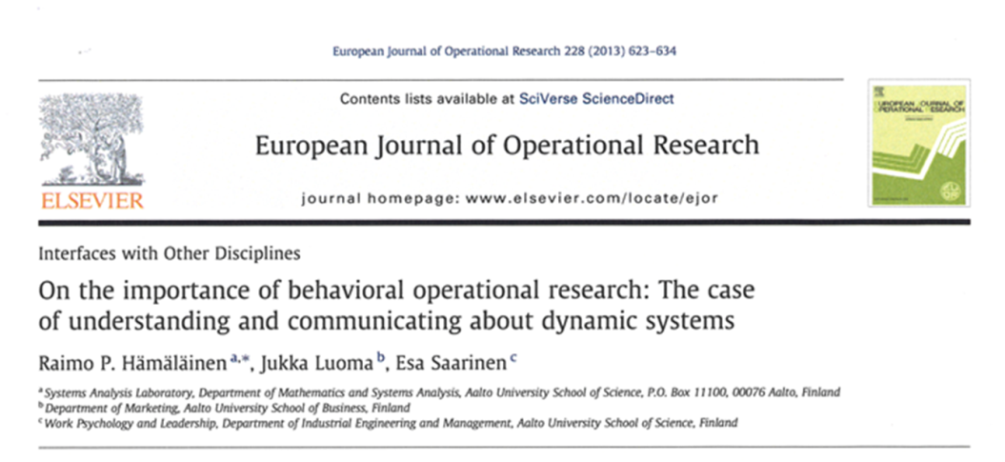
Behavioral Operational Research (BOR) R.P. Hämäläinen, J.Luoma and E.Saarinen, EJOR 2013
´´ The study of behavioral aspects related to the use of operations research methods in modeling, problem solving and decision support´´
What is the impact of the OR modeller and facilitator on the outcome?

Slide 17
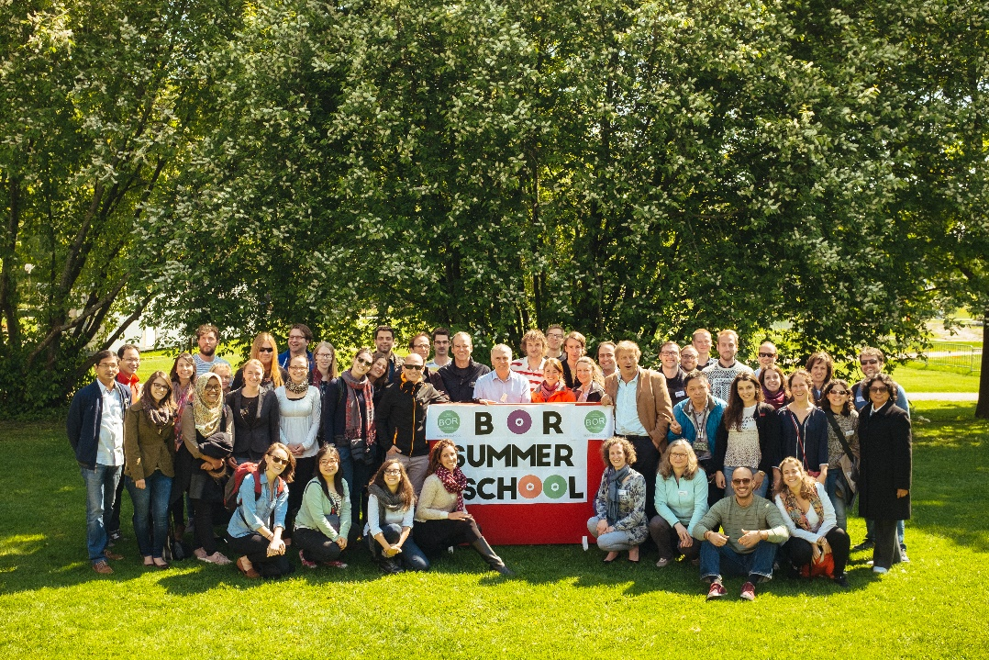
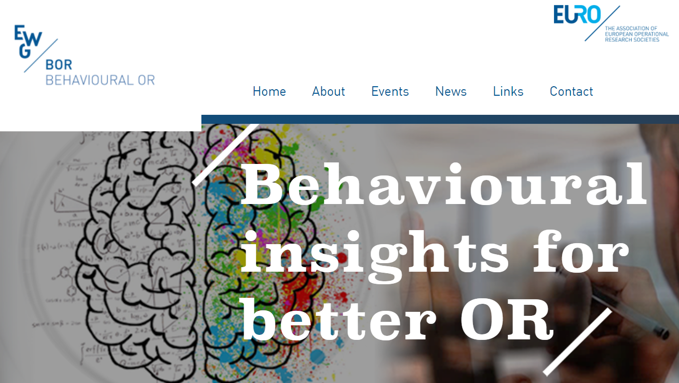
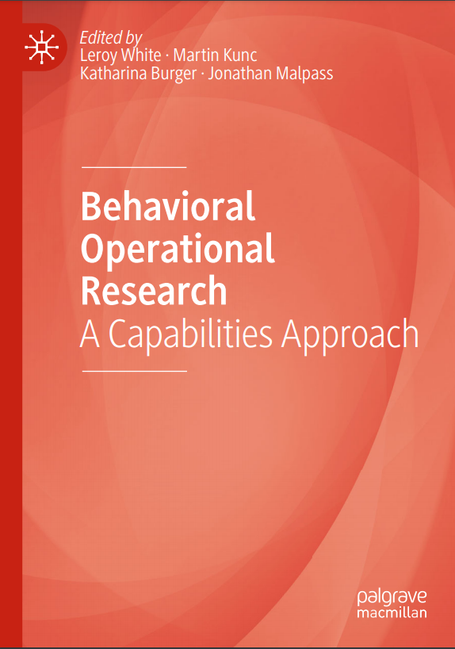
BOR – A New Active Research Area
- EURO Working Group
Special issue and edited volumes
Conference streams and workshops
Summer Schools

Slide 18
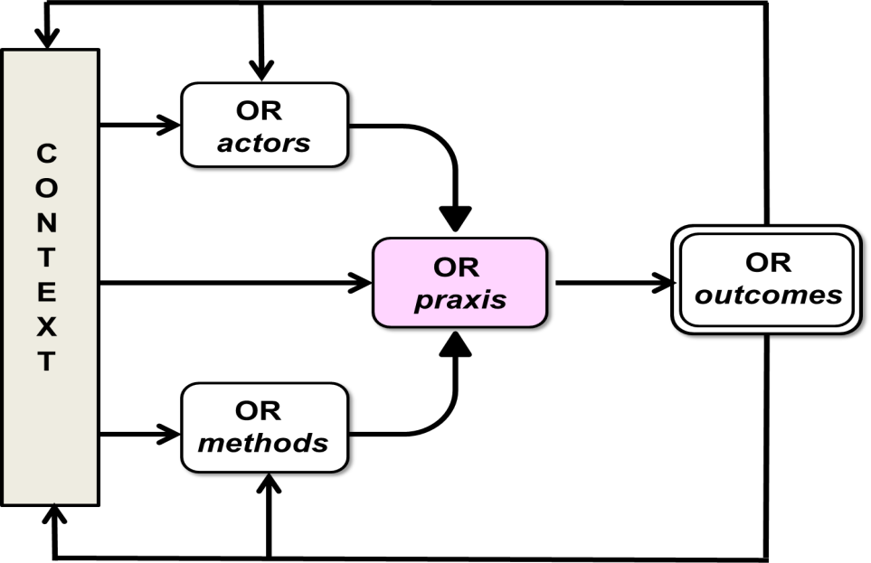
Problem Solving Creates a Social System
Formed by the context and the interaction of the clients and the OR analyst
The actors are subject to behavioral effects
Structure creates behavior
The OR professional needs to observe and understand this overall system
F
Franco and Hämäläinen, 2016

Slide 19
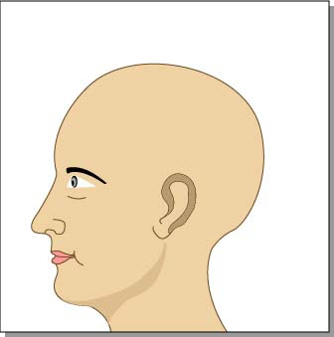
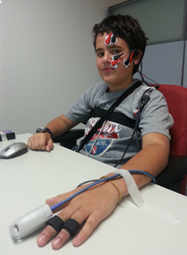
Systemic Intrapersonal Emotional Effects
I. Leppänen, R. P. Hämäläinen, E. Saarinen and M. Viinikainen, GDN 2018
Person A
Person B
Communication Behavior (advocacy/enquiry)
Cognition
Emotion
Cognition
Emotion
Cognition
Emotion
Emotion
Emotional expressions
Cgnition
Psycho-physiological measurements

Slide 20
Actors and Roles in Model Based Group Problem Solving
Commissioner, supervisors and sub-contractors
Project leader designs and oversees the project’s progress
Project manager runs the process following the project plan
Facilitator facilitates the group’s interactions and dynamics
Modeller develops the model and conducts the analysis
Negotiator or mediator helps the group to negotiate
Recorder observes and documents the process
Stakeholders and decision makers
Different skills and behavioral challenges

Slide 21
A Competency Framework S. Elsawah, E. Bakhanova, R. P. Hämäläinen, A. Voinov, 2021

Slide 22
Importance of Competences Survey Among Academics
E-mailing lists:
International MCDA Society
EURO Working Group on Behavioural OR
Modelling and Simulation Society of Australia and New Zealand
Participatory Modelling Community of Practice
Over 5500 e-mails
System Dynamics Society FB page
Over 5800 followers
Very low response rate: Only 48 complete replies
Most of them were from very experienced practitioners
The academic community is not working on real life projects?
People do not like surveys?

Slide 23
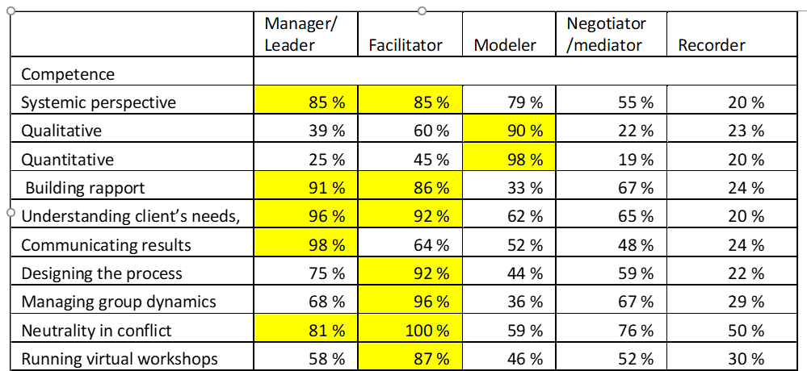
Importance of Competences in Roles
Important or very important
role is on the level of 4 or 5 on the scale 0-5 , where 5 is very important
:
Strong call for better training :``I think that facilitation training needs to be encouraged as well as modelling training. These skills are almost diametrically opposed to that of a modeller, so it is almost crazy to think that modellers can have both sets of skills.``

Slide 24
Systems Thinking and Leadership Competences

Slide 25
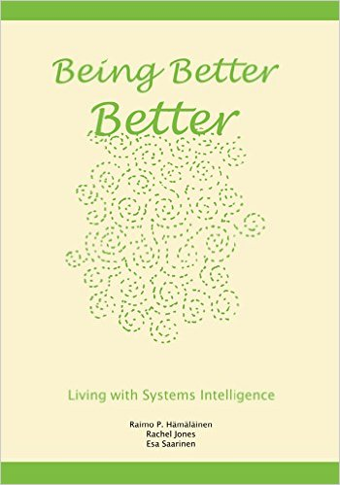
Systems Intelligence (SI) E. Saarinen and R.P. Hämäläinen 2004
``Intelligent behaviour in the context of complex systems involving interaction and feedback``
``Seeing oneself as being part of the overall system including both the technical and human elements``
A core competence in group problem solving
http://systemsintelligence.aalto.fi/

Slide 26
8 Factors of Systems Intelligence J. Törmänen, R.P. Hämäläinen and E. Saarinen, 2016
Systemic Perception: Ability to see systems around us
Attunement: Capability to feel and tune into people and systems
Positive Engagement: The character of our communicative interactions
Reflection: Reflecting on our thoughts and thinking about our thinking
Spirited Discovery: Passionate engagement with new ideas
Effective Responsiveness: Taking timely, appropriate actions
Wise Action: Acting wih consideration and a long time horizon
Positive Attitude: Our overall approach to life in systems

Slide 27
SI Skills Have a Role in the 4 Functions of Participatory Modelling D. C. Kenny, E. Bakhanova, R.P. Hämäläinen and A.Voinov, 2021
The four functions of PM by Lamere et al. 2020

Slide 28
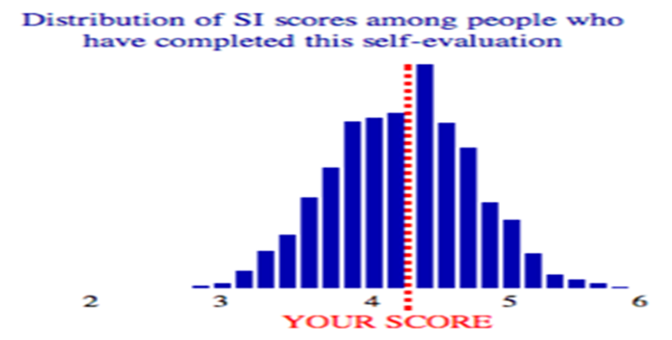
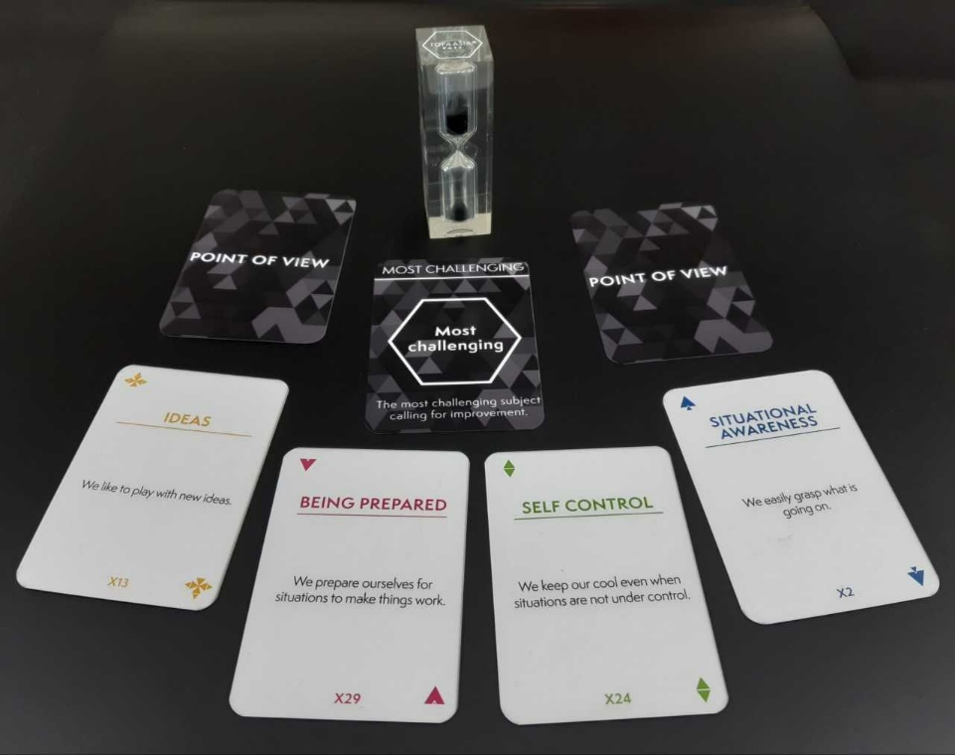
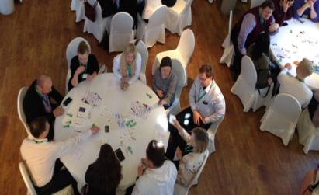
Learning Systems Intelligence R.P. Hämäläinen, K. Kumpulainen, T. Harviainen and E. Saarinen, 2020
SI test: Self and peer evaluation of individuals and organizations – strengths and growth challenges
Gamification: A serious SI card game.
Engages participants in a dialogue.
Teams start improvement processes without a formal facilitator.
Applicability in group problem solving ?

Slide 29
Leadership in Participatory Modelling R.P. Hämäläinen, I. Miliszewska and A.Voinov, 2020
Leadership is the focus
when the performance of
any function is considered
Special concerns in model based group problem solving:
Transparent, ethical and bias-aware modelling and people engagement

Slide 30
Leadership Theories and Styles
Laissez-faire leadership - style in the academia
Shared and distributed leadership - no hierarchy
Transactional and transformational leadership – leader follower
Systems leadership – considers the big picture
Complexity leadership – a description only
Servant and spiritual leadership – non-neutral
Leadership and management are different but can overlap

Slide 31
Thinking process
Leadership
Management
Looks at the big picture
Designs the project
Considers alternative modelling approaches
Focuses on mental models, values, beliefs and biases
Sensitive to ethical issues
Looks inwards
Plans sessions
Focuses on details
Correct use of model, method and data
Efficient use of time
Minimizes uncertainty

Slide 32
Modeller as the Leader
Modellers are eager to start projects with their new methods
Modellers can become leaders implicitly - is this good?
Pros
Understands the method
Knows how to use the model
Technical competency
Risks
Advocates the method rather than solves the problem
Is not willing to talk about the limitations of the method
Does not consider other methods
May solve the wrong problem right
Lacks people skills
Main point: Assigning leadership in group problem solving is important

Slide 33
Summary
Modeling is invaluable but not enough in group problem solving
How to engage the people?
Consider the big picture
Pay attention to behavioural factors
Success requires systems thinking and leadership
A mature professional has both modelling and people skills
The field of group decision making is very rich and full of exciting challenges
Thanks to you, the GDN community, for providing an inspiring environment for working on these ideas!

Slide 34
References
R.P. Hämäläinen: Computer assisted energy policy analysis in the parliament of Finland, Interfaces, Vol. 18, No. 4, 1988, pp. 12-23.
R.P. Hämäläinen, A.A. Salo and K. Pöysti: Observations about consensus seeking in a multiple criteria environment, in: Proceedings of the 25th HICSS, Vol. IV, 1991, IEEE Computer Society Press, pp. 190-198
M. Verkama, R.P. Hämäläinen and H. Ehtamo: Multi-agent interaction processes: From oligopoly theory to decentralized artificial intelligence, Group Decision and Negotiation, Vol. 1, No. 2, 1992, pp. 137-159.
A. Salo and R.P. Hämäläinen: Preference assessment by imprecise ratio statements Operations Research, Vol. 40, No. 6, November-December 1992, pp. 1053-1061.
R.P. Hämäläinen and M. Pöyhönen: On-line group decision support by preference programming in traffic planning, Group Decision and Negotiation, Vol. 5, 1996, pp.485-500
R.P. Hämäläinen, M. Lindstedt and K. Sinkko: Multi-attribute risk analysis in nuclear emergency management, Risk Analysis, Vol. 20, No 4, 2000, pp. 455-467
H. Ehtamo and R.P. Hämäläinen: Interactive multiple-criteria methods for reaching Pareto optimal agreements in negotiations, Group Decision and Negotiation, Vol. 10, No. 6, 2001, pp. 475-491
R.P. Hämäläinen, E. Kettunen, M. Marttunen and H. Ehtamo: Evaluating a framework for multi-stakeholder decision support in water resources management , Group Decision and Negotiation, Vol. 10, No. 4, pp. 331-353, 2001
R.P. Hämäläinen: Decisionarium - Aiding decisions, negotiating and collecting opinions on the Web. Journal of Multi-Criteria Decision Analysis, Vol. 12, 2003, 101-110
E. Saarinen and R. P. Hamäläinen: Systems Intelligence: connecting engineering thinking with human sensitivity. In: Hämäläinen, R.P., Saarinen, E. (Eds.), Systems Intelligence – Discovering a Hidden Competence in Human Action and Organizational Life, A88. Helsinki University of Technology: Systems Analysis Laboratory Research Reports, pp. 1–29, 2004

Slide 35
J. Mustajoki, R.P. Hämäläinen and M. Marttunen: Participatory multicriteria decision support with Web-HIPRE: A case of lake regulation policy Environmental Modelling & Software, Vol. 19, No. 6, 2004
J. Mustajoki, R.P. Hämäläinen, A. Salo : Decision Support by Interval SMART/SWING - Incorporating Imprecision in the SMART and SWING Methods Decision Sciences, Vol. 36, No.2, 2005, pp. 317-339.
R.P. Hämäläinen, J. Luoma and E. Saarinen: On the Importance of Behavioral Operational Research: The Case of Understanding and Communicating about Dynamic Systems. European Journal of Operational Research 2013, Vol. 228, Issue 3, pp. 623-634
R.P. Hämäläinen, Rachel Jones, Esa Saarinen :Being Better Better - Living with Systems Intelligence Aalto University Publications, CROSSOVER 4/2014
J. Törmänen, R.P. Hämäläinen and E. Saarinen : Systems Intelligence Inventory, Learning Organization, vol. 23(4), 2016, pp. 218-231
L.A. Franco and R.P. Hämäläinen: Engaging with Behavioural OR: On Methods, Actors and Praxis, In M. Kunc, J. Malpass, L. White (eds.), Behavioural Operational Research: Theory, Methodology and Practice, Palgrave, Macmillan, UK. 2016, pp. 3-25.
I. Leppänen, R.P. Hämäläinen, E. Saarinen and M. Viinikainen: Intrapersonal Emotional Responses to the Inquiry and Advocacy Modes of Interaction: A Psychophysiological Study, Group Decision and Negotiation, 6, July 2018
R.P. Hämäläinen, K. Kumpulainen, J.T. Harviainen and E. Saarinen: Design Gaming for Learning Systems Intelligence in Socio-Emotional Systems Syst Res Behav Sci. 2020;1–5.
R. P. Hämäläinen, I. Miliszewsk and A. Voinov: Leadership in participatory modelling – Is there a need for it? Environmental Modelling & Software, Volume 133, November 2020, 104834
S. Elsawah, E. Bakhanova, R. P. Hämäläinen, A. Voinov :Towards a competency framework for participatory modelling: Identifying core competencies, Manuscript 2021
D. C. Kenny, E. Bakhanova, R.P. Hämäläinen and A. Voinov: Participatory modelling and systems Intelligence: A systems-based and transdisciplinary partnership, Manuscript 2021

