Slide 1
Path Dependence in
Operational Research –
How the modeling process can influence the results
Raimo P. Hämäläinen
Systems Analysis Laboratory, Aalto University , Finland
University of Cape Town, 2020
The document can be stored and made available to the public on the open internet pages of Aalto University. All other rights are reserved.

Slide 2
The lure of objectivity in modelling
Focus on model validity in early OR literature
Hidden assumption:
A valid model automatically produces a valid process and bias free objective results
Theory and algorithms are free of behavioral effects
But as soon as we use them in real life problem solving behavioral effect will be present

Slide 3

Behavioral Operational Research (BOR)
Hämäläinen ,Luoma and Saarinen , European J. on OR 2013
A new very active research area in OR
What is the human impact on the OR process?
Statistics: G. Box (1987) ´´All models are wrong but some are useful."

Slide 4
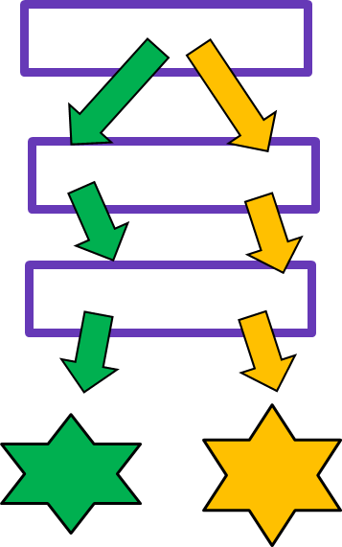
Paths in problem solving
The sequence of steps over the modelling project
Different paths always available
Outcome can depend on the path followed – path dependence
Best practice literature implicitly acknowledges this

Slide 5

Path dependence
Discussed in economics, policy studies and organizational decision making (Arthur 1989, Webster 2008, Sydow et al. 2009)
History matters
i.e. current state depends
on the history
Lock-in phenomena, e.g. QWERTY (David 1985)
Photo by Ileana Gonzales, CC BY-NC-ND 2.0

Slide 6
OR pioneers recognized path dependence already early
Morris (1967)
Discussed the process of model development
Little (1970)
Model needs to be adjustable in case we learn more about the problem
Landry et al. (1983)
Multiple ”valid” models with different outcomes can be built for the same problem

Slide 7

Choices made in problem solving influence the path
Problem identification, framing and structuring
Building the modelling team and stakeholder identification
Choice of the modelling approach
Data collection and preference elicitation
Stakeholder selection and engagement
Specifying and solving the model

Slide 8
Is path dependence a problem?
Yes in :
Optimization
Efficiency analysis
Important policy problems
Normative decision support
Analytics and statistical analysis
Machine learning in AI
Not necessarily :
When the goal is to increase learning
Trying different paths can be beneficial in learning
Creating of shared understanding of the problem

Slide 9
Drivers and origins of path dependence
System
Learning
Procedure
Behaviour
Motivation
Uncertainty
External environment
Can interact and occur together

Slide 10
System
Drivers of path dependence
This is the
right model
Social system
Formed by the people involved in the problem solving, Groupthink, working with ”our” models
Problem solving environment Irreversibility/constraints, budget, time or resources
System under study
Increasing returns, bifurcations, feedback loops
Yes
Yes
Yes
Yes
Yes
Yes

Slide 11
Learning
Drivers of path dependence
Problem owners, stakeholders and modelers learn about the problem: assumptions are revised
Unlearning preconceived solutions
Importance of initial framing
Procedure
Properties of the procedures used to solve the problem
Technical properties, convergence
Order of problem solving steps
Decomposition into sub-problems

Slide 12

Behaviour
Drivers of path dependence
Getting stuck with previously adopted models and software
Hammer and Nail Syndrome
We tend to use only the modelling
approach we know best
Cognitive biases of modelers
and decision makers
-Status quo bias, sunk cost effect,
anchoring, confirmation bias
Biases in preference elicitation can accumulate
Sanjay Bakshi,2006

Slide 13

Drivers of path dependence
Motivation
People’s goals affect the problem solving process
Higher risk in messy and controversial problems
Experts delivering the desired results
Strategic behavior in group processes
Self-deception
– narrow thinking

Slide 14
Uncertainty and the external environment
Drivers of path dependence
Uncertainty in model assumptions:
Sensitivity to initial modeling choices
Early commitment to initial data
Model fitting and training with biased data
Changes in the external environment:
The same modelling path can lead to different results at different times

Slide 15
Path issues in
Multi-Criteria Decision Analysis (MCDA)
Biases of decision makers are widely covered in the decision analysis literature and textbooks
Very little work on:
- How do biases affect the overall process?
- How to approach mitigation and debiasing in practice?
Biases can take place and accumulate in different phases of the decision support process

Slide 16
Accumulation of biases along the process
A
Starting
point
Bias
Ideal process = no bias
B
C
Step 1
Step 2
…

Slide 17
Reducing the effects of biases in MCDA
Approaches suggested in the literature:
Improve questions in preference elicitation
Consistency checks and feedback
Train decision makers - very difficult
Calibrate judgments - DMs do not like
Average responses

Slide 18
Path perspective in debiasing
Try to find paths where the effects of biases cancel out (Anderson and Hobbs 2002, Lahtinen and Hämäläinen 2016)
Possible if the mechanism of biases is well understood
Avoid paths where the effects of biases build up
A
B
C
Benefit: DM needs not change her behaviour
Result

Slide 19
Reseach challenges in debiasing the MCDA process
We need to know the effects over the whole process
Experiments are difficult
We cannot use real decision makers in process testing
Even with students it can be very cumbersome to go through different procedures repeatedly
Learning becomes a problem

Slide 20
Computational testing
Based on models and estimates of the assumed biases
(Bleichrodt et al. 2001, Anderson and Hobbs 2002, Delquié 2003, Jacobi and Hobbs 2008, Lahtinen and Hämäläinen 2016)
Select the types and levels of biases considered relevant
Design a debiasing method
Simulate the decision process to see the overall effects
Study the results with different parameter settings
Enables testing of multiple techniques and helps to identify promising ones

Slide 21

Ilustration with the Even Swaps method
Hammond, Keeney, Raiffa (1999)
Goal: Find the ’best’ alternative with an elimination process (even swap):
Simplify the problem by eliminating irrelenvant alternatives or attributes
Successive trade-offs questions between attributes
Multiple paths possible – different biases can accumulate

Slide 22
Techniques to create paths with reduced overall bias for the Even Swaps
Introduce a virtual reference alternative
Introduce an auxiliary measuring stick attribute
Repeatedly rotate the reference point
Intermediate restarting of the elicitation process with a reduced set of alternatives

Slide 23
Introduce an auxiliary measuring stick attribute
A new irrelevant attribute can be used as a measuring stick
Can mitigate the measuring stick bias (Delquié 1993) in trade-off judgments
 | Alternatives
Attributes | A | B | C
Rent (euros per month) | 700 | 900 | 800
Size (square meters) | 30 | 40 | 35
Condition (constructed scale) | 1 | 2 | 3
Commute time (minutes) | 60 | 60 | 60
Trade-offs against virtuals are widely used: Estimation of attribute weights, pricing out, Even Swaps method

Slide 24
Bias mitigation methods for Even Swaps
Reference method: Attribute elimination method with a fixed reference alternative
Method A: Attribute elimination method with a virtual reference alternative
Method B: Attribute elimination method with a virtual reference alternative and an auxiliary measuring stick
Method C: Pairwise attribute elimination method with an auxiliary measuring stick, rotating reference point and intermediate restarting
Method D: Pairwise attribute elimination method with an auxiliary measuring stick, virtual reference alternative, and intermediate restarting
  Method D requires about twice as many swaps as the other methods

Slide 25
Results from our computational experiments
New bias reduction techniques do work in simulations
The techniques have potential also in other decision analysis approaches
Virtual reference alternative and auxiliary measuring stick are applicable with almost any other method too
Potentially interesting also in interactive multi-criteria optimization procedures

Slide 26
Summary : Checklist for the practitioner
What is the main goal of the modeling process – learning or prescriptive modelling?
Is path dependence a real risk and do we want to avoid it?
Consider effects related to the system created by the problem solving team and process
Consider procedural, behavioral and motivational biases
Consider technical properties, such as irreversibilities, in the problem under study
Consider the possibility of an adaptive modelling approach
Design debiasing methods by computational analysis
Consider the possibility of using multiple models or modelling teams ?

Slide 27

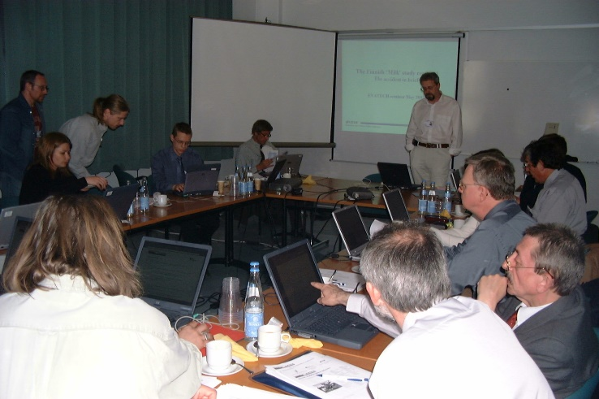
Path perspective highly relevant in environmental policy decisions
High stakes participatory processes with multiple stakeholders
Environmental, social, political and economical aspects
Multiple sources of uncertainties, strategic behaviour
R.P.Hämäläinen 2015:
Behavioural issues in environmental modelling - the missing perspective
Environmental Modelling & Software, 73: 244-253.
Photo by NASA, CC BY-NC 2.0

Slide 28
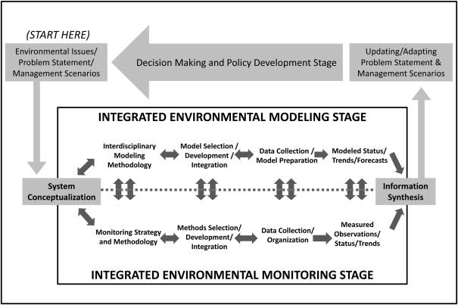
Forks along the path in every stage of environmental modelling
Laniak et al.: Integrated environmental modeling: A vision and roadmap for the future, Environmental Modelling & Software, January 2013

Slide 29
Mitigation of risks in different stages
Initial meeting between the problem owners and modelers
Forming the problem solving team
Defining the problem
Planning the modelling process
Data collection and elicitation of preferences
Checkpoints for the evaluation of the path followed

Slide 30
Stage: Initial meeting between the problem owners and modelers
Task | Risks to be mitigated | Comments
Describe the problem addressed by modelling and specify an initial list of the main objectives. | Anchoring to insignificant objectives, lack of deliberation | The problem definition sets the initial direction of the path. Redirecting the path later can be difficult.
Determine whether the goal of the project is to provide prescriptive recommendations or to improve learning. | Narrow thinking | Prescriptive use of modelling requires completeness and strong justifications for the choices made.
Consider the possibility of setting up an independent parallel problem solving process. | Problem solving may follow a poor path | The parallel process can follow an alternative path. This supports learning and can build confidence in the results.
Describe how to notice if an unsatisfactory path is followed. | Problem solving can get stuck on a poor path | If the path is unsatisfactory, predetermined criteria to notice the situation can be useful. Such criteria can help cope with hidden motives and biases.
Ensure that resources are reserved for possible backtracking, redirecting, or restarting of the project. If not, give reason why. | Lack of resources prevent backtracking steps or restarting | If the path is unsatisfactory, restarting the project can be the right choice.

Slide 31
Stage: Forming the problem solving team
Task | Risks to be mitigated | Comments
Form a modelling team with a diverse and balanced composition. If not, give reason why. | Narrow thinking | When faced with a fork in the path, a team with diverse backgrounds can more easily notice new posibilities and consider multiple perspectives.
Ensure appropriate stakeholder representation. | Marginal interests dominate choices | The choices that determine the path should be informed by the preferences and concerns of the relevant stakeholders. Marginal interests should not dominate the choices made.
Identify motivational goals of modelers and stakeholders. Plan how to ensure they do not cause a poor path to be followed. | Hidden motives affect choices | A poor path can result if choices are driven by hidden motives and self-interest.
Ensure that the role of Devil’s advocate is filled in the upcoming stages. If not, give reason why. | Lack of critical evaluation of the path taken | A Devil's advocate helps ensure that a successful path is followed. He or she questions the assumptions made by the team and introduces perspectives that have not been considered.

Slide 32
Stage: Defining the problem
Task | Risks to be mitigated | Comments
Search broadly for background information and prior work providing possible starting points for the project. | Setting off from a wrong starting point | To provide new insight, the path should start from the point where others have left off. Awareness of the background information helps ensure that effort is not spent redoing what has already been done.
List different perspectives that can be taken in the problem solving. Justify the perspective selected. | Narrow thinking | The choice of perspectives is a fork in the path. Explicitly considering the alternative perspectives helps ensure the team is thinking broadly enough.
List the most significant sources of uncertainty within the problem. | Lack of critical evaluation of the path taken | More information about the problem can reveal better paths to be followed. Awareness of the sources of uncertainty helps when searching new data and information.

Slide 33
Stage: Planning the modelling process
Task | Risks to be mitigated | Comments
Specify the objectives and requirements for the model. | Ill-defined goals drive the process | Clearly stated objectives and requirements help make choices at forks faced in model development. They reduce the risk that the choices are based on hidden motives or convenience.
Specify the criteria used to evaluate the success of the model. | Sunk cost fallacy | Predetermined criteria help notice if a poor path is followed. Explicit criteria can reduce cognitive and motivational biases when evaluating the model.
Plan mid-process checkpoints where the model and data are evaluated. If not, give reason why. | Project stuck on a poor path | The mid-process evaluation creates a fork where the path can be re-directed.
Use multiple modelling approaches in parallel. | The approaches used dominate thinking | More than one path can be followed. Using multiple approaches reduces the risk that important perspectives are missed.
Consider developing multiple prototype models. | The approaches used dominate thinking | Developing prototype models can be a resource-efficient way to use multiple modelling approaches.

Slide 34
Stage: Data collection and elicitation of preferences
Task | Risks to be mitigated | Comments
Identify data requirements that have not been adequately met. | Incomplete data drives thinking | How to deal with lack of data creates a fork in the path. One possibility is to collect expert judgments.
Identify biases that can affect preference assessment and expert judgment. Assess the possible impacts of these biases. | Biased judgments and choices | Effects of the biases can accumulate along the path. Reducing the overall bias can be possible. This possibility creates a fork in the path.
Use multiple techniques to assess preferences and obtain expert judgments. If not, give reason why. | Biased judgments and choices | Use of multiple elicitation techniques can reveal the effect of biases and generate additional insights compared to using one technique only.

Slide 35
Stage: Checkpoints for the evaluation of the path followed
Task | Risks to be mitigated | Comments
Evaluate the progress of the project in relation to its overall objectives. | Problem solving may follow a poor path | The path may need to be redirected if it is not the intended one or satisfying.
Evaluate the model in relation to the objectives and requirements for the model. | Problem solving may follow a poor path | If the model is not satisfying, there may be need to restart model development, or create a competing model.
Investigate whether there is new understanding about the problem to be taken into account in the problem solving process. | Lack of critical evaluation of the path taken | Improved understanding of the problem may call for changes in the approaches used.
Consider the possibility that external factors influencing the system under study have changed. | Incomplete data or information drives thinking | Changes in the external factors may require changes in the assumptions and approaches used.
Consider the possibility that the data used is not up-to-date. | Outdated data drives thinking | If the data set is outdated or incomplete, there may be need to gather more data.
Consider the possibility that stakeholder preferences have changed. | Unnoticed changes in preferences | Reassessment of stakeholder preferences may be needed.

Slide 36
Conclusions
Path dependence is a real phenomenon and a risk in modelling
Most important driver is human behavior
Awareness is the first step to cope with path dependence
Research on the mitigation of biases over the whole modelling process is needed
Leadership in modelling is essential

Slide 37
Leadership in participatory modelling
Hämäläinen, Miliszewska and Voinov, 2020
A manager does things right – A leader does the right things
The modeler can be either, or both, or a technical expert only
A leader in a modelling project should:
  Understand the big picture
  Clarify the context and boundaries
  Consider alternative approaches and tools
  Have good social and technical skills
  Understand modelling if not a modeler
  Know the stakeholders and empower them
  Reflect on technical, resource and behavioural factors that may affect the overall process
  The goal is a fair, transparent and ethical modelling process

Slide 38

Thank you

Slide 39
Papers on path dependence
Hämäläinen, Lahtinen 2016. Path Dependence in Operational Research - How the Modeling Process Can Influence the Results Operations Research Perspectives, 3:14-20.
Lahtinen, Hämäläinen 2016. Path dependence and biases in the even swaps decision analysis method European Journal of Operational Research, 249(3): 890-898
Lahtinen, Guillaume, Hämäläinen 2017. Why pay attention to paths in the practice of environmental modelling? Environmental Modelling and Software, 92: 74-81.
Lahtinen, Hämäläinen, Jenytin 2020. On preference elicitation processes which mitigate the accumulation of biases in multi-criteria decision analysis, European Journal of Operational Research, 282 (1): 201-210
Related Behavioural OR papers
Hämäläinen, Luoma and Saarinen 2013. On the Importance of Behavioral Operational Research: The Case of Understanding and Communicating about Dynamic Systems European Journal of Operational Research, 228, 3: 623-634.
Hämäläinen 2015. Behavioural issues in environmental modelling–The missing perspective, Environmental Modelling & Software, 73: 244-253
Franco and Hämäläinen 2016a. Behavioural operational research: Returning to the roots of the OR profession. European Journal of Operational Research, 249, 3: 791-795.
Franco and Hämäläinen 2016b: Engaging with behavioural OR: On methods, actors, and praxis. In Kunc, M, Malpass, J, White, L (eds) Behavioural operational research: Theory, methodology and practice:, pp.1-14
Hämäläinen, Miliszewska and Voinov Leadership in participatory modelling–Is there a need for it? Environmental Modelling & Software, 133

Slide 40
References
Anderson, R. M., Hobbs, B. F. 2002. Using a Bayesian Approach to Quantify Scale Compatibility Bias. Management Science, 48(12), 1555-1568
Arthur, W.B., 1989. Competing technologies, increasing returns, and lock-in by historical events. The Economic Journal 99 (394), 116-131.
Bleichrodt, H. J., Pinto, J. L., Wakker, P. 2001. Making descriptive use of prospect theory to improve the prescriptive use of expected utility. Management Science, 47(11), 1498-1514
David, P.A., 1985. Clio and the Economics of QWERTY. The American Economic Review 75 (2), 332
Hammond, J.S., Keeney, R.L., Raiffa, H., 1999. Smart Choices: A Practical Guide to Making Better Decisions. Harward Business School Press, Boston, MA.
Jacobi, S. K., Hobbs, B. F. 2007. Quantifying and mitigating the splitting bias and other value tree-induced weighting biases, Decision Analysis, 4(4), 194-210
Landry, M., Malouin, J-L., Oral, M. 1983. Model validation in operations research. European Journal of Operational Research 14 (3), 207-220.
Little, J.D.C., 1970. Models and Managers: The Concept of Decision Calculus. Management Science 16 (8), B466-B485. Reprinted in Management Science 50 (12 Supplement), 1841-1853.
Morris, W. T., 1967. On the Art of Modeling. Management Science 13 (12), B707-B717.
Mustajoki, J., Hämäläinen, R.P., 2007. Smart-Swaps - A decision support system for multicriteria decision analysis with the even swaps method. Decision Support Systems 44 (1), 313-325.
Sydow, J., Schreyögg, G., Koch, J., 2009. Organizational Path Dependence: Opening The Black Box. Academy of Management Review 34 (4), 689-709.
Webster, M., 2008. Incorporating Path Dependency into Decision-Analytic Methods: An Application to Global Climate-Change Policy. Decision Analysis 5 (2), 60-75.

