Slide 1
Creating a strategy portfolio for climate change mitigation –
A study of behavioral effects
Tuomas J. Lahtinen and Raimo P. Hämäläinen
tuomas.j.lahtinen@aalto.fi, raimo.hamalainen@aalto.fi
Systems Analysis Laboratory, Aalto University School of Science, Finland
The document can be stored and made available to the public on the open internet pages of Aalto University. All other rights are reserved.

Slide 2
Environmental management decisions are portfolio problems
Find the best basket (portfolio) of actions
Stakeholder perspectives
Environmental, societal and economical objectives
The overall consequences matter
Actions complement each other
Actions have dependencies and synergies
Budget, time and resource constraints
The portfolio perspective is needed
(Lahtinen, Hämäläinen, Liesiö 2017a)

Slide 3

Example: Climate Stabilization Wedges Game, Princeton

Slide 4
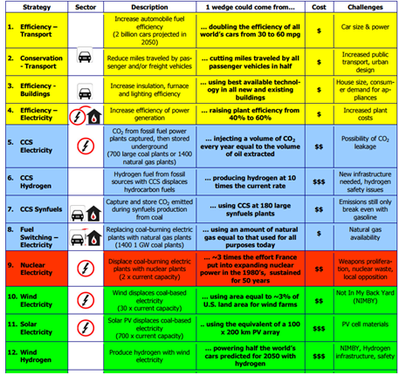
To keep carbon emissions on today’s level we need to create a basket of 8 emission reduction strategies
Billions of Tons Carbon Emitted per Year
16
15 strategy candidates
Projected path
8
Historical
emissions
Goal: Flat path
1.6
1950
2000
2050
Year
Notes:
4

Slide 5
Multi-criteria portfolio generation approaches
Unaided generation of portfolio alternatives without modelling or optimization support
Followed by MCDA evaluation of the portfolio alternatives
Common approach because of soft criteria and aspects that are difficult to measure
Benefit-cost approach
Portfolio decision analysis approach
Heuristic optimization approach
Behavioral issues in portfolio approaches need attention – there are new phenomena not discussed in MCDA
Result can be a sub-optimal or non-dominated portfolio

Slide 6
Behavioral issues in unaided portfolio generation
Portfolios generated in a step-by-step process
Path dependence (Hämäläinen and Lahtinen 2016, Lahtinen et al. 2017a,b)
the order in which the actions are considered has an impact
Behavioural drivers (see, e.g. Fasolo, Morton, von Winterfeldt 2011)
Heuristics and biases
Narrow thinking
See also Hämäläinen et al. 2013, Hämäläinen 2015

Slide 7
Different approaches can trigger different heuristics and biases
Elimination by aspects: eliminate actions below a treshold in a criterion (Tversky 1972)
Equal allocation of resources to categories (Benarzi and Thaler 2001)
Loss aversion: Adding a costly action to the portfolio causes a loss of money, removing a costly action saves money (Kahneman and Tversky 1991)
Approach and avoidance conflict: A choice between two undesirable outcomes can be very difficult to make (see, e.g. Terry 2010)
Premature commitment to actions that first come to mind

Slide 8
Narrow thinking
Individual actions considered in isolation of the big picture (Tversky and Kahneman 1985, Read et al. 1999)
Double counting benefits or costs
Not seeing that actions interact and complement each other
Affective decision making and insensitivity to scope (Loewenstein and Lerner 2003, Kahneman et al. 1999)
Costly actions with small impacts may get selected

Slide 9
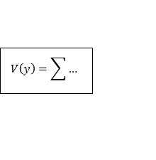
MCDA – The standard approach
Multiple objectives
Alternatives = portfolios of actions
Ranking of alternatives
Value compositions
Objective 1
Alternative A
1
2
3
Alternative B
1
5
7
Objective 2
Alternative C
3
4
5
Objective 3
MCDA value model
A
B
C
$$V\left(y\right)=\sum{…}$$
Evaluation of portfolios of actions generated in an unaided process
Behavioral issues:
Generation of alternatives
Behavioral effects in MCDA

Slide 10
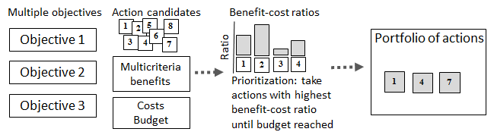
Simple benefit-cost approach
MCDA evaluation of individual actions – synergies and interactions not considered
Portfolio generation: Include the actions in the highest benefit-cost ratio order
See, e.g. Kleinmuntz 2007, Hajkowicz et al. 2008
Behavioral issues:
Narrow thinking: Omission of synergies and interactions
Behavioral effects in MCDA

Slide 11
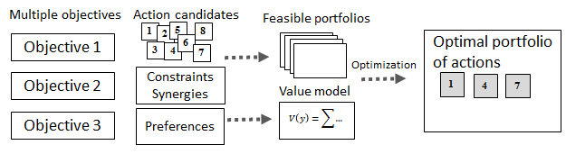

Portfolio Decision Analysis (PDA)
MCDA value model + constraints + optimization
Includes interactive value modeling
Synergies and interactions can be modeled using the constraints
Behavioural issues:
Ranges become problematic! Are weights based on consequences of individual actions or overall consequences of (feasible) portfolios of actions?
Behavioral effects in MCDA

Slide 12
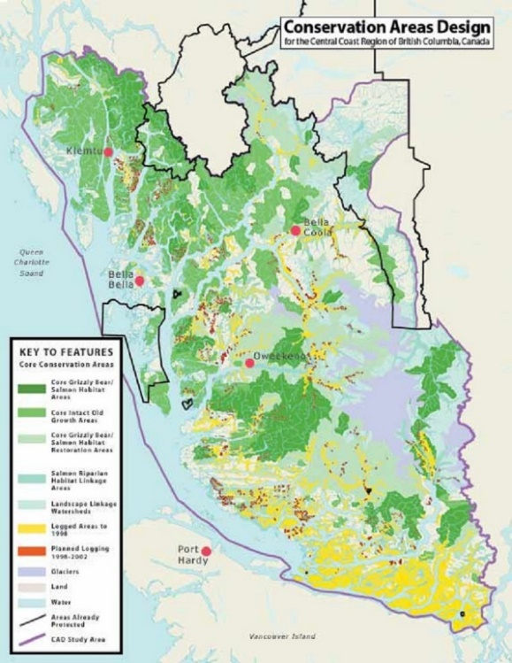
Heuristic optimization approach
Used extensively in conservation network design
(see, e.g. Moilanen 2007, Lehtomäki and Moilanen 2013)
The overall value model can include synergies and non-linearities
Start with all areas of land
Remove the area with the smallest
loss of overall value until feasible
solution is found
Behavioural issues:
Biases in creating the optimization criterion
Early commitment to suboptimal solution?
Beauty effect – a complicated model can become an unquestioned authority?

Slide 13

Behavioural experiment on the web carbcut.aalto.fi
Based on
the Climate Stabilization Wedge Game
Original CMI’s message:
We already have the technology needed for climate change mitigation
The problem is to choose the desired strategies
Our experimental treatments:
Two procedures for creating the preferred portfolio of emission reduction strategies
Adding strategies into the basket
Removing extra strategies from the basket

Slide 14
Adding procedure
Starting point:
Empty basket
Result:
8 strategies in the basket
1
2
5
8
Basket
3
12
11
13
Choices can be affected
by biases and heuristics
1
2
5
8
14
10
3
4
6
6
Strategies
7
4
7
9
10
15
12
11
14
13
9
15

Slide 15
Removing procedure
Starting point:
Extra strategies in the basket
Result:
8 strategies in the basket
1
2
5
8
1
2
5
8
Basket
6
3
4
7
3
9
10
10
12
11
14
13
12
14
15
Choices can be affected
by biases and heuristics
11
13
Strategies
4
6
7
15
9

Slide 16
Questions of interest
Does the result depend on the procedure followed?
If yes, can the result be explained by heuristics or biases such as elimination by aspects or loss aversion?
Adding a costly action causes loss of money
Removing a costly action saves money
Is one procedure more prone to trigger biases or non-systemic thinking?
Is one procedure perceived easier? Does the result reflect the approach / avoidance conflict?
People do not like choosing between undesirable options
Is there a tendency to prefer the result obtained with either one of the procedures?

Slide 17
How do the subjects choose their paths?
What perspectives are considered (costs, feasibility, sustainability, balance, fairness)?
Do the subjects use the possibility to backtrack?
Are the subjects more likely to select strategies shown first in the list?
Do the subjects make modifications to the completed portfolios?
Do the subjects prefer portfolios in which they have made modifications?
Does either procedure lead to modifications more often?

Slide 18
Similarity: the number of same strategies in the two portfolios created
How do the respondents’ backgrounds correlate with
i) the strategies chosen and ii) similarity of the portfolios created?
Background data: Field of study, age, gender, professional / student
How do the perspectives considered correlate with similarity?
How does perceived difficulty of using the procedures correlate with similarity?
How does the number of steps taken correlate with similarity?

Slide 19
Results
Number of subjects
Avg. Similarity (max is 8)
# Full similarity
Similarity measure: the number of same strategies in the two portfolios created
 | Add | Remove | P-value
Avg. # dollars
Avg. # steps taken
Min. # steps taken
Max. # steps taken
Difficulty evaluation
Preferred result

Slide 20
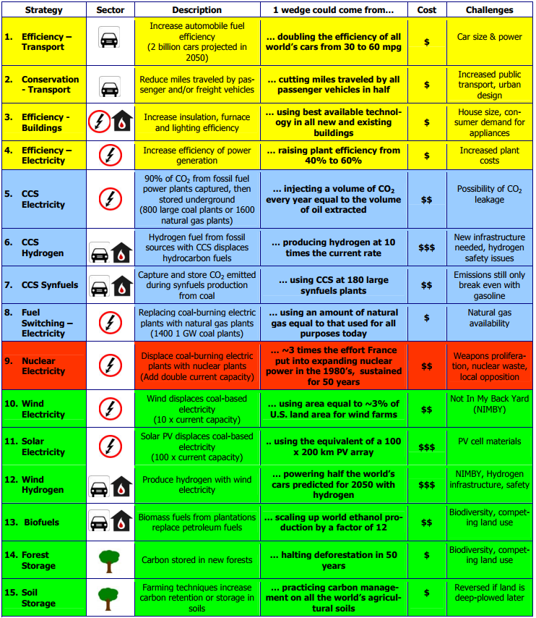
How many participants chose the actions
Add | Remove

Slide 21
Ideas for bias mitigation
Applying the path perspective (Lahtinen et al. 2016)
Follow multiple paths and compare the results
Use intermediate checkpoints
Training decision makers to avoid biases
Does not always work, e.g. did not help to avoid the splitting bias (Hämäläinen and Alaja 2008)
Not studied in portfolio decision making?
Use portfolio modeling approaches
Can mitigate path dependence and narrow thinking but may bring in other biases

Slide 22
Checking procedure
Result:
8 strategies in the basket
1
2
5
8
3
Check if a strategy swap improves the basket?
12
11
13
14
4
6
7
15
10
9

Slide 23
Conclusions for environmental policy analysts
Behavioral research on environmental portfolio problems is very limited but important
The most significant environmental issues faced by mankind are portfolio problems, e.g. climate policy
We need to pay attention to the decision processes when creating climate policy
There can be unanticipated phenomena related to the systemic nature of the problem
Portfolio thinking is needed to mitigate path dependence and narrow thinking
Portfolio modeling can help? All actions and relevant interactions included simultaneously in the same model

Slide 24
Conclusions for decision analysts
The generation of alternatives is studied very little from the behavioral perspective
Portfolio generation is often an implicit part of alternative generation
What is the role of path dependence, cognitive biases and heuristics?
Methods for portfolio decision analysis are promising but coping with behavioral effects and synergies is still difficult
How to mitigate biases? How to support problem framing and identification of synergies?
Limited software support for handling synergies

Slide 25
References and links
Benartzi, S. and Thaler, R.H., 2001. Naive diversification strategies in defined contribution saving plans. American economic review, 91(1), 79-98.
Fasolo, B., Morton, A., von Winterfeldt, D., 2011. Behavioural issues in portfolio decision analysis. In: Salo, A., Keisler, J.M., Morton, A. (Eds.), Portfolio Decision Analysis. Springer, pp. 149-165.
Hajkowicz, S., Spencer, R., Higgins, A., & Marinoni, O. 2008. Evaluating water quality investments using cost utility analysis. Journal of Environmental Management, 88(4), 1601-1610.
Hämäläinen, R.P., Alaja, S. 2008. The Threat of Weighting Biases in Environmental Decision Analysis Ecological Economics, Vol. 68, 2008, pp. 556-569.
Hämäläinen, R.P., Luoma, J., and Saarinen, E. 2013. On the Importance of Behavioral Operational Research: The Case of Understanding and Communicating about Dynamic Systems European Journal of Operational Research, 228, 3: 623-634.
Hämäläinen, R.P. 2015. Behavioural issues in environmental modelling - the missing perspective Environmental Modelling & Software, 73, 244-253.
Hämäläinen R.P., and Lahtinen, T.J. 2016. Path Dependence in Operational Research –
How the Modeling Process Can Influence the Results Operations Research Perspectives, 3:14-20.
Kahneman D, Ritov I, Schkade D. 1999. Economic preferences or attitude expressions?: An analysis of dollar responses to public issues. Journal of Risk and Uncertainty,19(1–3):203–35.
Kleinmuntz, D.N., 2007. Resource allocation decisions. In: Advances in Decision Analysis: from Foundations to Applications. Cambridge University Press, pp. 400-418.
Lahtinen, T. J., Hämäläinen, R. P. and Liesiö J. 2017a. Portfolio Decision Analysis Methods in Environmental Decision Making Environmental Modelling and Software, 94, 73-86
Lahtinen, T.J., Guillaume, J.H., Hamäläinen, R.P., 2017b. Why pay attention to paths in the practice of environmental modelling? Environ. Model. Softw. 92, 74-81.
Lahtinen T.J., Hämäläinen R.P., Jenytin C., 2017c. A systems perspective on bias mitigation in decision analysis. Manuscript available on request.

Slide 26
Lehtomäki, J. and Moilanen, A., 2013. Methods and workflow for spatial conservation prioritization using Zonation. Environmental Modelling & Software, 47, 28-137
Loewenstein, G., and Lerner, J. 2003. The role of affect in decision making. In R. J. Davidson, H. H. Goldsmith, & K. R. Scherer (Eds.), The handbook of affective science. Oxford, England: Oxford University Press
Moilanen, A., 2007. Landscape zonation, benefit functions and target-based planning: unifying reserve selection strategies. Biol. Conserv. 134 (4), 571-579.
Read, D., Loewenstein, G., Rabin, M., Keren, G. and Laibson, D., 1999. Choice bracketing. Journal of Risk and Uncertainty, 19:1-3; 171-197.
Salo, A., Keisler, J. and Morton, A. (Eds.), 2011. Portfolio decision analysis: improved methods for resource allocation. Springer.
Thaler, R. H., and Sunstein, C. R. 2008. Nudge: Improving decisions about health, wealth, and happiness. New Haven, CT: Yale University Press.
Thaler, R. H., Sunstein, C. R., and Balz, J. P. 2014. Choice architecture. In E. Shafir (Ed.), Behavioral foundations of public policy: 428-439. Princeton, NJ: Princeton University Press.
Tversky, A., 1972. Elimination by aspects: A theory of choice. Psychological review, 79(4), 281.
Tversky, A. and Kahneman, D., 1985. The framing of decisions and the psychology of choice. Science, 211, 453-458.
Tversky, A. and Kahneman, D., 1991. Loss aversion in riskless choice: A reference-dependent model. The quarterly journal of economics, 106(4), pp.1039-1061.

