Slide 1
Path Dependence in Operational Research l
How the Modeling Process
Can Influence the Results
Tuomas J. Lahtinen, Raimo P. Hämäläinen
tuomas.j.lahtinen@aalto.fi, raimo.hamalainen@aalto.fi
Systems Analysis Laboratory, Department of Mathematics and Systems Analysis
EURO 2016, Poznan, 4.7.2016
The document can be stored and made available to the public on the open internet pages of Aalto University. All other rights are reserved.

Slide 2
A modelling process can be realized in different ways
Process descriptions and best practices provide instructions to be followed in modelling
The literature has not discussed that
a given process can be realized in different ways
Following a
best practice procedure does not guarantee a desired outcome

Slide 3
Path is a new and needed concept!
It refers to:
the actual sequence of steps taken
in a modelling effort
the trajectory of the problem solving process
formed by the interaction of
actors, praxis, methods and context
A key perspective in Behavioural Operational Research (Hämäläinen et al. 2013, Franco and Hämäläinen 2016a, 2016b)
The steps where behavioral phenomena occur
are not isolated

Slide 4
Idea of paths discussed in multi-criteria methods
Camp David Negotiations
Raiffa (1982)
Starting point matters in negotiation processes
French (1984)
Anchoring to initial point in multi-criteria optimization
Korhonen, Moskowitz, Wallenius (1990)
Reservation
value
Egypt
Reservation
value
Israel
Reference points matter in multi-criteria optimization due to loss aversion

Slide 5
The whole modelling process creates a path
Forks where choices can strongly influence the path
Who are included in the problem solving team?
How is the problem framed?
Which modelling approach is chosen?
How the problem is decomposed into parts?
How are data and preferences collected?
How does the communication take place?
...

Slide 6
Path dependence:
Outcome depends on the path followed

Slide 7
Origins and drivers of path dependence in OR
System
Learning
Procedure
Behavior
Motivation
Uncertainty
External environment
Can interact and occur together
Hämäläinen and Lahtinen (2016): Path Dependence in Operational Research - How the Modeling Process Can Influence the Results
Operations Research Perspectives, Vol. 3, pp. 14-20.

Slide 8
Phenomena related to path dependence
One can take a path which seems good but leads to an inferior outcome
One can get stuck with the initial solution path
Early steps and framing can be critical
Biases and errors can accumulate (or cancel out) Their overall effect matters!

Slide 9
Accumulation of bias along the process
A
Starting
point
Bias
Ideal process = no bias
B
C
Step 1
Step 2
…

Slide 10
Getting stuck with one approach
Man with a hammer syndrome
Anchoring to initial thoughts
Groupthink
  Cohesive group of modellers can endorse their solution without critical evaluation of alternatives
Wishful thinking
Confirmation bias
Sunk cost effect
This is the
right model
Yes
Yes
Yes
Yes
Yes
Yes

Slide 11
Awareness of path dependence
Challenges the modeling team to reflect on
The critical forks on the modelling path such as
Who are included in the problem solving team?
How data is collected?
What drives the team’s behavior and choices?
Are we stuck with an inferior approach?
Do we need to backtrack steps, or restart?

Slide 12
Procedures for coping with path dependence
More than one problem solving process
Adaptive problem solving
Debiasing

Slide 13
More than one problem solving process
Multiple independent teams solving the same problem
To consider alternative problem formulations and model structures
Devil’s advocate team?
To find and challenge crucial assumptions by primary team
To perform worst case analyses

Slide 14
Adaptive problem solving
The desired path can change when we learn more
In policy problems there often is
Incomplete information and uncertainty about the problem
Changes in the problem environment
Decide checkpoints where process can be revised
Take into account learning, intermediate results, new data

Slide 15
Debiasing
Reduce effects of cognitive biases in preference elicitation and expert judgment
Approaches suggested in the literature:
Reframe questions, train decision makers, calibrate judgments (see, e.g. Montibeller, von Winterfeldt 2015)
Lahtinen, Hämäläinen (2016):
Design elicitation process so that effects of biases cancel out
Possible only if the mechanism of bias is well understood

Slide 16
Effects of biases can cancel out
A
B
C
Example of such procedures
Even Swaps: Lahtinen, Hämäläinen (2016)
Trade-off weighting: Anderson, Hobbs (2002)
Not always necessary to debias individual judgments

Slide 17
The path can be intentionally directed to support learning
What happens if we take a different starting point?
How our view about the problem changes if we use another model?
Backcasting (Robinson 1982)
Working backwards from an envisioned outcome to figure how that outcome can be reached

Slide 18
Learning outcomes can also depend on the path followed
A
Starting
point
B
C
Learning outcomes can differ even if two paths have the same starting point and the same result

Slide 19
Conclusions
The term path captures a relevant concept in OR –
the actual realization of the modelling process
Path dependence is a real phenomenon
Originates from: Human interaction with the methods,
problem, and the context
Challenges us to reflect on the forks ahead,
and the path taken
Important in prescriptive decision support for
major policy problems such as climate policy

Slide 20
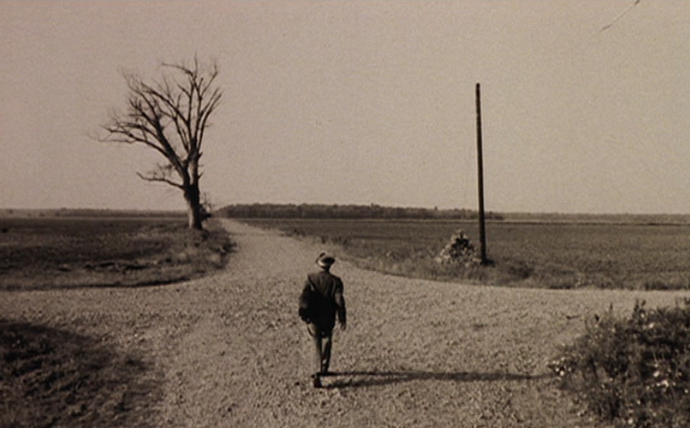
Thank you
Presentation based on the following papers and references therein
Lahtinen TJ, Hämäläinen RP (2016)
Path dependence and biases in the even swaps decision analysis method,
European Journal of Operational Research, special issue on Behavioural OR.
Hämäläinen RP, Lahtinen TJ (2016)
Path Dependence in Operational Research – How the Modeling Process Can Influence the Results, Operations Research Perspectives.
Available at http://sal.aalto.fi/publications/

Slide 21
References that are not included in the path dependence papers by Hämäläinen and Lahtinen
Franco L.A., Hämäläinen R.P., 2016a. Behavioural operational research: Returning to the roots of the OR profession. European Journal of Operational Research, Vol. 249, Issue 3, pp 791-795.
Franco L.A., Hämäläinen R.P., 2016b. Engaging with behavioural OR: On methods, actors, and praxis. Behavioural operational research: Theory, methodology and practice. Palgrave.
Robinson, J. B. 1982. Energy backcasting: A proposed method of policy analysis. Energy policy Vol. 10, Issue 4, pp 337-344.

Slide 22
Some OR professionals recognized the idea of path dependence already early
Morris (1967)
Discusses the process of model development
Little (1970)
Model needs to be adjustable in case we learn more about the problem
Landry et al. (1983)
Multiple ”valid” models with different outcomes can be built for the same problem

Slide 23
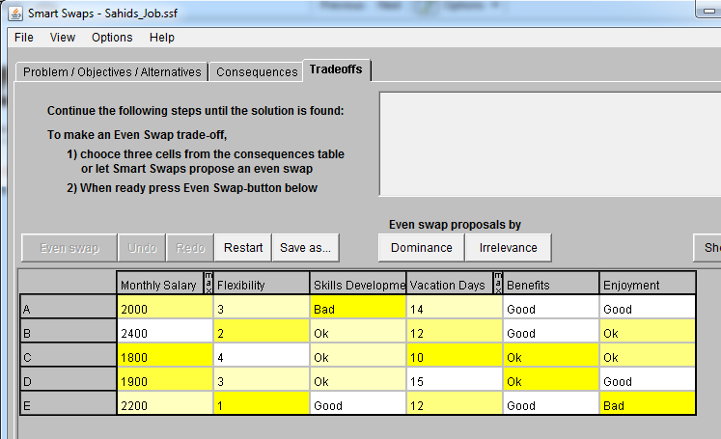
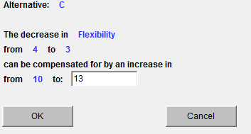
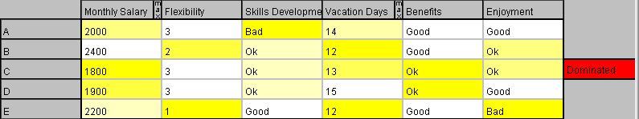
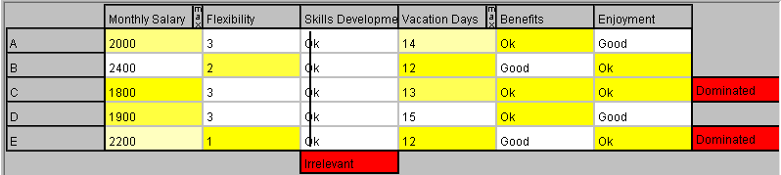
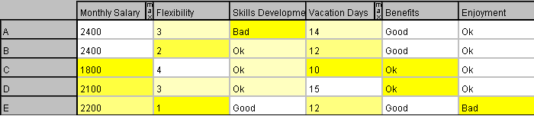
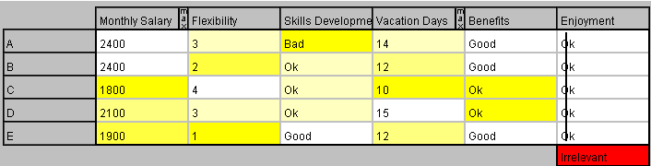
Accumulation of bias in the Even Swaps process
Lahtinen and Hämäläinen (2016):
Accumulation of loss aversion and scale compatibility biases creates path dependence in Even Swaps
DM chooses A
DM chooses B

Slide 24
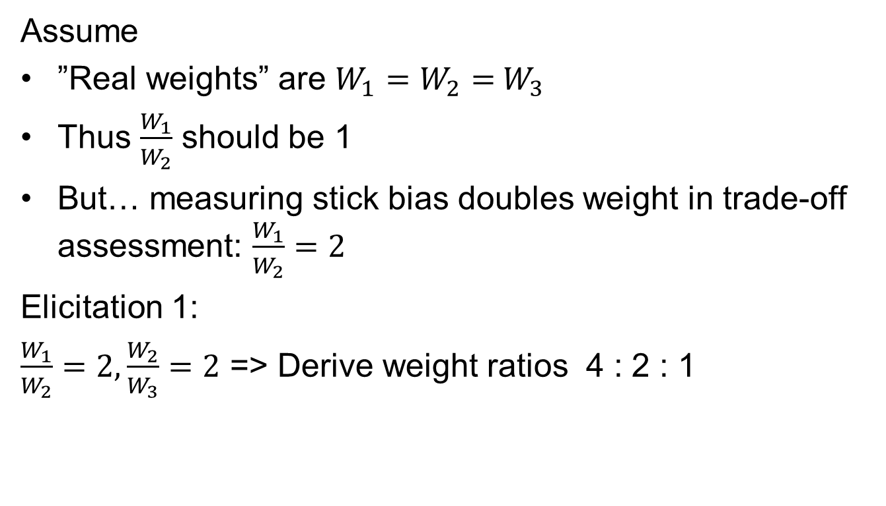
Example of cancelling out bias
Assume
”Real weights” are $W_{1}=W_{2}={ W}_{3}$
Thus $\frac{W_{1}}{W_{2}}$ should be 1
But… measuring stick bias doubles weight in trade-off assessment: $\frac{W_{1}}{W_{2}}=2$
Elicitation 1:
$\frac{W_{1}}{W_{2}}=2,\frac{W_{2}}{W_{3}}=2$ => Derive weight ratios 4 : 2 : 1

Slide 25

Example of cancelling out bias
Assume
”Real weights” are $W_{1}=W_{2}={ W}_{3}$
But… measuring stick effect doubles weight in trade-off assessment: $\frac{W_{1}}{W_{2}}=2$
Elicitation 1:
$\frac{W_{1}}{W_{2}}=2,\frac{W_{2}}{W_{3}}=2$ => Derive weight ratios 4 : 2 : 1
Elicitation 2:
$\frac{W_{1}}{W_{2}}=2,\frac{W_{2}}{W_{3}}=2,\frac{W_{3}}{W_{1}}=2$ => Estimate weight ratios 1 : 1 : 1

