Slide 1
Path Dependence in Operational Research An illustration with the Even Swaps Decision Analysis method
Tuomas J. Lahtinen, Raimo P. Hämäläinen
tuomas.j.lahtinen@aalto.fi, raimo.hamalainen@aalto.fi
Systems Analysis Laboratory, Department of Mathematics and Systems Analysis
The document can be stored and made available to the public on the open internet pages of Aalto University. All other rights are reserved.
Notes:
Good afternoon everyone and welcome to hear this talk.
My name is Tuomas Lahtinen. I am going to present you research that I have conducted together with my supervising professor, Raimo Hämäläinen. We work at the Systems Analysis Laboratory of Aalto university.

Slide 2

Path dependence
Earlier in economics, policy studies and organizational decision making (Arthur 1989, Webster 2008, Sydow et al. 2009)
’History matters’, i.e. current state depends on the history
Lock-in phenomena, e.g. QWERTY (David 1985)
Photo by Ileana Gonzales, CC BY-NC-ND 2.0
Notes:
Lyhyesti tämä.
The term path dependence has earlier been used mostly in economics literature but also in other disciplines such as polciy studies and organizational decision making.
In general, the term refers to the idea that current state of the world is not inevitable result of history but instead it is path dependent.
One specific example is how the path can end up locked-in to a particular course. The most famous being about the QWERTY keyboard layout.

Slide 3
Path in Operational Research
The sequence of steps taken in the OR process
Stakeholder engagement
Framing and structuring
Choice of model
Data collection and preference elicitation
Order of steps in specifying and solving the model
Notes:
The OR engagement is also a process that can follow different paths.
The steps of the path can relate to stakeholder engagement, framing and structuring, choice of model, data collection, order of steps in building the model. There are multiple degrees of freedom in how to conduct each of these steps and also they can be conducted in different orders.

Slide 4
Path dependence in OR: Process outcome depends on the path followed
Implicitly recognized already early
Best practices: Morris (1967), Pidd (1999)
Adaptive problem solving: Little (1970), Ormerod (2008)
Model validity: Landry et al. (1983)
Ethics: Rauschmayer et al. (2009)
Integrative perspective:
Path dependence refers to all the phenomena where different paths lead to different outcomes.
Notes:
By path dependence in OR we simply mean that the outcome of the OR process can depend on which path is followed.
This has been implicitly recognized already in several places such as best practices, adaptive, model validity and ethics literature. For example, Landry et al. Notice that two different but both valid models can lead to different results in the same problem.
However, currently there does not exist one term for the phenomena and the literature is scattered. Therefore we suggest that path dependence in OR is useful as an integrative perspective.

Slide 5
Is path dependence a risk?
Likely to be in
Optimization, efficiency
Important policy problems, normative decision support
Not necessarily if goal is to increase understanding
Learning with modeling
Creation of shared understanding of the problem
Stakeholder engagement
Trying different paths can be beneficial to learning
Notes:
So, is path dependence a risk?
We suggest that it is more likely to be in optimization, reaching efficiency and normative decision support where one would like to find one ”best” solution.
In important policy problems one should at least be aware of the phenomena and its possible origins.
However, path dependence is not such a big risk if the goal is to increase understanding. It can even be beneficial to try out different paths.

Slide 6
Drivers and origins
System
Learning
Procedure
Behavior
Motivation
Uncertainty
External environment
Can interact and occur together
Notes:
Next I will present seven drivers and origins of path dependence which can interact and occur together.

Slide 7
System
Formed by the people involved in the problem solving process
Lock-in to one approach. Groupthink, working with ”our” models
Irreversibility. Due to budget, time or resource constraints
Also the system under study
’Mathematical’: Increasing returns, bifurcations, feedback loops
This is the
right model
Yes
Yes
Yes
Yes
Yes
Yes
Notes:
By systemic drivers we refer to phenomena related to either the social system formed by the people involved in the problem solving OR to the system under study.
One example of systemic path dependence in OR is the the possible lock-in to one modeling approach. In peer group it is easy to convince each other that this is the right model.
Then there is different sources of irreversibility, for example if you have started by collecting a set of data, then you can be forced to work with that since you do not have the possibility to start over and collect a different set.
More generally, there the systemic sources can be described mathematically as increasing returns, bifrucations and feedback loops.
Bifurcation collapse of a fishery.

Slide 8
Learning
Problem owners, stakeholders and modelers learn about the problem: revise assumptions, redirect the process
Unlearning preconceived solutions
Importance of early framing: Value-focused thinking?
Procedure
Properties and structure of the procedure used to solve the problem
Technical properties, convergence
Order of problem solving steps
Decomposition into sub-problems
Notes:
Learning is important because it is actually one outcome of the OR process but also something that happens during the process and it influences the direction to which the process will develop.
One particularly important thing in practice can be unlearning: When the OR intervention begins, the stakeholders and problem owners can have strong opinions about what the solution should be like.
Then to the next one.
Procedural origins are related to the properties and structure of the procedure used to solve the problem. The procedure can be for example “building a regression model and making conclusions based on it” or “use of MCDA”.
Procedural path dependence can arise from technical properties, from order of steps but also from decomposition of the procedure.

Slide 9
Behavior
Cognitive biases: Accumulation of effects
Anchoring: Preference elicitation, negotiation, valuation, forecasting…
Status quo bias, Sunk cost effect: Commitment to previously adopted models and software
Motivation
People’s goals affect the OR process
High risk in messy and controversial problems
OR expert delivering desired result, confirmation bias
Strategic behavior in group processes
Notes:
By behavioral origins we refer to behavioral effects such as biases.
One possibility is that effects of cognitive biases accumulate. For example there could be a process consisting of three steps, in each of these there can be a cognitive bias. If all of these biases work in favor of alternative A then the effects accumulate.
Another relevant phenomena is anchoring.
But then there is also status quo bias and sunk cost effect. These could lead a modeler or an organization to even irrationally commit to use of previously adopted models or software.
Motivational drivers relate to people’s goals. These pose a high risk in messy and controversial problems. One thing that could happen is that OR expert would deliver the desired result.

Slide 10
Uncertainty and changes in the external environment
Uncertainty in assumptions: No one ’right’ path, sensitivity to initial modeling choices
Changes in external environment: Same path can lead to different results at different times
Mitigation
Multi-modeling: Use of multiple models in the same problem. To help find path dependence, average results, find robust solutions.
Adaptive modeling: Adjust the OR intervention and the model adaptively as the process evolves.
Notes:
MIETI When there exists uncertainty in assumptions there is clearly no one right path to be followed. Also the outcome can be sensitive to initial modeling choices, possibly chosen by chance or convenience. Changes in the external environment can cause the same path to lead to different results at different times.
Two possibilities for mitigating are multi-modeling and adaptive modeling.
Multi-modeling refers to the idea of use of multiple models in same problems. This helps to detect path dependence, also results can be averaged and robust solutions can be found.
Adaptive modeling refers to the idea that one does not commit to a whole process from the start, instead one adaptively builds the model and checks for assumptions and results as the process evolves.

Slide 11
Checklist for the practitioner
What is the main goal of the modeling process – learning or prescriptive modelling?
Is path dependence a real risk and do we want to avoid it?
Consider measures and risks related to the system created by the problem solving process
Consider procedural, behavioral and motivational biases
Consider technical properties, such as irreversibilities, in the problem under study
Is it possible to use multiple models?
Consider the possibility of an adaptive modelling approach

Slide 12

Illustration with the Even Swaps method
Even Swaps (Hammond et al. 1998):
Simple, clearly defined paths
Well known in the Decision Analysis community
Goal: Find the ’best’ alternative with multi-attribute evaluation
Multiple paths possible
Trade-offs between attributes
Notes:
Nopeasti:
The Even Swaps method is introduced in the book Smart Choices by Hammond Keeney and Raiffa.
The goal is to find the best alternative with multi-attribute evaluation.
Preferences of the DM are elicited using even swaps that basically consist of trade-offs between two attributes.

Slide 13
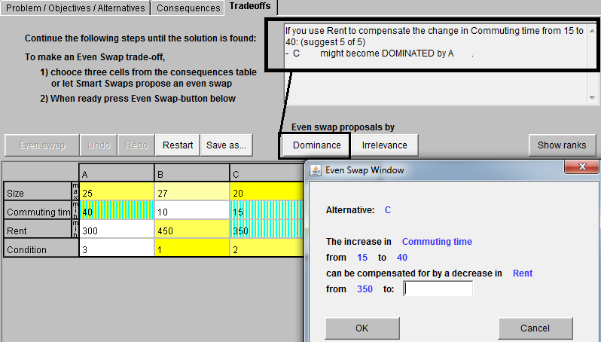
Even Swap Smart-Swaps software by Mustajoki and Hämäläinen (2007)
Notes:
Here is an example of an even swap. The interface is from the smart-swaps software.
The decision is about choosing a rental apartment.
The decision maker conducts a swap in which he modifies the alternative C.
The idea is that the DM improves the alternative in one attribute and makes it worse in another. These changes compensate for each other so that the value of the alternative does not change.
Here the DM increases the commuting time related to alternative C from 15 to 40 minutes. As compensation he should decrease the rent from 350 to somewhere less depending on his preferences.

Slide 14
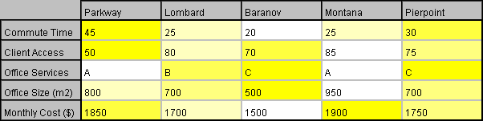
Office selection problem (Hammond, Keeney, Raiffa 1999)
25
78
Practically
dominated
by
Montana
An even swap
Dominated
by
Lombard
Commute time removed as irrelevant
(Slightly better in Monthly Cost, but equal or worse in all other attributes)
Notes:
The Even Swaps process begins with a consequences table where the consequences of the alternatives are listed.
Dominance.
Here the DM makes an even swap, as result all alternative have equal consequences in commuting time.
This way the DM can be reduced until there is only one non-dominated alternative left.

Slide 15
Biases in the even swaps
Paths consist of different sequences of trade-off judgments (even swaps)
Biases:
Scale compatibility: Extra weight for the measuring stick
Loss aversion: Extra weight for the loss attribute
Effects of biases can accumulate during the process
⇒Different paths favor different alternatives
How much should you pay to save 30 minutes of commuting time?

Slide 16
Experiment
148 students from Aalto university
Use Even Swaps method in
Apartment selection
Job selection
Each subject completed both tasks on two or three different paths.

Slide 17
Results 1: Pricing path favors alternatives good in monetary attribute
*
***
ns
***
ns: not significant, *: p-value < 0.05, ***: p-value < 0.001. Based on McNemar’s test.

Slide 18
Results 2: All swaps in same alternative ⇒ this alternative is favored
Result is significant with p=0.004. Based on McNemar’s test.

Slide 19
Summary of experiment
Use of one measuring stick attribute
⇒ alternatives that are good in this attribute will be favored
Explanation: Accumulated effects of scale compatibility bias
Many swaps carried out in same alternative
⇒ this alternative will be favored
Explanation: Accumulated effects of loss aversion bias
Mitigation:
Use measuring stick in which alternatives differ least
Conduct swaps evenly in all alternatives
Restarting the process after each elimination by dominance

Slide 20
Conclusions
Path dependence is a real phenomenon and risk in OR
Extra concern in large policy problems and normative decision support
Most important driver is likely to be human behavior
Exists in the Even Swaps method
Awareness is the first step to cope with path dependence
Think of the perspectives, use the checklist
More research on mitigation needed
Challenge to develop methods when path dependence is seen as a risk

Slide 21

Thank you
Based on manuscript:
http://sal.aalto.fi/publications/pdf-files/mham15b.pdf
Photo by Dioboss, CC BY-NC-SA 2.0

Slide 22
Presentation based on manuscript:
Hämäläinen, R.P., Lahtinen, T.J., 2015. Path Dependence in Operational Research - An Illustration with the Even Swaps Decision Analysis Method. http://sal.aalto.fi/publications/pdf-files/mham15b.pdf
References: Little, J.D.C., 1970. Models and Managers: The Concept of Decision Calculus. Management Science 16 (8), B466-B485. Reprinted in Management Science 50 (12 Supplement), 1841-1853. Morris, W. T., 1967. On the Art of Modeling. Management Science 13 (12), B707-B717. David, P.A., 1985. Clio and the Economics of QWERTY. The American Economic Review 75 (2), 332-337. Landry, M., Malouin, J-L., Oral, M. 1983. Model validation in operations research. European Journal of Operational Research 14 (3), 207-220. Arthur, W.B., 1989. Competing technologies, increasing returns, and lock-in by historical events. The Economic Journal 99 (394), 116-131. Hammond, J.S., Keeney, R.L., Raiffa, H., 1999. Smart Choices: A Practical Guide to Making Better Decisions. Harward Business School Press, Boston, MA. Pidd, M., 1999. Just Modeling Through: A Rough Guide to Modeling. Interfaces 29 (2), 118-132.
Mustajoki, J., Hämäläinen, R.P., 2007. Smart-Swaps - A decision support system for multicriteria decision analysis with the even swaps method. Decision Support Systems 44 (1), 313-325. Webster, M., 2008. Incorporating Path Dependency into Decision-Analytic Methods: An Application to Global Climate-Change Policy. Decision Analysis 5 (2), 60-75. Ormerod, R. J. 2008. The transformation competence perspective. Journal of the Operational Research Society 59(11), 1435-1448. Rauschmayer, F., Kavathatzopoulos, I., Kunsch, P.L., Menestrel, M. Le., 2009. Why good pratice of OR is not enough – Ethical challenges for the OR practitioner. Omega 37 (6), 1089-1099. Sydow, J., Schreyögg, G., Koch, J., 2009. Organizational Path Dependence: Opening The Black Box. Academy of Management Review 34 (4), 689-709.

