Slide 1
Spatial Multi-Attribute Decision Analysis with Incomplete Preference Information
Mikko Harju*, Juuso Liesiö**, Kai Virtanen*
* Systems Analysis Laboratory, Department of Mathematics and Systems Analysis, Aalto University School of Science
** Department of Information and Service Economy, Aalto University School of Business

Slide 2

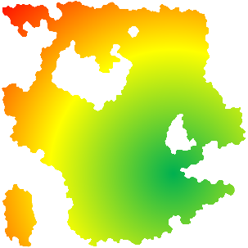


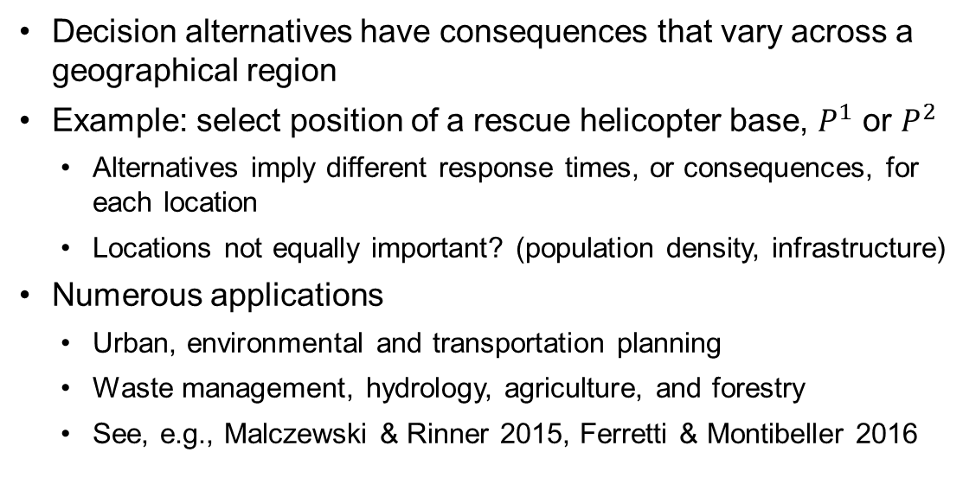
Spatial Decision Analysis
Alternative 1
Decision alternatives have consequences that vary across a geographical region
Example: select position of a rescue helicopter base, $P^{1}$ or $P^{2}$
Alternatives imply different response times, or consequences, for each location
Locations not equally important? (population density, infrastructure)
Numerous applications
Urban, environmental and transportation planning
Waste management, hydrology, agriculture, and forestry
See, e.g., Malczewski & Rinner 2015, Ferretti & Montibeller 2016
$$P^{1}$$
Alternative 2
$$P^{2}$$
Long
Short
Response time

Slide 3
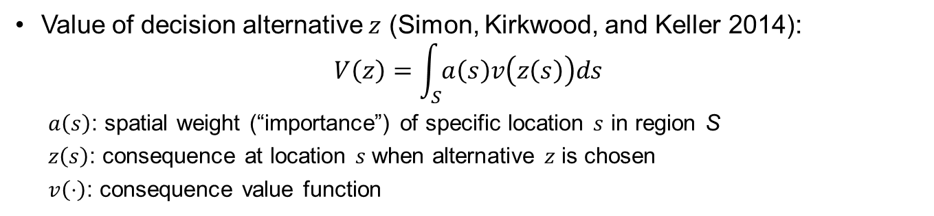
Spatial Value Function
Value of decision alternative $z$ (Simon, Kirkwood, and Keller 2014):
$$V\left(z\right)=\int_{S}{a\left(s\right)v\left(z\left(s\right)\right)ds}$$
$a\left(s\right)$: spatial weight (“importance”) of specific location $s$ in region S
$z\left(s\right)$: consequence at location $s$ when alternative $z$ is chosen
$v\left(⋅\right)$: consequence value function
Our contribution:
Axiomatic foundation for representing preferences with the spatial value function
Incomplete preference information – determining dominances among alternatives based on preference statements
Challenges:
Specifying spatial weights 𝑎(𝑠) for an infinite number of locations 𝑠
Only a conjecture on the underlying preference assumptions

Slide 4














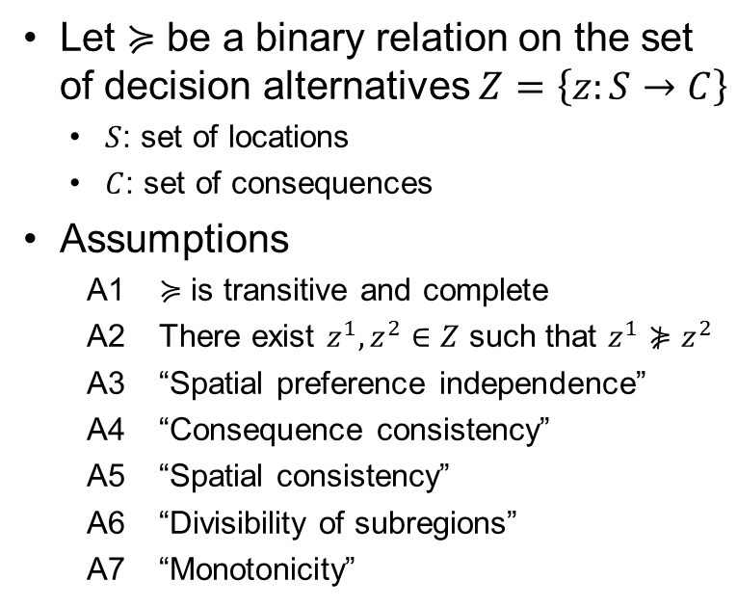
Preference Assumptions
A3: Preference between two alternatives does not depend on locations with equal consequence
Let $≽$ be a binary relation on the set of decision alternatives $Z=\left\{z:S→C\right\}$
$S$: set of locations
$C$: set of consequences
Assumptions
A1 ​$≽$ is transitive and complete
A2 There exist $z^{1},z^{2}∈Z$ such that $z^{1}⋡z^{2}$
A3 “Spatial preference independence”
A4 “Consequence consistency”
A5 “Spatial consistency”
A6 “Divisibility of subregions”
A7 “Monotonicity”
$$z^{1}$$
$$z^{2}$$
$$≽$$
$$⇔$$
$$z^{3}$$
$$z^{4}$$
$$≽$$
Consequences $C$
Least preferred
Most preferred

Slide 5
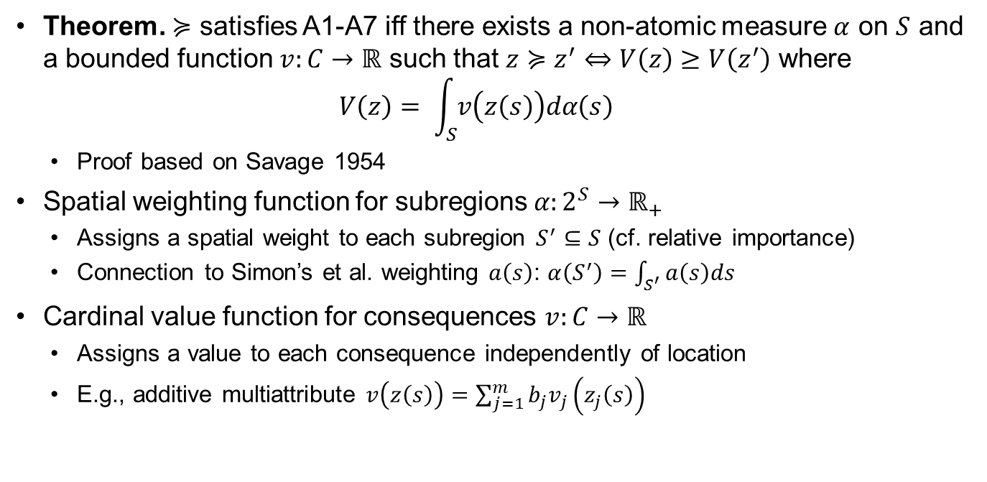

Additive Spatial Value Function $V\left(z\right)$
Theorem. $≽$ satisfies A1-A7 iff there exists a non-atomic measure $α$ on $S$ and a bounded function $v:C→ℝ$ such that $z≽z^{′}⇔V\left(z\right)≥V\left(z^{′}\right)$ where $V\left(z\right)= \int_{S}{v\left(z\left(s\right)\right)dα\left(s\right)}$
Proof based on Savage 1954
Spatial weighting function for subregions $α:2^{S}→ℝ_{+}$
Assigns a spatial weight to each subregion $S^{′}⊆S$ (cf. relative importance)
Connection to Simon’s et al. weighting $a\left(s\right)$: $α\left(S^{′}\right)=\int_{S^{′}}{a\left(s\right)ds}$
Cardinal value function for consequences $v:C→ℝ$
Assigns a value to each consequence independently of location
E.g., additive multiattribute $v\left(z\left(s\right)\right)=\sum_{j=1}^{m}{b_{j}v_{j}\left(z_{j}\left(s\right)\right)}$

Slide 6


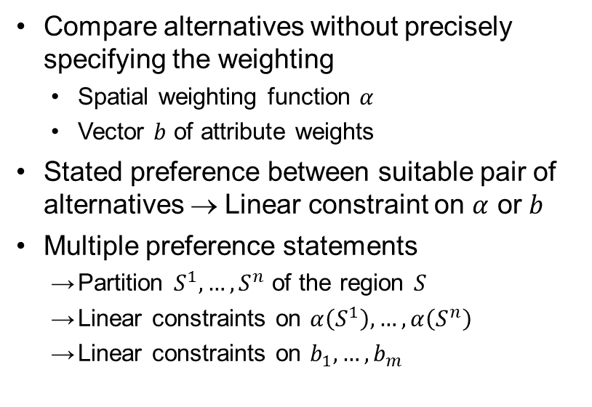


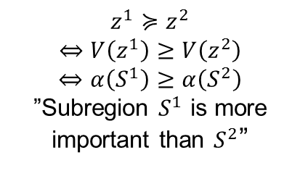




Incomplete Preference Information
$$z^{1}$$
$$z^{2}$$
Compare alternatives without precisely specifying the weighting
Spatial weighting function $α$
Vector $b$ of attribute weights
Stated preference between suitable pair of alternatives → Linear constraint on $α$ or $b$
Multiple preference statements
Partition $S^{1},…,S^{n}$ of the region $S$
Linear constraints on $α\left(S^{1}\right),…,α\left(S^{n}\right)$
Linear constraints on $b_{1},…,b_{m}$
$$≽$$
$$S^{2}$$
$$S^{1}$$
$$z^{1}≽z^{2}$$
$$⇔V\left(z^{1}\right)≥V\left(z^{2}\right)$$
$$⇔α\left(S^{1}\right)≥α\left(S^{2}\right)$$
”Subregion $S^{1}$ is more important than $S^{2}$”
Consequences $C$
Least preferred
Most preferred

Slide 7



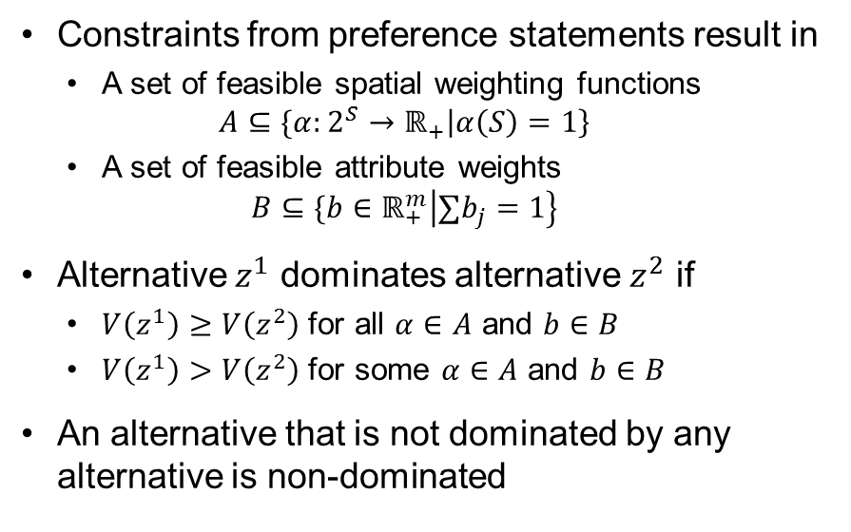



Dominance
Constraints from preference statements result in
A set of feasible spatial weighting functions $A⊆\{α:2^{S}→ℝ_{+}\left|α\left(S\right)=1\right\}$
A set of feasible attribute weights $B⊆\{b∈ℝ_{+}^{m}\left|∑b_{j}=1\right\}$
Alternative $z^{1}$ dominates alternative $z^{2}$ if
$V\left(z^{1}\right)≥V\left(z^{2}\right)$ for all $α∈A$ and $b∈B$
$V\left(z^{1}\right)>V\left(z^{2}\right)$ for some $α∈A$ and $b∈B$
An alternative that is not dominated by any alternative is non-dominated
$z^{1}$ and $z^{3}$
non-dominated
$$z^{3}$$
$V(z)$
$$z^{1}$$
$$z^{2}$$
$α,b$

Slide 8
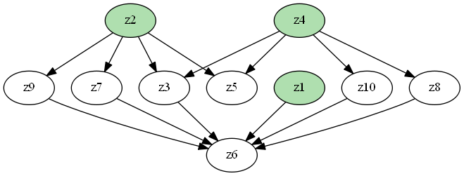
Comparison of Non-Dominated Alternatives
No definite answers, only decision support
Dominance graph – which alternative dominates which
Value intervals – interval of possible values for each alternative
Decision rules
Maximin
Minimax-regret

Slide 9
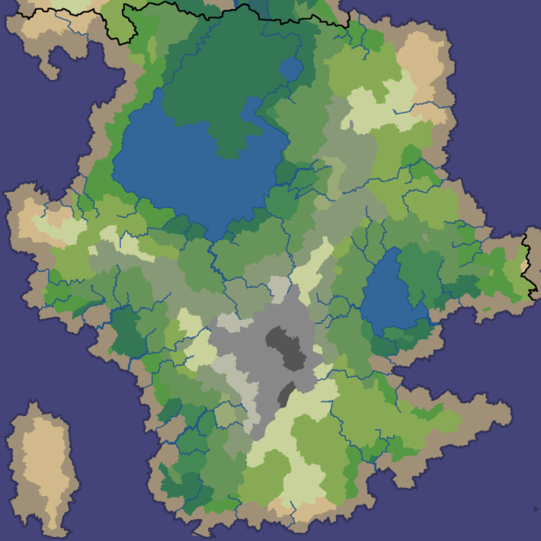

Air Defense Planning: Positioning of Air Bases
Select positions for air bases from a list of candidates
Main bases: 2 out of 3 candidates
Secondary bases: 3 out of 5 candidates
30 possible combinations, or decision alternatives
Threat
Large city
City
Power plant
Threat

Slide 10
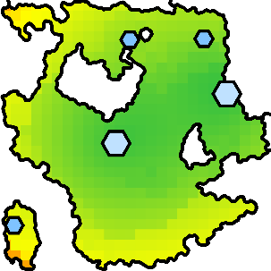
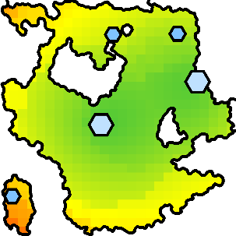
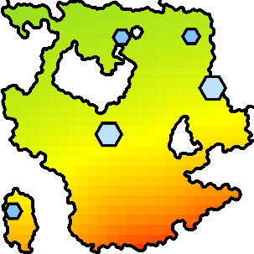


Attributes of Air Defense Capability
“Force fulfillment”
Attribute #1: Average number of defensive flying units available at the location
Attribute #2: As attribute #1, but with a secondary base destroyed (combat sustainability)
“Engagement frontier” where hostiles can first be intercepted by aircraft on alert at the bases
Attribute #3: Location’s distance to south frontier
Attribute #4: Location’s distance to west frontier
Attribute #1
Attribute #2
Attribute #3
Attribute #4
Consequences $C_{j}$
Least preferred
Most preferred

Slide 11
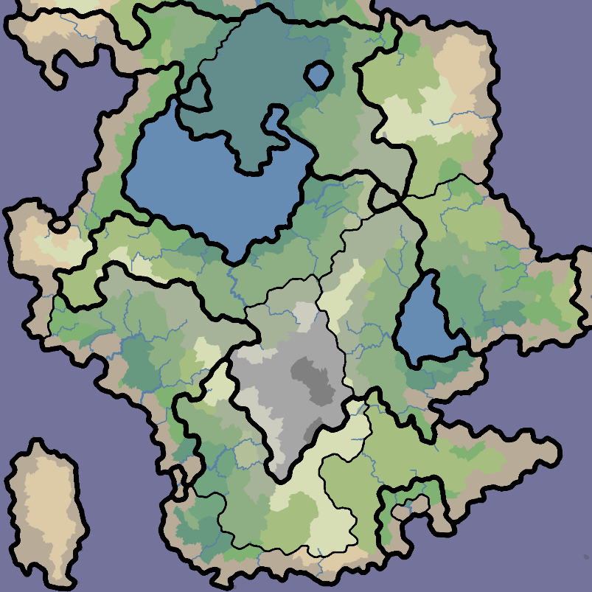
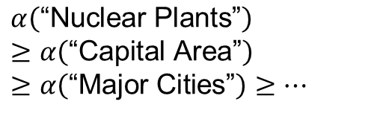

Spatial Preference Statements ($α$)
Partition into 9 areas (thick borders)
Order of importance:
Nuclear
Plants
Nuclear Plants
Capital Area
Major Cities
South Area
West Area
Central Area
East Area
North Area
Island
Major
Cities
Capital
Area
$$α\left(\text{“}\text{Nuclear} \text{Plants}\text{”}\right)$$
$$≥α\left(\text{“}\text{Capital} \text{Area}\text{”}\right)$$
$$≥α\left(\text{“}\text{Major} \text{Cities}\text{”}\right)≥…$$

Slide 12
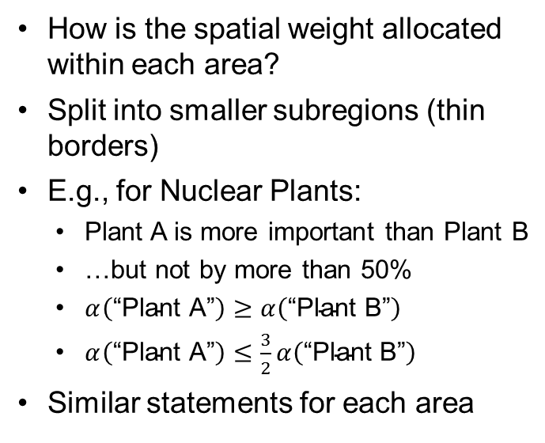
Spatial Preference Statements ($α$)
How is the spatial weight allocated within each area?
Split into smaller subregions (thin borders)
E.g., for Nuclear Plants:
Plant A is more important than Plant B
…but not by more than 50%
$α\left(\text{“}\text{Plant} \text{A}\text{”}\right)≥α\left(\text{“}\text{Plant} \text{B}\text{”}\right)$
$α\left(\text{“}\text{Plant} \text{A}\text{”}\right)≤\frac{3}{2}α\left(\text{“}\text{Plant} \text{B}\text{”}\right)$
Similar statements for each area
Plant B
Plant A

Slide 13

Attribute Preference Statements ($b$)
“Western engagement frontier” ≥ “Southern engagement frontier”
“Southern engagement frontier” ≥ “Force fulfillment”
“Force fulfillment” ≥ “Force sustainability”
“Force fulfillment” + “Force sustainability” ≥ “Western engagement frontier”
Threat
Threat

Slide 14
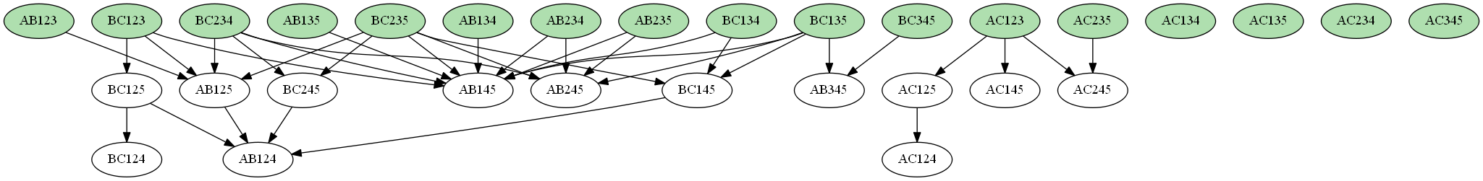
Dominances
3
17 non-dominated alternatives
Secondary base position candidate 3 is included in all non-dominated alternatives
All other candidates are included in some, but not all, non-dominated alternatives
More preference information is needed!
5
4
A
C
2
B
1
Main base
Secondary base
Large city
Power plant

Slide 15
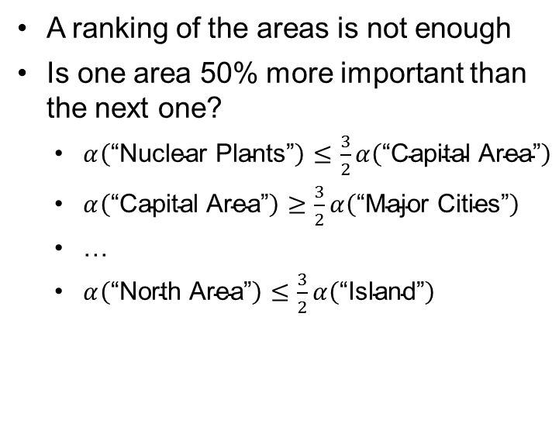
Additional Preference Statements
A ranking of the areas is not enough
Is one area 50% more important than the next one?
$α\left(\text{“}\text{Nuclear} \text{Plants}\text{”}\right)≤\frac{3}{2}α\left(\text{“}\text{Capital} \text{Area}\text{”}\right)$
$α\left(\text{“}\text{Capital} \text{Area}\text{”}\right)≥\frac{3}{2}α\left(\text{“}\text{Major} \text{Cities}\text{”}\right)$
…
$α\left(\text{“}\text{N}\text{orth} \text{Area}\text{”}\right)≤\frac{3}{2}α\left(\text{“}\text{Island}\text{”}\right)$
Nuclear
Plants
North
Area
Major
Cities
Capital
Area
Island

Slide 16
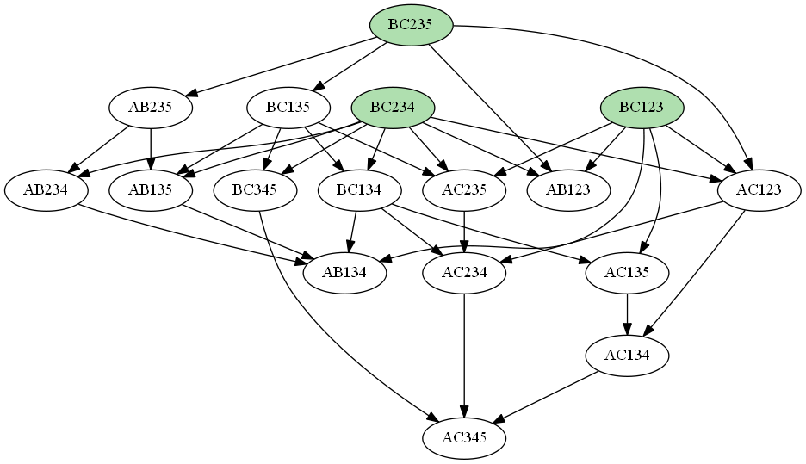
Dominances
Three non-dominated alternatives: BC123, BC234, and BC235
Main bases at B and C
Secondary bases at 2 and 3
Three options for the final secondary base
3
5
4
A
C
2
B
1
Main base
Secondary base
Large city
Power plant

Slide 17
Non-Dominated Alternatives
Similar value intervals
Maximin recommendation: BC123
Minimax-regret recommendation: BC235
3
5
4
A
C
2
B
1
Main base
Secondary base
Large city
Power plant

Slide 18
Conclusion
The additive spatial value function
Axiomatic basis
Weighting subregions rather than locations
Incomplete preference information & non-dominated decision alternatives
Burden of DM eased considerably by not requiring unique spatial weighting
Global sensitivity analysis: Effect of spatial weighting on ranking of alternatives
Future development
Practices and behavioral issues of eliciting the spatial weighting function
Spatial decision support systems: Graphical user interface, utilization of GIS data

Slide 19
References
Ferretti, V. and Montibeller, G., 2016. Key challenges and meta-choices in designing and applying multi-criteria spatial decision support systems. Decision Support Systems, 84
Malczewski, J. and Rinner, C., 2015. Multicriteria decision analysis in geographic information science. New York: Springer
Salo, A. and Hämäläinen, R.P., 1992. Preference assessment by imprecise ratio statements. Operations Research, 40(6)
Savage, L.J., 1954. The foundations of statistics. New York: John Wiley and Sons
Simon, J., Kirkwood, C.W. and Keller, L.R., 2014. Decision analysis with geographically varying outcomes: Preference models and illustrative applications. Operations Research, 62(1)

