Slide 1
Preference Programming for Spatial Multiattribute
Decision Analysis
Mikko Harju*, Juuso Liesiö**, Kai Virtanen*
* Systems Analysis Laboratory,
Department of Mathematics and Systems Analysis, Aalto University School of Science
** Department of Information and Service Economy, Aalto University School of Business

Slide 2




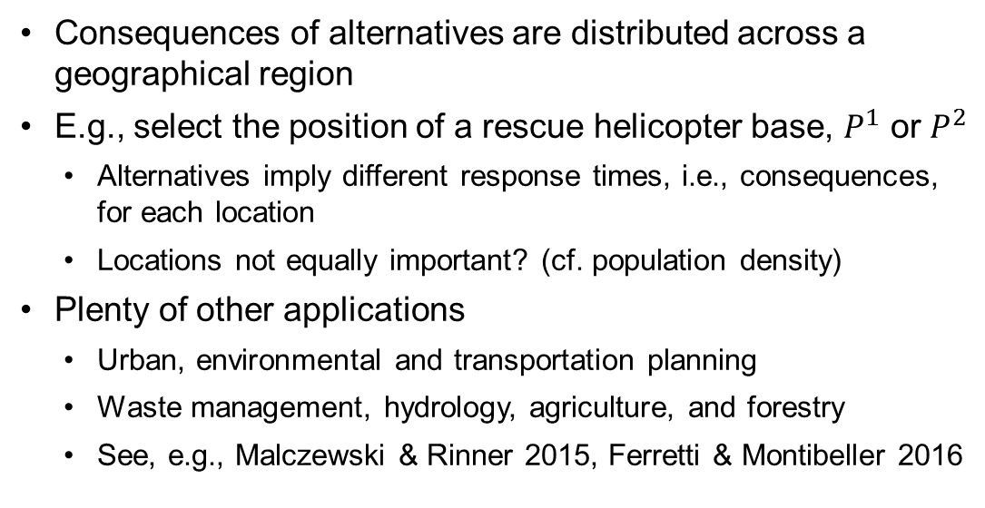
Spatial Decision Analysis
Alternative 1
  Consequences of alternatives are distributed across a geographical region
  E.g., select the position of a rescue helicopter base, $P^{1}$ or $P^{2}$
    Alternatives imply different response times, i.e., consequences, for each location
    Locations not equally important? (cf. population density)
  Plenty of other applications
    Urban, environmental and transportation planning
    Waste management, hydrology, agriculture, and forestry
    See, e.g., Malczewski & Rinner 2015, Ferretti & Montibeller 2016
$$P^{1}$$
Alternative 2
$$P^{2}$$
Long
Short
Response time

Slide 3
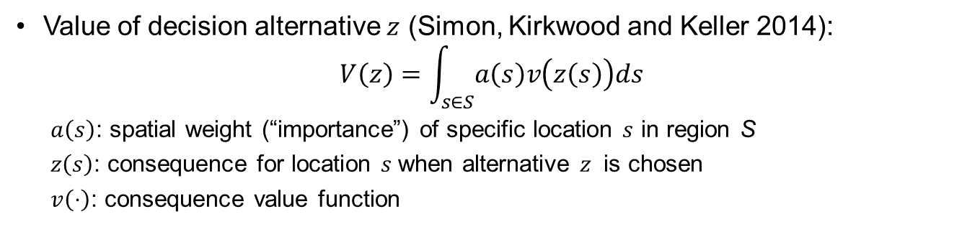
Spatial Value Function
Value of decision alternative $z$ (Simon, Kirkwood and Keller 2014):
$$V\left(z\right)=\int_{s∈S}{a\left(s\right)v\left(z\left(s\right)\right)ds}$$
  $a\left(s\right)$: spatial weight (“importance”) of specific location $s$ in region S
  $z\left(s\right)$: consequence for location $s$ when alternative $z$ is chosen
  $v\left(⋅\right)$: consequence value function
Our contribution:
  Axiomatic basis for preferences that can be represented with the spatial value function
  Spatial preference programming: Determination of dominances among alternatives based on incomplete specification of weights
Challenges:
  Specifying spatial weights 𝑎(𝑠) for an infinite number of locations 𝑠
  Only a conjecture on the underlying preference assumptions exists

Slide 4















Preference Assumptions
Let $≽$ be a binary relation on the set of decision alternatives $Z=\left\{z:S→C\right\}$
  $S$: set of locations
  $C$: set of consequences
Assumptions
  A1 ​$≽$ is transitive and complete
  A2 There exist $z^{1},z^{2}∈Z$ such that $z^{1}⋡z^{2}$
  A3 “Spatial preference independence”
  A4 “Consequence consistency”
  A5 “Spatial consistency”
  A6 “Divisibility of subregions”
  A7 “Monotonicity”
A3: Preference between two alternatives does not depend on locations with equal consequence
$$z^{1}$$
$$z^{2}$$
$$≽$$
$$⇔$$
$$z^{3}$$
$$z^{4}$$
$$≽$$
Consequences $C$
Least preferred
Most preferred

Slide 5
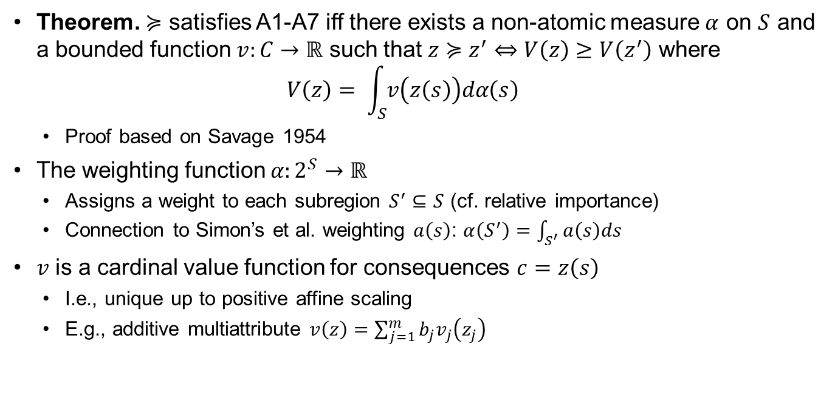

Additive Spatial Value Function $V\left(z\right)$
Theorem. $≽$ satisfies A1-A7 iff there exists a non-atomic measure $α$ on $S$ and a bounded function $v:C→ℝ$ such that $z≽z^{′}⇔V\left(z\right)≥V\left(z^{′}\right)$ where
$V\left(z\right)= \int_{S}{v\left(z\left(s\right)\right)dα\left(s\right)}$
  Proof based on Savage 1954
The weighting function $α:2^{S}→ℝ$
  Assigns a weight to each subregion $S^{′}⊆S$ (cf. relative importance)
  Connection to Simon’s et al. weighting $a\left(s\right)$: $α\left(S^{′}\right)=\int_{S^{′}}{a\left(s\right)ds}$
$v$ is a cardinal value function for consequences $c=z\left(s\right)$
  I.e., unique up to positive affine scaling
  E.g., additive multiattribute $v\left(z\right)=\sum_{j=1}^{m}{b_{j}v_{j}\left(z_{j}\right)}$

Slide 6




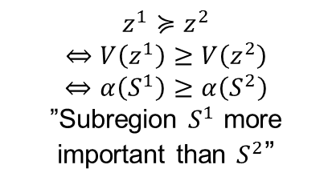




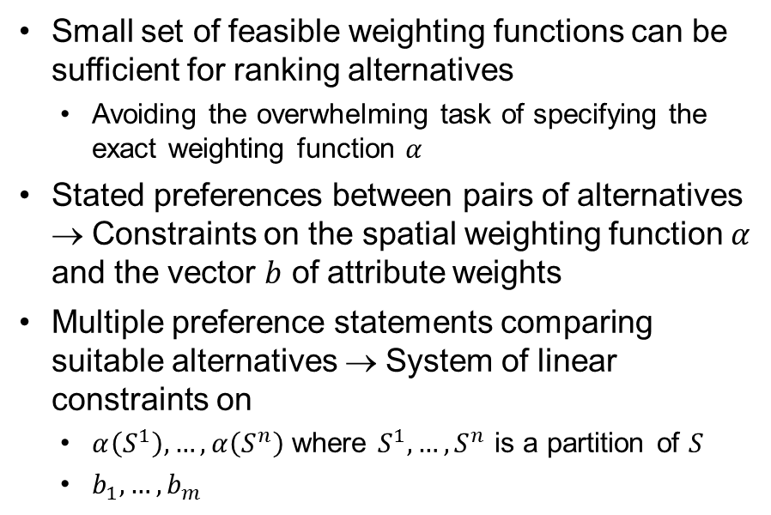
Incomplete Preference Information
$$z^{1}$$
$$z^{2}$$
Small set of feasible weighting functions can be sufficient for ranking alternatives
  Avoiding the overwhelming task of specifying the exact weighting function $α$
Stated preferences between pairs of alternatives → Constraints on the spatial weighting function $α$ and the vector $b$ of attribute weights
Multiple preference statements comparing suitable alternatives → System of linear constraints on
  $α\left(S^{1}\right),…,α\left(S^{n}\right)$ where $S^{1},…,S^{n}$ is a partition of $S$
  $b_{1},…,b_{m}$
$$≽$$
$$S^{2}$$
$$S^{1}$$
$$z^{1}≽z^{2}$$
$$⇔V\left(z^{1}\right)≥V\left(z^{2}\right)$$
$$⇔α\left(S^{1}\right)≥α\left(S^{2}\right)$$
”Subregion $S^{1}$ more
important than $S^{2}$”
Consequences $C$
Least preferred
Most preferred

Slide 7
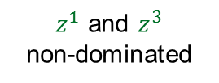


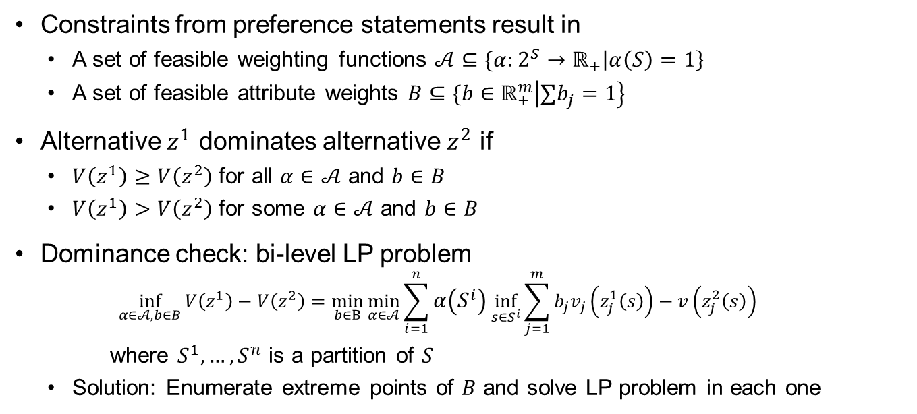



Dominance
Constraints from preference statements result in
  A set of feasible weighting functions $𝒜⊆\{α:2^{S}→ℝ_{+}\left|α\left(S\right)=1\right\}$
  A set of feasible attribute weights $B⊆\{b∈ℝ_{+}^{m}\left|∑b_{j}=1\right\}$
Alternative $z^{1}$ dominates alternative $z^{2}$ if
  $V\left(z^{1}\right)≥V\left(z^{2}\right)$ for all $α∈𝒜$ and $b∈B$
  $V\left(z^{1}\right)>V\left(z^{2}\right)$ for some $α∈𝒜$ and $b∈B$
Dominance check: bi-level LP problem
  $$\inf_{α∈𝒜,b∈B}{V\left(z^{1}\right)−V\left(z^{2}\right)}=\min_{b∈B}{\min_{α∈𝒜}{\sum_{i=1}^{n}{α\left(S^{i}\right)\inf_{s∈S^{i}}{\sum_{j=1}^{m}{b_{j}v_{j}\left(z_{j}^{1}\left(s\right)\right)−v\left(z_{j}^{2}\left(s\right)\right)}}}}}$$
  where $S^{1},…,S^{n}$ is a partition of $S$
  Solution: Enumerate extreme points of $B$ and solve LP problem in each one
$z^{1}$ and $z^{3}$
non-dominated
$$z^{3}$$
$V(z)$
$$z^{1}$$
$$z^{2}$$
$α,b$

Slide 8
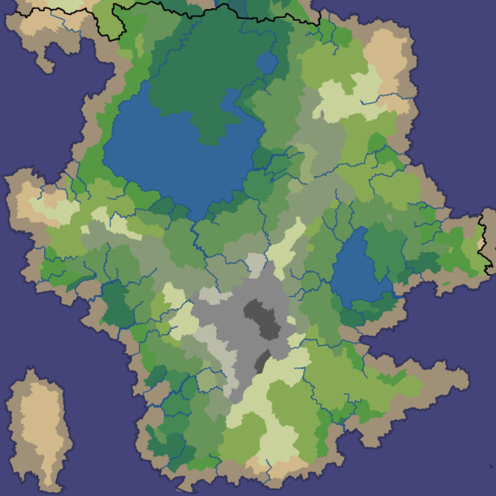

Air Defense Planning:
Positioning of Air Bases
Major city
City
Power plant
Select positions for 2 main and 3 secondary air bases to maximize air defense capability
  Main bases: 3 position candidates
  Secondary bases: 5 position candidates
Spatial consequences provided by a simulation tool – input parameters:
  Number of defensive flying units; fuel consumption; weapons consumption; flight speed
  Positions of air bases; turnaround times; refueling and rearming times; alert, taxi and scramble delays
Threat
Threat

Slide 9
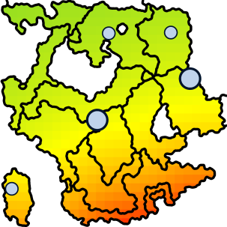

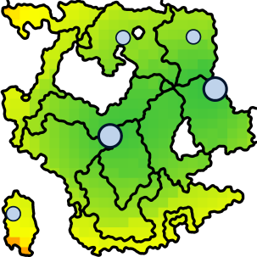
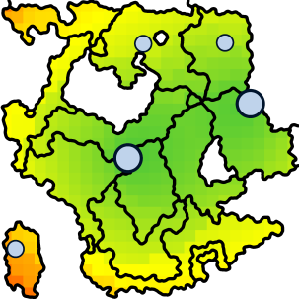

Attributes of Air Defense Capability
Alternative with bases at the highlighted positions
Positions of air bases affect…
“Engagement frontier” where hostile aircraft can first be intercepted by defensive flying units
  Attribute #1: Location’s distance to south frontier
  Attribute #2: Location’s distance to west frontier
“Force fulfillment”
  Attribute #3: Average number of defensive flying units available at the location
  Attribute #4: As attribute #3 with one secondary base destroyed (cf. combat sustainability)
Attribute #1
Attribute #2
Attribute #3
Attribute #4
Consequences $C_{j}$
Least preferred
Most preferred

Slide 10
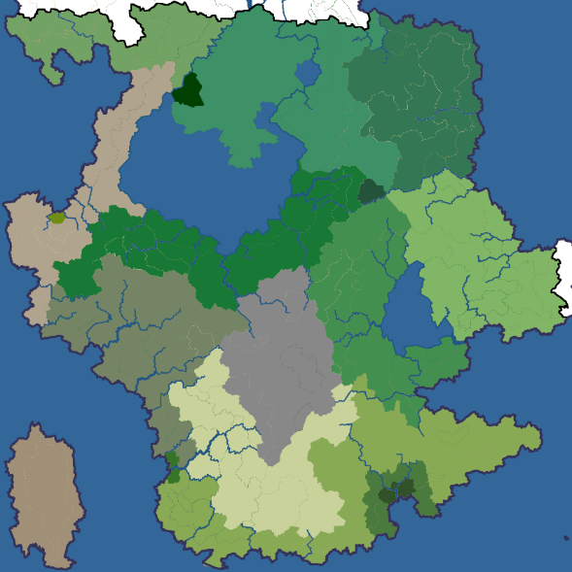
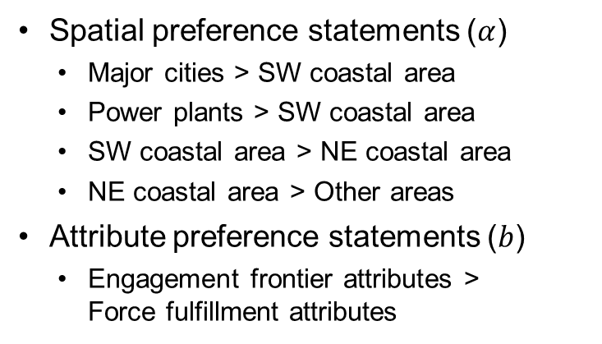
Preference Statements
Spatial preference statements ($α$)
  Major cities > SW coastal area
  Power plants > SW coastal area
  SW coastal area > NE coastal area
  NE coastal area > Other areas
Attribute preference statements ($b$)
  Engagement frontier attributes >
  Force fulfillment attributes

Slide 11
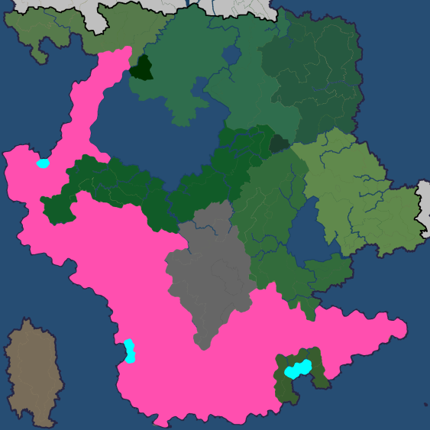
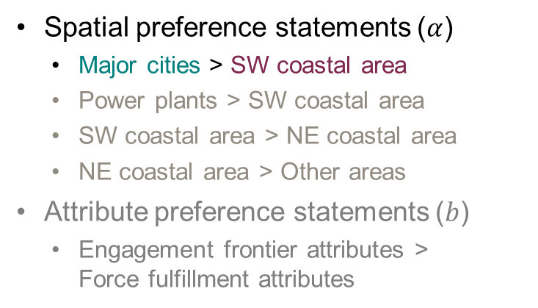
Preference Statements
Spatial preference statements ($α$)
  ​Major cities > SW coastal area
  Power plants > SW coastal area
  SW coastal area > NE coastal area
  NE coastal area > Other areas
Attribute preference statements ($b$)
  Engagement frontier attributes >
  Force fulfillment attributes

Slide 12
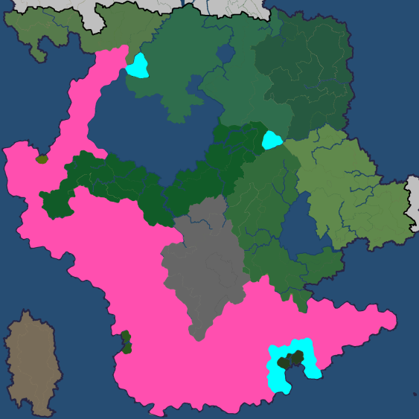
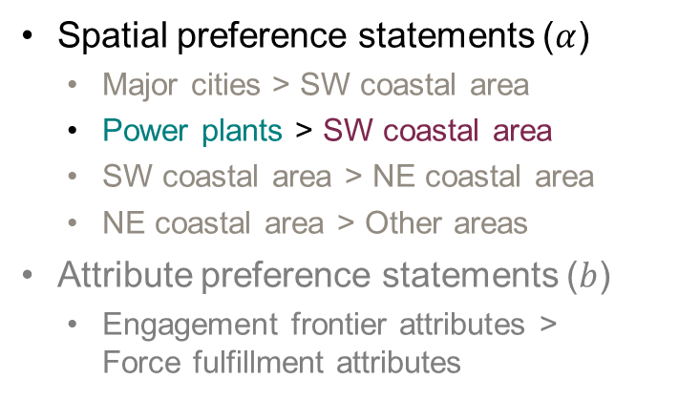
Preference Statements
Spatial preference statements ($α$)
  Major cities > SW coastal area
  ​Power plants > SW coastal area
  SW coastal area > NE coastal area
  NE coastal area > Other areas
Attribute preference statements ($b$)
  Engagement frontier attributes >
  Force fulfillment attributes

Slide 13
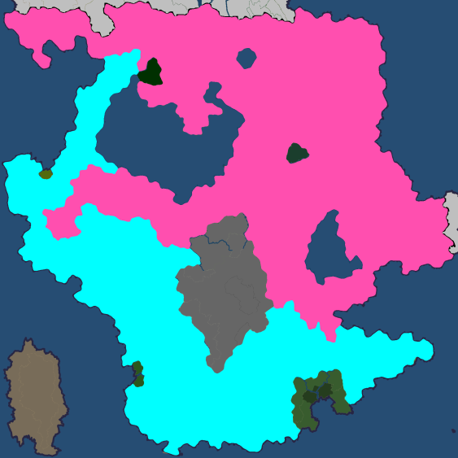
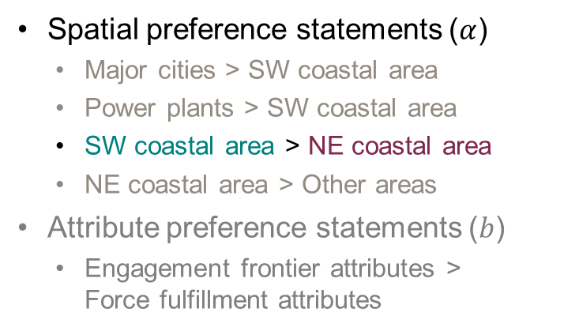
Preference Statements
Spatial preference statements ($α$)
  Major cities > SW coastal area
  Power plants > SW coastal area
  ​SW coastal area > NE coastal area
  NE coastal area > Other areas
Attribute preference statements ($b$)
  Engagement frontier attributes >
  Force fulfillment attributes

Slide 14
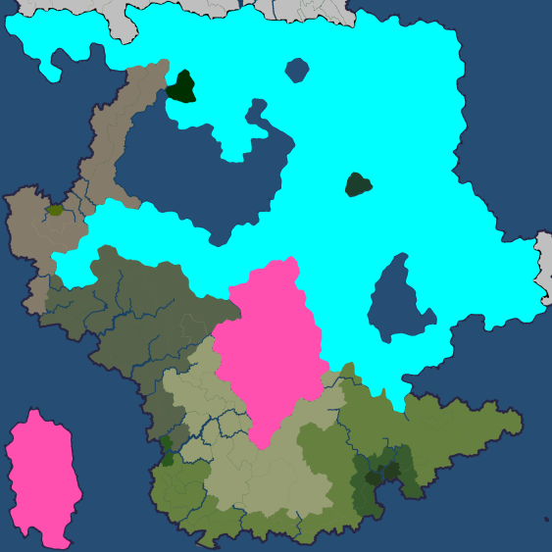
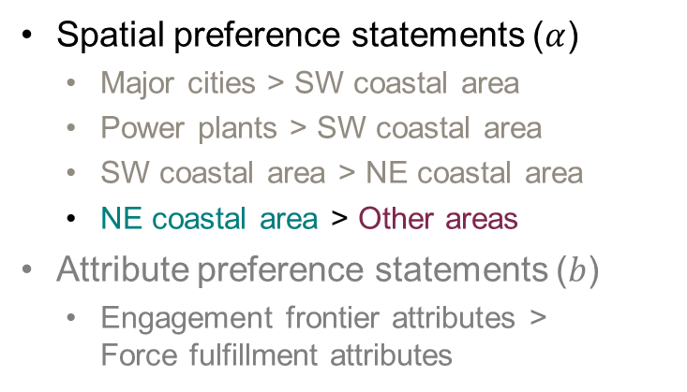
Preference Statements
Spatial preference statements ($α$)
  Major cities > SW coastal area
  Power plants > SW coastal area
  SW coastal area > NE coastal area
  ​NE coastal area > Other areas
Attribute preference statements ($b$)
  Engagement frontier attributes >
  Force fulfillment attributes

Slide 15
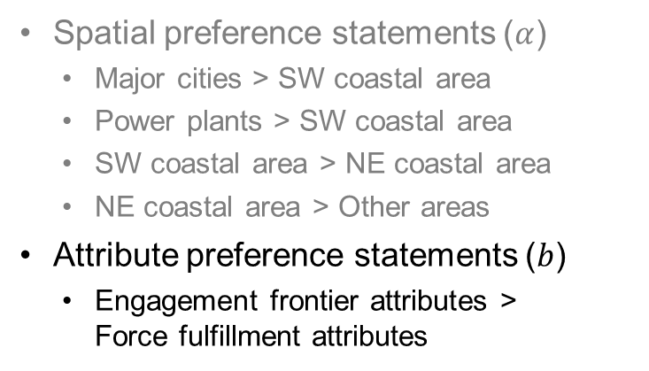
Preference Statements
Spatial preference statements ($α$)
  Major cities > SW coastal area
  Power plants > SW coastal area
  SW coastal area > NE coastal area
  NE coastal area > Other areas
Attribute preference statements ($b$)
  Engagement frontier attributes >
  Force fulfillment attributes
Threat
Threat

Slide 16
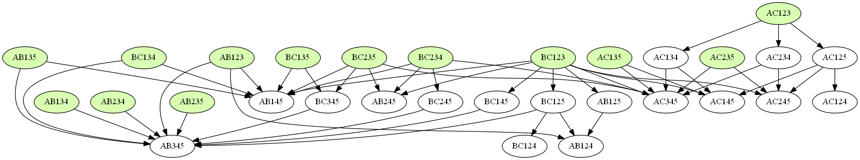
Preference Statements
Spatial preference statements ($α$)
  Major cities > SW coastal area
  Power plants > SW coastal area
  SW coastal area > NE coastal area
  NE coastal area > Other areas
Attribute preference statements ($b$)
  Engagement frontier attributes >
  Force fulfillment attributes
13 non-dominated alternatives

Slide 17

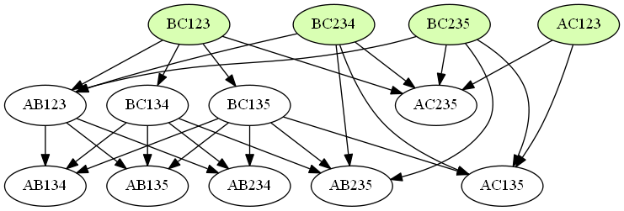
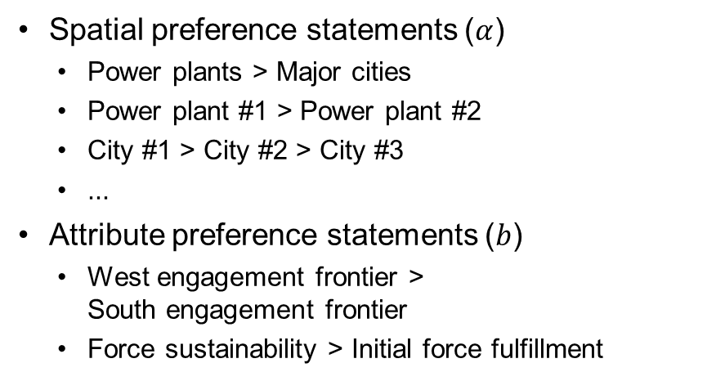
Additional Preference Statements
Spatial preference statements ($α$)
  Power plants > Major cities
  Power plant #1 > Power plant #2
  City #1 > City #2 > City #3
  ...
Attribute preference statements ($b$)
  West engagement frontier >
  South engagement frontier
  Force sustainability > Initial force fulfillment
3
5
4
2
3
1
A
C
2
2
B
4 non-dominated alternatives
1
1
Main base
Secondary base
Major city
Power plant

Slide 18
Conclusion: Spatial Decision Analysis Benefits from Preference Programming
The additive spatial value function
  Axiomatic basis
  Weighting subregions rather than locations
Preference programming for spatial decision analysis
  Incomplete preference information & non-dominated decision alternatives
    Burden of DM eased considerably by not requiring unique spatial weighting
    Global sensitivity analysis: Effect of spatial weighting on ranking of alternatives
Future development
  Practices and behavioral issues of eliciting the weighting function
  Spatial decision support systems: Graphical user interface, utilization of GIS data

Slide 19
References
Ferretti, V. and Montibeller, G., 2016. Key challenges and meta-choices in designing and applying multi-criteria spatial decision support systems. Decision Support Systems, 84
Malczewski, J. and Rinner, C., 2015. Multicriteria decision analysis in geographic information science. New York: Springer
Salo, A. and Hämäläinen, R.P., 1992. Preference assessment by imprecise ratio statements. Operations Research, 40(6)
Savage, L.J., 1954. The foundations of statistics. New York: John Wiley and Sons
Simon, J., Kirkwood, C.W. and Keller, L.R., 2014. Decision analysis with geographically varying outcomes: Preference models and illustrative applications. Operations Research, 62(1)

