Slide 1


Systems Intelligence - A Core Competence for Next Generation Engineers?
Raimo P. Hämäläinen, Esa Saarinen and Juha Törmänen
Systems Analysis Laboratory,
Aalto University, Finland
Systems Analysis Laboratory

Slide 2
Systems in the Engineering Profession
• Engineers work with and from within systems
• How one frames the system defines the
problem and what solutions one sees
• Today engineering challenges are increasingly systemic
There is a need for widening the perspective on systems in engineering – the system can also be emotional and social

Slide 3
Engineer’s Basic Competences
Technical skills:
engineering disciplines and physics/mathematics
In a modern society, hard engineering skills are not enough
Recognized early by e.g. Florman 1997, Nguyen 1998 – social skills, communication, and attitudes count as well
A challenge for the design of engineering education and curricula!

Slide 4
Widening the Requirements for Engineering Competences
Soft capabilities important: emotional and social intelligence and empathy Riemer (2003), Boyatzis et al (2017), Walther et al (2017)
Emotional and social intelligence predict engineer’s effectiveness (Boyatzis et al, 2017):
➔ EI and relationship building training potentially useful in engineering education

Slide 5
Systems Thinking
Systems Thinking in Systems Engineering
Developed as an engineering-oriented competence only
Simulating complex systems
Peter Senge :The Fifth Discipline (1990), the Fifth discipline being Systems Thinking
Systems Thinking recognized as a key competence for managers to understand organizational behaviour
System Dynamics
Modelling socio-economic systems as well
Very little work on the process of systems thinking and on the emotional and subjective dimensions in systemic problem solving

Slide 6
Capacity for Engineering Systems Thinking (CEST) Frank 2000, 2002, 2006
Understanding interconnections; closed-loop thinking
Understanding the whole system and seeing the big picture
Understanding systems synergy
Understanding the system from multiple perspectives
Thinking creatively
Understanding systems without getting stuck on details; tolerance for ambiguity and uncertainty
Understanding the implications of proposed change
Understanding a new system/concept immediately upon presentation
Understanding analogies and parallelism between systems
Understanding limits to growth

Slide 7
The Future of Job Skills World Economic Forum 2016
“Overall, social skills – such as persuasion, emotional intelligence and teaching others – will be in higher demand across industries than narrow technical skills, such as programming or equipment operation and control.
In essence, technical skills will need to be supplemented with strong social and collaboration skills.”

Slide 8
Ten skills you need to have in the Fourth Industrial Revolution World Economic Forum 2016
Complex Problem Solving
Critical Thinking
Creativity
People Management
Coordinating with Others
Emotional Intelligence
Judgement and Decision Making
Service Orientation
Negotiation
Cognitive Flexibility
Could these competences be included in future engineering education programs?

Slide 9
Systems Intelligence (SI) Saarinen and Hämäläinen 2004
Intelligent behaviour in the context of complex systems involving interaction and feedback.
One sees herself being part of the overall system which includes both the technical and social elements
By considering the overall system one looks for intelligent ways of acting
People understand the SI concept intuitively
It stimulates systems thinking and behavioural change

Slide 10
Invisible System
We often perceive systems only through a mechanistic perspective
We see materials, products and costs
When people are considered:
the true system often includes invisible subsystems
such as processes of trust or fear generation or cjhanges in organizational culture

Slide 11
Managing the Invisible
To understand the system, it can be more important to know what is not produced than what the standard output is
SI tries to understand both the visible and the invisible part

Slide 12
Perceptual and Behavioural Change
Seeing both the organizational/physical and the human parts (observability)
The whole system needs richer inputs (controllability)
SI looks for productive inputs to impact both parts

Slide 13

Perceiving
Systemic Perception
Attunement
Attitude
Attitude
Spirited Discovery
Thinking
Reflection
Wise Action
Acting
Positive Engagement
Effective Responsiveness
Notes:
Perceiving: seeing and feeling

Slide 14
Factors of Systems Intelligence
Systemic Perception | Seeing, identifying and recognizing systems, patterns, and interconnections, having situational awareness
Attunement | Engaging intersubjectively, being present, mindful, situationally sensitive and open
Attitude | Keeping a positive outlook, not getting stuck on negative impressions and effects
Spirited Discovery | Engaging with new ideas, embracing change
Reflection | Reflecting upon one’s thinking and actions, challenging one’s own behaviour
Wise Action | Exercising long-term thinking and realizing its implications, understanding that consequences may take time to develop
Positive Engagement | Taking systemic leverage points and means successfully into action with people
Effective Responsiveness | Taking systemic leverage points and means successfully into action with the environment, being able to dance with systems

Slide 15
The SI Self Evaluation Test
Self-report, 32 item questionnaire
Takes 5 to 10 minutes to complete
Results compared against a distribution of scores from over 2000 participants
Describes your strengths and developmental opportunities in the SI factors
Online questionnaire is freely available at: http://systemsintelligence.aalto.fi/
Can be easily used in teaching programs

Slide 16
Some of the Questions
I quickly get a sense of what matters
I critically evaluate my ways of thinking
I view things from many different perspectives
I praise people for their achievements
I am willing to take advice
I successfully manage problematic situations
Scale - how often? : Always ….. Almost never

Slide 17
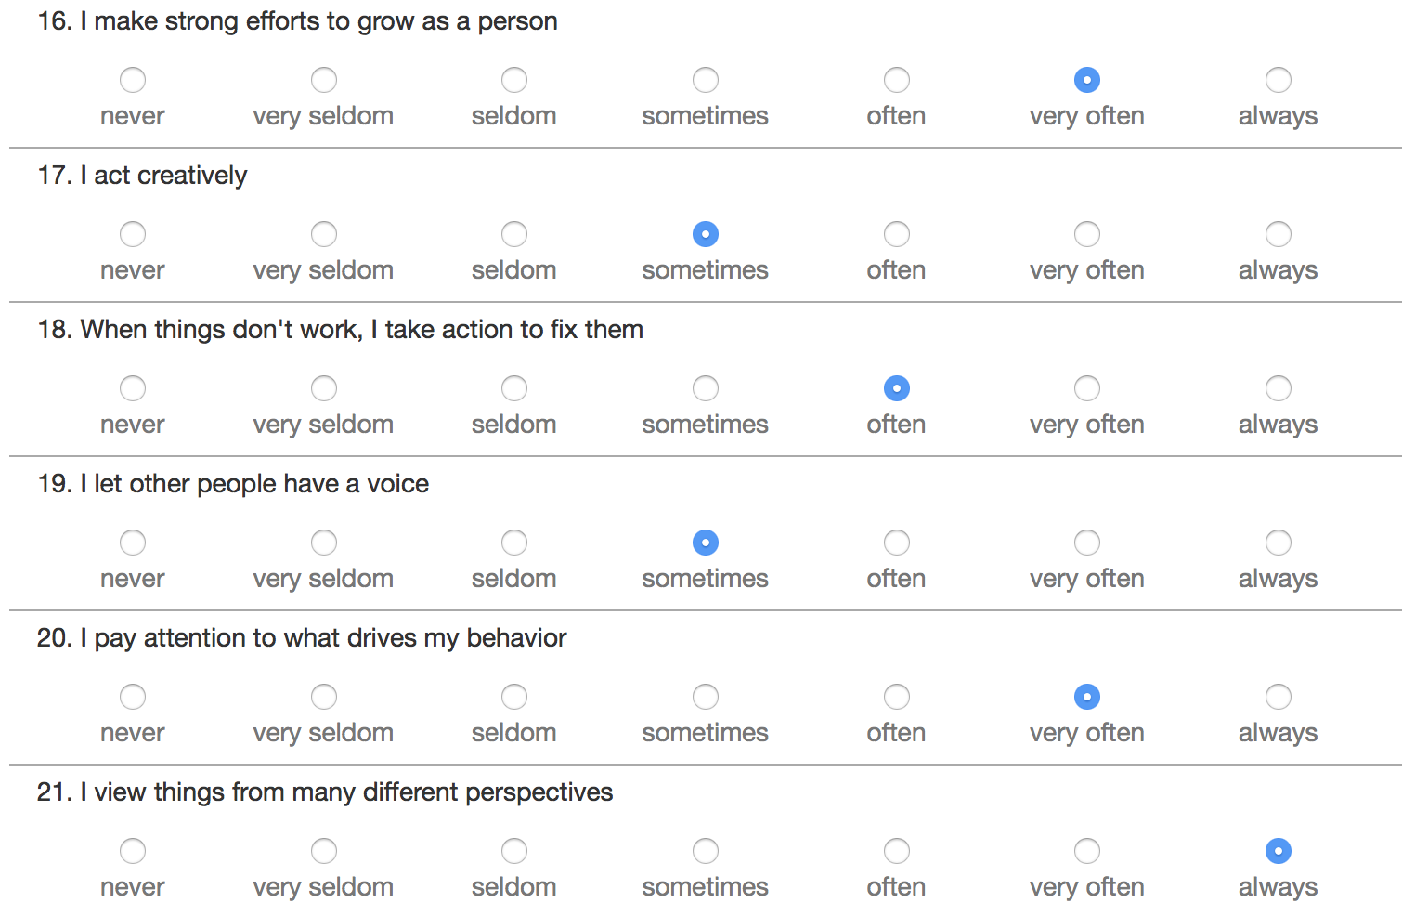
Online Questionnaire

Slide 18
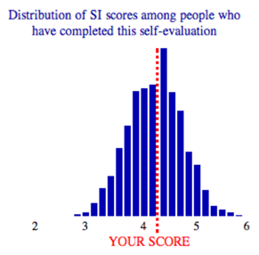
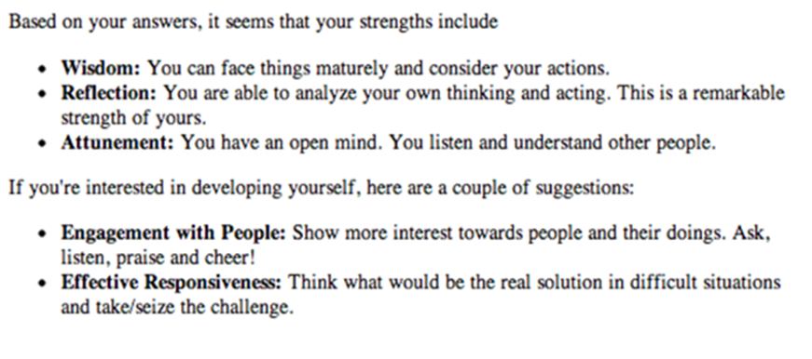
SI Test Results and Feedback

Slide 19
Systems Intelligence as an Engineering Competence
Integrates engineering systems skills with human related competences
- Relates directly to the future job skills
- Embeds emotional intelligence
- Integrates Senge’s First discipline, Personal Mastery, with systems thinking aiming at personal growth
- Helps to understand complex dynamics in organizational settings
Complements the Capacity for Engineering Systems Thinking (CEST) Systems are not only seen from outside as objective technical entities

Slide 20
SI test also works for peers and organizations
The questionnaire can be modified to evaluate:
Peers:
My colleaque
… quickly gets a sense of what matters
... views things from many different perspectives
…
Organizations:
In my organization people
… quickly get a sense of what matters
... views things from many different perspectives
…
We can measure and develop Organizational Systems Intelligence
The same SI factor structure is found for peer evaluations and in organizations

Slide 21
Relevance of SI Factors for Work Performance in Different Professions Peer evaluation by a colleague
 |  | CORRELATIONS |  |  |  |  |  |  |  | PARTIAL CORRELATIONS
Group | N | Systemic percep-tion | Attune-ment | Attitude | Spirited discovery | Reflec-tion | Wise action | Positive engage-ment | Effective respon-siveness | Systemic percep-tion | Attune-ment | Attitude | Spirited discovery | Reflec-tion | Wise action | Positive engage-ment | Effective respon-siveness
Managers | 389 | 0,77 | 0,59 | 0,54 | 0,63 | 0,68 | 0,70 | 0,70 | 0,74 | 0,22*** | -0,10 | 0,07 | 0,00 | 0,05 | 0,04 | 0,19*** | 0,21***
Non-managers | 514 | 0,78 | 0,53 | 0,57 | 0,66 | 0,72 | 0,71 | 0,65 | 0,77 | 0,24*** | -0,09* | 0,09* | -0,01 | 0,05 | 0,06 | 0,05 | 0,22***
Tech/IT | 98 | 0,70 | 0,44 | 0,56 | 0,65 | 0,64 | 0,66 | 0,66 | 0,65 | 0,08 | -0,23* | 0,30** | 0,16 | -0,06 | 0,13 | 0,28** | 0,05
Education | 115 | 0,84 | 0,55 | 0,57 | 0,66 | 0,74 | 0,77 | 0,72 | 0,81 | 0,37*** | -0,15 | 0,11 | -0,17 | -0,04 | 0,10 | 0,23* | 0,24*
Manufacturing | 60 | 0,73 | 0,55 | 0,58 | 0,69 | 0,73 | 0,70 | 0,63 | 0,74 | 0,18 | -0,10 | 0,10 | -0,06 | 0,17 | 0,01 | -0,06 | 0,16
All correlations are statistically significant at a p < 0.001 level
* p < 0.05; ** p < 0.01; *** p < 0.001
In Tech/IT industry, attitude and positive engagement seem to be the two factors that cannot be compensated with other SI skills

Slide 22
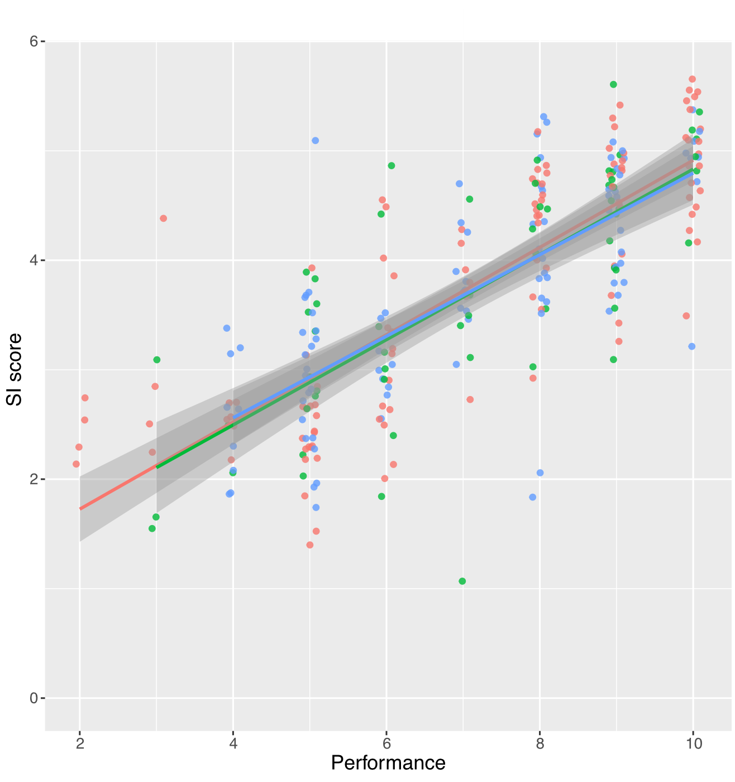
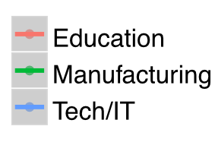
SI and Work Performance go Hand in Hand
Peer evaluation of a person´s work performance and SI by a colleague of hers

Slide 23
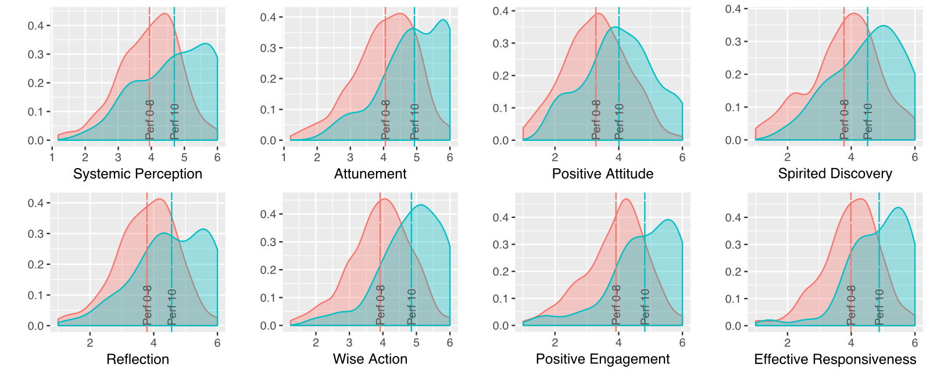
Top organizations score higher in all SI factors Employee rating of the performance of their organization: rated 0-8, rated 10

Slide 24
Introducing SI to engineering students by life-philosophical lectures
Professor Esa Saarinen: Life philosophical lecture series in Aalto University for 15 years
General themes with a systems thinking perspective: Philosophy of life, Ethics, Self-leadership, Organizational behaviour
Approach shown to stir up systems intelligence thinking in students (Lappalainen, 2017)
Course is elective with 600 students

Slide 25
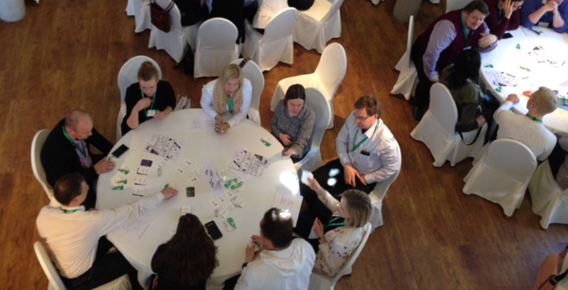
New interactive ways of learning -Gamification
A serious game for learning Systems Intelligence:
A card based game engages participants in a team dialogue session related to SI
Pilot tests extremely positive – helps people and teams initiate learning and improvement without a formal instructor (Hannula and Harviainen, 2018) Easy to organize in engineering education courses as well?

Slide 26
SI as an Engineering Competence Summary
Embeds new skills suggested for engineers: emotional intelligence and empathy, including self and other awareness, perspective taking, and ability to switch modes between empathic and analytic thinking using a systems perspective
Emerging themes in future jobs (World Economic Forum): Competences must also include skills in human interaction and systemic problem solving
Systems Intelligence integrates these themes
SI is aligned with the philosophy of engineering in making things better
SI is a candidate for a core engineering competence

Slide 27
References
S. C. Florman, “Non-technical Studies for Engineers: The Challenge of Relevance,” Eur. J. Eng. Educ., vol. 22, no. 3, pp. 249–258, Sep. 1997.
D. Q. Nguyen, “The Essential Skills and Attributes of an Engineer: A Comparative Study of Academics, Industry Personnel and Engineering Students,” Glob. J. Eng. Educ., vol. 2, no. 1, 1998.
C. S. Nair, A. Patil, and P. Mertova, “Re-engineering graduate skills – a case study,” Eur. J. Eng. Educ., vol. 34, no. 2, pp. 131–139, May 2009.
S. A. Male, M. B. Bush, and E. S. Chapman, “Perceptions of Competency Deficiencies in Engineering Graduates,” Australas. J. Eng. Educ., vol. 16, no. 1, pp. 55–68, Jan. 2010.
P. Lappalainen, “Predictors of effective leadership in industry – should engineering education focus on traditional intelligence, personality, or emotional intelligence?,” Eur. J. Eng. Educ., vol. 40, no. 2, pp. 222–233, Mar. 2015.
S. A. Male, M. B. Bush, and E. S. Chapman, “An Australian study of generic competencies required by engineers,” Eur. J. Eng. Educ., vol. 36, no. 2, pp. 151–163, 2011.
H. J. Passow, “Which ABET competencies do engineering graduates find most important in their work?,” J. Eng. Educ., vol. 101, no. 1, pp. 95–118, Jan. 2012.
R. Boyatzis, K. Rochford, and K. V Cavanagh, “Emotional intelligence competencies in engineer’s effectiveness and engagement,” Career Dev. Int., vol. 22, no. 1, pp. 70–86, 2017.
M. J. Riemer, “Integrating emotional intelligence into engineering education,” World Trans. Eng. Technol. Educ., vol. 2, no. 2, 2003.
J. Walther, S. E. Miller, and N. W. Sochacka, “A Model of Empathy in Engineering as a Core Skill, Practice Orientation, and Professional Way of Being,” J. Eng. Educ., vol. 106, no. 1, pp. 123–148, Jan. 2017.
M. Frank, “Knowledge, abilities, cognitive characteristics and behavioral competences of engineers with high capacity for engineering systems thinking (CEST),” Syst. Eng., vol. 9, no. 2, pp. 91–103, 2006.
P. M. Senge, The fifth discipline: The art and science of the learning organization. New York: Doubleday/Currency, 1990.
R. P. Hämäläinen and E. Saarinen, “Systems intelligence - The way forward? A note on Ackoff’s ‘why few organizations adopt systems thinking,’” Syst. Res. Behav. Sci., vol. 25, no. 6, pp. 821–825, 2008.
World Economic Forum, “The future of jobs: employment, skills and workforce strategy for the fourth industrial revolution.” World Economic Forum, 2016.
E. Saarinen and R. P. Hämäläinen, “Systems Intelligence: Connecting engineering thinking with human sensitivity,” in Systems Intelligence - Discovering a Hidden Competence in Human Action and Organizational Life, Espoo, Finland: Helsinki University of Technol., 2004, pp. 1–29.
J. Törmänen, R. P. Hämäläinen, and E. Saarinen, “Systems intelligence inventory,” Learn. Organ., vol. 23, no. 4, pp. 218–231, May 2016.
J. L. Hess, J. Strobel, and A. O. Brightman, “The Development of Empathic Perspective-Taking in an Engineering Ethics Course,” J. Eng. Educ., vol. 106, no. 4, pp. 534–563, Oct. 2017.
E. Saarinen, R. P. Hämäläinen, M. Martela, and J. Luoma, “Systems Intelligence Thinking as Engineering Philosophy,” in Workshop on Philosophy & Engineering, 2008, pp. 7–9.
Y. Sasaki, “A note on systems intelligence in knowledge management,” Learn. Organ., vol. 24, no. 4, pp. 236–244, May 2017.
E. Saarinen and T. Lehti, “Inducing mindfulness through life-philosophical lecturing,” in The Wiley Blackwell Handbook of Mindfulness, A. Ie, C. T. Ngnoumen, and E. J. Langer, Eds. Chichester, UK: John Wiley & Sons, 2014, pp. 1105–1131.
P. Lappalainen, “Stirring up Engineers’ Systems Intelligence: A Case Study of Life-Philosophical Pedagogy,” Int. J. Eng. Pedagog., vol. 7, no. 3, p. 61, Sep. 2017.
O. Hannula and J. T. Harviainen, “User Perceptions of Design Games as Settings for Organizational Learning : Case Topaasia,” in ServDes2018, June 2018.

