Slide 1
Why pay attention to paths in the practice of environmental modelling?
Raimo P. Hämäläinen, Tuomas J. Lahtinen, Joseph H. A. Guillaume
raimo.hamalainen@aalto.fi*, tuomas.j.lahtinen@aalto.fi*, joseph.guillaume@aalto.fi**
*Systems Analysis Laboratory, Aalto University School of Science
**Water & Development Research Group, Aalto University School of Engineering
Based on the paper by Lahtinen, Guillaume, Hämäläinen 2017.
Why pay attention to paths in the practice of environmental modelling?
Environmental Modelling and Software, 92: 74-81.
The document can be stored and made available to the public on the open internet pages of Aalto University. All other rights are reserved.

Slide 2
Path perspective Different paths almost always available Outcome can depend on the path followed Important in prescriptive policy decision support

Slide 3
Systemic behavioral issues
Path consists of a sequence of interrelated steps over the whole modelling project
The overall effect of behavioral phenomena results from
Reversible and irreversible behavioral effects
Interdependencies between phenomena
Accumulation of effects

Slide 4

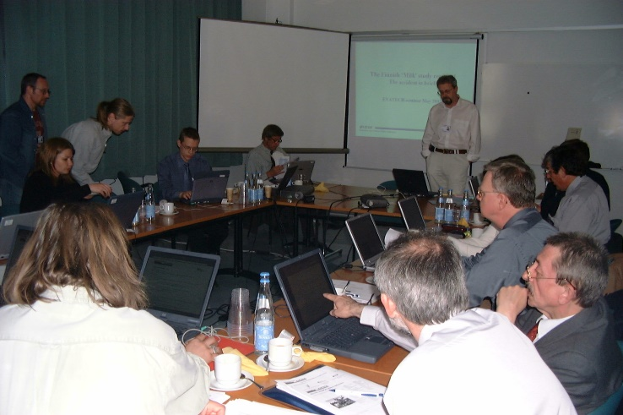
Path perspective highly relevant in environmental policy making
High stakes participatory processes with multiple stakeholders
Environmental, social, political and economical aspects
Multiple sources of uncertainties, deep uncertainty
Hämäläinen 2015:
Behavioural issues in environmental modelling - the missing perspective
Environmental Modelling & Software, 73: 244-253.
Photo by NASA, CC BY-NC 2.0

Slide 5
Paths discussed implicitly early in OR
Morris 1967. On the art of modeling
Management Science, 13(12): B707-B717.
Landry, Malouin, Oral 1983. Model validation in operations research
European Journal of Operational Research, 14(3): 207-220.
and explicitly today
Lahtinen, Hämäläinen 2016. Path dependence and biases in the even swaps decision analysis method
European Journal of Operational Research, 249(3): 890-898
Hämäläinen, Lahtinen 2016. Path Dependence in Operational Research - How the Modeling Process Can Influence the Results
Operations Research Perspectives, 3:14-20.
Lahtinen, Guillaume, Hämäläinen 2017.
Why pay attention to paths in the practice of environmental modelling?
Environmental Modelling and Software, 92: 74-81.

Slide 6
A modelling process can be realized in different ways
Process descriptions and best practices provide instructions for modelling
In practice a given process can be realized in different ways
Best practices do not guarantee a unique ”best” outcome

Slide 7
Interacting drivers of paths
Hämäläinen and Lahtinen (2016)
System
Learning
Procedure
Behavior
Motivation
Uncertainty
External environment

Slide 8
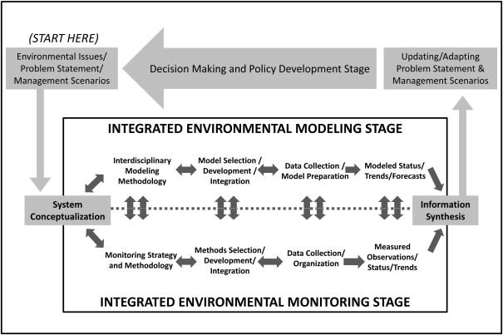
Forks in the path in every stage of environmental modelling
Laniak et al.: Integrated environmental modeling: A vision and roadmap for the future, Environmental Modelling & Software, January 2013

Slide 9
Common reasons for path effects
Behavioral phenomena influence modeler’s choices at decision forks along the path
Cognitive and motivational biases
Narrow thinking
Lack of critical evaluation of the path taken
Who should care:
modelling team, steering group, stakeholders
problem owner, commissioner of the project

Slide 10
Mitigating risks along modelling paths Using a checklist can help

Slide 11
Stages with critical forks
Initial meeting between the problem owners and modelers
Forming the problem solving team
Defining the problem
Planning the modelling process
Data collection and elicitation of preferences
Checkpoints for the evaluation of the path followed

Slide 12
Stage: Initial meeting between the problem owners and modelers
Task | Risks to be mitigated | Comments
Describe the problem addressed by modelling and specify an initial list of the main objectives. | Anchoring to insignificant objectives, lack of deliberation | The problem definition sets the initial direction of the path. Redirecting the path later can be difficult.
Determine whether the goal of the project is to provide prescriptive recommendations or to improve learning. | Narrow thinking | Prescriptive use of modelling requires completeness and strong justifications for the choices made.
Consider the possibility of setting up an independent parallel problem solving process. | Problem solving may follow a poor path | The parallel process can follow an alternative path. This supports learning and can build confidence in the results.
Describe how to notice if an unsatisfactory path is followed. | Problem solving can get stuck on a poor path | If the path is unsatisfactory, predetermined criteria to notice the situation can be useful. Such criteria can help cope with hidden motives and biases.
Ensure that resources are reserved for possible backtracking, redirecting, or restarting of the project. If not, give reason why. | Lack of resources prevent backtracking steps or restarting | If the path is unsatisfactory, restarting the project can be the right choice.

Slide 13
Stage: Forming the problem solving team
Task | Risks to be mitigated | Comments
Form a modelling team with balanced composition. If not, give reason why. | Narrow thinking | When faced with a fork in the path, a team with diverse backgrounds can more easily notice alternatives and consider multiple perspectives.
Ensure appropriate stakeholder representation. | Marginal interests dominate choices | The choices that determine the path should be informed by the preferences and concerns of the relevant stakeholders. Marginal interests should not dominate the choices made.
Identify motivational goals of modelers and stakeholders. Plan how to ensure they do not cause a poor path to be followed. | Hidden motives affect choices | A poor path can result if choices are driven by hidden motives and self-interest.
Ensure that the role of Devil’s advocate is filled in the upcoming stages. If not, give reason why. | Lack of critical evaluation of the path taken | A Devil's advocate helps ensure that a successful path is followed. He or she questions the assumptions made by the team and introduces perspectives that have not been considered.

Slide 14
Stage: Defining the problem
Task | Risks to be mitigated | Comments
Search broadly for background information and prior work providing possible starting points for the project. | Setting off from a wrong starting point | To provide new insight, the path should start from the point where others have left off. Awareness of the background information helps ensure that effort is not spent redoing what has already been done.
List different perspectives that can be taken in the problem solving. Justify the perspective selected. | Narrow thinking | The choice of perspectives is a fork in the path. Explicitly considering the alternative perspectives helps ensure the team is thinking broadly enough.
List the most significant sources of uncertainty within the problem. | Lack of critical evaluation of the path taken | More information about the problem can reveal better paths to be followed. Awareness of the sources of uncertainty helps when searching new data and information.

Slide 15
Stage: Planning the modelling process
Task | Risks to be mitigated | Comments
Specify the objectives and requirements for the model. | Ill-defined goals drive the process | Clearly stated objectives and requirements help make choices at forks faced in model development. They reduce the risk that the choices are based on hidden motives or convenience.
Specify the criteria used to evaluate the success of the model. | Sunk cost fallacy | Predetermined criteria help notice if a poor path is followed. Explicit criteria can reduce cognitive and motivational biases when evaluating the model.
Plan mid-process checkpoints where the model and data are evaluated. If not, give reason why. | Project stuck on a poor path | The mid-process evaluation creates a fork where the path can be re-directed.
Use multiple modelling approaches in parallel. | The approaches used dominate thinking | More than one path can be followed. Using multiple approaches reduces the risk that important perspectives are missed.
Consider developing multiple prototype models. | The approaches used dominate thinking | Developing prototype models can be a resource-efficient way to use multiple modelling approaches.

Slide 16
Stage: Data collection and elicitation of preferences
Task | Risks to be mitigated | Comments
Identify data requirements that have not been adequately met. | Incomplete data drives thinking | How to deal with lack of data creates a fork in the path. One possibility is to collect expert judgments.
Identify biases that can affect preference assessment and expert judgment. Assess the possible impacts of these biases. | Biased judgments and choices | Effects of the biases can accumulate along the path. Reducing the overall bias can be possible. This possibility creates a fork in the path.
Use multiple techniques to assess preferences and obtain expert judgments. If not, give reason why. | Biased judgments and choices | Use of multiple elicitation techniques can reveal the effect of biases and generate additional insights compared to using one technique only.

Slide 17
Stage: Checkpoints for the evaluation of the path followed
Task | Risks to be mitigated | Comments
Evaluate the progress of the project in relation to its overall objectives. | Problem solving may follow a poor path | The path may need to be redirected if it is not the intended one or satisfying.
Evaluate the model in relation to the objectives and requirements for the model. | Problem solving may follow a poor path | If the model is not satisfying, there may be need to restart model development, or create a competing model.
Investigate whether there is new understanding about the problem to be taken into account in the problem solving process. | Lack of critical evaluation of the path taken | Improved understanding of the problem may call for changes in the approaches used.
Consider the possibility that external factors influencing the system under study have changed. | Incomplete data or information drives thinking | Changes in the external factors may require changes in the assumptions and approaches used.
Consider the possibility that the data used is not up-to-date. | Outdated data drives thinking | If the data set is outdated or incomplete, there may be need to gather more data.
Consider the possibility that stakeholder preferences have changed. | Unnoticed changes in preferences | Reassessment of stakeholder preferences may be needed.

Slide 18
Conclusions
The path perspective emphasizes the systemic overall effects of behavioral phenomena
We need systems thinking of the modelling and OR processes
Important to navigate modelling projects in a
reflective mode
The checklist items help to keep in mind critical steps to cope with path dependence

Slide 19
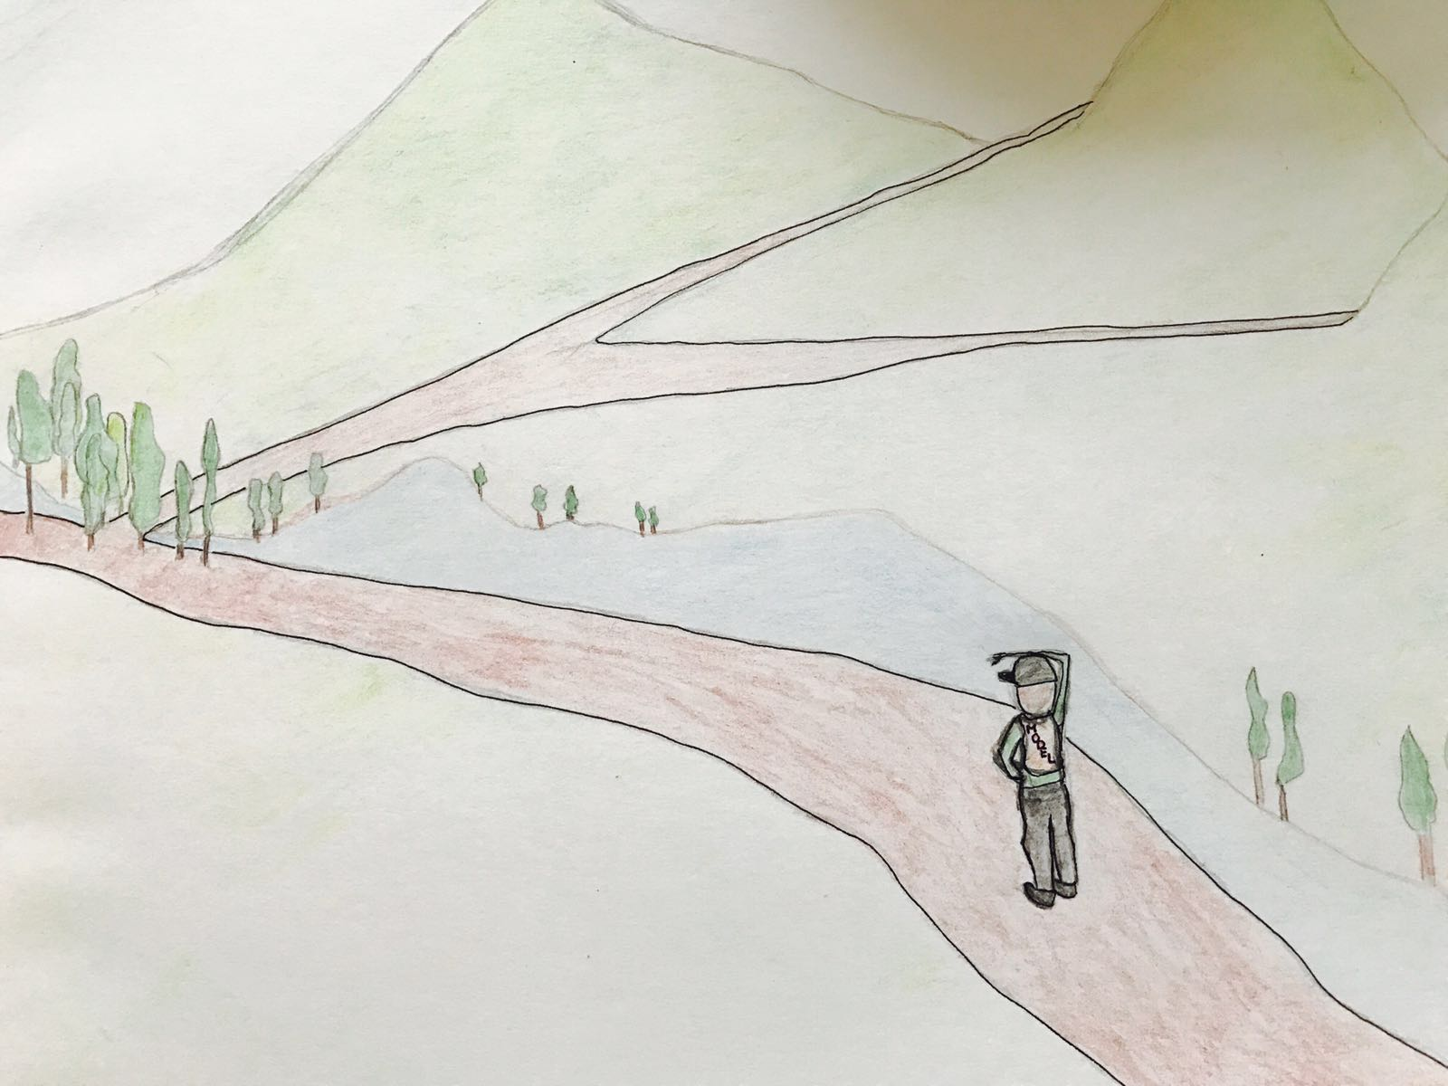
Thank you

