Slide 1


Behavioural Issues in environmental modelling – the missing perspective
Raimo P. Hämäläinen
Systems Analysis Laboratory
Aalto University, School of Science
Paper: Behavioural issues in environmental modelling - the missing perspective, Environmental Modelling & Software, 73, 2015, pp. 244-253.

Slide 2
Models in environmental management
  Models and equations are free of behavioral effects
  but
  as soon as we use them in real life problem solving behavioral effects will be present.
  This missing perspective needs more attention!

Slide 3
Why consider behavioural issues?
Improve the undestanding of decision modelling and processes.
Improve model supported participatory planning and decision making.
Avoid wrong conclusions which are driven by behavioural effects and biases.
Improve the trustworthiness of modelling.
Ethics in modelling.
Produce better policies.

Slide 4
Model validity
Science based models
The lure of objectivity
There exists one ideal model and a good specialist needs to find it
Hidden assumption:
A valid or science based model automatically produces a valid process and bias free objective results

Slide 5
Some modeling areas have a tradition in behavioral studies

Slide 6



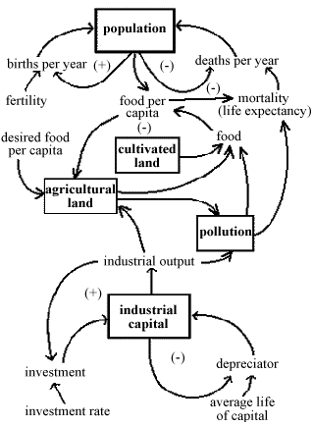
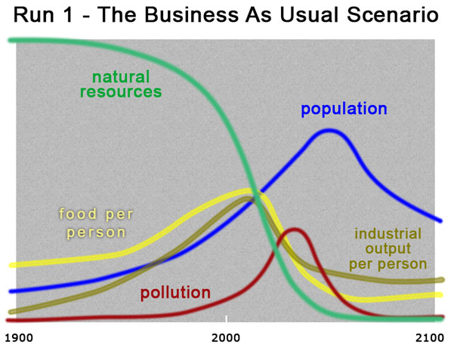
Early Global System Dynamics Models Included Social Behaviour
Donella Meadows
The Limits to Growth
1972

Slide 7
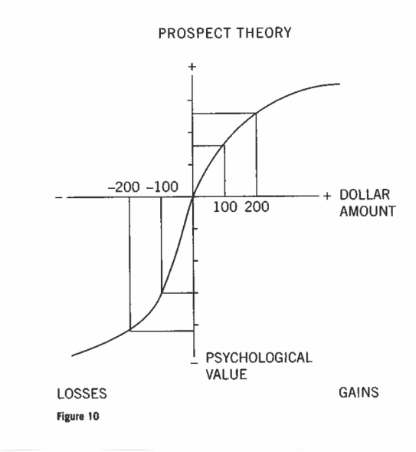
Judgement and Decision making
Decision theory is not enough to explain human choices
Axioms of rationality not followed
Cognitive biases
Bounded rationality (Herbert Simon)
Prospect theory: gains and
losses seen differently (Daniel
Kahneman and Amos Tversky)
Heuristics (Gerd Gigerenzer)
Systems 1 and 2 thinking (Evans, Stanovich, Kahneman)
From: Kahneman and Tversky

Slide 8






Decision Analysis: The Splitting Bias
Higher weight if environmental attribute is split into more detailed lower level attributes
1/6
Variation in water level
1/6
Recreational fishing
2/6
1/6
Reproduction of fish
Recreation
1/6
2/6
Dense bay vegetation
Nature
1/6
Shoreline vegetation
2/6
Economy
1/6
Economy
Occurs e.g. when people give equal weights to all attributes

Slide 9
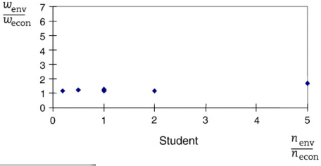
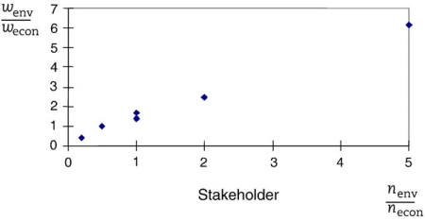
Splitting bias is difficult to eliminate
Students with debiasing guidance: no splitting bias
Stakeholders: systematic bias, guidance did not help
Hämäläinen and
Alaja (2008)

Slide 10
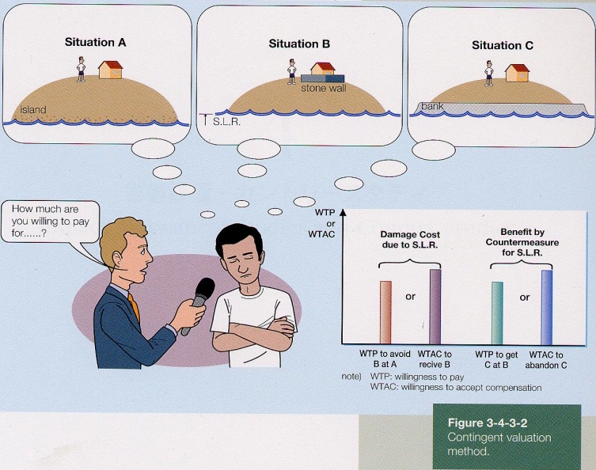
Environmental valuation –
Cost / Benefit analysis
Behavioural issues recognized
Contingent valuation:
Disparity
Willingness – to – pay
Willingness – to - accept compensation
Endowment effect
”Use” values / ”non-use” values
Travel cost method is very problematic

Slide 11

Behavioural Operational Research BOR
(Hämäläinen, Luoma & Saarinen 2013)
Forthcoming Special Issue in EJOR
Papers on different aspects of BOR
Actors
  People, including stakeholders
  What happens in the process, learning
Praxis
  Conceptual frameworks
Methods
  Phenomena related to different types of problems e.g. simulation, decision making and forecasting
BOR community – www.bor.aalto.fi

Slide 12
Best practices in environmental modelling
Acknowledgement that models can be used in different ways
Based on successful case studies
So far, no behavioral research
Comparison of best practices against each other? Can different processes lead to different outcomes?
What are the benefits to the client?

Slide 13
Modellers are subject to cognitive biases
Cognitive Dissonance: the effect of simultaneously trying to believe in two incompatible things (model/real world) at the same time
Commitment Bias: once we are publicly committed ourselves to a position (model) we find it difficult to retreat
Man With A Hammer Syndrome: people have a single tool, hammer, (model) and see every problem as a nail
Overconfidence: we're way too confident in our abilities (models)

Slide 14
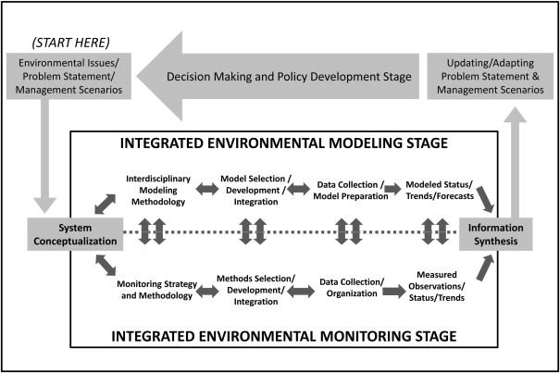
Behavioural effects can be related to every stage in the modelling process
G.F. Laniak, G. Olchin, J. Goodall, A. Voinov, M. Hill, P. Glynn, G. Whelan, G. Geller, N. Quinn, M.Blind, S. Peckham, S. Reaney, N. Gaber, R. Kennedy, A. Hughes: Integrated environmental modeling: A vision and roadmap for the future, Environmental Modelling & Software, January 2013

Slide 15
Social group processes
Participatory modelling is social
The client and the modeller are subject to behavioral effects
Gender and cultural effects
Facilitator styles, personality etc.
Dialogue skills needed (Slotte & Hämäläinen, 2015)
Groupthink – overconfidence (Irving Janis, 1972)
This is the
right model
Yes
Yes
Yes
Yes
Yes
Yes

Slide 16
Risk of Groupthink in environmental modeling is high
Occus in groups with
  Desire of harmony, loyalty to the group (common goal to save the envinronment)
  Homogeneity of background, illusion of invulnerability (one modelling tradition)
  Stressful external threats (the complex environmental issue studied can produce pressures)
Early paper: Groupthink tendencies in the US Forest Service prevented adaptation in environmental change (Kennedy, 1988)

Slide 17
Strategic behaviour
  Motivational interests of environmental modelers related to the problem at hand
  Political / social / cultural orientation can stimulate strategic goal-seeking behaviour
  Stakeholders can mispresent preferences (and even data) in negotiations
  Model boundaries and assumptions
  ”Cheap talk” – costless information which can have an effect on the stakeholders and the process
  Can models be used as cheap talk?

Slide 18
Communication with and about models
  Visual representation of system models are essential in communication
  Effects of graphs and scales used
  What is the effect of educational and cultural backgrounds of the problem owners?
  What can we learn from statistics?
  Is software development based on behavioral studies?

Slide 19

The modeling process creates a system
Formed by the interaction of the client and the modelling a team
The facilitator needs to observe and understand this system to improve its performance
Use Systems Intelligence: Your ability to successfully manage and engage with systems (Saarinen and Hämäläinen, 2004)

Slide 20
Adopting the behavioural lens –
What should we do first?

Slide 21
Research challenge
Comparative experimental research on problem solving and participatory processes is very difficult
Real problems can seldom be approached repeatedly with the real decision makers
Experiments with students a good first step

Slide 25
Improving the understanding of behavioural issues and developing practitioner skills with
the behavioral lens is a necessity in environmental modelling.
Thank you!

Slide 26
References and links
Presentation based on manuscript:
R.P. Hämäläinen: Behavioural issues in environmental modelling - the missing perspective, Environmental Modelling & Software, 73, pp. 244-253.
References:
L.A. Franco and R.P. Hämäläinen: Behavioural operational research: Returning to the roots of the OR profession, Special Issue on Behavioural Operational Research, European Journal of Operational Research.2015
R.P. Hämäläinen and S. Alaja: The Threat of Weighting Biases in Environmental Decision Analysis Ecological Economics, 68, 2008: 556-569.
R.P. Hämäläinen, J. Luoma and E. Saarinen: On the Importance of Behavioral Operational Research: The Case of Understanding and Communicating about Dynamic Systems European Journal of Operational Research, 228 (3), (2013): 623-634.
R.P. Hämäläinen and T. J. Lahtinen: Path Dependence in Modelling and Operational Research - How the Modeling Process Can Influence the Results. 2015. Manuscript: http://sal.aalto.fi/publications/pdf-files/mham15c.pdf
R.P. Hämäläinen and E. Saarinen: Systems intelligence - the way forward? A note on Ackoff’s “Why few organizations adopt systems thinking.” Systems Research and Behavioral Science, 2008, 25(6), 821-825.

Slide 27
I. Janis: Groupthink: Psychological Studies of Policy Decisions and Fiascoes , Wadsworth, USA,1982.
Lahtinen T.J. and R.P . Hämäläinen: Path Dependence and Biases in the Even Swaps Decision Analysis Method. European Journal of Operational Research, 2015,
J. Luoma, R.P. Hämäläinen and E. Saarinen: Acting with systems intelligence: integrating complex responsive processes with the systems perspective. Journal of the Operational Research Society, 2010, 62(1), 3-11.
Montibeller, G., and D. Winterfeldt. Cognitive and Motivational Biases in Decision and Risk Analysis. Risk Analysis, 2015.
E. Saarinen and R.P. Hämäläinen: Systems Intelligence: Connecting Engineering Thinking with Human Sensitivity. Systems Intelligence: Discovering a Hidden Competence in Human Action and Organizational Life, Systems Analysis Laboratory Research Reports. Helsinki University of Technology, 2004.
H. Simon: Models of Bounded Rationality, MIT Press, 502 pp,1997.
S. Slotte and R.P. Hämäläinen: Decision Structuring Dialogue, EURO Journal on Decision Processes, Vol. 3, Issue 1, pp. 141-159.
Systems Intelligence Research Group
www.systemsintelligence.aalto.fi/
Behavioural OR
www.bor.aalto.fi

