Slide 1
Supporting Environmental Decision Making with Portfolio Decision Analysis
Raimo P. Hämäläinen, Tuomas J. Lahtinen, Juuso Liesiö
raimo.hamalainen@aalto.fi, tuomas.j.lahtinen@aalto.fi, juuso.liesio@aalto.fi
Systems Analysis Laboratory, Department of Mathematics and Systems Analysis
The document can be stored and made available to the public on the open internet pages of Aalto University. All other rights are reserved.

Slide 2
Content
Why portfolio methods are needed in environmental management?
Review of portfolio approaches
A framework for Portfolio Decision Analysis in environmental management
An illustrative example with Robust Portfolio Modeling
Conclusions

Slide 3
Multicriteria evaluation in environmental decisions
Experts and stakeholders develop a number of feasible alternatives with sets of different actions
Evaluation of alternatives using standard MCDA
This is a heuristic portfolio approach!
Problems:
Analysis limited to the predetermined alternatives
Risk of biases in unaided development of portfolios: champion actions, insensitivity to scope, failure to see synergies and complementaries (Fasolo et al. 2011)

Slide 4
Environmental management decisions are portfolio problems
Find the best set of actions with respect to environmental, societal and economical objectives
Budget, time and resource constraints
Dependencies and synergies of actions
Actions can complement each other
Bottom line: Overall consequences matter

Slide 5
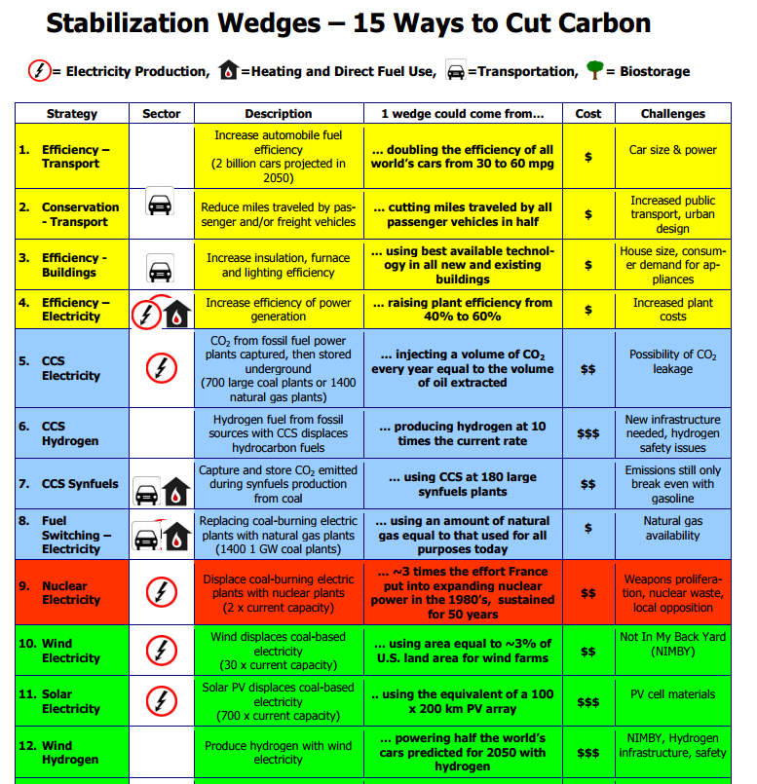
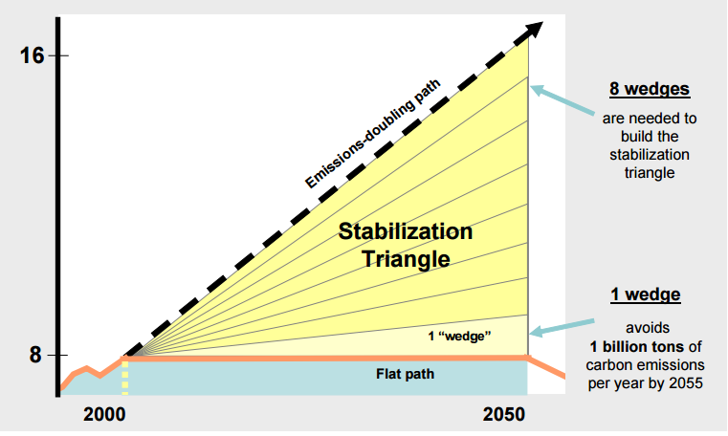
Example: Climate Stabilization Wedges Game
Choose wedges
To fill the stabilization triangle
Consider economic and social objectives
Synergy problems: miles driven, fuel efficiency

Slide 6
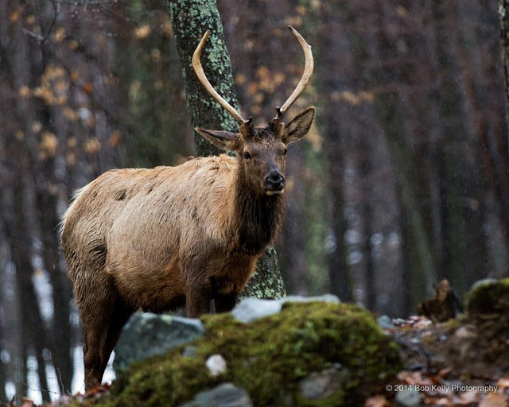

Used a lot in practice
Examples
Create a conservation area consisting of a set of pieces of land
Maximize environmental value (Possingham et al. 2000)
Invest limited budget to implement several actions that improve the irrigation system
Consider climate scenarios and maximize long term profit (Paydar and Qureshi 2012)
Photos by Bob Kelly and John Curley CC BY-NC-SA 2.0

Slide 7
Portfolio approaches
Multi-criteria decision analysis (standard MCDA)
Multi-criteria value-cost analysis
Portfolio decision analysis (PDA)
Modern portfolio theory
Multi-objective optimization
Robust Portfolio Modeling

Slide 8
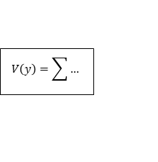
Multi-criteria decision analysis
Multiple objectives
Alternatives = portfolios of actions
Ranking of alternatives
Value compositions
Objective 1
Alternative A
1
2
3
Alternative B
1
5
7
Objective 2
Alternative C
3
4
5
Objective 3
Value model
A
B
C
$$V\left(y\right)=\sum{…}$$
Standard approach
Experts develop portfolios together with stakeholders without modelling support
Evaluation with an MCDA value model

Slide 9
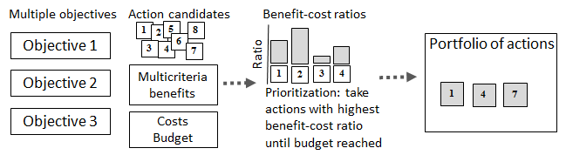
Simple benefit-cost analysis
Take actions with highest benefit-cost ratio until budget cap is reached
Heuristic solution to the knapsack problem
No modeling of interdependencies or synergies
Kleinmuntz (2007)

Slide 10
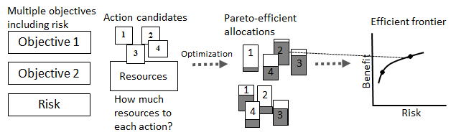
Modern Portfolio Theory
Based on Markowicz (1952)
How much resources to each action? (cf. select action or not)
Find the efficient resource allocations
Benefit and risk: Multicriteria expected benefit and variance calculated with scenarios
Example: Marinoni et al. (2011)

Slide 11
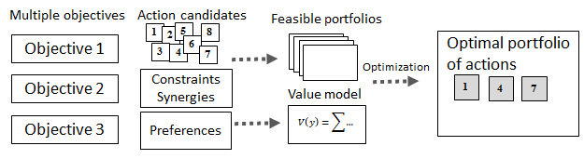

Portfolio Decision Analysis (PDA)
Combines MCDA with an optimization model
Find optimal set of actions: An action is included or not
Synergies, interactions and other portfolio constraints included in the model
Salo et al. (2011)

Slide 12
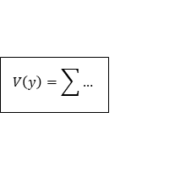
Robust Portfolio Modeling
PDA with incomplete information
Multiple objectives
Action candidates
Feasible portfolios
Non-dominated portfolios
1
2
5
8
Portfolio A
Objective 1
3
4
6
3
7
7
Objective 2
Constraints
synergies
Portfolio B
$$V\left(y\right)=\sum{…}$$
1
4
Portfolio C
Objective 3
Incomplete
Information:
consequences
weights
8
6
5
Portfolio value model
2
Interval data and ordinal weight information
”reducing one ton of nitrogen emissions more valuable than reducing two tons of phosphorus”
Identify non-dominated portfolios and core actions ⇒ DMs can focus on a reduced set of actions
Liesiö et al. (2007)

Slide 13
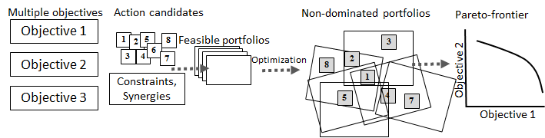
Multi-Objective Optimization
Identify non-dominated portfolios
Visualize Pareto-frontier
⇒ What is possible to achieve, what are the trade-offs?
Preferences used to select ”best”
Stummer and Heidenberger (2003), Zheng and Hobbs (2013)

Slide 14
A portfolio decision analysis framework
Define problem context and scope
Generate actions and objectives
Specify portfolio constraints and consequences
Construct the value model
Optimize and analyze results

Slide 15
1. Define problem context and scope
Problem framing
Identify stakeholders
Structure the process
2. Generate actions and objectives
Generate initial set of objectives and actions
Use objectives to generate additional actions
Use actions to generate additional objectives
Define attributes and measurement scales
Specify actions
Estimate consequences of actions

Slide 16
3. Specify portfolio constraints and consequences
Resource constraints
Budget, workforce
Performance targets: e.g. reduce emissions by X%
Constraints on actions
Contingency: B can be selected if A is selected
Mutually exclusive: Only C or D can be chosen
Synergies and interdepencies
How to aggregate consequences? Additive, multiplicative, other?
E.g. CO2 reduction from decreased car use depends on fuel efficiency

Slide 17
5. Optimize and analyze results
4. Construct the value model
Determine forms of value functions on attributes
Elicit weights
Communicate and visualize
Robustness and sensitivity analysis
What is the effect of the budget?
What are the core actions?
Compare results between stakeholder groups

Slide 18
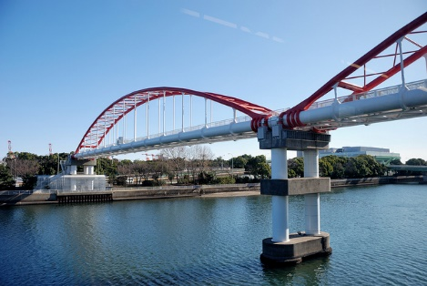
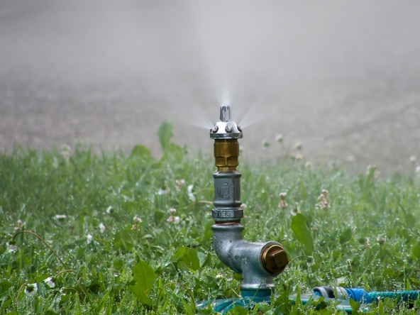
Illustrative example: Water savings in urban environment Mitchell et al. 2007
A new development: ’Bridgewater downs’ is planned near the metropolitan area of Bass, Australia
The local water utility Bass Water has decided to consider water saving actions
Case analyzed with Robust Portfolio Modeling (RPM)
Photos by ykanazawa1999 and Albert Schäferle CC BY-NC-SA 2.0

Slide 19
Objectives and actions
Objectives
Reduction in phosphorus release
Reduction in nitrogen release
Mitigation of climate change
Long-run savings
Implementation cost
Reduction in water demand
Actions
Nine actions related to
Increase of the efficiency of washing machines etc.
Raintanks (different sizes and purposes)
Recycling water
Changes to the piping system
9 actions ⇒ 511 combinations

Slide 20
Constraints and consequences
Budget constraint: Total cost less than B
Water reduction constraint: At least X% decrease in water demand
Contingency constraint: Extra raintanks can be installed only on top of the basic version
Exclusivity constraint 1: Cannot implement both: raintanks for garden use and raintanks for hot water use
Total water reduction is multiplicative:
Actions 8 and 9 save 34% and 46% water.
Together the saving is (1-0.66 x 0.54) x 100%=64%

Slide 21
Things typically looked for
Are there?
core actions (included in all non-dominated portfolios)
exterior actions (not included in any non-dominated portf.)
Changes in portfolio composition and performance
If a constraint is relaxed
If different preference statements are given
Cost of including exterior actions?
Conclusions:
Do we find robust core actions?
What is learned?

Slide 22
Value model
Additive value function over the overall consequences of the portfolio
Weights
Case 1: No weights used
Case 2: Incomplete weight statements
E.g.: One unit of climate change mitigation more valuable than 2 ton/y nitrogen reduction

Slide 23
Three cases analyzed
Case 1
No weights used
Water demand reduction target 50%. Fixed budget B=45M$.
Interval consequence scores (+- 10%)
Case 2a
Incomplete weight statements
Water demand reduction target 50%. Fixed budget B=45M$.
Interval consequence scores (+- 10%)
Case 2b
Incomplete weight statements
Water demand reduction target 50%. Budget not fixed.
Interval consequence scores (+- 10%)

Slide 24
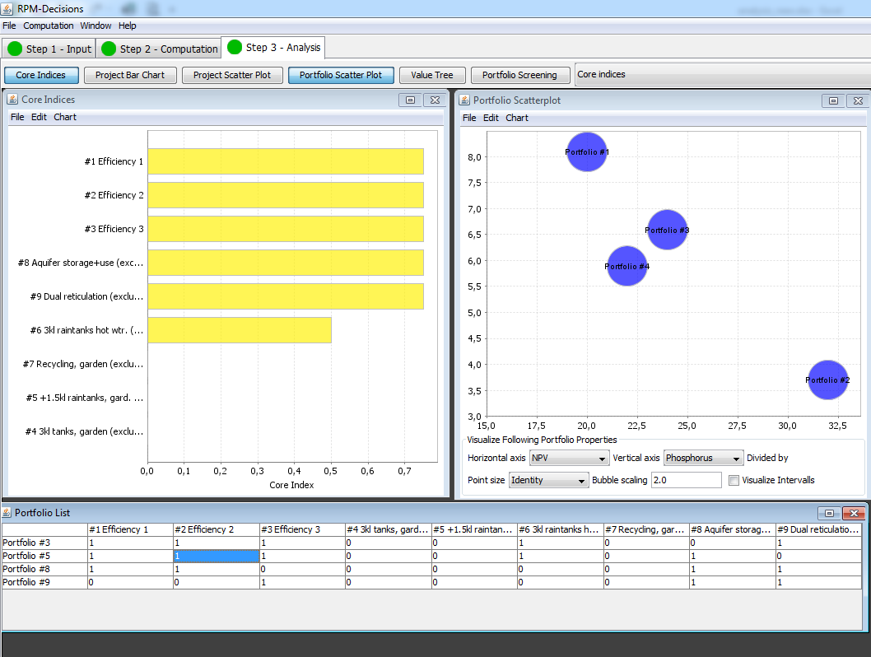
Case 1 (no weights used)
Analysis of results on the RPM interface

Slide 25
Non-dominated portfolios
Four portfolios are non-dominated
Combinations of six different actions
A: (1,2,3,6,9)
B: (1,2,3,6,8)
C: (1,2,8,9)
D: (3,8,9)
Actions 4,5 and 7 not included in any non-dominated portfolio
Efficiency improvement for appliances 1
Efficiency improvement for appliances 2
Efficiency improvement for appliances 3
Water tanks for garden use
Extra water tanks for garden and toilet use
Water tanks for residential hot water
Recycling water for garden and toilet use
Acquifer storage for irrigation
Large scale dual reticulation

Slide 26
Performances of non-dominated portfolios
Portfolio B best in dollars and climate change mitigation

Slide 27
Case 2 (Incomplete weight statements)
Decision maker says:
One unit of climate change mitigation more valuable than 2 ton/y nitrogen reduction
1 ton/y nitrogen reduction is more valuable than 2 ton/y phosphorus reduction
1 ton/y phosphorus reduction is more valuable than 3M$ in NPV
12M$ in NPV is more valuable than one unit of climate change mitigation

Slide 28
Case 2a (Incomplete weight statements, budget 45M$)
Result: Portfolio B dominates portfolios A,C and D
Portfolio B:
Efficiency improvement for appliances 1
Efficiency improvement for appliances 2
Efficiency improvement for appliances 3
Water tanks for garden use
Extra water tanks for garden and toilet use
Water tanks for residential hot water
Recycling water for garden and toilet use
Acquifer storage for irrigation
Large scale dual reticulation
What if budget was different?

Slide 29
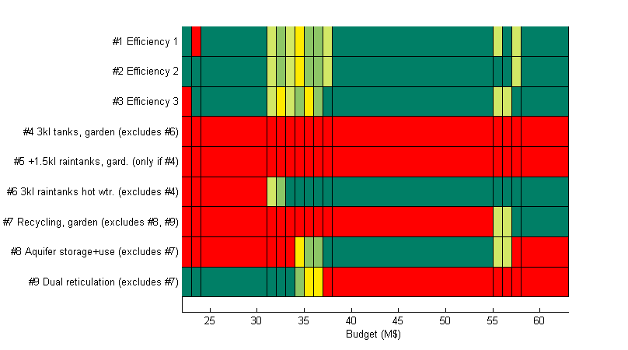
Case 2b (Incomplete weight statements, budget not fixed)
Non-dominated portfolios calculated with all possible budgets
Portfolio B dominates with all budgets between 38M$ and 55M$
Core action (dark green): included in all non-dominated portfolios with given budget
Exterior actions (red): not included in any non-dominated portfolio with given budget
Same actions
1,2,3,6 and 8
(= portfolio B)
are core actions
with all budgets
38-55M$

Slide 30
Robust Portfolio Modeling
Easy to use
Interface
Computational support
Visualizations
Results can be obtained even without precise weights
Possible to focus analysis on non-dominated portfolios
What if analyses
What if budget was increased?
What if action A is included in the portfolio?

Slide 31
Conclusions
Environmental community starting to realize that environmental decisions require portfolio thinking
We need to take the next step:
From MCDA evaluation to portfolio analysis
Synergies and interdependencies important
Challenge to develop ways to engage stakeholders in interactive portfolio analysis
Enumeration with Excel feasible with up to 19 actions
First step to practice and experiment with role playing students?

Slide 32
Thank you
References:
Markowitz, H. (1952). Portfolio selection. The journal of finance, 7(1):77–91
Possingham, H., Ball, I., and Andelman, S. (2000). Mathematical methods for identifying representative reserve networks. In Quantitative methods for conservation biology, pages 291–306. Springer.
Stummer, C. and Heidenberger, K. (2003). Interactive R&D portfolio analysis with project interdependencies and time profiles of multiple objectives. IEEE Transaction on Engineering Management, 50(2):175–183.
Kleinmuntz, D. N. (2007). Resource allocation decisions. In Advances in Decision Analysis: From Foundations to Applications, pp. 400–418. Cambridge University Press.
Liesiö, J., Mild, P., and Salo, A. (2007). Preference programming for robust portfolio modeling and project selection. European Journal of Operational Research, 181(3):1488–1505
Mitchell, C., Fane, S., Willetts, J., Plant, R., and Kazaglis, A. (2007). Costing for sustainable outcomes in urban water systems: A guidebook. CRC for Water Quality and Treatment.
Hotinski, Roberta. (2009) Stabilization Wedges: A Concept & Game. Princeton University: http://cmi.princeton.edu/wedges/
Fasolo, Barbara, Alec Morton, and Detlof von Winterfeldt. Behavioural issues in portfolio decision analysis. Springer New York, 2011.
Marinoni, O., Adkins, P., and Hajkowicz, S. (2011). Water planning in a changing climate: Joint application of cost utility analysis and modern portfolio theory. Environmental Modelling & Software, 26(1):18–29.
Salo, A., Keisler, J., and Morton, A. (2011). Portfolio Decision Analysis. Springer.

Slide 33
Paydar, Z. and Qureshi, M. E. (2012). Irrigation water management in uncertain conditions: application of modern portfolio theory. Agricultural Water Management, 115:47–54.
Convertino, M. and Valverde Jr, L. J. (2013). Portfolio decision analysis framework for value-focused ecosystem management. PloS one, 8(6):e65056.
Lehtomäki, J. and Moilanen, A. (2013). Methods and workflo wfo rspatia lconservatio nprioritizatio nusin gzonation. Environmental Modelling & Software, 47:128–137.
Zheng, P. Q. and Hobbs, B. F. (2013). Multiobjective portfolio analysis of dam removals addressing dam safety, fish populations, and cost. Journal of Water Resources Planning and Management, 139(1):65–75.
Kreitler, J., Stoms, D. M., and Davis, F. W. (2014). Optimization in the utility maximization framework for conservation
planning: a comparison of solution procedures in a study of multifunctional agriculture. PeerJ, 2:e690.

