Slide 1
Cross-impact Analysis and Adversarial Risk Analysis
Juho Roponen
Aalto University Systems Analysis Laboratory

Slide 2
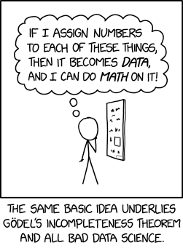
Motivation
Systematic foresight is important for strategic decisions in business, policy and defense planning.
One cannot accurately predict what future will be, so decisions must also account for uncertainties.
https://xkcd.com/2610/

Slide 3
Agenda
Cross-impact Analysis
Adversarial Risk Analysis

Slide 4
Terminology
Uncertainty factor
Also known as: random variable, key factor, lottery, and distinction
Division of reality into mutually exclusive and jointly exhaustive possibilities
State
One possible future for an uncertainty factor.
Scenario
Combination of states of several uncertainty factors.
Industry growth | New graduates | Standardization
Slower | Current level | No standardization
Current | Doubles | Minimal
Faster | More than triples | Comprehensive

Slide 5
Scenario analysis
Helps analyze situations with significant uncertainties and the possibility of very different outcomes.
The goal is not to predict the future accurately, but to understand how the future may unfold.
The number of scenarios can become a challenge, as the number possible scenarios increases exponentially with the number of uncertainty factors.
With 10 uncertainty factors and 3 possible states for each, it is possible to produce 3¹⁰ = 59 049 scenarios by combining different states.

Slide 6
Managing the number of scenarios
Focus on relatively few scenarios attempting to span the possible futures comprehensively.
None of these scenarios will happen exactly as described.
Focus on only few uncertainty factors.
The scenarios may end up too nondescript.
Accommodate a large number of scenarios.
Interacting with the scenario set will be more challenging.
Probabilistic approaches can be employed.

Slide 7
Cross Impact Analysis (CIA)
Can be used to estimate scenario probabilities for a large scenario set.
Scenario probabilities are derived from conditional dependencies between uncertainty factors.
Dependencies can increase or decrease the probability of outcomes coinciding.
Industry growth | New graduates | Standardization
Slower | Current level | No standardization
Current | Doubles | Minimal
Faster | More than triples | Comprehensive

Slide 8
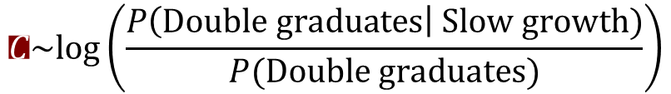
Cross-impact matrix
 |  | Industry |  |  | New graduates |  |  | Industry standards
 |  | Slower | Current | Faster | Current | Double | Triple + | No | Minimal | Compreh.
Industry | Slower |  |  |  | +1 | -1 | -2 | -1 | 2 | 1
 | Current |  |  |  | -2 | 0 | 2 | 0 | -1 | 0
 | Faster |  |  |  | -3 | 0 | 3 | 2 | 0 | -1
New graduates | Current |  |  |  |  |  |  | -1 | 1 | -1
 | Double |  |  |  |  |  |  | 1 | 0 | 1
 | Triple + |  |  |  |  |  |  | 1 | -1 | 1
Industry standards | No
 | Minimal
 | Compreh.
Each element of the cross impact matrix indicates how the probability of outcome A changes, knowing outcome B occurs.
For example: How much more likely is that the number of new graduates doubles when industry growth slows down from the current level?
$$C\sim log⁡\left(\frac{P\left(Double graduates\right| Slow growth)}{P(Double graduates)}\right)$$

Slide 9
3D-printing technology forecasting
We carried out a pilot project how the future developments in 3D-printing would affect the Finnish military.
Uncertainty factors were chosen based literature research and interviews with experts.
To collect the cross-impact estimates we organized a workshop and invited experts from 3D-printing field and the military.

Slide 10
Expert judgement process
In the 3D-printing example, there were 11 uncertainty factors with 3 states each.
The number of state probabilities for the uncertainty factors was 33.
The cross-impact matrix had 495 elements.
It is possible to form 3¹¹ = 177 147 scenarios as a combination of the states.
The workshop lasted 4 hours
1/3 on familiarizing the participants with CIA,
1/3 on examining and adjusting the uncertainty factors and estimating state probabilities,
1/3 on eliciting the cross-impact matrix.

Slide 11
Uncertainty factors in the years 2030-2040
Global industry growth
Finnish industry growth
Technology development – price of printing
Technology development – speed of printing
Number of graduates from Finnish universities and polytechnics.
Changes in the laws governing 3D-printing
Standardization of printing processes and 3D-models
Use of 3D-printed objects in the Finnish military
Availability of 3D-models and digital plans in the Finnish military
The use of 3D-printing capacity in the Finnish military in peacetime
The use of 3D-printing capacity in the Finnish military in crisis time

Slide 12
A. Global 3D-printing industry growth
The growth slows down. p=0.3
Max. 16% annually, around 4-times increase by 2030 and 17-times increase by 2040.
The growth continues at the current pace. p=0.5
21% annually, around 5.5-times increase by 2030 and 37-times increase by 2040.
This corresponds to about 0,15% of the expected growth for the entire manufacturing industry.
The growth speed increases p=0.2
26% annually, about 8-times increase by 2030 and 80-times increase by 2040.

Slide 13
Cross-impact scale
The cross impacts were estimated on a scale from -3 to 3, so that the experts would not have to focus on exact probability calculations.
How much does the probabilty of event A change when we know B has happened? -3 Decreases to one third
-2 Decreases to half
-1 Decreases to two thirds
0 Remains the same
1 Increases by half
2 Increases to double
3 Increases to triple

Slide 14
Dependencies between uncertainty factors

Slide 15
Computing the scenario probabilities
Scenario probabilities were computed with an optimization model.
The resulting joint probability distribution over scenarios is the best fit for the cross-impact estimates.
We also get conditional probability distributions for the states of the uncertainty factors.
Optimization is done in less than 10 seconds. ⇒ The estimates can be readjusted, and the distributions quickly recalculated.

Slide 16
Optimization model
Determines the scenario probability distribution that best fits the given cross-impact estimates.
Using constraints:
Scenarios are exhaustive and mutually exclusive ⇒ Conditional probability mass distribution sums up to 1.
Conditional probability distributions match the probability estimates for the states of uncertainty factors.
All probabilities are in the interval [0,1].

Slide 17
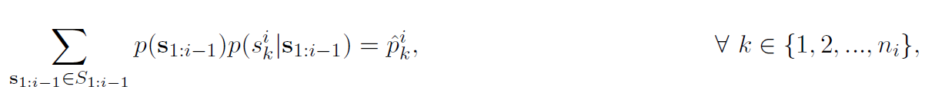
Optimization model
Determines the scenario probability distribution that best fits the given cross-impact estimates.
Using constraints:
Scenarios are exhaustive and mutually exclusive ⇒ Conditional probability mass distribution sums up to 1.
Conditional probability distributions match the probability estimates for the states of uncertainty factors.
All probabilities are in the interval [0,1].

Slide 18
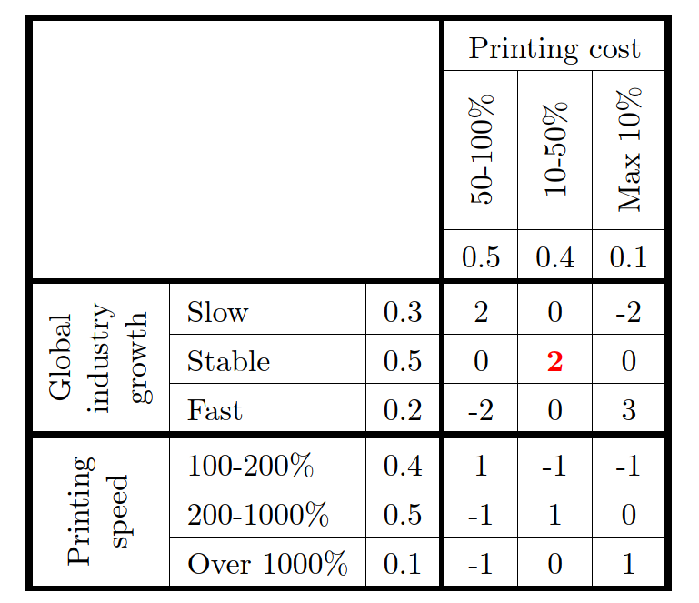
Example: The changes in the price of 3D-printing
-3 Decreases to one third
-2 Decreases to half
-1 Decreases to two thirds
0 Remains the same
1 Increases by half
2 Increases to double
3 Increases to triple
A
B

Slide 19
Uses of probabilistic scenario analysis
The optimization model and all tools are generic. ⇒ They can be used in any expert judgement based scenario processes.
Scenario probabilities can be used to examine the total system risk or to identify high risk scenarios.
Conditional probability distributions for the states of the uncertainty factors can be used to create a Bayes network to explore what-if questions.

Slide 20
1. Global industry growth
Network Skeleton
2. Speed of printing
3. Price of printing
4. Finnish industry growth
5. Number of graduates
9. 3D-models available to PV
10. Use of 3D-printing in PV in peacetime
6. Changes in the laws
8. Use of 3D-printed objects in PV
7. Standardi-zation
11. Use of 3D-printing in PV in crisis time

Slide 21
Dependencies between uncertainty factors

Slide 22
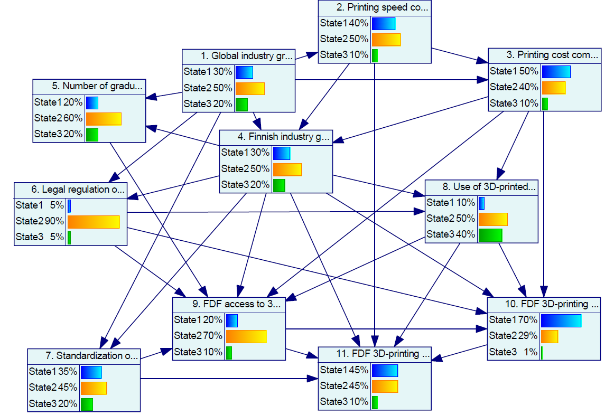
GeNIe Modeler available at https://www.bayesfusion.com/

Slide 23
Agenda
Cross-impact Analysis
Adversarial Risk Analysis

Slide 24
Adversarial risk analysis (ARA)
Analyzes problems in which intelligent actors with conflicting interests make interdependent decisions under uncertainty.
Limitations of earlier methods:
Standard reliability/risk approaches do not account for intentional harm.
Game theoretic approaches necessitate many assumptions about rationality, utilities and information.
Standard decision analysis does not forecast what other actors will do.
Adversarial risk analysis addresses these limitations.

Slide 25
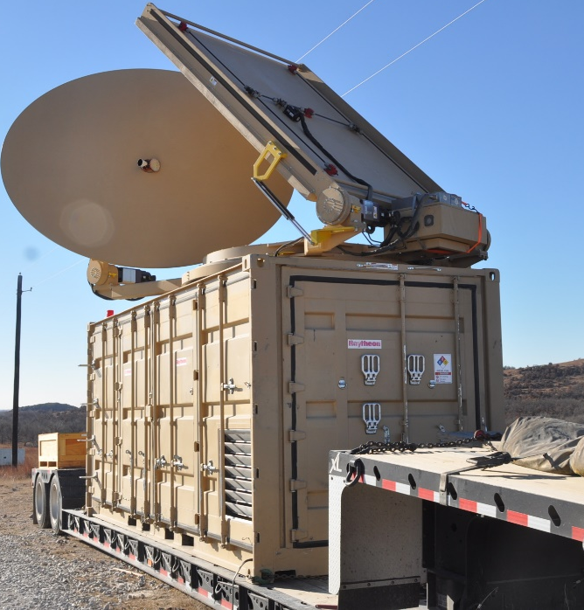
Realistic example
We support the Defender who considers investments into countermeasures to protect a supply company.
The supply company is threatened by unmanned aerial vehicles (UAVs) that try to reconnoiter targets for artillery fire.
The Defender can purchase any number of systems.
System | Cost
Old Radar | 60
New Radar | 100
Projectile Weapon | 110
Laser Weapon | 160
Better Camouflage | 130

Slide 26
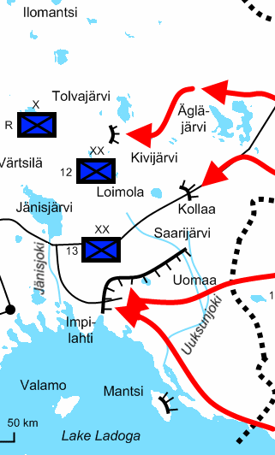
ARA-methodology
Identify objectives
Describe the objectives and utilities of all actors.
Define the problem scope
Identify decision alternatives and relevant uncertainties.
Model the problem with an influence diagram.
Forecast consequences
Describe interdependent decisions as a game.
Solve the optimal strategies for all actors.
Deliver decision support
Provide recommendations for risk mitigation.

Slide 27
A simple influence diagram
Defender’s decision
Defender’s utility
Combat
Attacker’s decision
Attacker’s utility

Slide 28
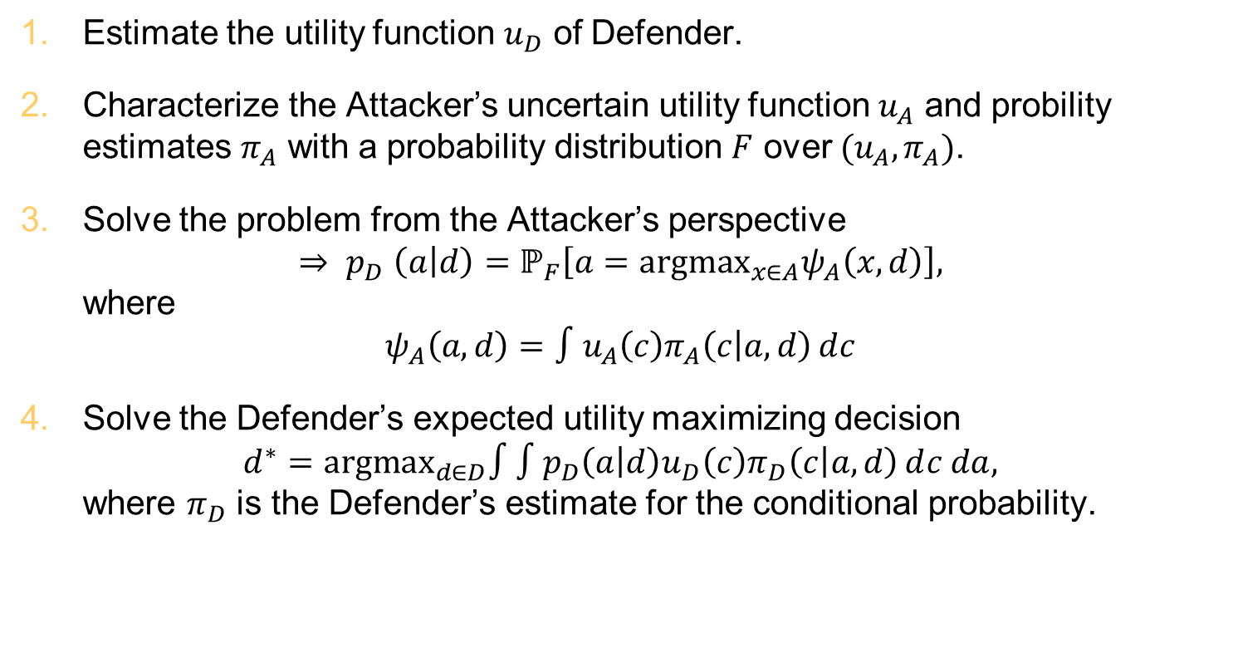
Mathematical problem formulation
Estimate the utility function $u_{D}$ of Defender.
Characterize the Attacker’s uncertain utility function $u_{A}$ and probility estimates $π_{A}$ with a probability distribution $F$ over $(u_{A},π_{A})$.
Solve the problem from the Attacker’s perspective ${⇒ p}_{D}\left(\left.a\right|d\right)=ℙ_{F}\left[a={argmax}_{x∈A}ψ_{A}\left(x,d\right)\right],$ where
$$ψ_{A}\left(a,d\right)=∫u_{A}\left(c\right)π_{A}\left(\left.c\right|a,d\right)ⅆc$$
Solve the Defender’s expected utility maximizing decision $d^{∗}={argmax}_{d∈D}∫∫p_{D}\left(\left.a\right|d\right)u_{D}\left(c\right)π_{D}\left(\left.c\right|a,d\right)ⅆc da,$ where $π_{D}$ is the Defender’s estimate for the conditional probability.

Slide 29
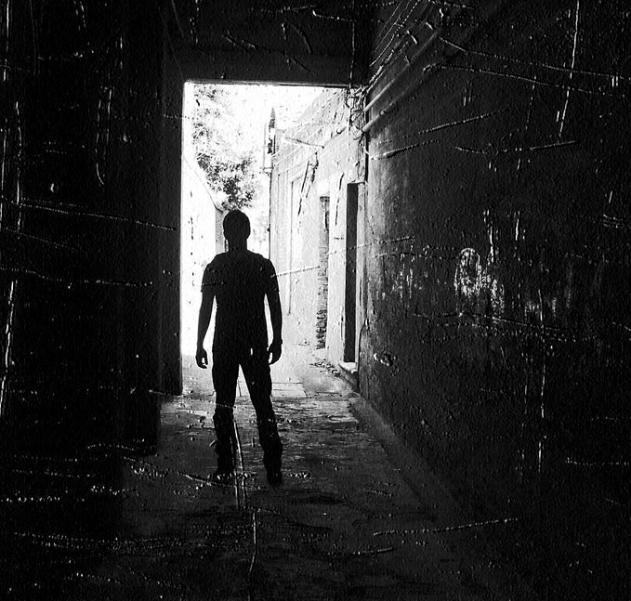

Standard adversary model
Characterize the Attacker’s uncertain utility function $u_{A}$ and probility estimates $π_{A}$ with a probability distribution $F$ over $(u_{A},π_{A})$.
$u_{A}$ and $π_{A}$ are random variables whose realizations are functions.
Works well mathematically, but obtaining estimates for probability distribution $F$ is difficult.
Is there any other way to characterize the adversary?

Slide 30
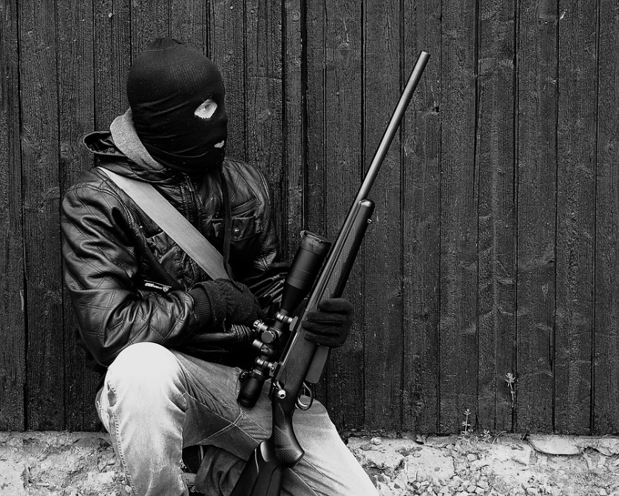

Proposed partial information approach
Characterize the Attacker’s utility function $u_{A}$ and probability estimates $π_{A}$ by assuming they belong in the set $U_{A}×Π_{A}$ of utility functions $U_{A}$ and probability distributions $Π_{A}$.
Probability distribution over $(u_{A},π_{A})$ is no longer needed.
Practically any information about the adversary can be used.
This information can be elicited from the experts.
The optimal solution may not be unique.

Slide 31
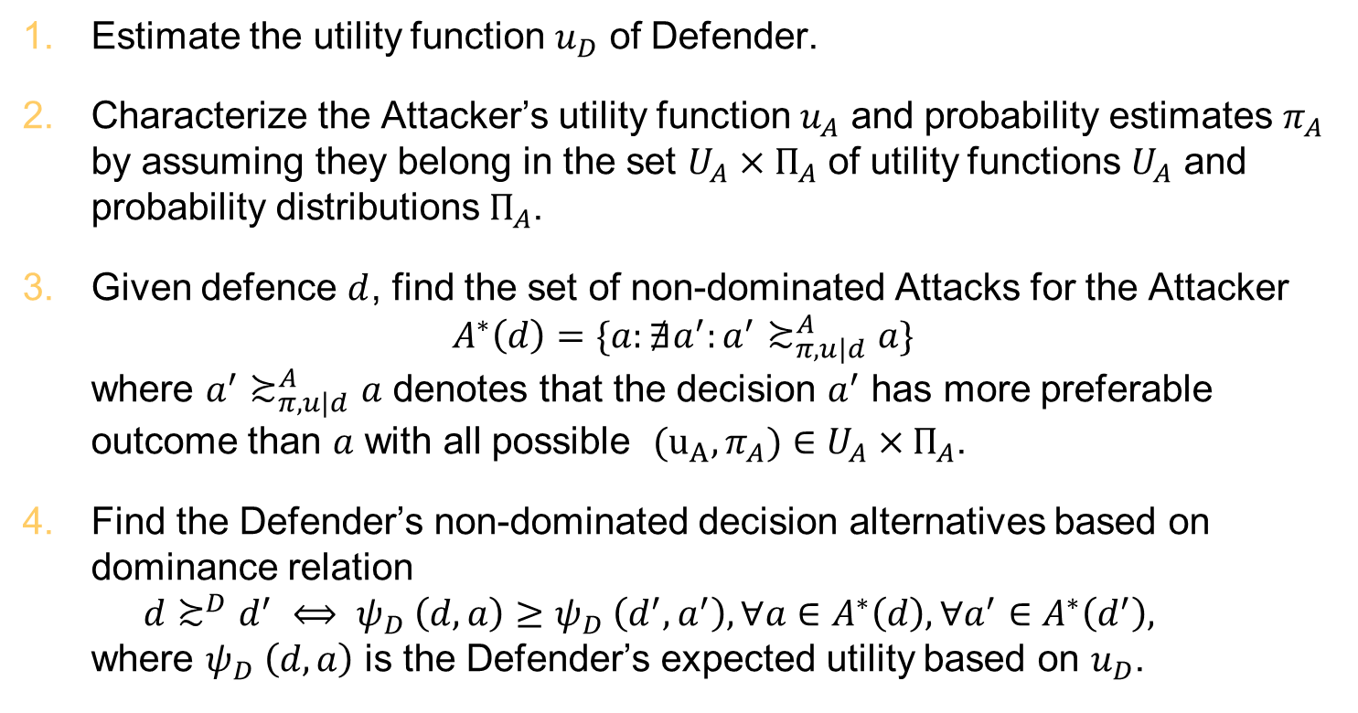
Updated mathematical problem formulation
Estimate the utility function $u_{D}$ of Defender.
Characterize the Attacker’s utility function $u_{A}$ and probability estimates $π_{A}$ by assuming they belong in the set $U_{A}×Π_{A}$ of utility functions $U_{A}$ and probability distributions $Π_{A}$.
Given defence $d$, find the set of non-dominated Attacks for the Attacker $A^{∗}\left(d\right)=\{a:∄a^{′}:a^{′}≿_{π,u|d}^{A}a\}$ where $a^{′}≿_{π,u|d}^{A}a$ denotes that the decision $a^{′}$ has more preferable outcome than $a$ with all possible ${(u}_{A},π_{A})∈U_{A}×Π_{A}$.
Find the Defender’s non-dominated decision alternatives based on dominance relation $d≿^{D}d^{′} ⟺ ψ_{D} \left(d,a\right)≥ψ_{D} \left(d^{′},a^{′}\right), ∀a∈A^{∗}\left(d\right), ∀a^{′}∈A^{∗}\left(d^{′}\right),$ where $ψ_{D} \left(d,a\right)$ is the Defender’s expected utility based on $u_{D}$.

Slide 32
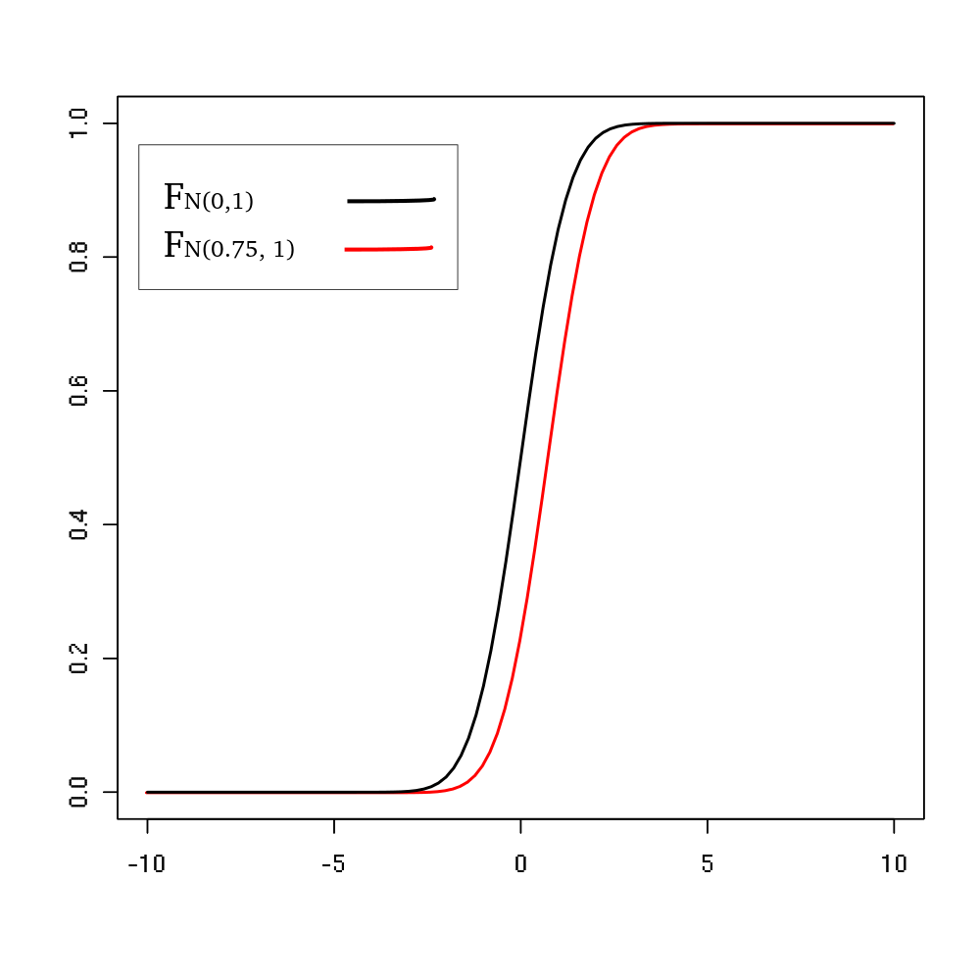
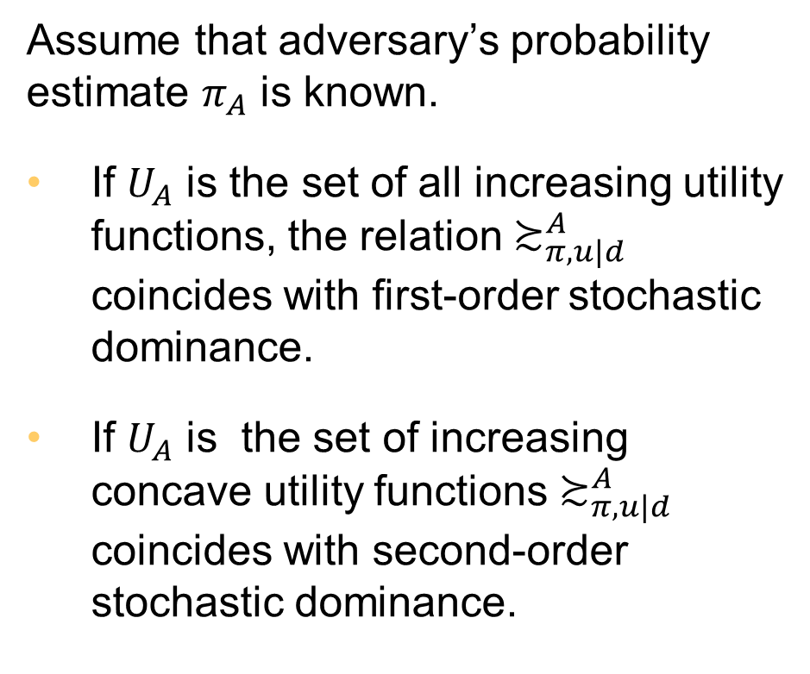
Connection to stochastic dominance relations
Assume that adversary’s probability estimate $π_{A}$ is known.
If $U_{A}$ is the set of all increasing utility functions, the relation $≿_{π,u|d}^{A}$ coincides with first-order stochastic dominance.
If $U_{A}$ is the set of increasing concave utility functions $≿_{π,u|d}^{A}$ coincides with second-order stochastic dominance.

Slide 33

Practical implications
Results are based minimal assumptions about the adversary.
For example: The adversary wants to inflict harm to us while keeping their own costs and losses low.
No need to associate a probability distribution with adversary’s possible utility functions.
The decision recommendation is not unique.
The results show what alternatives are viable under the stated assumptions.

Slide 34
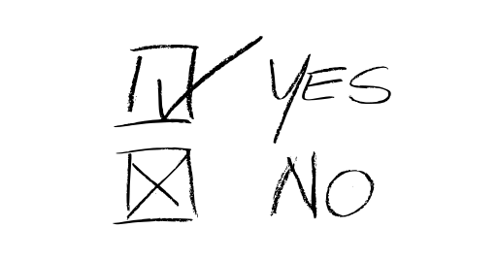
Decision rules
Provide a unique decision recommendation.
Maximin, maximax and minimax regret decision rules do not require knowledge about probabilities.
A cautious decision maker could use maximin decision rule to choose a decision alternative.
Adversary’s actions will not increase the risks above a certain level.

Slide 35
Realistic example
We support the Defender who considers investments into countermeasures to protect a supply company.
The supply company is threatened by unmanned aerial vehicles (UAVs) that try to reconnoiter targets for artillery fire.
The Defender can purchase any number of systems.
System | Cost
Old Radar | 60
New Radar | 100
Projectile Weapon | 110
Laser Weapon | 160
Better Camouflage | 130

Slide 36
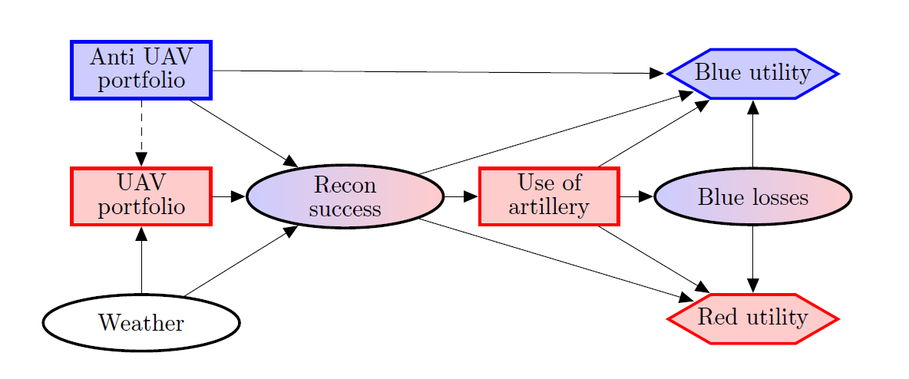
Protecting a supply company

Slide 37
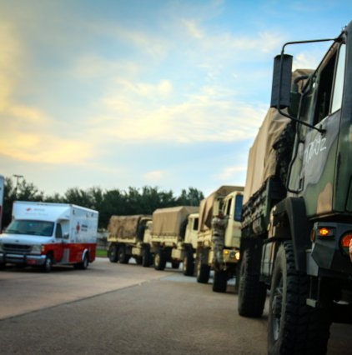
Defender’s objectives
Protect the personnel of the supply company.
Protect the equipment of the supply company.
Minimize investment costs.
No is assumptions about the priorities of these objectives.

Slide 38
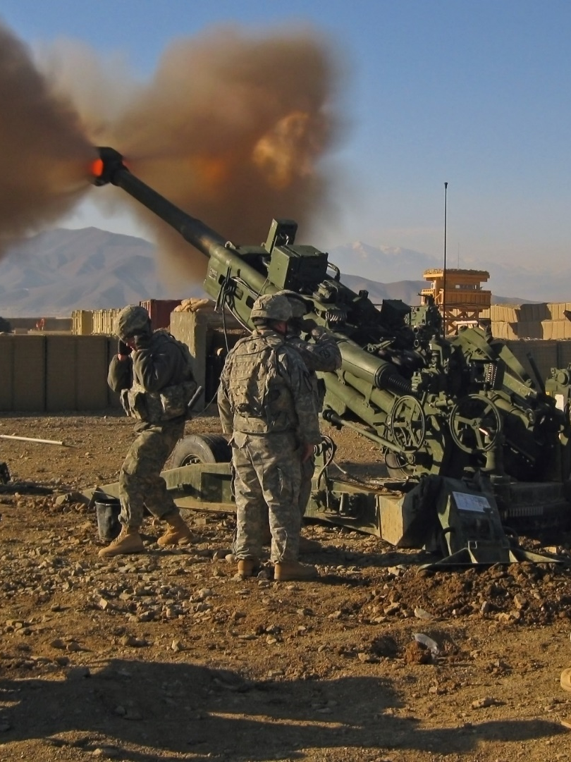
Attacker’s objectives
Cause casualties to the personnel of the Defender’s supply company.
Cause damage the equipment of the supply company.
Minimize artillery ammunition consumption and risks to the UAVs.
No assumptions about the priorities of these objectives.

Slide 39
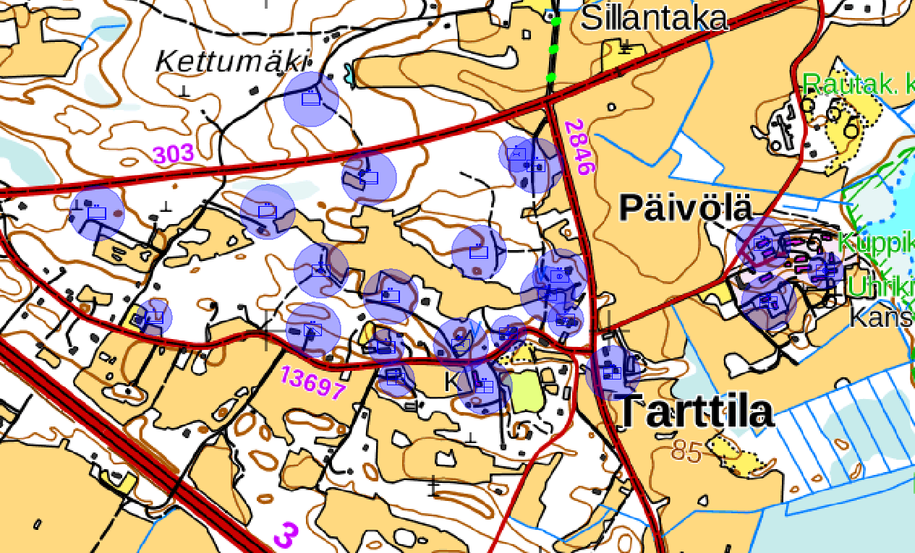
The supply company

Slide 40
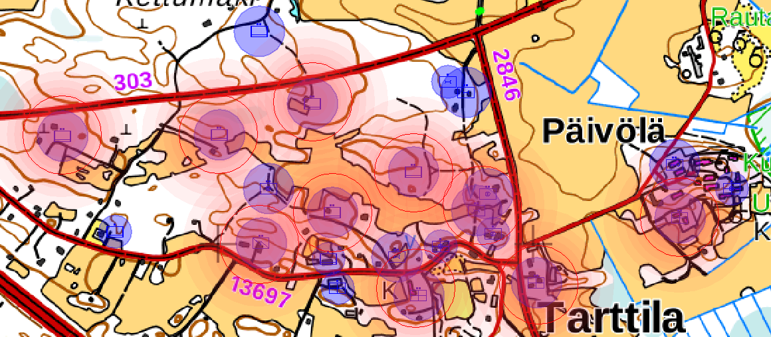
The supply company under artillery fire

Slide 41
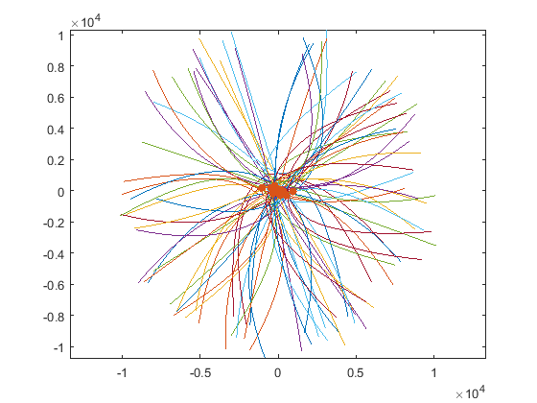
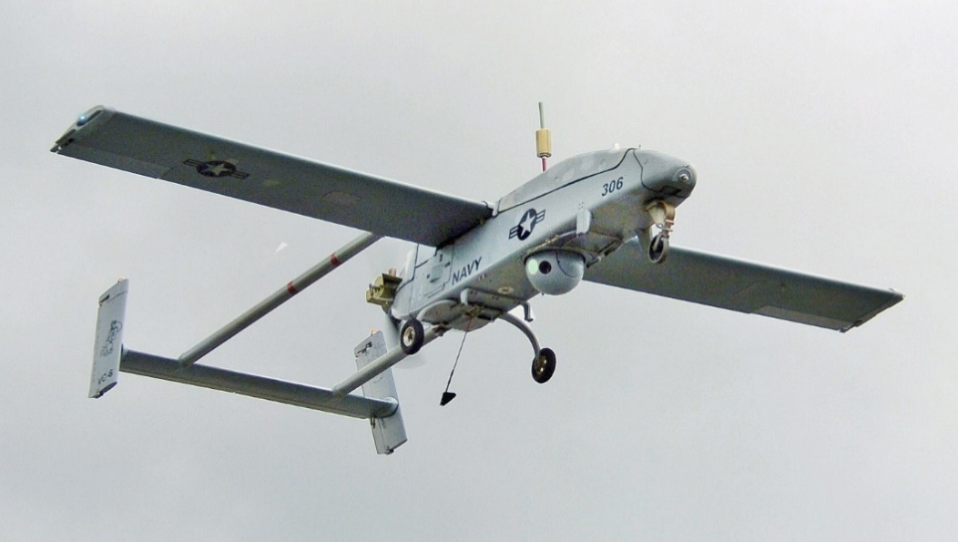
UAV-reconnaissance
The success probability of the UAV-reconnaissance was analyzed using Monte Carlo method.
We created our own simulation tool to account for the technical specifications of the radar and weapon systems.

Slide 42
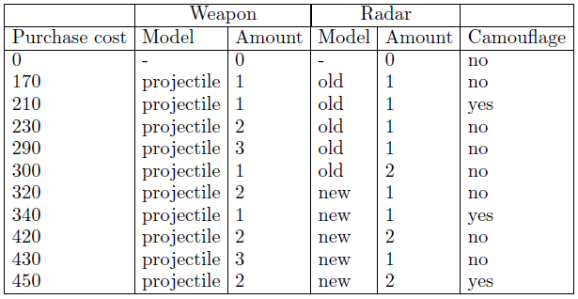
Computational results
Non-dominated decision alternatives for the Attacker.
Non-dominated decision alternatives for the Defender.
Maximin decision rule was used to finalize the list of best counter- measure portfolios for each cost level.

Slide 43
Summary
Cross-impact analysis can derive joint probabilities from conditional dependencies between uncertainty factors.
The probability information can be used to construct network models.
Adversarial risk analysis uses multi-agent influence diagrams to model multi-actor decision problems.
Adversarial risks can be analyzed even if the adversary’s priorities and his available information is not well known.

Slide 44
