Slide 1
Journal Lists: OR/MS
Jyrki Wallenius

Slide 2
JUFO-classification OR/MS Category 3
Journal of Operations Management
Management Science
Mathematical Programming
Operations Research
Transportation Science
Computer Science and AI:
IEEE Transactions On Evolutionary Computation
IEEE Transactions On Fuzzy Systems

Slide 3
JUFO-classification OR/MS Category 2
Decision Support Systems
EJOR
Journal of Global Optimization
JORS
Manufacturing and Service Oper. Mgmt.
Mathematics of Operations Research
Naval Research Logistics
Networks
Omega
Production and Oper Management
Reliability Eng. and System Safety
Systems and Control Letters
Technovation
Transportation Research Part B
Transportation Research Part E

Slide 4
FT50 List
1. Academy of Management Journal
2. Academy of Management Review
3. Accounting, Organizations and Society
4. Administrative Science Quarterly
5. American Economic Review
6. Contemporary Accounting Research
7. Econometrica
8. Entrepreneurship Theory and Practice
9. Harvard Business Review
10. Human Relations
11. Human Resource Management
12. Information Systems Research
13. Journal of Accounting and Economics
14. Journal of Accounting Research
15. Journal of Applied Psychology
16. Journal of Business Ethics
17. Journal of Business Venturing
18. Journal of Consumer Psychology
19. Journal of Consumer Research
20. Journal of Finance
21. Journal of Financial and Quantitative Analysis
22. Journal of Financial Economics
23. Journal of International Business Studies
24. Journal of Management
25. Journal of Management Information Systems

Slide 5
FT50 cont.
26. Journal of Management Studies
27. Journal of Marketing
28. Journal of Marketing Research
29. Journal of Operations Management
30. Journal of Political Economy
31. Journal of the Academy of Marketing Science
32. Management Science
33. Manufacturing and Service Operations Management
34. Marketing Science
35. MIS Quarterly
36. Operations Research
37. Organization Science
38. Organization Studies
39. Organizational Behavior and Human Decision Processes
40. Production and Operations Management
41. Quarterly Journal of Economics
42. Research Policy
43. Review of Accounting Studies
44. Review of Economic Studies
45. Review of Finance
46. Review of Financial Studies
47. Sloan Management Review
48. Strategic Entrepreneurship Journal
49. Strategic Management Journal
50. The Accounting Review

Slide 6
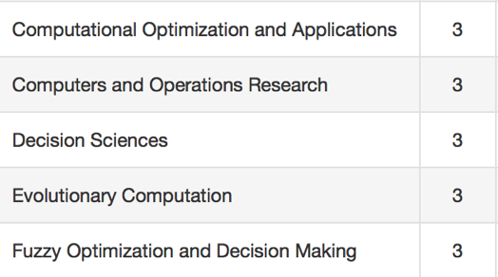
AJG (ABS)

Slide 7
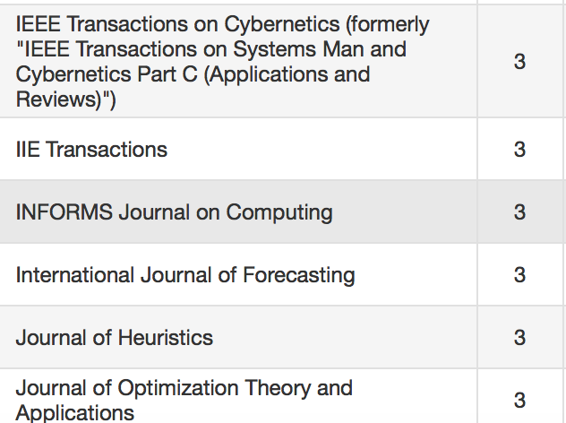
AJG (ABS) cont.

Slide 8
To sum up
AJG and FT 50 lists honored by B-schools all over the world. Engineering schools? AJG and FT 50 lists important if you apply for jobs in B-schools
Excellent: FT 50, JUFO 3, AJG 4
Very good: JUFO 2, AJG 3
(It does not really matter if a journal is in JUFO 1, if it is in AJG 3?)
How to influence the lists?
FT 50 (periodically B-School Deans vote)
AJG (spring 2018 updated; minimal changes)
JUFO (via the system or lobbying, too late now)

