Slide 1
Modeling crowd dynamics in an evacuation as a multi-agent system
Doctoral student: Anton von Schantz,
Faculty&funding: Dep. Math. and Syst., Aalto University
Instructor&supervisor: prof. Harri Ehtamo
The document can be stored and made available to the public on the open internet pages of Aalto University. All other rights are reserved.

Slide 2
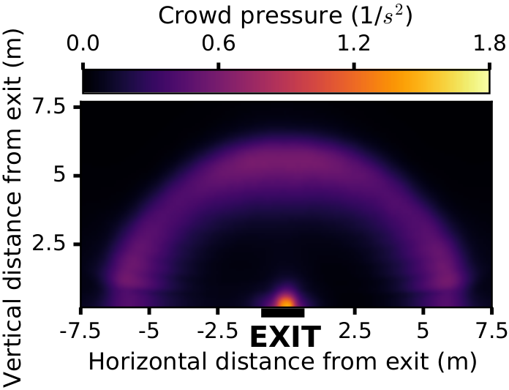
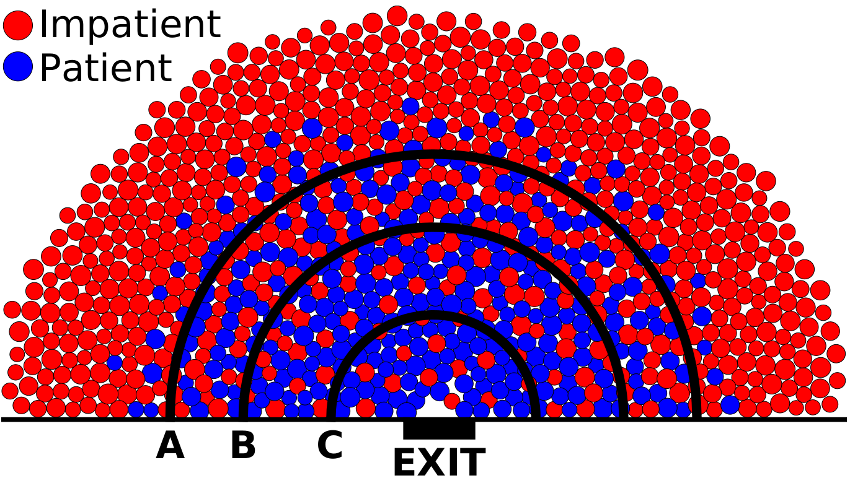
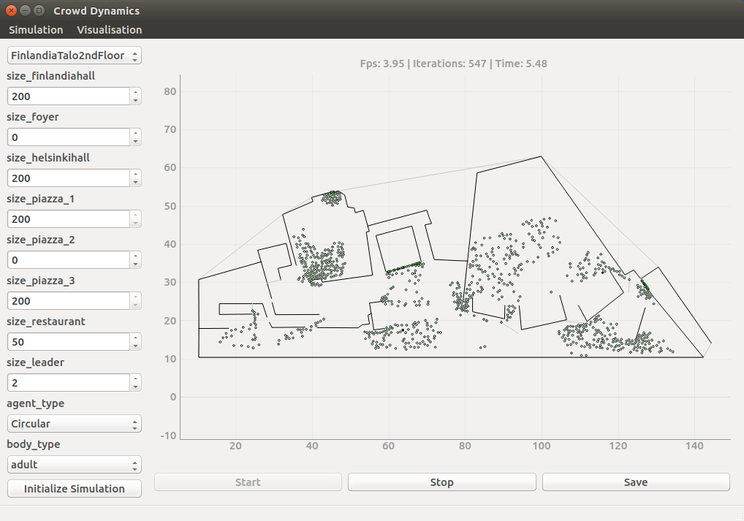
Key research questions:
How to model movement and decision-making of a human crowd in evacuation?
How to improve evacuation safety with these models?
Build-up of crowd pressure due to locally played game
Spatial game in exit congestion
Expected contribution:
Computationally efficient cellular automaton model
Physical phenomena as a result of a locally played game coupled to a physics-inspired model
Optimal guidance of pedestrians from a complex environment
Simulation platform coded by von Schantz & Tollander de Balsch

Slide 3
Articles published so far:
Cellular automaton evacuation model coupled with a spatial game, Lecture Notes in Computer Science (Aug. 2014)
Spatial game in cellular automaton evacuation model, Phys. Rev. E (Nov. 2015)
Twotype multiagent game for egress congestion, Proc. 50th Hawaii International Conference on System Sciences (Jan. 2017)
Plans towards completion and beyond:
Overtaking others in a spatial game of exit congestion, PNAS (manuscript ready, submission Jun. 2018)
A genetic algorithm approach to optimal guidance of a crowd, Transp. Res. Part B (manuscript ready Aug. 2018)
Unnamed article (manuscript ready 2019)
Dissertation (mid 2019)

