Slide 1
Tampere University of Technology (TUT)
Technology for the benefit of people and the environment

Slide 2
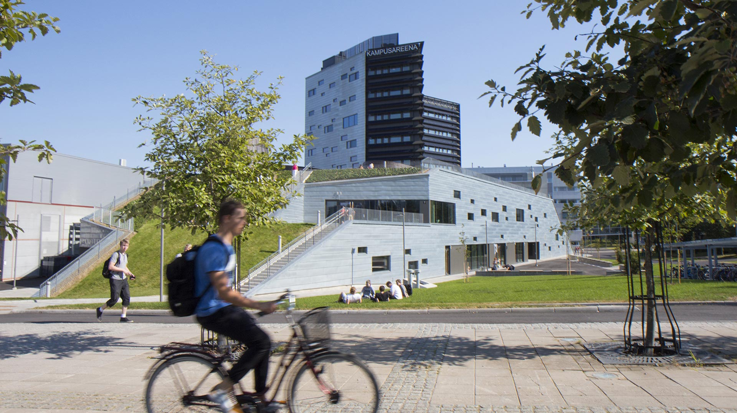
Tampere University of Technology
Established in 1965
Collaborates with approx. 230 universities around the world
Approx. 1,600 employees and 7,900 students (2017)
Quality Assurance System audited by the Finnish Higher Education Evaluation Council in 2014
Started operating in the form of a foundation in 2010

Slide 3
Tampere
Third largest city in Finland, 230,000 inhabitants
Tampere3
Tampere University of Technology, University of Tampere and Tampere University of Applied Sciences
33,000 students
4,300 employees
One of the fastest growing urban centres in Finland
The most popular city to live and study in
“The new university will provide a unique hub for the interdisciplinary research on the economy, technology, health and society”
Notes:
The Tampere3 project builds on the interfaces between fields of study and science to establish a new kind of research and education environment.
TUT and University of Tampere merge into a new foundation university that will also act as a university of applied sciences as the majority shareholder of Tampere University of Applied Sciences. The new foundation university is to begin its operation on 1 January 2019.

Slide 4
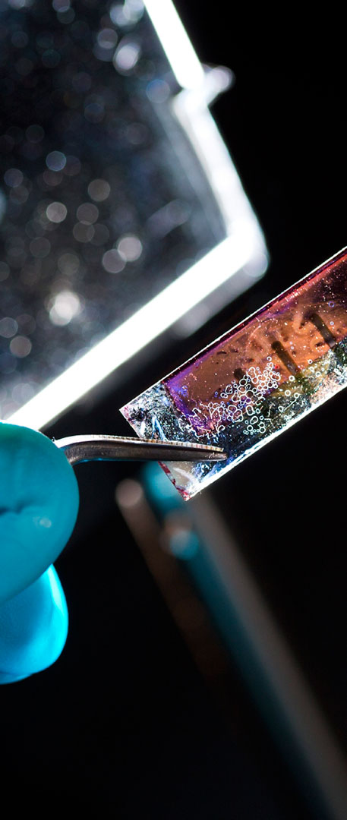
Research profile
We develop technologies that reshape the competitive landscape of Finnish industry.
Digital operating environment
Energy- and eco-efficiency
Health technology
Light-based technologies

Slide 5
TUT in numbers in 2017
1,318 JUFO-classified publications
Employees
1,578
100 professors
JUFO 1
940
24% international employees
57 nationalities
JUFO 2–3
378

Slide 6
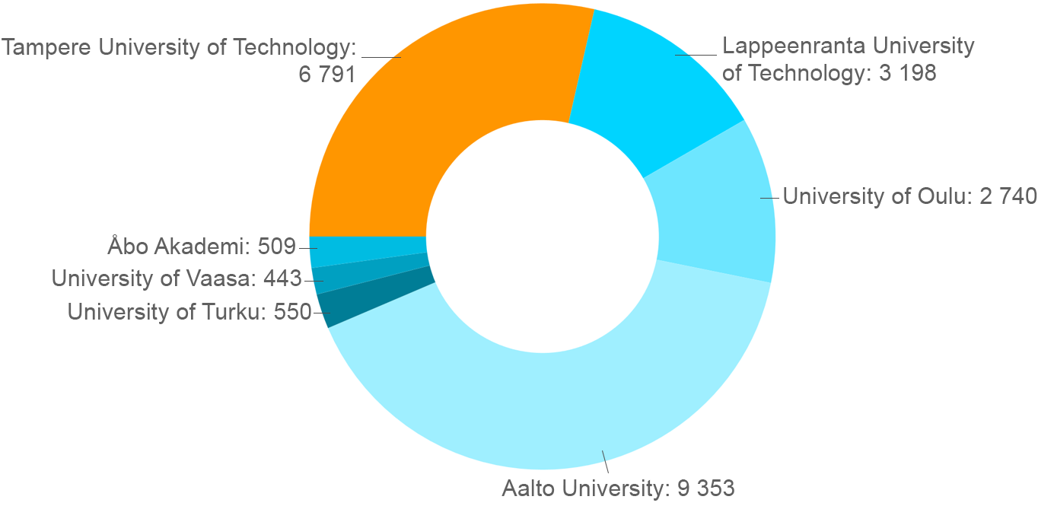
Undergraduate students of technology in Finland in 2017
Source: Vipunen - Education Statistics Finland, 23 April 2018

Slide 7
Strong impact on society
Forerunner in university-industry collaboration.
1
Active transfer of research results and new technologies to industry through R&D projects conducted in collaboration with companies.
2
Fertile breeding ground for innovations and new knowledge-based companies.
3
Graduates enjoy an excellent employment rate and they are readily absorbed by industry, companies and other facets of society.
4

Slide 8
Video: Research is the key to the future
https://youtu.be/aLEc13QSiIc

Slide 9
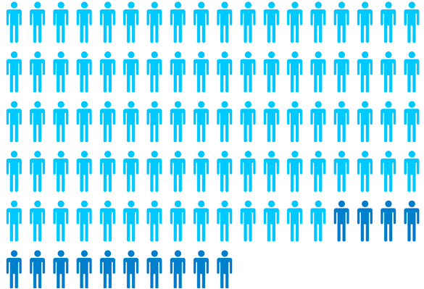
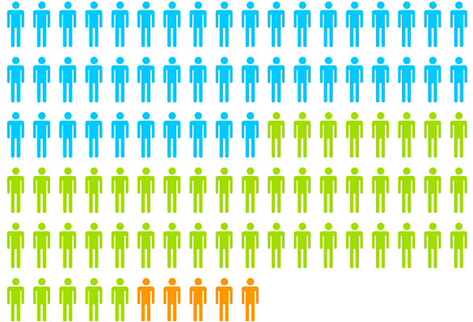
TUT in numbers in 2017
over 80% of students are employed upon graduation
7,898 students
1,391 degrees
PLACES OF EMPLOYMENT
EMPLOYERS
Private sector 79%
Entrepreneur 3%
REGIONS
Western Finland Province 69%
Southern Finland Province 27%
6,881 BSc/MSc students, of whom 529 international
BSc (Tech) 579
1,017 doctoral students, of whom 207 international
MSc (Tech/Arch) 733
Doctors 79

Slide 10
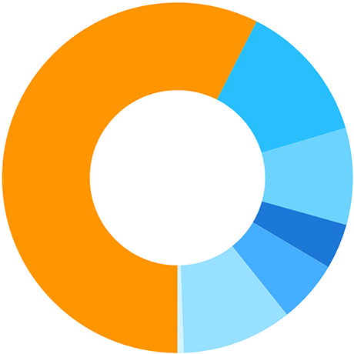
TUT in numbers in 2017
Total funding 134 MEUR
State funding
77.7
13.8 Tekes
13.6 Academy of Finland
Supplementary funding
56 MEUR
State funding
78 MEUR
5.8 EU and other foreign
9.6 Other domestic
12.2 Business operations
1.1 Other revenue

Slide 11
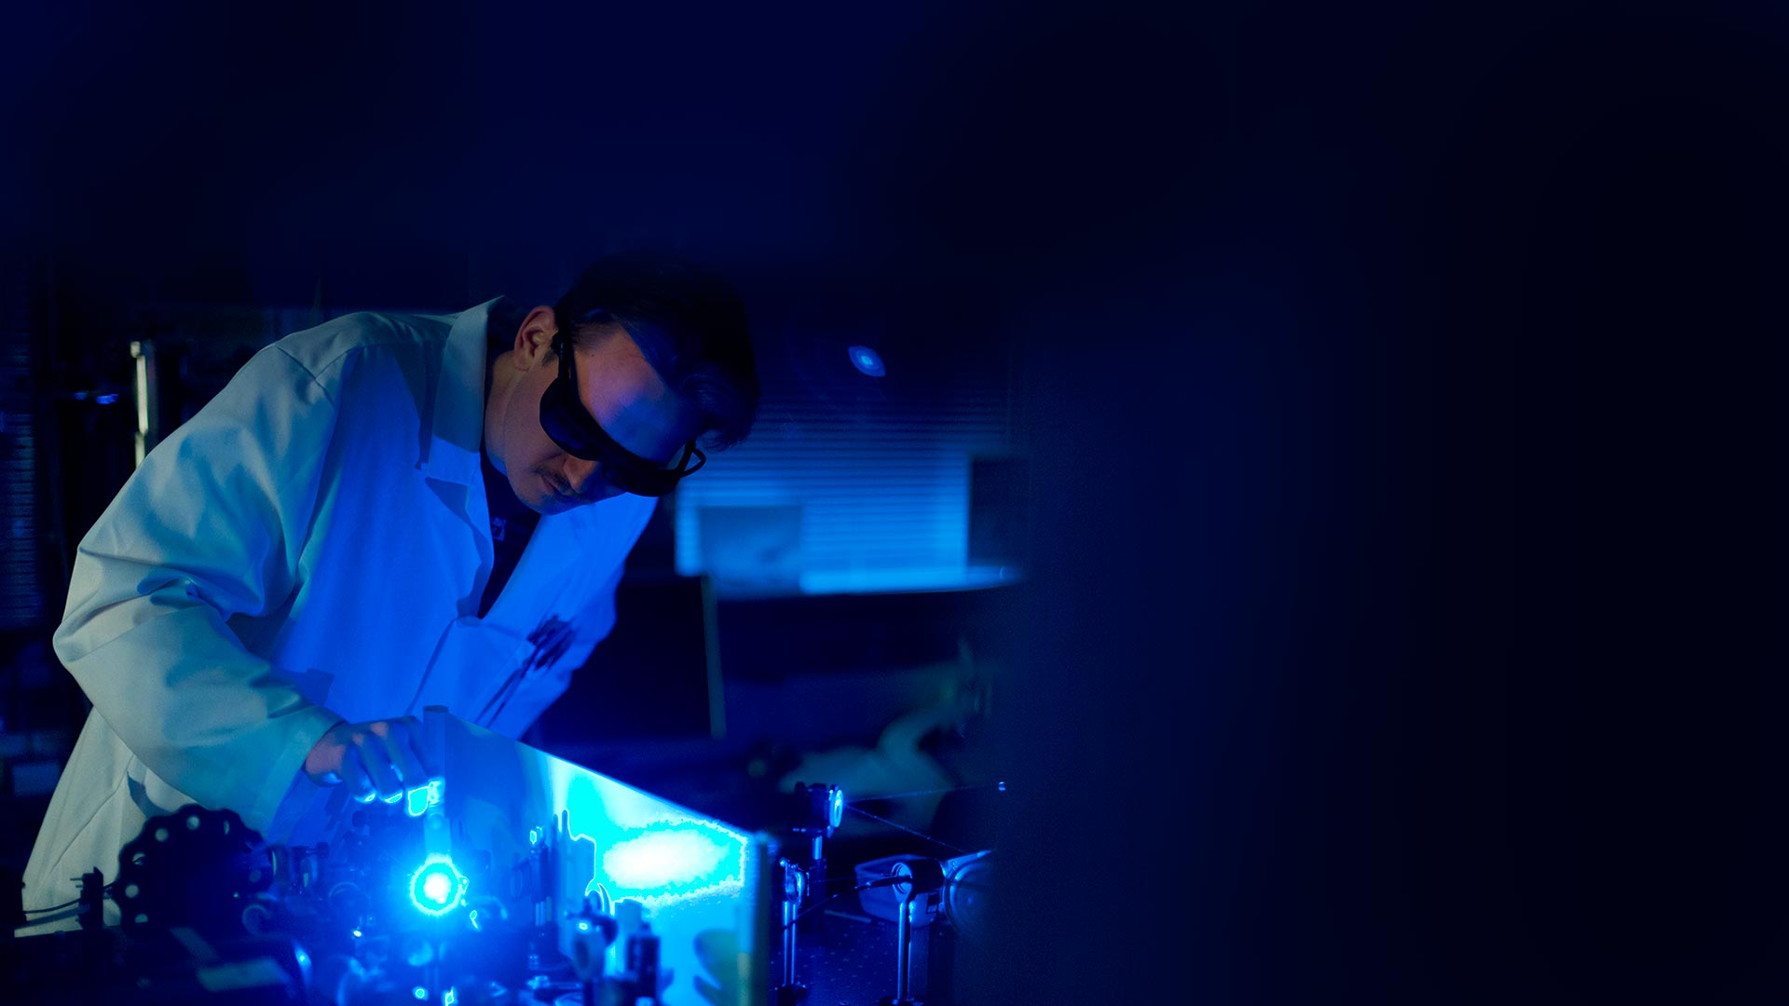
TUT – pioneer in technological development
Courageously explores new avenues of research and education in the fields of engineering
Sought-after partner for research and business endeavours
Educates valued experts for various fields of society

Slide 12
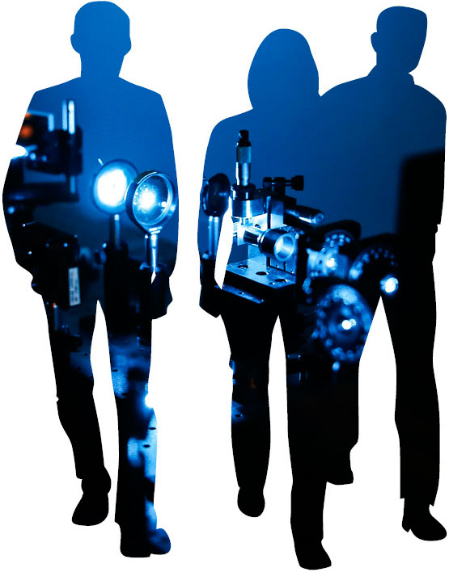
Technology for the benefit of people and the environment
Our research combines
natural sciences
technology
business
The research fields represented at the University play a key role in addressing global challenges, such as climate change and demographic ageing.

Slide 13
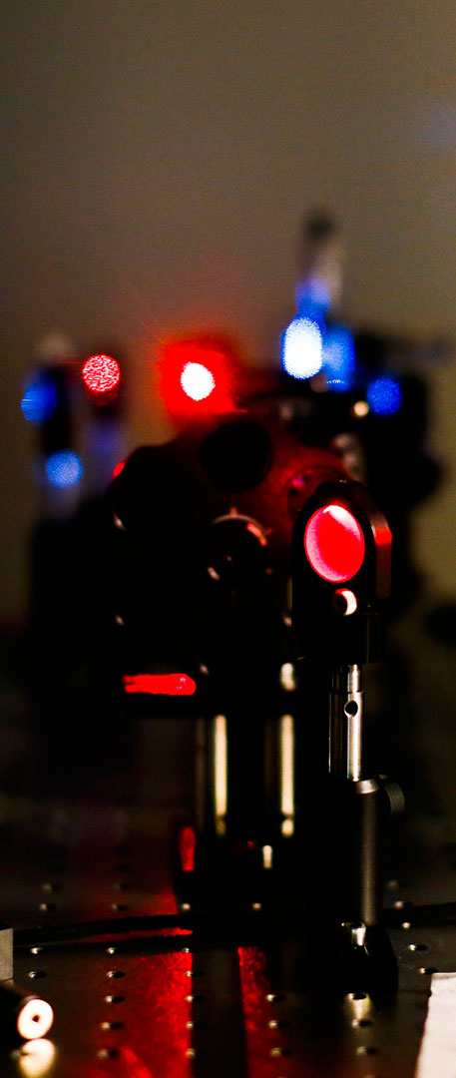
TUT in rankings
TUT has climbed the key international university rankings and in many of them established itself among the top 400.
47th on the QS 2017 ranking of world's top young universities.
380th on the QS World University Ranking in 2017. TUT achieved its best positions in the categories for teacher-student relationship and international staff.

Slide 14
Digital operating environment – harnessing machine intelligence for the benefit of people
We refine exponentially growing volumes of data and study machine-to-machine communication technologies.
Our University enjoys a reputation for research excellence in signal processing.
We are seeking to become the world’s foremost hub of research in intelligent machines and networked systems.

Slide 15
Energy- and eco-efficiency – circular economy for a greener tomorrow
We develop new technologies and materials for
energy production
intelligent energy systems
efficient life-cycle performance
environmental impact management.
Our goal is to establish an international reputation for research in circular economy.
We maintain a world-class research infrastructure.

Slide 16
Health technology – better quality of life through new technology
We develop new methods for monitoring and maintaining human health. We place special emphasis on diagnostic and regenerative technologies.
The key to our success is our close and multidisciplinary collaboration with biologists and clinicians.
We are internationally recognized for our expertise in biomodelling.

Slide 17
Light-based technologies – natural sciences lay the foundation for technological breakthroughs
We develop new laser sources and methods for the sophisticated control and utilization of the properties of light. Together with new photosensitive materials, they drive the development of unique new applications in multiple areas.
Our University is one of the world’s leading centres for photonics research.

Slide 18
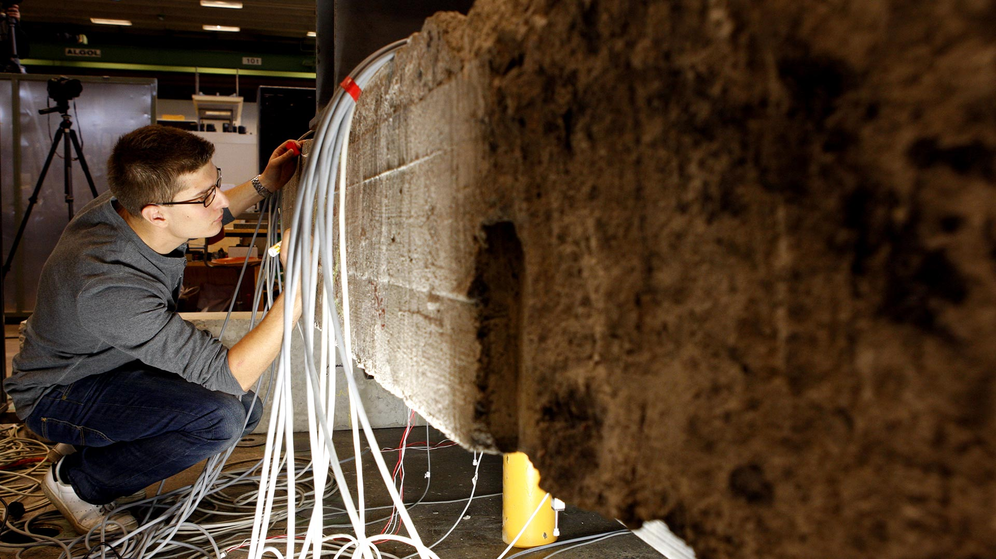
Our graduates are highly competent, responsible and self-directed
TUT provides its students with broad-based, cross-technical education and a range of tracks for lifelong learning.
The students gain an understanding of the significance of technology for tackling the challenges of sustainable development. Their capacities for entrepreneurship are supported and further developed.
We blaze the trail for the development and utilization of new learning environments.
Our graduates enjoy an excellent employment rate.

Slide 19
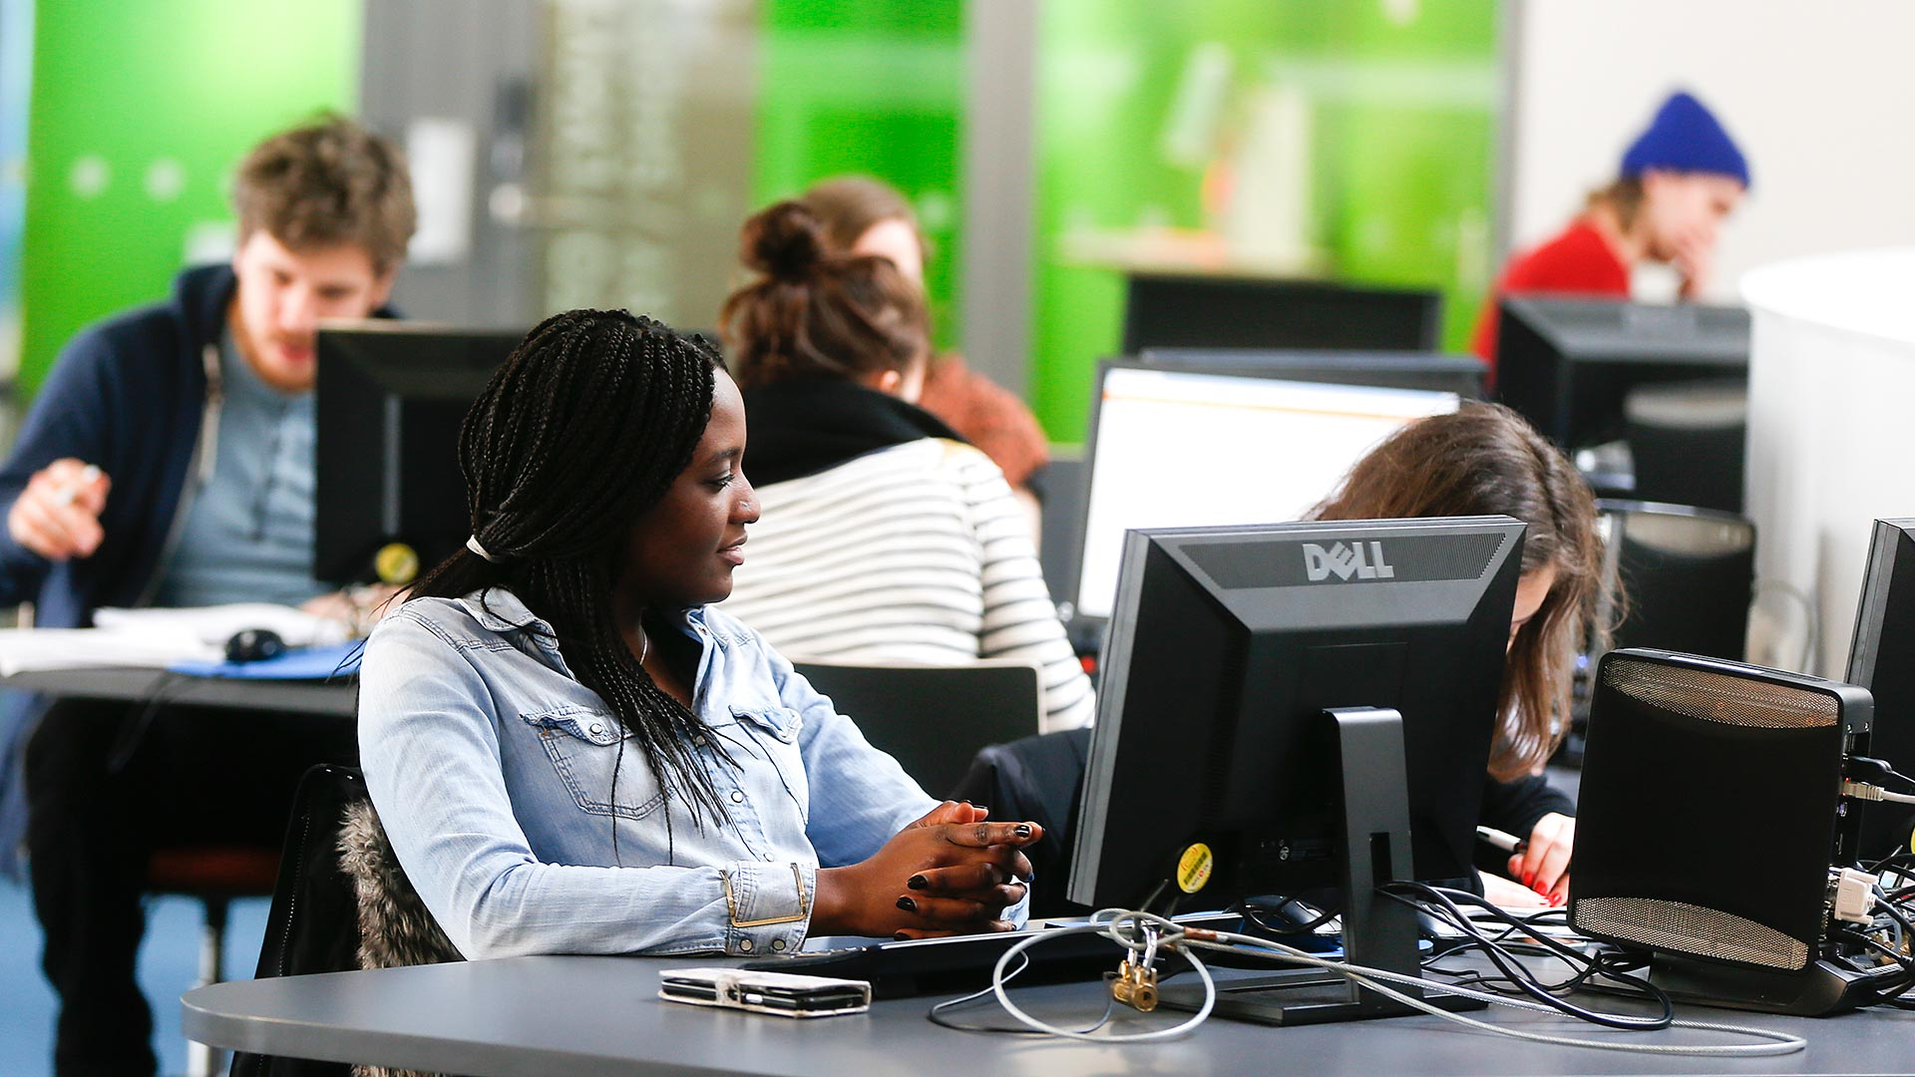
Reach your potential – studies in English
Bachelor’s programme taught in English in the field of technology:
Science and Engineering
Seven Master’s programmes:
Biomedical Science and Engineering
Business and Technology
Electrical Engineering
Engineering Materials Science
Factory Automation and Robotics
Information Technology
Sustainable Architecture

Slide 20
Partner for companies of all sizes
Roughly a half of our inventions are transferred to companies
Advanced contractual practices and flexible forms of cooperation.
Cooperation with approx. 800 companies annually
What the company gains:
broad-based multidisciplinary expertise
research knowledge and environments
international networks
fresh views and expertise from students.
2/3 of master’s theses are prepared directly for industry demand

Slide 21
Partner for companies of all sizes
Research & development
Competence development
New talent
Commissioned research
solutions tailored for business needs
Continuing education
Enhanced expertise through off-the-shelf or tailored training
Bachelor’s and master’s theses
additional resource for analysis and development work
Research collaboration
a minor contribution opens the doors to an extensive research and collaboration community
Doctoral education
Gaining doctorate while working
Teaching cooperation
Expert lecturers, new ideas through project work or Demola projects
Networking events
Research findings and expert contacts
Co-creation platforms industry development within university-industry networks
Student recruitment
Job advertisements in the POPJob service and on-campus recruitment events
Measuring and analysis services
unbiased information that supports product development
Doctoral recruitment
Scientific in-depth expertise in support of corporate renewal
Services with innovation vouchers
evaluate new ideas or plan further development

Slide 22
TUT makes an impact
In 2010–14, 180 TUT-based companies
provided employment worth 6,100 person-years or more
created a turnover of at least 1,200 MEUR.
INNOVATION ACTIVITIES 2017
Invention disclosures 53
Patent applications 3
Patents granted 2

Slide 23
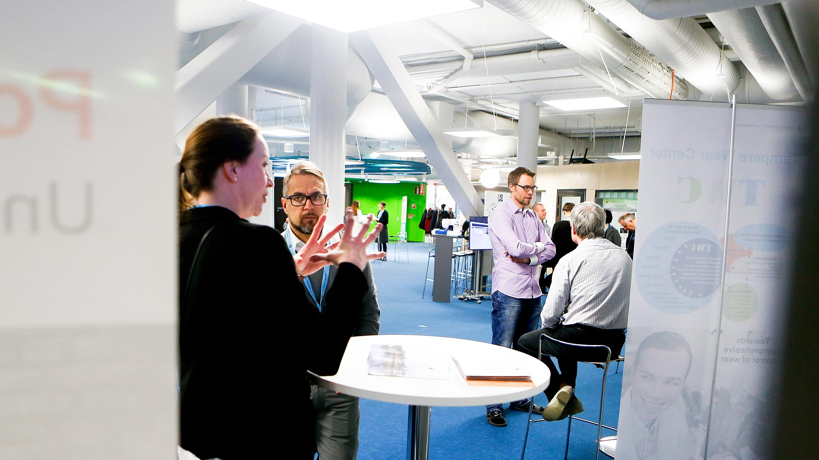
Kampusareena – a hub of science, research and technology
Interdisciplinary encounters fuel new ideas that can grow into collaborative R&D projects, innovations, jobs and successful businesses.
Gathers researchers, students, alumni and companies at the heart of the campus.

