Slide 1
Data Science for Safety and Security
ICMAT – DataLab
David Ríos, AXA-ICMAT and Royal Academy
Notes:
Ejemplo portada 02

Slide 2
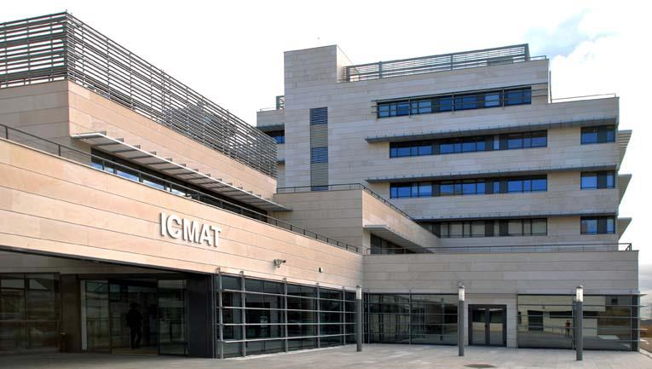
ICMAT – Institute of Mathematical Sciences
Founded in 2007. New building in 2011.
A joint research center: CSIC + UCM + UAM + UC3M
Severo Ochoa Excellence Center (2011, 2016) (2017-2020)
Notes:
Ejemplo interior 01

Slide 3
Research funding
12 ERC grants: 8 Starting + 3 Consolidator + 1 Advanced
4 Marie Curie Fellowships
2 BBVA Foundation projects
1 AXA Chair
2 H2020 Projects
22 National projects (including 2 EXPLORA)
Severo Ochoa (1M €/year)
6 Projects from private sector
Notes:
Ejemplo interior 02

Slide 4
DataLab Our vision
Tackle complex mathematical problems to address real society demands.
Build bridges between academia and industry.
Achieve highest standard research and postgrad training in data science
3 senior, 3 postdocs, 9 PhDs, 1 PM
ICMAT
Datalab
Academia
Society
Notes:
Ejemplo interior 01

Slide 5
Datalab Research lines
Theory
Applications
Machine learning
Bayesian statistics
Decision theory
Optimization
Network theory
Mathematical modelling
Financial mathematics
Stochastic processes
Adversarial risk analysis
Prediction of human behaviour
Decision support for complex systems under uncertainty
Cybersecurity
Fraud detection
Aviation safety
Counterterrorism
Notes:
Ejemplo interior 01

Slide 6
What can we offer ?
A thriving new team of talented young researchers
An open mind to tackle problems
Very good mathematical & hacking skills
Financial support for PhDs and postdocs
In-House HPC cluster

Slide 7
What are we looking for ?
Interesting projects to collaborate
Joint partnership to apply for large project funding
Opportunities for student exchange
Inspiring ideas
Advice & guidance

