Slide 1
Management Science @ Aalto
Juuso Liesiö, Dr.Sc. (Tech)
Assistant Professor of Management Science
Department of Information and Service Management
Aalto University School of Business
juuso.liesio@aalto.fi

Slide 2
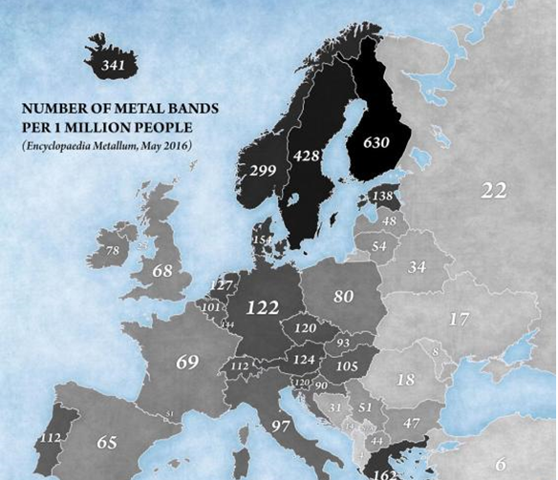
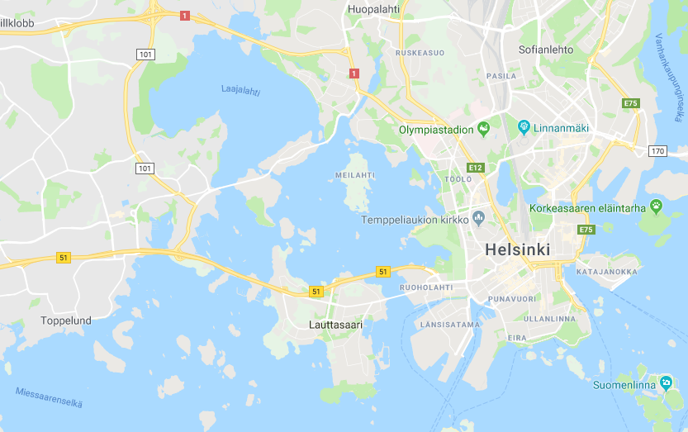
Aalto University
Aalto
(SCI, ELEC, CHEM…)
Aalto BIZ

Slide 3
Aalto University School of Business (Aalto BIZ)
2007−
1997−
1998−
1998−
2001−
The leading business school in Finland
Global business school rankings by Financial Times 2015:
Master’s in Management: #54
CEMS MIM Master’s in Management: #4
Aalto Executive MBA: The best in the Nordic countries
Vision: Towards ’top ten’ in Europe by 2020
104 faculty members (incl. 77 professors)
+ 20 post docs + visiting faculty
3,600 B.Sc. & M.Sc. students
270 Doctoral students
+ MBA students
Notes:
A globally active player in management education and research.
Accreditations by AACSB, AMBA and EQUIS make the School a prestigious “Triple Crown” business school.

Slide 4
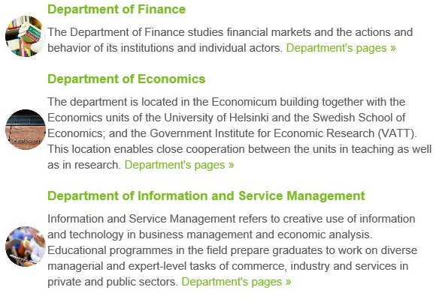
Aalto BIZ
Research groups:
Information System Science
Logistics
Management Science

Slide 5
Management Science = Science of Better
Management Science deals with the application of advanced analytical methods to help make better decisions. The term business analytics is sometimes used as a synonym for management science.
Techniques:
Mathematical optimization
Data analytics
Decision analysis
MCDM
Efficiency Analysis
Statistics
Simulation
Application areas:
Logistics
Operations management
Risk analysis & management
Healthcare
Military planning
Environment & Energy
Strategy development

Slide 6
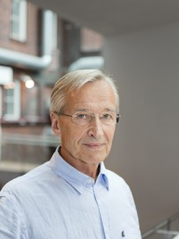
Management Science: Emeritus Professors
Jyrki Wallenius
Markku Kallio
Decision theory, investment theory; stochastic optimization; Regulation of Financial Networks
Multiple Criteria Decision Making: Theory, Applications, Computations; Decision Support; Behavioral Decision Theory; Performance Evaluation; Negotiation Modeling; Online Auctions
Pekka Korhonen
Multiple Criteria Decision Making: Theory, Applications and Tools; Data Envelopment Analysis, Election machines, Semantic Text-Analysis

Slide 7
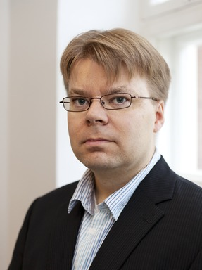
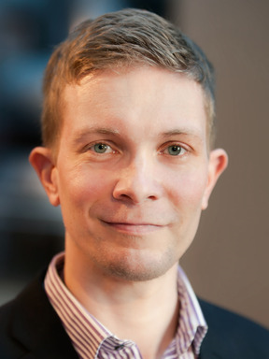
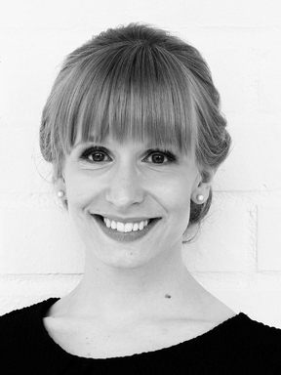
Management Science: Professors
Timo Kuosmanen
Pekka Malo
Axiomatic nonparametric modeling of production, consumption and investment decisions with applications in agriculture, banking, education, energy, environment, transportation, and utilities.
Machine learning
Artificial Intelligence
Evolutionary computation
Semantic info. retrieval
Statistical natural language processing
Multiobjective optimization
Bi-level optimization
Juuso Liesiö
Eeva Vilkkumaa
Portfolio Decision Analysis: Axiomatic preference models
Incomplete preference information (risk & multiple objectives)
Robust optimization
Resource allocation models
Modelling of uncertainties Dynamic decision problems Group decision making
Value of information

