Slide 1
Aalto Tenure Track
Doctoral Education Network Seminar
Stockholm 29.5.2018
Hannele Wallenius

Slide 2
Aalto academic positions

Slide 3
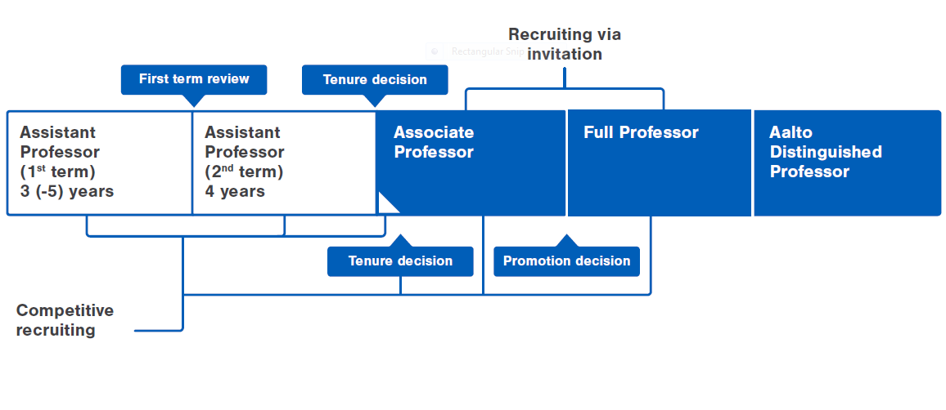
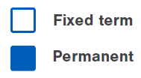
Aalto tenure track
Principles of Aalto tenure track are described in detail in ”Aalto Tenure Track – Policies and procedures –document” (updated February 2016) https://inside.aalto.fi/display/enhrs/Principles

Slide 4
Evaluation criteria –
The performance of candidates and professors to be tenured/promoted is evaluated through three dimensions:
Evaluation of Assistant Professor first term mainly based on the potential of the candidate. Assistant Professor second term evaluation based on both merits and potential.
Excellence in either research or teaching is required to be awarded a tenure.
Expected that everyone meets high international level in other evaluation dimensions.
A
B
C
Research
Teaching
Service

Slide 5
The following aspects may be considered in the evaluations:
Tenure or hiring decisions for Associate/Full Professors
Most important publications, impact and quality of publication forums
Research work in other universities and research institutes (including doctoral studies and post-doct periods)
The ability to build and lead a research team including possible doctoral students and post-doctoral researchers
The capability of raising competitive research funding
The ability to conduct independent research
First term Assistant Professors
Early exceptional research
Early exceptional teaching merits
Rate of progress in earning merits
Comparison and benchmarking of the candidates (including bibliometric indicators)
Independence and originality
Networking
Recommendation letters

Slide 6
Generic work time allocation in tenure track

