Slide 1
Notes:
Jokaisen sivun alakulmaan:
Aalto University

Slide 2
Towards an innovative society
Aalto University was established in 2010 as the spearhead project of Finland’s university reform. It was given the national mission of strengthening Finland's innovative capability through research, arts and education.
The university was named in honour of Alvar Aalto, the famous Finnish architect.
Notes:
View of the renovated A-hall of the Undergraduate Centre. The building was designed by Alvar Aalto.

Slide 3
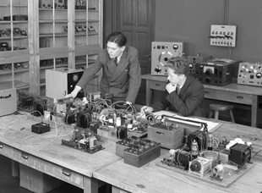
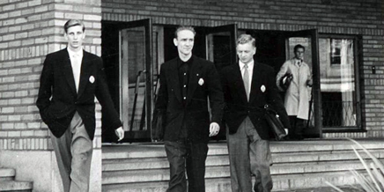
More than 150 years of wellbeing, innovation and entrepreneurship
Aalto University can draw on the unique expertise of Helsinki University of Technology, the University of Art and Design Helsinki and the Helsinki School of Economics.
Notes:
Helsinki University of Technology was established in 1849,
the University of Art and Design Helsinki in 1871 and
the Helsinki School of Economics in 1911.

Slide 4
Key figures
About
18 000
students
A total of 9 984 applicants sough admission
to Aalto University in spring 2017
and approximately 15% of them were admitted.
Number of graduates in 2015:
260 doctoral degrees, 1 998 master’s degrees,
1 970 bachelor’s degrees and
310 graduates from the MBA and EMBA programmes
A staff of about 4 200 of which more than 400 are professors.
Foreign academics account for about 36% of this total.

Slide 5
Our global success
number 7 among the best universities under 50 years of age in the world
(QS Top 50 under 50)
number 2 among Nordic business schools
(Financial Times, European Business Schools 2016 Special Report)
number 14 in the world in collaboration between the university and industries
(CWTS Leiden Industry Collaboration 2015)
number 3 in bachelor’s programmes in fashion in the world
(Business of Fashion, Global Fashion School Rankings 2016)
Notes:
There are between 17 000–22 000 universities in the world, about 1 000 in Europe, about 70 in the Nordic area and 14 in Finland.
Universities are often compared by rankings which are based on criteria that differ significantly from one another.
Typically, the universities that succeed in overall rankings are those that have received a Nobel prize at some point or that have published a large number of scientific articles.
Because of publication practices, the universities that do well in the rankings are those that teach medicine or the natural sciences.
Aalto University specialises in technology, business and art, and collaboration with companies is important for the university. That is why the rankings that are the most relevant for Aalto are the sector or subject specific rankings.

Slide 6
Organisation
School of Arts,
Design and Architecture
School of Business
School of
Chemical
Engineering
School of Electrical Engineering
School of Engineering
School of Science
Departments
Departments
Departments
Departments
Departments
Departments
Academic
Committee
Academic
Committee
Academic
Committee
Academic
Committee
Academic
Committee
Academic
Committee
Dean
Anna Valtonen
Dean
Ingmar Björkman
Dean
Janne Laine
Dean
Jyri Hämäläinen
Dean
Gary Marquis
Dean
Jouko Lampinen
Professors’ Council
Academic Affairs Committee
Vice Presidents and services
Antti Ahlava (VP, Campus Development), Eero Eloranta (VP, Education), Tuija Pulkkinen (VP, Research and Innovation), Hannu Seristö (VP, External Relations),
Anna Valtonen (VP, Art and Creative Practices), Marianna Bom (Chief Financial Officer), Kati Hagros (Chief Digital Officer),
Sirkku Linna (Director, Development), Jaakko Salavuo (Director, Communications), Eliisa Lassila (Acting Director, Human Resources)
Provost Kristiina Mäkelä
President
Ilkka Niemelä
Board
Professor of Practice Anne Brunila (Chair), President Mikko Kosonen (Vice Chair), Professor Bengt Holmström, Professor Saku Mantere,
Professor Liqiu Meng, Museum Director Susanna Pettersson, Professor Colin Whitehouse

Slide 7
School of Science
Degree students 3,000
of which Doctoral students 400
Departments
Applied Physics
Computer Science
Industrial Engineering and Management
Mathematics and Systems Analysis
Neuroscience and Biomedical Engineering
Partnerships
Helsinki Institute for Information Technology HIIT (joint institute with the University of Helsinki)
EIT Digital Helsinki Node
250 Master of Science (Technology) and 80 Doctoral degrees every year
Faculty & staff 1,200
Professors 114

Slide 8
School of Science Degrees and programmes
Academic degrees can be obtained at the Bachelor’s, Master’s, and Doctoral levels.
4 years, full time
40 ECTS credits + doctoral dissertation In English and Finnish
Bachelor of Science (Tech.)
180 ECTS credits
3 years, full time
In Finnish
Master of Science (Tech.)
120 ECTS credits
2 years, full time
In English and Finnish
Doctor of Science (Tech.)
Bachelor studies (in Finnish)
Master’s programmes in English
Industrial Engineering and Management
Information Networks
Computer Science and Engineering
Engineering Physics and Mathematics
Computer, Communication and Informatics Sciences
Engineering Physics
Industrial Engineering and Management
Information Networks
International Design Business Management (IDBM)
Life Science Technologies
Mathematics and Operations Research
Double degree programmes
ICT Innovation (EIT Digital Master School)
Advanced Materials for Innovation and Sustainability (EIT Raw Materials)

Slide 9
Systems and operations research
http://sal.aalto.fi/
The Systems Analysis Laboratory (SAL) (i) contributes to the theory, methods, practice of operations research (ii) carries out research projects in support of decisions, thus creating scientific, business and societal impacts
Application areas ❶ operations research in defence ❷ people flow planning and traffic optimization ❸ energy and climate change policies ❹ environmental decision making ❺ risk analysis of safety critical systems ❻ innovation and technology strategies

Slide 10
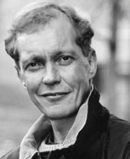
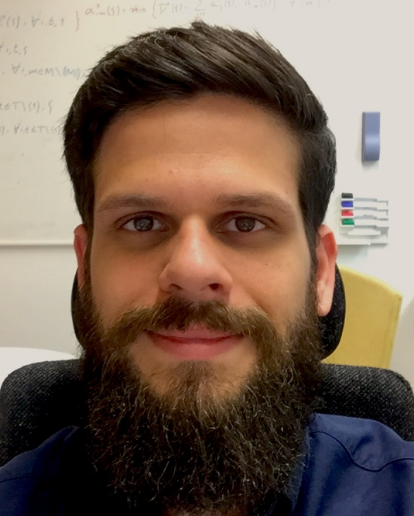
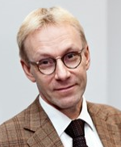
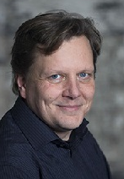
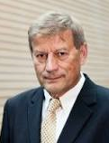
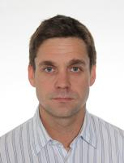
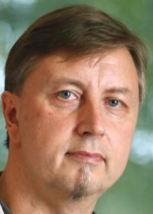
Professors
Harri Ehtamo
Optimization
Game theory
Fabricio Oliveira (9/2017 )
Stochastic optimization
Supply chain mgmt
Ahti Salo
Risk and decision analysis
Foresight and innovation
Kai Virtanen
Operations research in defence
Raimo Hämäläinen (emeritus 8/2016 ➔)
Environmental decision making
Systems intelligence
Antti Punkka (12/2017 )
Decision analysis
Resource management
Risto Lahdelma (9/2017 ➔, 50% double affiliation)
Linear programming
Energy modelling

