Slide 1
Research activities and career opportunities at IIASA
Dr. Elena Rovenskaya
Director, Advanced Systems Analysis Program
rovenska@iiasa.ac.at
International Institute for Applied Systems Analysis
(IIASA), Laxenburg, Austria

Slide 2

















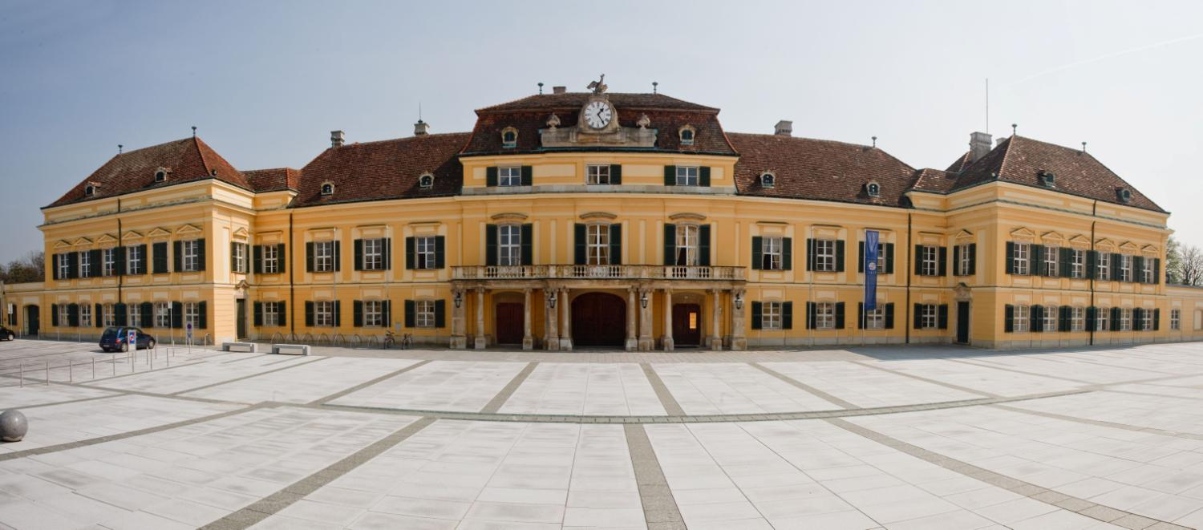





What is IIASA?
Established in 1972 by USA and USSR: bridge between East and West, science diplomacy
2019: International, independent, interdisciplinary research on major global problems; currently 22 member countries
Dimensions: economy, energy, land use, climate, air quality, technology, biodiversity, demography, natural hazards
Solution oriented, integrated systems analysis into the issues of sustainability and global transformation

Slide 3
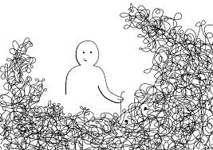
Complexity as an immanent property of public policy planning
All or almost all modern-age public policy plannings focus on complex problems
Complex does not mean just complicated or difficult!
A complex system:
Cannot be explained by breaking it down into components due to their strong interdependency
Non-linear dynamics, positive (amplifying) and negative (dampening) feedback loops
Sensitive to initial conditions
Emergence, local interactions define macro behavior
Bounce between equilibria and bursts of change
Interdisciplinary in nature
Source: Cairney 2012 Complexity Theory in Political Science and Public Policy, Political Studies Review, 10(3) 346-358

Slide 4


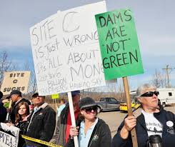
Challenges
Escalations are difficult to predict
Little time to react
Policy making is based on the government structure with silo mentality, but nexus solutions are needed
No/lack of quantitative data available
Trial-and-error approach not applicable, no public tolerance for the failure of a policy
Validation difficult
A feasible solution needed, not a right one
Multiple solutions possible

Slide 5

Social policy planning is a wicked problem
Churchman 1967 and Rittel & Webber 1973 introduced the notion of a “wicked” problem as a problem that is difficult or impossible to solve because of incomplete, contradict and evolving requirements
“Wicked” => resisting to resolution
Require systems thinking approach to reduce the risks of unwanted consequences

Slide 6
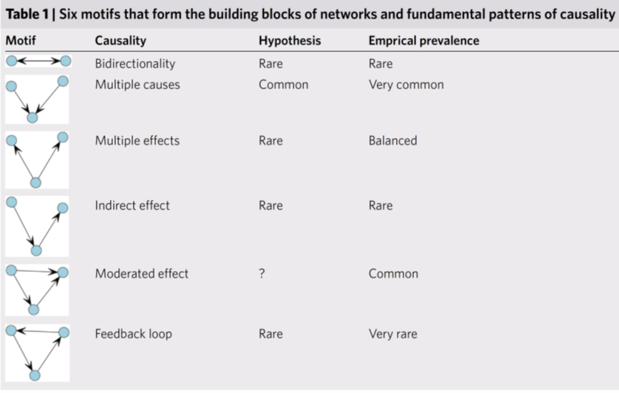
Systems thinking is not easy
Source: Levy MA, MN Lubell, N McRoberts. 2018. The structure of mental models of sustainable agriculture. Nature Sustainability 1(8): 413-420.

Slide 7

Why model?
0. Predict
Explain
Guide data collection
Illuminate core dynamics
Suggest dynamical analogies
Discover new questions
Promote a scientific habit of mind
Bound (bracket) outcomes to plausible ranges
Illuminate core uncertainties
Offer crisis options in near-real time
Demonstrate tradeoffs/suggest efficiencies
Challenge robustness of prevailing theory through perturbations
Expose prevailing wisdom as incompatible with available data
Train practitioners
Discipline a policy dialogue
Educate the general public
Reveal the apparently simple/complex to be complex (simple)
Source: JM Epstein (2008): Why Model Journal of Artificial Societies and Social Simulation 11(4): 12

Slide 8
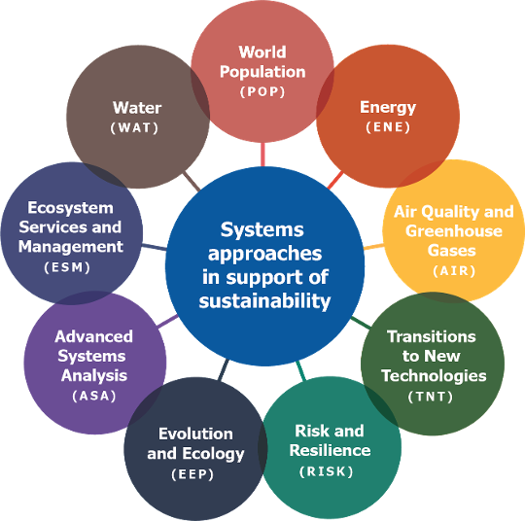
IIASA research structure

Slide 9

ASA mission
Develops and advances modeling methodologies to be used to deal with problems related to global change to enable deriving more efficient and effective solutions or to address problems that cannot be addressed by existing tools
Focus on methodological challenges that are not specific to a particular application, but which are of relevance to multiple areas

Slide 10





Six key method areas
Data
Stylized facts
Agent behavior
Network structure
Robust decisions
Stakeholder processes

Slide 11
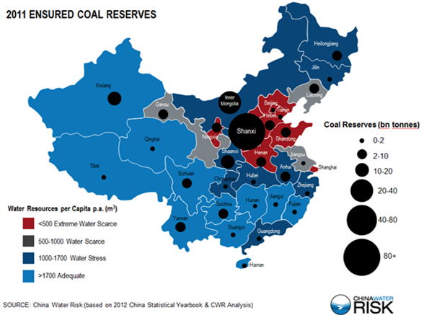
Example: Robust food-water-energy nexus solutions
Case study area: Shanxi province with large coal mining and scarce water
Water availability in Shanxi varies across prefectures and time
How to ensure a compatibility between energy security goals and food security goals given a scarce and volatile water supply?

Slide 12
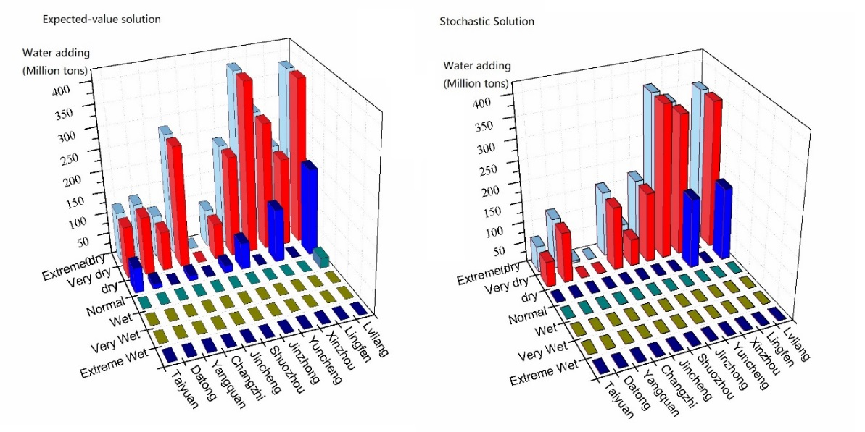
Example: Robust food-water-energy nexus solutions
The traditional and widely-used approach to rely on mean parameter values can be misleading -> risk-adjusted optimization is required instead
In particular, it enables to save on ex-post adaptation measures!

Slide 13
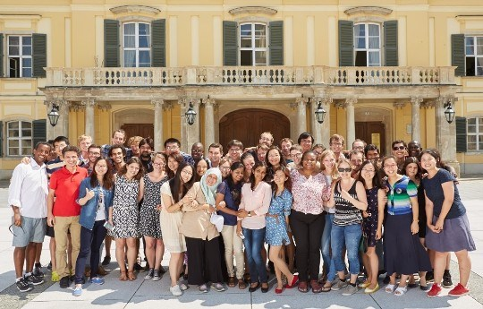
Options how to engage with IIASA
Young Scientist Summer Program (YSSP)
50 PhD student participants per year
June-August
Main goal: conduct a research project with an IIASA supervisor(s)

Slide 14
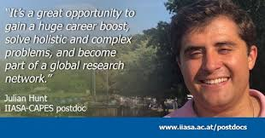
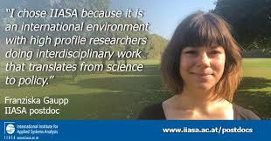
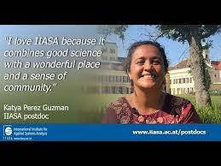
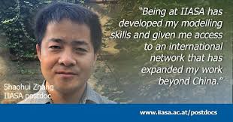
Options how to engage with IIASA
Postdoc program
Two-year term
Possibility to carry out own research project

Slide 15

Options how to engage with IIASA
Sabbatical
“Guest” contracts
Open positions
All are publicly advertised on the website
Can be project based

Slide 16

Thank you for your attention!

