Slide 1
Examples from Research Projects at IIASA
Behnam Zakeri, Research Scholar, Energy Program
International Institute for Applied Systems Analysis (IIASA)

Slide 2
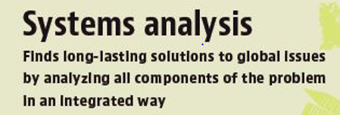
Global challenges
By 2030, the world’s population will increase by one billion
2.5 billion people are without access to modern energy
Global temperature change is likely to exceed 1.5°C by the end of the century
783 million people have inadequate access to safe freshwater
835 million people are still living in extreme poverty
IIASA’s mission ➔
Notes:
Our world is changing at an unprecedented rate. The challenges of rapid globalization, radical shifts in economic and political power, pressing environmental problems, and geopolitical conflicts require a global transformation. IIASA is uniquely positioned to respond to these challenges. As a leader in applied systems analysis, the institute is able to integrate natural, social, and economic systems to produce independent, interdisciplinary research into real-world problems. The institute’s collaborations with research institutions and policymakers around the world ensures the highest quality, most relevant science.

Slide 3
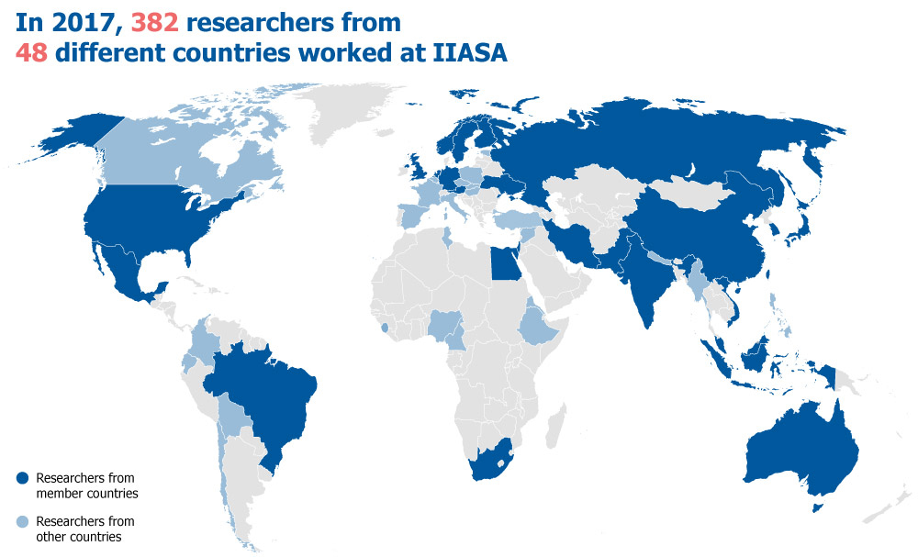
IIASA Research and Funding
Annual income in 2017 €21 million, 58% was from IIASA National Member Organizations
Notes:
Our world is changing at an unprecedented rate. The challenges of rapid globalization, radical shifts in economic and political power, pressing environmental problems, and geopolitical conflicts require a global transformation. IIASA is uniquely positioned to respond to these challenges. As a leader in applied systems analysis, the institute is able to integrate natural, social, and economic systems to produce independent, interdisciplinary research into real-world problems. The institute’s collaborations with research institutions and policymakers around the world ensures the highest quality, most relevant science.

Slide 4
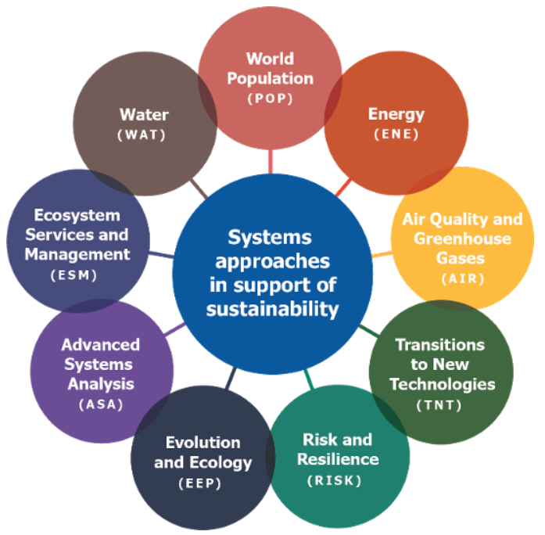
IIASA’s Nine Programs
Developing methods and models and
Applying them in different projects
Large-scale initiatives:
The World in 2050 (TWI2050)
Integrated Solutions for Water, Energy, and Land (ISWEL)
Futures initiatives:
Arctic Futures Initiative
Eurasian Economic Integration
Tropical Futures Initiative
Water Futures and Solutions
Notes:
IIASA has multiple major research initiatives that are designed to work at the intersection of global issues, in addition to internally funded, methodology-focused projects that cut across several disciplines.
The large-scale integrated projects supporting major global transformations include
The World in 2050 (TWI2050)
TWI2050 is an initiative that develops integrated pathways for achieving the UN Sustainable Development Goals (SDGs).
Integrated Solutions for Water, Energy, and Land (IS-WEL)
The IS-WEL partnership aims to develop an assessment framework for informing decision-making regarding the sustainable development of water, energy, and land resources at urban, regional, and global scales.
The IIASA futures initiatives are cross-sectoral projects designed to explore plausible futures for a number of the world’s rapidly changing regions and resources.
The Arctic Futures Initiative works collaboratively with key Arctic institutions and organizations to bring together affiliated stakeholders to support an integrated, “end to end” science to decision-making framework.
The Challenges and Opportunities of Economic Integration within a Wider European and Eurasian Space Initiative aims to discuss and analyze critical issues of economic cooperation between the EU, Eurasian Economic Union, and their neighbors, extending, where relevant, to the USA as well as the key Asian players, such as China, India, Japan, and Korea.
The Tropical Futures Initiative (TFI) aims to tackle tropical deforestation through policy assessment and capacity building.
Water Futures and Solutions applies systems analysis to help identify water policies and management practices that work together consistently across scales and sectors.
IIASA also has a number of internally funded, methodology-focused projects which examine unaddressed research challenges that require an integrated and interdisciplinary expertise and focus.
These include: dynamic vegetation models: the next generation; Socioeconomic Heterogeneity in Model Applications: and Systemic Risk and Network Dynamics.

Slide 5
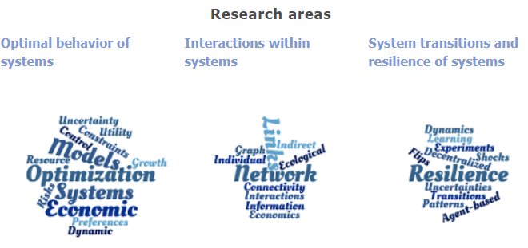
Advanced Systems Analysis (ASA)
develop, test, and make available new quantitative and qualitative methods
areas including mathematics, statistics, operations research, and management science
policy analysis of study of complex socio-environmental systems
Notes:
IIASA has multiple major research initiatives that are designed to work at the intersection of global issues, in addition to internally funded, methodology-focused projects that cut across several disciplines.
The large-scale integrated projects supporting major global transformations include
The World in 2050 (TWI2050)
TWI2050 is an initiative that develops integrated pathways for achieving the UN Sustainable Development Goals (SDGs).
Integrated Solutions for Water, Energy, and Land (IS-WEL)
The IS-WEL partnership aims to develop an assessment framework for informing decision-making regarding the sustainable development of water, energy, and land resources at urban, regional, and global scales.
The IIASA futures initiatives are cross-sectoral projects designed to explore plausible futures for a number of the world’s rapidly changing regions and resources.
The Arctic Futures Initiative works collaboratively with key Arctic institutions and organizations to bring together affiliated stakeholders to support an integrated, “end to end” science to decision-making framework.
The Challenges and Opportunities of Economic Integration within a Wider European and Eurasian Space Initiative aims to discuss and analyze critical issues of economic cooperation between the EU, Eurasian Economic Union, and their neighbors, extending, where relevant, to the USA as well as the key Asian players, such as China, India, Japan, and Korea.
The Tropical Futures Initiative (TFI) aims to tackle tropical deforestation through policy assessment and capacity building.
Water Futures and Solutions applies systems analysis to help identify water policies and management practices that work together consistently across scales and sectors.
IIASA also has a number of internally funded, methodology-focused projects which examine unaddressed research challenges that require an integrated and interdisciplinary expertise and focus.
These include: dynamic vegetation models: the next generation; Socioeconomic Heterogeneity in Model Applications: and Systemic Risk and Network Dynamics.

Slide 6
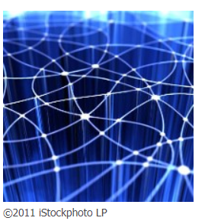
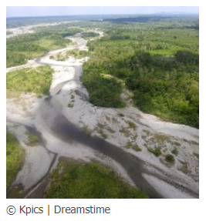
Advanced Systems Analysis (ASA): Examples
Systematic Risk and Network Dynamics
how different types of systems, from financial to ecological and beyond,
are at risk of cascades of failures.
Dynamic Vegetation Models: The next generation
centered on adaptation and optimization principles rooted in natural selection
to account for uncertainty
Other projects
Economic Integration within a Wider European and Eurasian Space
Economic Migration, Capital flows, and Welfare
Simulation Games as New Methods for Understanding Stakeholder Interaction and Decision-Making in Complex Systems
Notes:
IIASA has multiple major research initiatives that are designed to work at the intersection of global issues, in addition to internally funded, methodology-focused projects that cut across several disciplines.
The large-scale integrated projects supporting major global transformations include
The World in 2050 (TWI2050)
TWI2050 is an initiative that develops integrated pathways for achieving the UN Sustainable Development Goals (SDGs).
Integrated Solutions for Water, Energy, and Land (IS-WEL)
The IS-WEL partnership aims to develop an assessment framework for informing decision-making regarding the sustainable development of water, energy, and land resources at urban, regional, and global scales.
The IIASA futures initiatives are cross-sectoral projects designed to explore plausible futures for a number of the world’s rapidly changing regions and resources.
The Arctic Futures Initiative works collaboratively with key Arctic institutions and organizations to bring together affiliated stakeholders to support an integrated, “end to end” science to decision-making framework.
The Challenges and Opportunities of Economic Integration within a Wider European and Eurasian Space Initiative aims to discuss and analyze critical issues of economic cooperation between the EU, Eurasian Economic Union, and their neighbors, extending, where relevant, to the USA as well as the key Asian players, such as China, India, Japan, and Korea.
The Tropical Futures Initiative (TFI) aims to tackle tropical deforestation through policy assessment and capacity building.
Water Futures and Solutions applies systems analysis to help identify water policies and management practices that work together consistently across scales and sectors.
IIASA also has a number of internally funded, methodology-focused projects which examine unaddressed research challenges that require an integrated and interdisciplinary expertise and focus.
These include: dynamic vegetation models: the next generation; Socioeconomic Heterogeneity in Model Applications: and Systemic Risk and Network Dynamics.

Slide 7

Air Quality and Greenhouse Gases (Air)
Mission
examines the linkages between air pollution controls, health and other development policy priorities
Developing GAINS Model with global coverage
Working with the World Bank and policymakers in Beijing (China), Delhi (India), Hanoi (Vietnam), etc. to tackle city-level pollution and other specific issues.
Informing EU policies
European Clean Air Policy
The EU Climate and Energy Strategy for 2030
Notes:
IIASA has multiple major research initiatives that are designed to work at the intersection of global issues, in addition to internally funded, methodology-focused projects that cut across several disciplines.
The large-scale integrated projects supporting major global transformations include
The World in 2050 (TWI2050)
TWI2050 is an initiative that develops integrated pathways for achieving the UN Sustainable Development Goals (SDGs).
Integrated Solutions for Water, Energy, and Land (IS-WEL)
The IS-WEL partnership aims to develop an assessment framework for informing decision-making regarding the sustainable development of water, energy, and land resources at urban, regional, and global scales.
The IIASA futures initiatives are cross-sectoral projects designed to explore plausible futures for a number of the world’s rapidly changing regions and resources.
The Arctic Futures Initiative works collaboratively with key Arctic institutions and organizations to bring together affiliated stakeholders to support an integrated, “end to end” science to decision-making framework.
The Challenges and Opportunities of Economic Integration within a Wider European and Eurasian Space Initiative aims to discuss and analyze critical issues of economic cooperation between the EU, Eurasian Economic Union, and their neighbors, extending, where relevant, to the USA as well as the key Asian players, such as China, India, Japan, and Korea.
The Tropical Futures Initiative (TFI) aims to tackle tropical deforestation through policy assessment and capacity building.
Water Futures and Solutions applies systems analysis to help identify water policies and management practices that work together consistently across scales and sectors.
IIASA also has a number of internally funded, methodology-focused projects which examine unaddressed research challenges that require an integrated and interdisciplinary expertise and focus.
These include: dynamic vegetation models: the next generation; Socioeconomic Heterogeneity in Model Applications: and Systemic Risk and Network Dynamics.

Slide 8
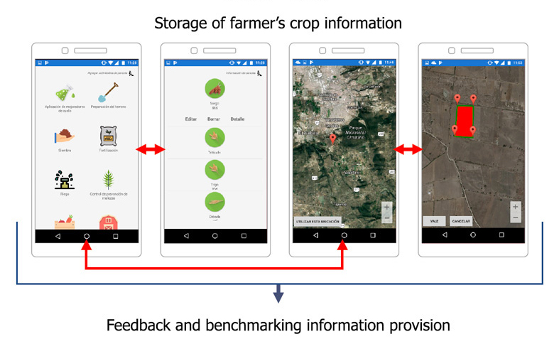
Ecosystem Services and Management (ESM)
Mission
to improve our understanding of ecosystems in today’s changing world
Harnessing the power of “citizen science”
improving land cover and land use monitoring
satellite data, image processing, and local observations
Developing dynamic land use models
Exploring trade-offs between food, energy and biodiversity
Notes:
IIASA has multiple major research initiatives that are designed to work at the intersection of global issues, in addition to internally funded, methodology-focused projects that cut across several disciplines.
The large-scale integrated projects supporting major global transformations include
The World in 2050 (TWI2050)
TWI2050 is an initiative that develops integrated pathways for achieving the UN Sustainable Development Goals (SDGs).
Integrated Solutions for Water, Energy, and Land (IS-WEL)
The IS-WEL partnership aims to develop an assessment framework for informing decision-making regarding the sustainable development of water, energy, and land resources at urban, regional, and global scales.
The IIASA futures initiatives are cross-sectoral projects designed to explore plausible futures for a number of the world’s rapidly changing regions and resources.
The Arctic Futures Initiative works collaboratively with key Arctic institutions and organizations to bring together affiliated stakeholders to support an integrated, “end to end” science to decision-making framework.
The Challenges and Opportunities of Economic Integration within a Wider European and Eurasian Space Initiative aims to discuss and analyze critical issues of economic cooperation between the EU, Eurasian Economic Union, and their neighbors, extending, where relevant, to the USA as well as the key Asian players, such as China, India, Japan, and Korea.
The Tropical Futures Initiative (TFI) aims to tackle tropical deforestation through policy assessment and capacity building.
Water Futures and Solutions applies systems analysis to help identify water policies and management practices that work together consistently across scales and sectors.
IIASA also has a number of internally funded, methodology-focused projects which examine unaddressed research challenges that require an integrated and interdisciplinary expertise and focus.
These include: dynamic vegetation models: the next generation; Socioeconomic Heterogeneity in Model Applications: and Systemic Risk and Network Dynamics.

Slide 9
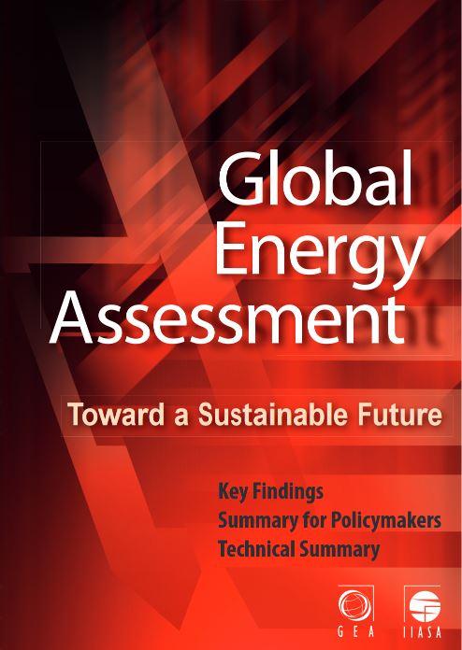
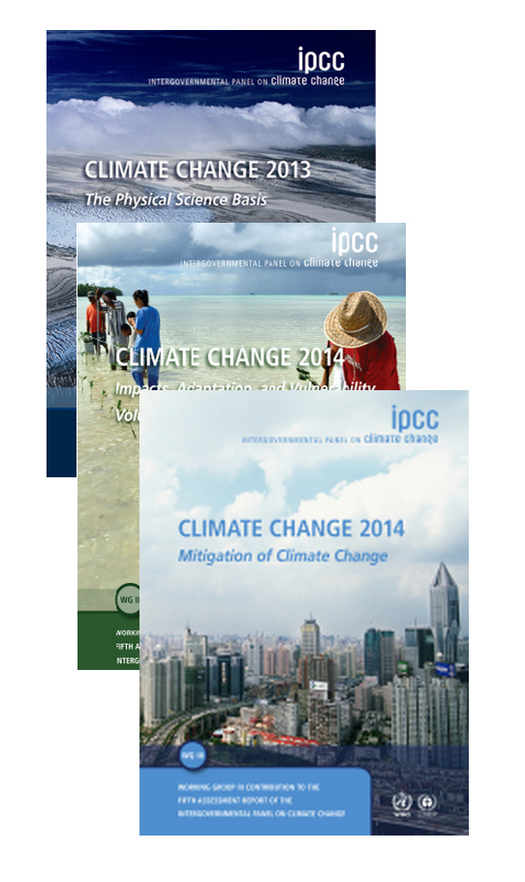
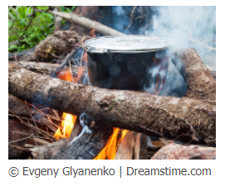
Energy (ENE)
Mission
to understand the nature of alternative future energy transitions, their implications for human well-being and the environment
Energy and sustainable development
energy scenarios and their environmental impact
Integrated Assessment Modelling (MESSAGEix)
Multi-criteria analysis
Energy access and energy security
clean and affordable energy
security of energy supply (energy trade)
Notes:
IIASA has multiple major research initiatives that are designed to work at the intersection of global issues, in addition to internally funded, methodology-focused projects that cut across several disciplines.
The large-scale integrated projects supporting major global transformations include
The World in 2050 (TWI2050)
TWI2050 is an initiative that develops integrated pathways for achieving the UN Sustainable Development Goals (SDGs).
Integrated Solutions for Water, Energy, and Land (IS-WEL)
The IS-WEL partnership aims to develop an assessment framework for informing decision-making regarding the sustainable development of water, energy, and land resources at urban, regional, and global scales.
The IIASA futures initiatives are cross-sectoral projects designed to explore plausible futures for a number of the world’s rapidly changing regions and resources.
The Arctic Futures Initiative works collaboratively with key Arctic institutions and organizations to bring together affiliated stakeholders to support an integrated, “end to end” science to decision-making framework.
The Challenges and Opportunities of Economic Integration within a Wider European and Eurasian Space Initiative aims to discuss and analyze critical issues of economic cooperation between the EU, Eurasian Economic Union, and their neighbors, extending, where relevant, to the USA as well as the key Asian players, such as China, India, Japan, and Korea.
The Tropical Futures Initiative (TFI) aims to tackle tropical deforestation through policy assessment and capacity building.
Water Futures and Solutions applies systems analysis to help identify water policies and management practices that work together consistently across scales and sectors.
IIASA also has a number of internally funded, methodology-focused projects which examine unaddressed research challenges that require an integrated and interdisciplinary expertise and focus.
These include: dynamic vegetation models: the next generation; Socioeconomic Heterogeneity in Model Applications: and Systemic Risk and Network Dynamics.

Slide 10
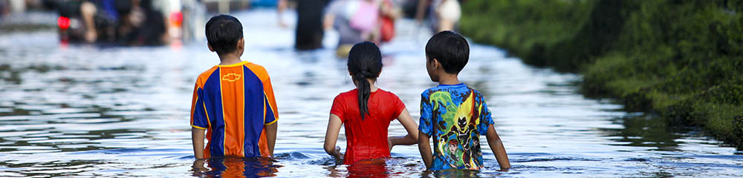

Risk and Resilience (RISK)
Mission
to better understand the risks to economic, ecological, and social systems arising from global change and to help transform the ways in which societies manage them.
Zurich Flood Resilience Alliance
- strengthens the resilience of communities against floods
- more than 110 country has benefited
Buoying up resilience in financial systems
- impact of climate change on business and insurance
- halving systemic risk in government bond markets by
optimizing investment portfolios
Notes:
IIASA has multiple major research initiatives that are designed to work at the intersection of global issues, in addition to internally funded, methodology-focused projects that cut across several disciplines.
The large-scale integrated projects supporting major global transformations include
The World in 2050 (TWI2050)
TWI2050 is an initiative that develops integrated pathways for achieving the UN Sustainable Development Goals (SDGs).
Integrated Solutions for Water, Energy, and Land (IS-WEL)
The IS-WEL partnership aims to develop an assessment framework for informing decision-making regarding the sustainable development of water, energy, and land resources at urban, regional, and global scales.
The IIASA futures initiatives are cross-sectoral projects designed to explore plausible futures for a number of the world’s rapidly changing regions and resources.
The Arctic Futures Initiative works collaboratively with key Arctic institutions and organizations to bring together affiliated stakeholders to support an integrated, “end to end” science to decision-making framework.
The Challenges and Opportunities of Economic Integration within a Wider European and Eurasian Space Initiative aims to discuss and analyze critical issues of economic cooperation between the EU, Eurasian Economic Union, and their neighbors, extending, where relevant, to the USA as well as the key Asian players, such as China, India, Japan, and Korea.
The Tropical Futures Initiative (TFI) aims to tackle tropical deforestation through policy assessment and capacity building.
Water Futures and Solutions applies systems analysis to help identify water policies and management practices that work together consistently across scales and sectors.
IIASA also has a number of internally funded, methodology-focused projects which examine unaddressed research challenges that require an integrated and interdisciplinary expertise and focus.
These include: dynamic vegetation models: the next generation; Socioeconomic Heterogeneity in Model Applications: and Systemic Risk and Network Dynamics.

Slide 11
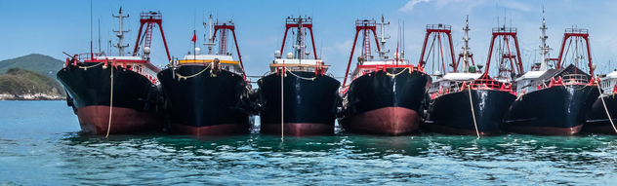
Evolution and Ecology Program (EEP)
Mission
analyzes and forecasts how ecological and evolutionary dynamics shape populations, communities, and ecosystems.
Integrated Assessment of Fisheries
- how fish populations react to pressures from fishing
Equitable Governance of Common Goods
help avoid “tragedy of the commons” by improving
the regulation of open resources
Notes:
IIASA has multiple major research initiatives that are designed to work at the intersection of global issues, in addition to internally funded, methodology-focused projects that cut across several disciplines.
The large-scale integrated projects supporting major global transformations include
The World in 2050 (TWI2050)
TWI2050 is an initiative that develops integrated pathways for achieving the UN Sustainable Development Goals (SDGs).
Integrated Solutions for Water, Energy, and Land (IS-WEL)
The IS-WEL partnership aims to develop an assessment framework for informing decision-making regarding the sustainable development of water, energy, and land resources at urban, regional, and global scales.
The IIASA futures initiatives are cross-sectoral projects designed to explore plausible futures for a number of the world’s rapidly changing regions and resources.
The Arctic Futures Initiative works collaboratively with key Arctic institutions and organizations to bring together affiliated stakeholders to support an integrated, “end to end” science to decision-making framework.
The Challenges and Opportunities of Economic Integration within a Wider European and Eurasian Space Initiative aims to discuss and analyze critical issues of economic cooperation between the EU, Eurasian Economic Union, and their neighbors, extending, where relevant, to the USA as well as the key Asian players, such as China, India, Japan, and Korea.
The Tropical Futures Initiative (TFI) aims to tackle tropical deforestation through policy assessment and capacity building.
Water Futures and Solutions applies systems analysis to help identify water policies and management practices that work together consistently across scales and sectors.
IIASA also has a number of internally funded, methodology-focused projects which examine unaddressed research challenges that require an integrated and interdisciplinary expertise and focus.
These include: dynamic vegetation models: the next generation; Socioeconomic Heterogeneity in Model Applications: and Systemic Risk and Network Dynamics.

Slide 12
Science to policy: Impact
IIASA research in Brazil shows compromise between agriculture and the environment and underpinned Brazil’s Nationally Determined Contribution (NDC) under the Paris Agreement, to reduce emissions by 43% by 2030
IIASA researchers led the development of new guidance for EU member states estimating greenhouse gas emissions and removals from forests for 2021-2030.
IIASA research was used in the preparation of two major UN-linked reports – The World in 2050 (TWI2050) and the Intergovernmental Panel on Climate Change Special Report on Global Warming of 1.5°C.
Notes:
Science and policy must work together to achieve a sustainable future for humanity, and providing robust policy advice is a key objective for IIASA. Below are a few examples of IIASA research that has helped to inform policy around the globe:
A recently published study led by IIASA, shows that if Brazil’s new Forest Code is properly enforced, a compromise could be established between agriculture and the environment. In Brazil, to be successful, any land-use policy must take into account both sectors. The work in Brazil has been ongoing for a while and was used in the development of Brazil’s Nationally Determined Contribution (NDC) under the Paris Agreement, to reduce emissions by 43% by 2030. The NDC now specifies that 12 million ha of deforested areas should be restored and the Forest Code properly enforced.
Researchers from IIASA led a project to develop guidance for EU member states estimating greenhouse gas emissions and removals from their forests 2021 -2030 (so-called Forest Reference Levels) and report National Forestry Accounting Plans showing how member states will account for these emissions and removals. Member states and the European Commission were involved in the production of the report, which was launched in 2018.
The IIASA Low Energy Demand (LED) Database covers scenarios, or futures, in which the earth could meet the aspirational target set out in the Paris Agreement of limiting global warming to 1.5°C, focusing on drastically lowering global energy demands, without having to resort to unproven technologies such as bioenergy with carbon capture and storage. The LED scenarios look at decarbonizing the planet while simultaneously achieving the Sustainable Development Goals, rather than merely focusing on the former. The research was used in the preparation of two major UN-linked reports – The World in 2050 (TWI2050) and the Intergovernmental Panel on Climate Change Special Report on Global Warming of 1.5°C.

Slide 13
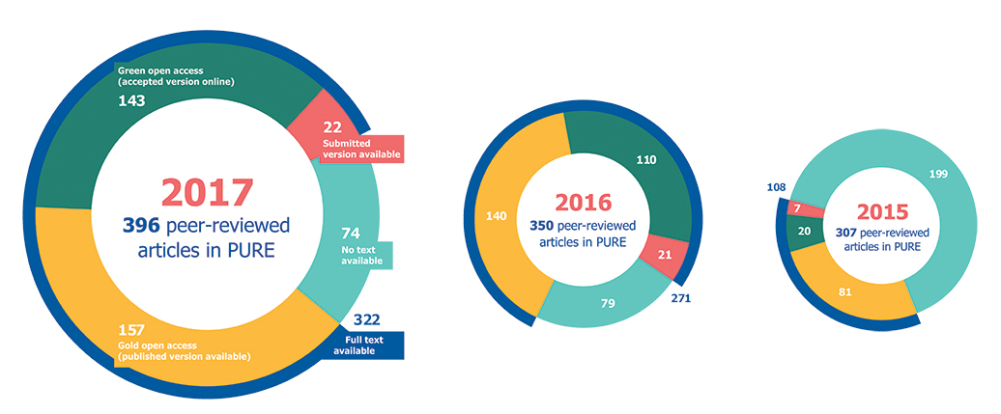
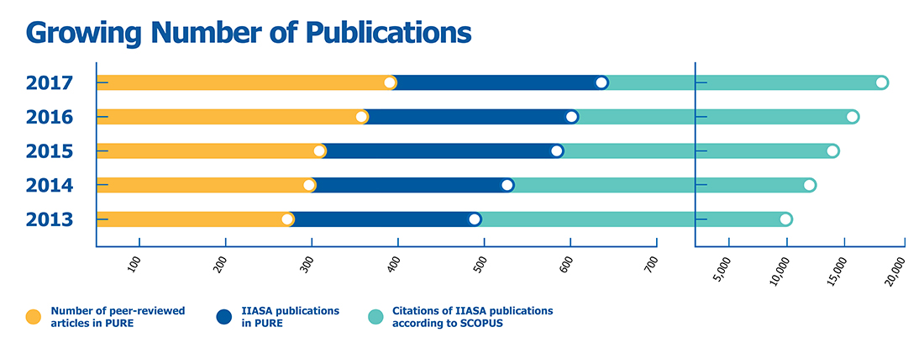
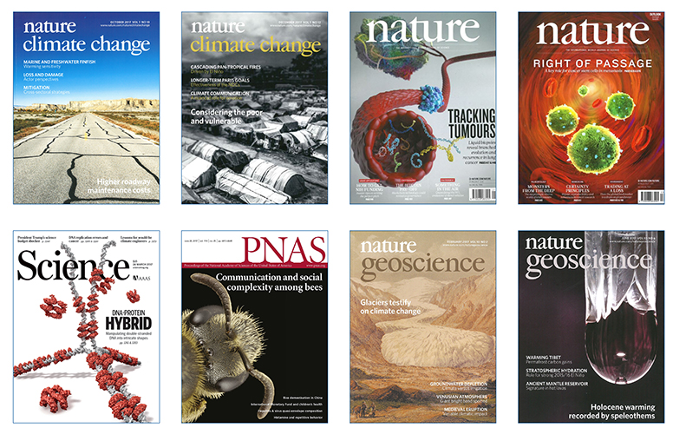
Scientific Output
Notes:
Through fostering strong collaborations and supporting up-and-coming young scientists, IIASA produces the highest quality science. This can be seen though publications in peer-reviewed journals including many of the most prestigious publications. Citations of IIASA research has increased significantly over recent years according to SCOPUS, the independent database of peer-reviewed literature. This shows an increasing uptake of the Institute’s research findings.

Slide 14
Thank you
For further information about IIASA:
www.iiasa.ac.at or info@iiasa.ac.at
Subscribe to IIASA publications:
www.iiasa.ac.at/subscribe

