Slide 1
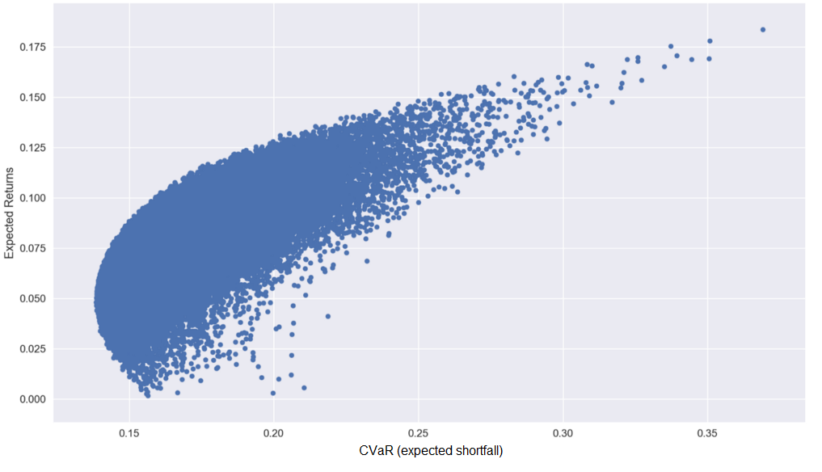
Optimization of a Portfolio of Venture Investments
Analyzing performance and developing stochastic optimization models for venture capital investments
Andrei Vedernikov
Date: 10.06.2019
Instructors: Dr. Tomi Seppälä, Dr. Juuso Liesiö
A new contribution to venture capital and operations research. A tool for practical applications by VC investors.
Contract and grant based funding: Marcus Wallenberg Foundation, Kaute Foundation

Slide 2
Developed articles
Optimization of a Portfolio of Venture Investments
- Copula-based Monte Carlo simulation and MILP CVaR minimization, empirical setup based on real VC data, Late stage draft
Analysis of Performance of Venture Capital Investments in Europe
- Performance data on ~9000 VC investments collected with multiple attributes for hypotheses testing, Early stage development
3) Modelling for Macroeconomic Scenarios in Optimization of a Portfolio of Venture Investments
- Linking the modelled behavior of VC investments to macroeconomic proxies in a copula model, Early planning
Andrei Vedernikov
Date: 10.06.2019

