Slide 1
Scenario-based Analytics for Strategic Decision Support
Management Science Group
Department of Information and Service Management
Aalto University School of Business

Slide 2
Scenario-based Analytics for Strategic Decision Support
Supervisors Eeva Vilkkumaa, Juuso Liesiö
First two years’ funding with BIZ doctoral studies funding model
56% work contract with ISM department
Half-grant from HSE foundation (1st year) and Liikesivistysrahasto (2nd year)
Key research question:
How to augment traditional trend extrapolation based decision support methods with scenario-based analytics, which integrates expert judgment and statistical methods to support strategic decision making?
Expected contribution
Analytical methods with solid theoretical foundations and their implementations in academia-industry collaboration

Slide 3
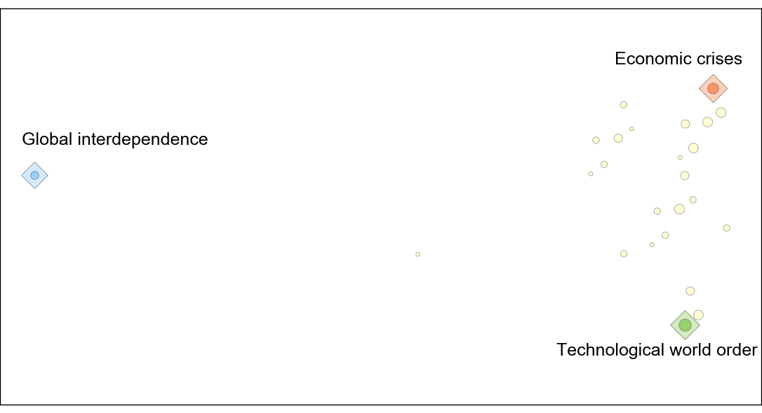
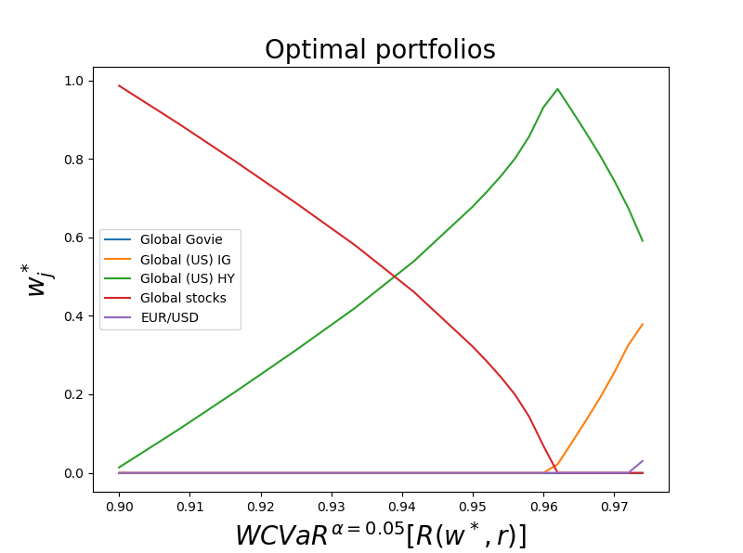
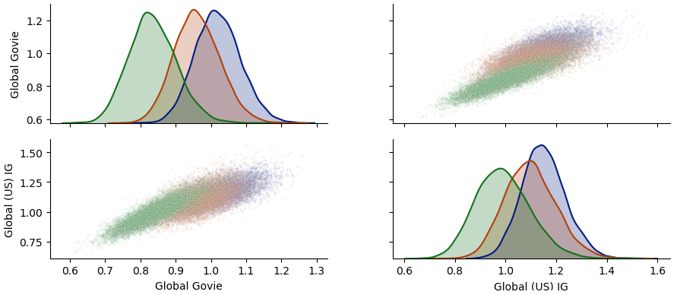
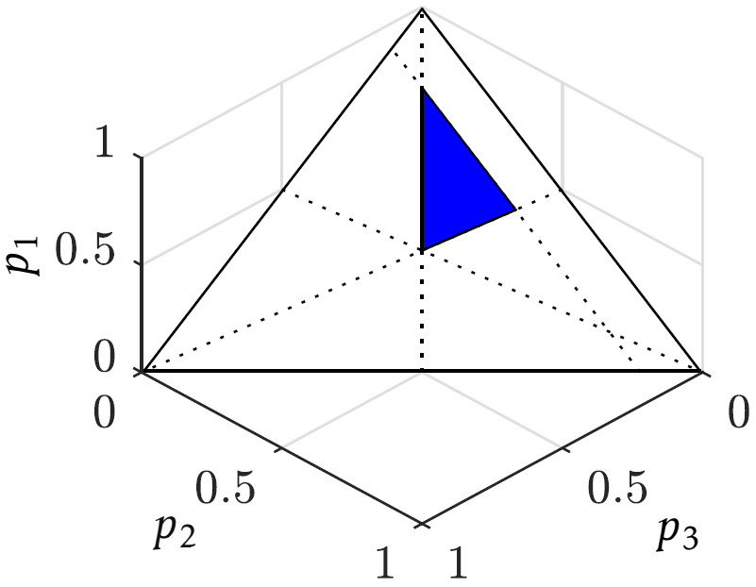
Manuscripts and plans
► 1st paper “Visualization-based analytic method to identify a set of scenario for strategic planning” (manuscript phase)
Economy | Technology | European union
A. Equally growth | A. Digital evolution | A. Slow decline
B. Polarized growth | B. Digital revolution | B. Harmonization
C. Stagnation | C. Digital stagnation | C. Internal blocs
D. Crises & turbulence |  | D. Decay of the EU
 |  | Tech. |  |  | EU
 |  | A | B | C | A | B | C | D
Econ. | A | 1 | -2 | -2 | 1 | 2 | -2 | -2
 | B | 0 | 3 | -1 | 1 | -2 | 3 | 2
 | C | 1 | 1 | 1 | 2 | 1 | 1 | 2
 | D | 1 | 2 | 2 | 2 | -1 | 3 | 1
Tech. | A |  |  |  | 0 | 0 | 0 | 0
 | B |  |  |  | 0 | 0 | 0 | 0
 | C |  |  |  | 1 | -1 | 0 | 2
Econ. | Tech. | EU
A | A | A
B | B | B
C | C | C
D |  | D
► 2nd paper “Scenario-based portfolio models for strategic asset allocation” (early development phase)
Regime 1 | Regime 2 | Regime 3

